Slide 3
So Far…
Who Are You?
Made in the very image of God, you have been given life and told, as a Christian, you are salt and light, a chosen generation, a royal priesthood, a peculiar people, the temple of God
What Are You?
You are a child and servant of God and all that entails…your time, your efforts on His behalf, the entirety of every minute of every day of the life God gives you
Monday Night-Where Are You?
Tuesday Night- Why Are You?
Wednesday Night-How Are You?

Slide 6
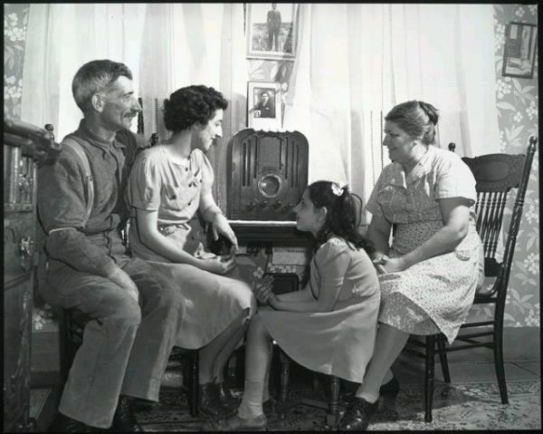

Slide 10
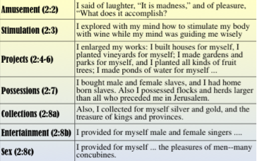
Ecclesiastes 2:1-11

Slide 34
Matthew 4:1-11

Slide 45
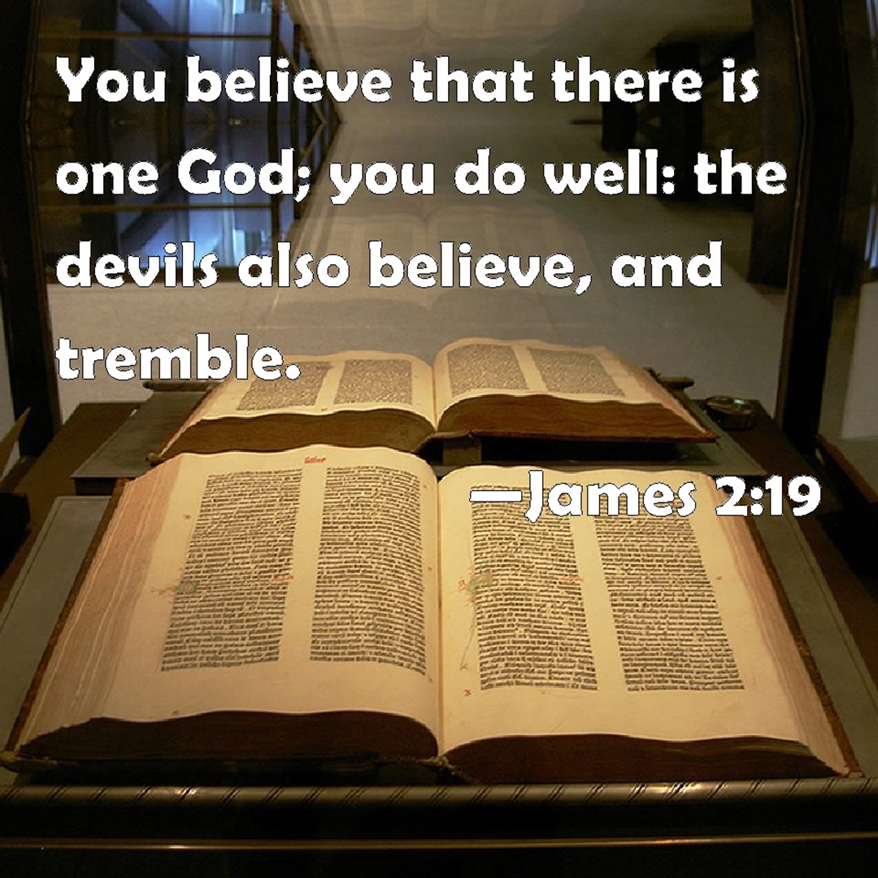

Slide 46
