Slide 3
So Far…
Who Are You?
Made in the very image of God, you have been given life and told that you are salt and light, a chosen generation, a royal priesthood, a peculiar people, the temple of God
What Are You?
A child and servant of God and everything that entails. Your time. Your efforts on his behalf. The entirety of every minute of every day of the life God gives you
When Are You?
You are living in the middle of a crooked and perverse generation among whom we should shine as lights in the world
Tomorrow Night- Why Are You?
Wednesday Night- How Are You

Slide 11
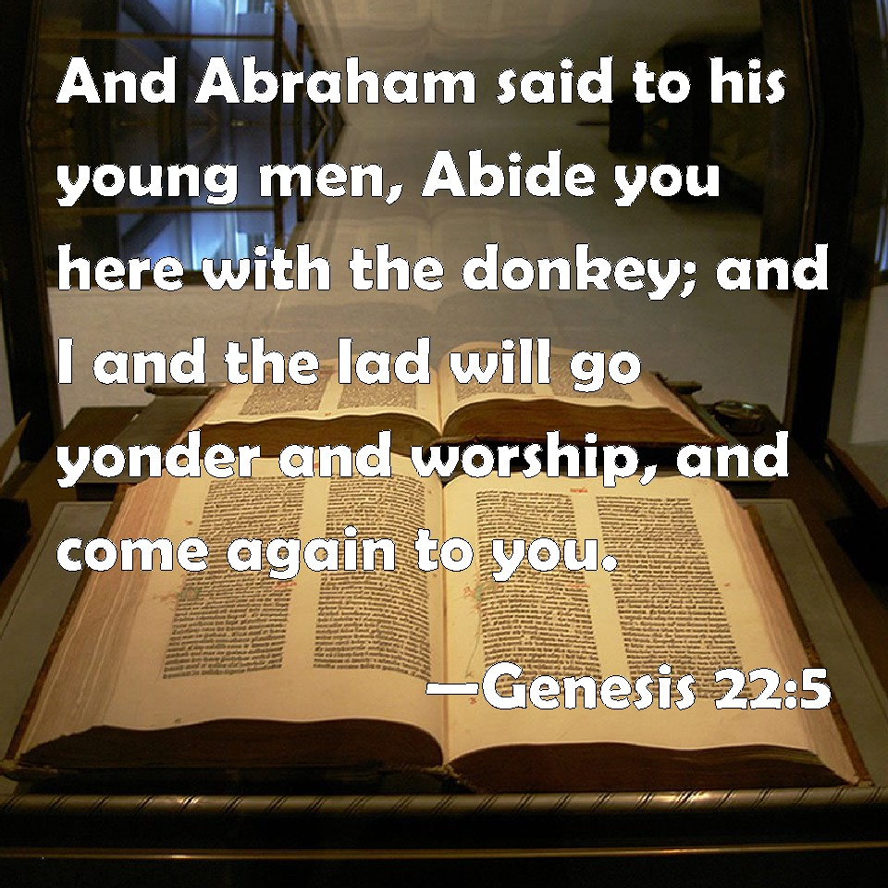

Slide 12
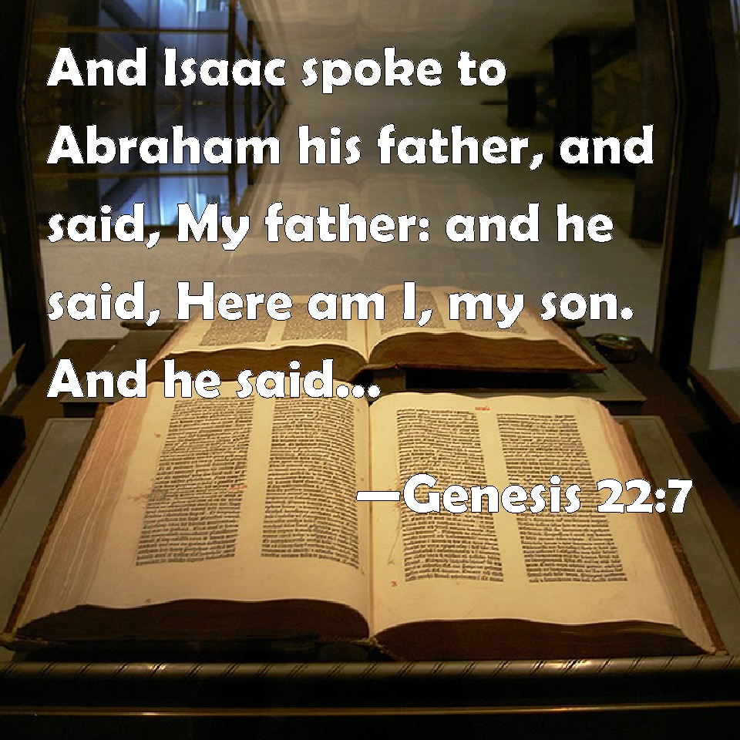

Slide 22
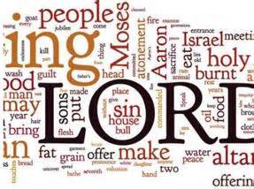

Slide 26
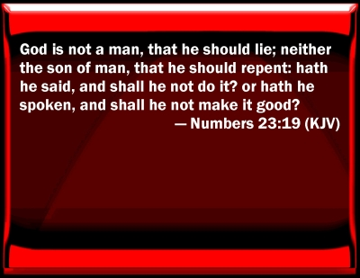

Slide 35
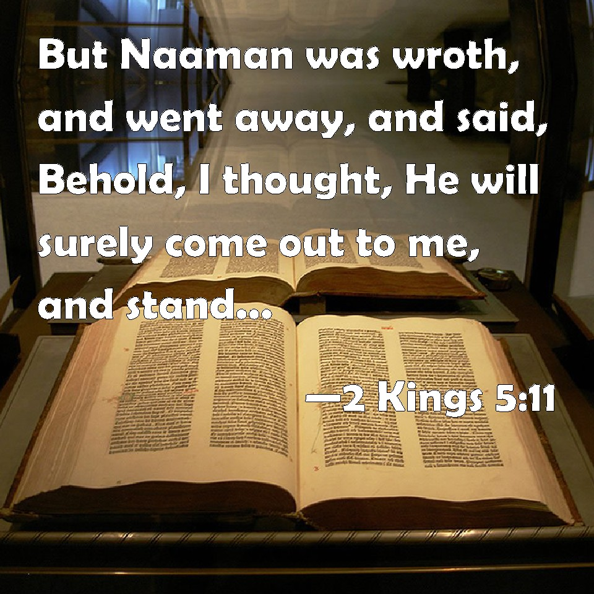

Slide 36
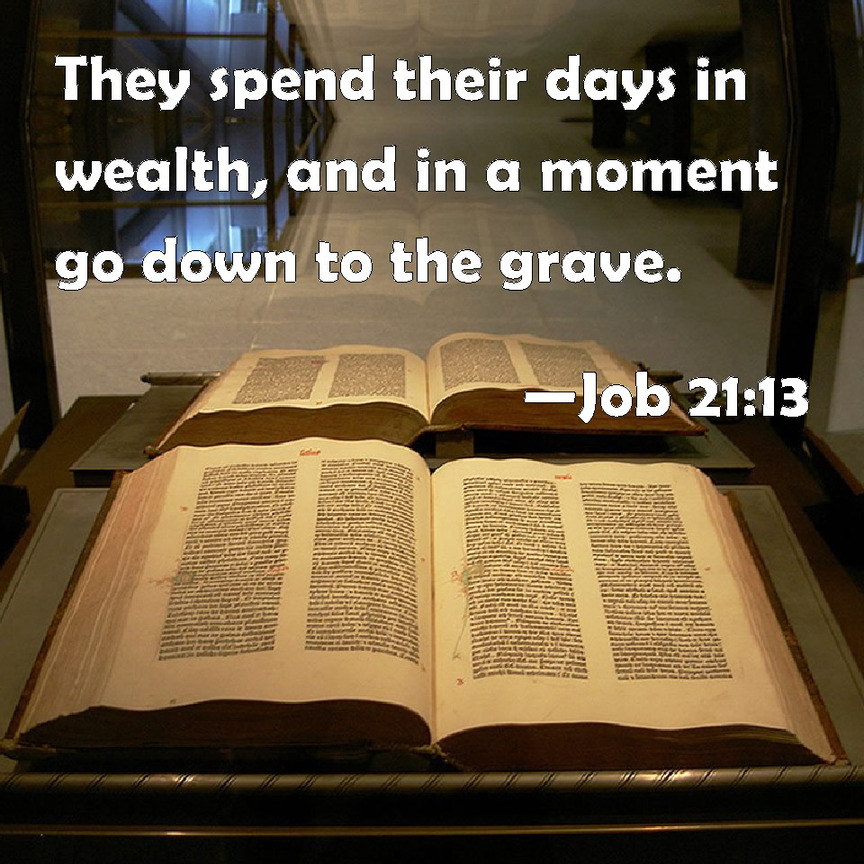

Slide 43
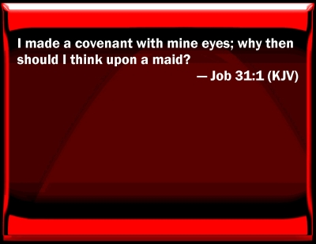

Slide 46
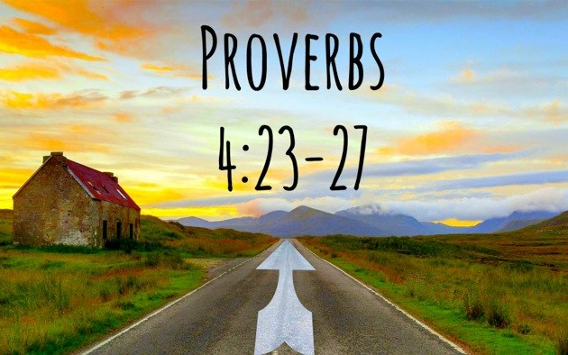

Slide 53
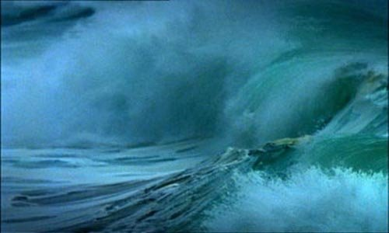
Matthew 14:25-31

