Slide 1
Does God Still

Slide 2
Does God Still

Slide 3
Does God Still

Slide 4
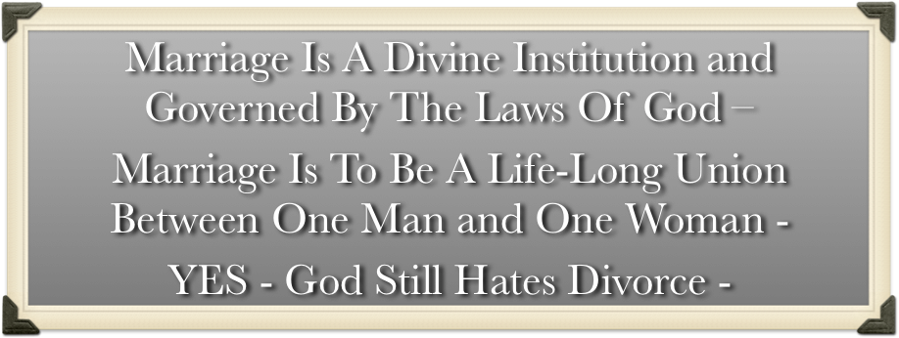
Does God Still

Slide 5
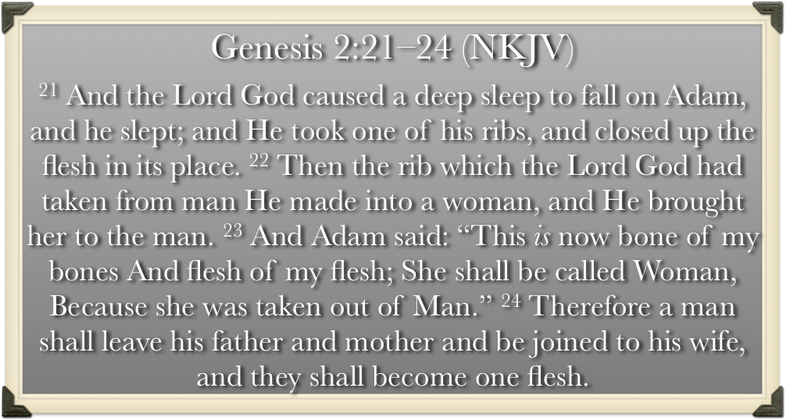
Does God Still

Slide 6
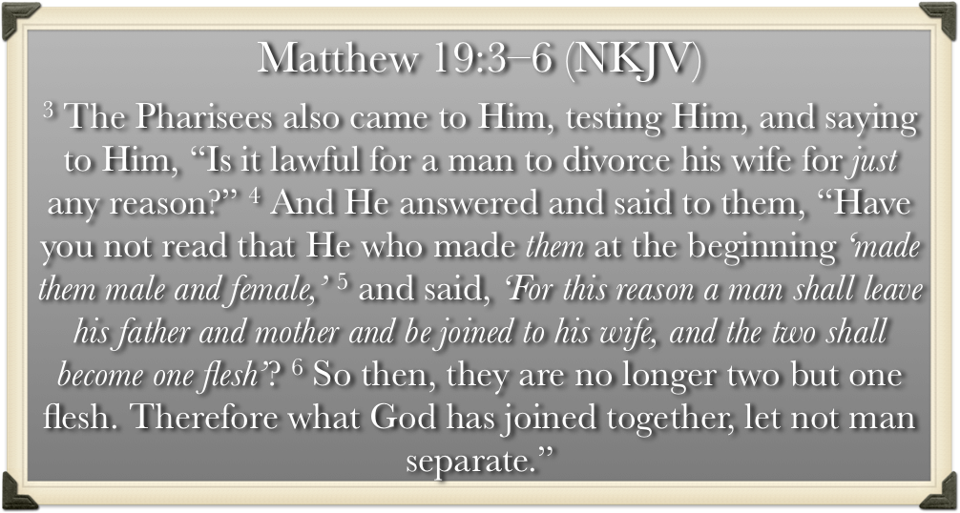
Does God Still

Slide 7
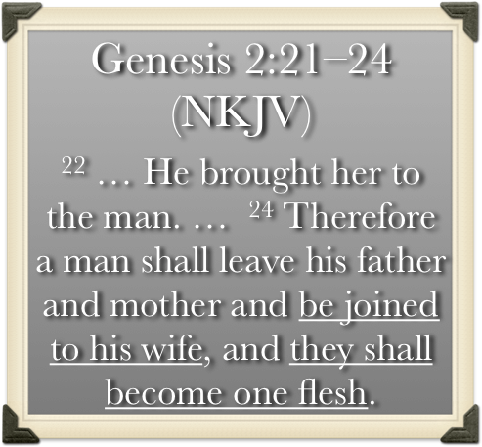
Does God Still

Slide 8
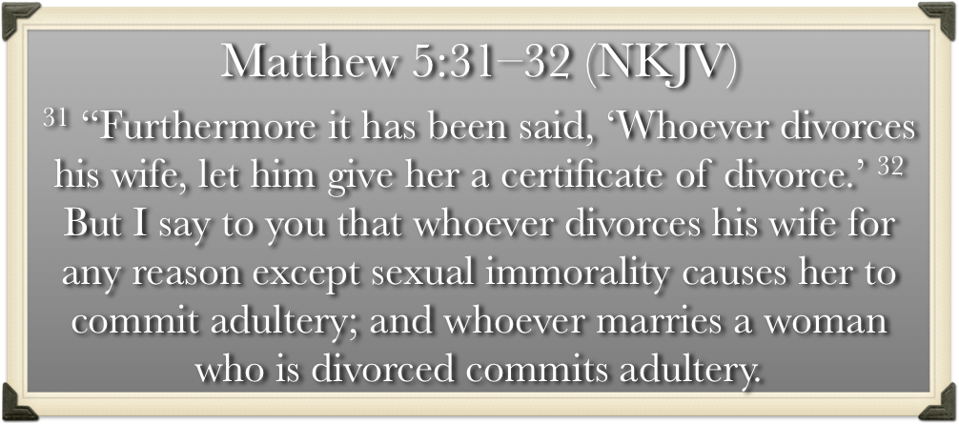
Does God Still

Slide 9
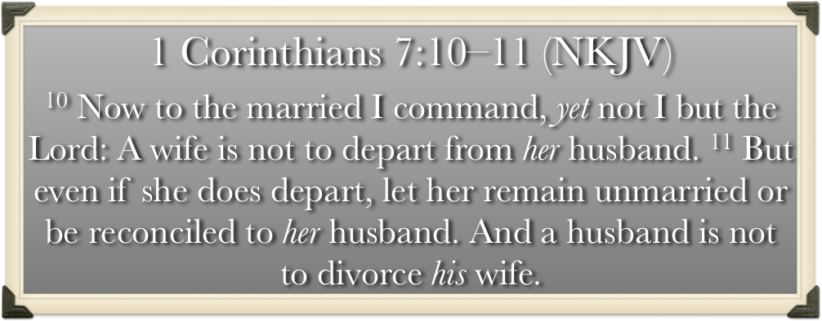
Does God Still

Slide 10
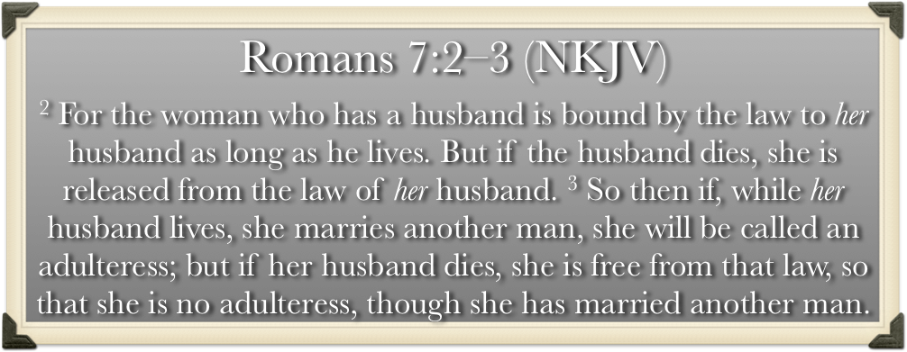
Does God Still

Slide 11
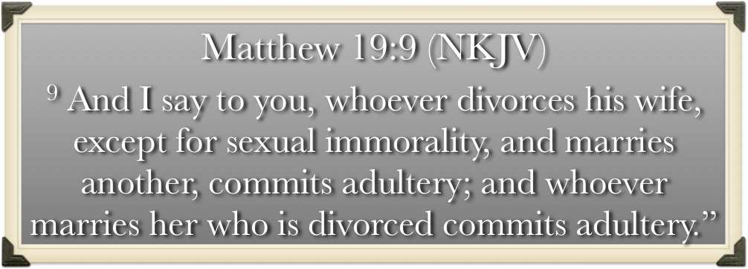
Does God Still

Slide 12
Malachi 2:13–16 (NKJV)
¹³ And this is the second thing you do: You cover the altar of the Lord with tears, With weeping and crying; So He does not regard the offering anymore, Nor receive it with goodwill from your hands. ¹⁴ Yet you say, “For what reason?” Because the Lord has been witness Between you and the wife of your youth, With whom you have dealt treacherously; Yet she is your companion And your wife by covenant.

Slide 13
Malachi 2:13–16 (NKJV)
¹⁵ But did He not make them one, Having a remnant of the Spirit? And why one? He seeks godly offspring. “Therefore take heed to your spirit, And let none deal treacherously with the wife of his youth. ¹⁶ “For the Lord God of Israel says That He hates divorce, For it covers one’s garment with violence,” Says the Lord of hosts. Therefore take heed to your spirit, That you do not deal treacherously.”

Slide 14
Why Does God
God loves
Humility!
Honesty!
Love!
Godliness!
Righteousness!
Faithfulness!
Peacemakers!

Slide 15
Why Does God
Because God

Slide 16
Why
God
Mal 2:13-16
Eccl 5:1-6
Mat 5:31,32
Mat 19:3-9
1 Cor 7:10,11
Remember Your Vows
I ____, take thee ____, to be my wedded wife, to have and to hold from this day forward, for richer or poorer, in sickness and in health, to love and to cherish, till in death we part, -
I, ___, take thee ____ to be my wedded husband, to have and to hold from this day forward, for richer or poorer, in sickness and in health, to love and to cherish, till in death we part, -

Slide 17
Why
God
Dishonors God — (Gen 2:21-24; Mat 19:4-6; Prov. 14:2)
Violates the law of love — (Eph 5:25; Col. 3:19; 1 Pet 3:7; Tit. 2:4)
Harms put away spouse — (Mal. 2:14,16; Mat 5:31,32)
Harms self — (Is. 59,1,2; Gal 6:7-9)
Harms children — (Mal. 2:15)
Harms society as a whole — (Mal. 2:15; Prov. 14:34; Mat. 19:9)

Slide 18
Why
God
Companionship - (Gen. 2:18; Prov. 2:17; Mal. 2:14; 1 Pet. 3:7)
Happiness – (Prov. 5:18)
To Prevent Sexual Immorality – (1 Cor. 7:2-5; Prov. 5:19; Heb. 13:4)
Godly Families - (Mal. 2:15; Deut 6:6-9)

Slide 19
Why
God
Submission to God’s order - (Eph. 5:21-31; 1 Pet. 3:1-7)
Learning contentment WITHIN God’s will – (Phili. 4:11-13; Ep. 5:21-31; 1 Pt 3:1-7)
Honoring our Promises, commitment, covenant – (Prov 2:17; Eccl. 5:4,5)

Slide 20
Why
God
A Happy & Successful Marriage
. . .is not determined by the perfection of your partner, but the level of YOUR COMMITMENT to the Lord & to them.

Slide 21
Why
God
(Luke 14:28, NKJV)
“for better or worse”?
Spouse paralyzed?
Bad accident and disfigured?
Sickness?
Weight gain?
Job loss? / Financial Problems?
Marriage problems?
Getting older?

Slide 22
Why
God
“About One Another!”
Golden Rule / Forgiveness - (Mt. 7:12)
Respect / submit - (Eph. 5:33, 1 Tim. 3:11)
Use example over your tongue to persuade - (1 Pet. 3:1)
Bring happiness - (Deut. 24:5)
Be understanding - (1 Pet. 3:7)
Private time - (Prov. 5:18)
Find, do, talk about things that bring joy - (Eccl. 9:9; Phili. 4:8)
Love each other - (Eph. 5:25; Titus 2:4)

Slide 23
Why
God
Commitment -
Communication –
Control Self –
Consideration –
Compromise –
Contentment –
Carry Your Load -

Slide 24
Why
God
The Rule of Protection - (Guard against anything that weakens relationship)
The Rule of Care - (Provide emotional support)
The Rule of Time - (Undivided attention)
The rule of Honesty - (Historic, emotional, current, future)

Slide 25
Why
God
Problems will come!

Slide 26
Why
God
Agree beforehand that divorce Will NEVER be the answer / Under any circumstance!

Slide 27
Why
God
As long as the Lord’s will is respected by both parties –
Divorce will not come!
But Rather Joy & fulfillment

Slide 28
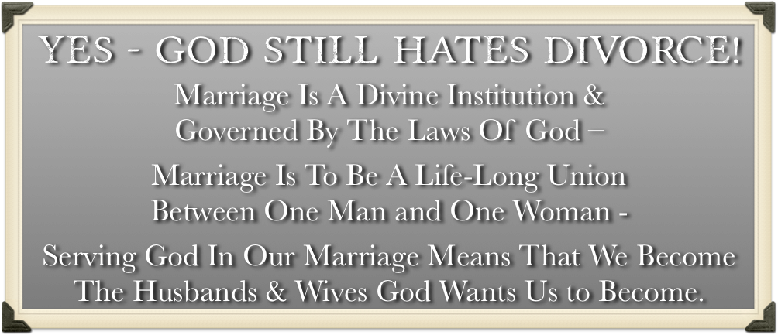
Yes God Still

Slide 29
Yes God Still

Slide 30
Yes God Still

Slide 32
Does God Still
Charts by Don McClain / Preached August 13, 2017
West 65th Street church of Christ P.O. Box 190062 / Little Rock AR 72219 / 501-568-1062 / Email – donmcclain@sbcglobal.net
Prepared using Keynote 2014 – More PPT & Audio Sermons:
http://w65stchurchofchrist.org/coc/

Slide 33
Matthew 19:1–9 (NKJV)
¹ Now it came to pass, when Jesus had finished these sayings, that He departed from Galilee and came to the region of Judea beyond the Jordan. ² And great multitudes followed Him, and He healed them there. ³ The Pharisees also came to Him, testing Him, and saying to Him, “Is it lawful for a man to divorce his wife for just any reason?”

Slide 34
Matthew 19:1–9 (NKJV)
⁴ And He answered and said to them, “Have you not read that He who made them at the beginning ‘made them male and female,’ ⁵ and said, ‘For this reason a man shall leave his father and mother and be joined to his wife, and the two shall become one flesh’? ⁶ So then, they are no longer two but one flesh. Therefore what God has joined together, let not man separate.”

Slide 35
Matthew 19:1–9 (NKJV)
⁷ They said to Him, “Why then did Moses command to give a certificate of divorce, and to put her away?” ⁸ He said to them, “Moses, because of the hardness of your hearts, permitted you to divorce your wives, but from the beginning it was not so.

Slide 36
Matthew 19:1–9 (NKJV)
⁹ And I say to you, whoever divorces his wife, except for sexual immorality, and marries another, commits adultery; and whoever marries her who is divorced commits adultery.”

