Slide 1
WHY do we SIN
James 1:13-27

Slide 2
WHY do we SIN
James 1:13-27
Is SIN unavoidable?
Is SIN Something We Can Overcome?

Slide 3
WHY do we SIN
James 1:13-27
Is our understanding of SIN causing:
A lack of concern regarding our sins?
Undue fear?
Or confidence?

Slide 4
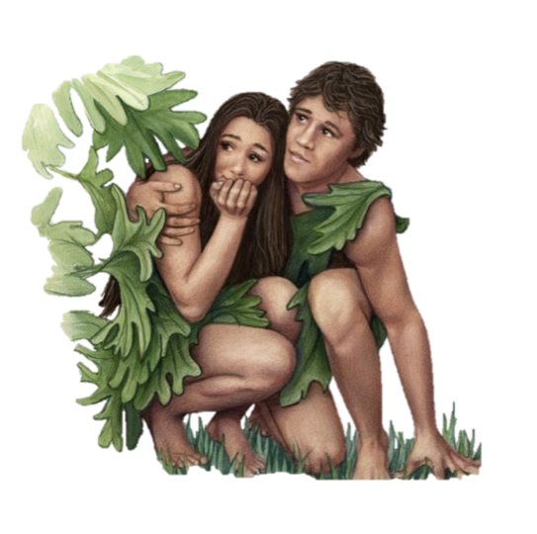
Why Do We Sin?
Can We Refuse?
Understanding What Sin Is
The first sin is a case study of all sin - Gen. 3:1-6; 1 Jn 2:15,16
Jesus was tempted through the same avenues - Mat 4:1-11; Heb. 4:15
Sin OCCURS when desire is enticed and the will yields - James 1:13-16; 1 Cor 9:27

Slide 5
Why Do We Sin?
Can We Refuse?
Understanding What Sin Is
It is NOT a sin to be human — (Gen 1:26,27,31; Jn 1:14)
There is a difference between a thing being unwise and a thing being sinful — (Gen 13:10,11; 1 Tim 6:10; etc.)
Lewdness is sin, (lasciviousness) — Gal. 5:19 - what about dancing?
Drunkenness is a sin — Gal 5:21 - what about having a beer after work? - 1 Pet 4:3; Prov 23:29-35

Slide 6
WHY do we SIN
Can We Refuse?
NOT Because:
Inherited Depravity – Ez 18
Sinful nature – Ps. 51; Ge 3,4
Lack of ability – 1 Jn 2:1
Unable to Bear – 1 Cor. 10:13
Can’t Understand – Ep. 5:17
Not Tempted – Jam 1:13-14
Predestination – Jam 1:12,17
Fulfill Scripture – Rom 3:23
Sin OCCURS when desire is enticed and the will yields
James 1:13-16;
Matthew 5:27-30

Slide 7
WHY do we SIN
Can We Refuse?
We Sin Because …
Because men do not fear the consequences of sin – (Prov 1:7; 16:6; Jer 2:18; Rom 3:18; Mat 5:29,30)
Because it is often easier to sin than to do that which is right – (Mat 7:13,14)
Because of habit – (2 Pet 2:14)
Because of the momentary pleasure which that sin brings them – (Heb 11:25; Jas 5:5)
Because of its deceptiveness – (Heb 3:13)
Wants to (Jas. 1: 14,15).

Slide 8
WHY do we SIN
Can We Refuse?
We Sin Because …
Not watchful (Mat. 26:41, Gal. 6:1).
Lacks self-control (I Cor. 9:27).
To fit in with the crowd, (Prov. 1:10; 1 Cor. 15:33; 1 Tim. 5:22).
Does not control his thoughts (Prov. 22:3; 15:26, 23:7, Phil 4:8).
Don’t resist the devil (Jas. 4:7).
Selfishness (cp. Lk. 15:12; 18:22,23).
Doesn’t have the word hidden in his heart – (Ps. 119:11).

Slide 9
WHY do we SIN
Can We Refuse?
We Sin Because …

Slide 10
WHY do we SIN
Can We Refuse?
What About Sins of Ignorance?
Old Testament Law Governing Ignorance – Leviticus 4:2,3; 13,14; 22,23, 27,28; 5:2-6, 15-18, 27-29; Hos. 4:6,14
Willful Ignorance: condemned – Hos. 4:6; 2Pet. 3:3-7; Eph. 4:18; 1Cor. 6:3,4; Rom. 1:19-22
Former Ignorance: condemned – Eph. 4:22; 1Pet. 1:14

Slide 11
WHY do we SIN
Can We Refuse?
What About Sins of Ignorance?
Unintentional Ignorance: condemned - 1Tim. 1:13-15; Acts 3:17,19; 8:18-22
Is There Hope For Unintentional Ignorance? - 1Tim. 1:13-16; 2:3-6
Can One Avoid Sinning In Ignorance? - Gen 20:6; Ps. 119:11; 1 Cor. 10:13; 2 Pet 3:17,18

Slide 12
WHY do we SIN
Can We Refuse?
God Demands His People
To live holy lives – 1 Peter 1:13-16
To cease living in sin – Rom. 6:1,2;
Awake to righteousness, and do not sin – 1 Cor. 15:34
Deny ungodliness and worldly lusts, . . . live soberly, righteously, and godly in the present age, - Titus 2:11-13
If we sin – repent, confess & pray!!

Slide 13
WHY do we SIN
Can We Refuse?
The Consequences of Losing Our Battle With Sin –
Temporal - (Pro. 13:15).
Spiritual - (Gen 2:27; Is. 59:1,2; Rom 6:23; 1 Tim 5:6; Heb 3:13; 2 Thes 2:9-12; Heb 6:4-8).
Eternal - (Rom 6:23; Rev 21:8; 1 Cor. 6:9-11 ).

Slide 14
WHY do we SIN
Can We Refuse?
GOD
Isa. 59:1,2
1 John 1:5
The Remedy For Sin is NOT
Sinless perfection - (Rom 3:23; Gal 3:10—12).
Works of law - (Gal 5:1-6).
Meritorious works - (Mat 6:2,5,16; Eph 2:8,9).
Morality - (Acts 10,11).
Honesty and sincerity - (Acts 9,10).

Slide 15
WHY do we SIN
Can We Refuse?
GOD
Acts 2:38;
Romans 6:3-6
Jesus –
1 John 2:1,2
The Remedy For Sin Is The blood of Christ
Matthew 26:28; “for the remission of sins”
1 John 1:7; “Cleanses us from all sin”
Revelation 1:5; “washed us from our sins”
1 Peter 3:18 “Suffered once for sins . . .

Slide 16
Don McClain
W. 65th St church of Christ - May 4, 2008

Slide 17
WHY do we SIN
James 1:13-27
Charts by Don McClain / Preached November 19, 2017 PM
West 65th Street church of Christ P.O. Box 190062 / Little Rock AR 72219 / 501-568-1062 / Email – donmcclain@sbcglobal.net
Prepared using Keynote – More PPT & Audio Sermons:
http://w65stchurchofchrist.com

Slide 18
James 1:13–21 (NKJV)
¹³ Let no one say when he is tempted, “I am tempted by God”; for God cannot be tempted by evil, nor does He Himself tempt anyone. ¹⁴ But each one is tempted when he is drawn away by his own desires and enticed. ¹⁵ Then, when desire has conceived, it gives birth to sin; and sin, when it is full-grown, brings forth death.

Slide 19
James 1:13–21 (NKJV)
¹⁶ Do not be deceived, my beloved brethren. ¹⁷ Every good gift and every perfect gift is from above, and comes down from the Father of lights, with whom there is no variation or shadow of turning. ¹⁸ Of His own will He brought us forth by the word of truth, that we might be a kind of firstfruits of His creatures.

Slide 20
James 1:13–21 (NKJV)
¹⁹ So then, my beloved brethren, let every man be swift to hear, slow to speak, slow to wrath; ²⁰ for the wrath of man does not produce the righteousness of God. ²¹ Therefore lay aside all filthiness and overflow of wickedness, and receive with meekness the implanted word, which is able to save your souls.

