Slide 1
The Most
Dangerous Sin?
1 John 5:16

Slide 2
The Most
Dangerous Sin?
EVERY SIN IS EQUALLY DEADLY!
Fornicators,
Idolaters,
Adulterers,
Homosexuals,
Sodomites,
Thieves,
Covetous,
Drunkards,
Revilers,
Extortioners,
Unclean,
Lewdness,
Sorcery,
Hatred,
Contentions,
Jealousies,
Outbursts Of Wrath,
Selfish Ambitions,
Dissensions,
Heresies,
Envy,
Murders,
Revelries,
And The Like;

Slide 3
The Most
Dangerous Sin?
EVERY SIN IS EQUALLY DEADLY!
Sin separates one from God - Isa. 59,1,2
Sin will keep one out of heaven unless they repent - 1 Co 6:11; Gal. 5:21
Repentance - a change of mind that results in a change in actions - cf. Ezekiel 18:21-32
“Except you repent you will perish” - Lk 13:3,5
“God commands all men everywhere to repent …” Acts 17:30,31;

Slide 4
The Most
Dangerous Sin?
God is willing to forgive the vilest of sinners
“Though your sins be as scarlet” - Isaiah 1:18;
If the wicked turns - Ez 18:21-23;
Jesus came to call - Mat 9:13;
The chief of sinners - 1 Tim 1:15;
God’s longsuffering - 2 Pet 3:9
For which sin is the blood of Christ insufficient? – 1 John 1:2
Grace does NOT allow us to continue in sin! — Rom 6:1-24

Slide 5
1 John 5:14–21 (NKJV)
¹⁴ Now this is the confidence that we have in Him, that if we ask anything according to His will, He hears us. ¹⁵ And if we know that He hears us, whatever we ask, we know that we have the petitions that we have asked of Him. ¹⁶ If anyone sees his brother sinning a sin which does not lead to death, he will ask, and He will give him life for those who commit sin not leading to death. There is sin leading to death. I do not say that he should pray about that. ¹⁷ All unrighteousness is sin, and there is sin not leading to death.

Slide 6
1 John 5:14–21 (NKJV)
¹⁸ We know that whoever is born of God does not sin; but he who has been born of God keeps himself, and the wicked one does not touch him. ¹⁹ We know that we are of God, and the whole world lies under the sway of the wicked one. ²⁰ And we know that the Son of God has come and has given us an understanding, that we may know Him who is true; and we are in Him who is true, in His Son Jesus Christ. This is the true God and eternal life. ²¹ Little children, keep yourselves from idols. Amen.

Slide 7
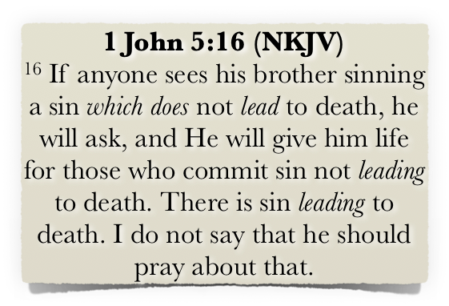
The Most
Dangerous Sin?
What Is The “Sin Unto Death?” 1 John 5:16
Not talking about Christians?
The specific sin of blasphemy against the Holy Spirit?
Physical death, not spiritual?

Slide 8
The Most
Dangerous Sin?
What Is The “Sin Unto Death?” 1 John 5:16
“Refers to believers, and it refers to physical death, not spiritual death … A believer can commit a sin which will cause the Lord to just take him to heaven. He doesn’t go to hell, he goes to heaven. … It is any sin the Lord deems to be serious to the point where you are better off removed from the church because of your influence.”
Bible Q & A with John MacArthur - https://vimeo.com/17087980

Slide 9
The Most
Dangerous Sin?
What Is The “Sin Unto Death?” 1 John 5:16
Fornicators,
Idolaters,
Adulterers,
Homosexuals,
Sodomites,
Thieves,
Covetous,
Drunkards,
Revilers,
Extortioners,
Unclean,
Lewdness,
Sorcery,
Hatred,
Contentions,
Jealousies,
Outbursts Of Wrath,
Selfish Ambitions,
Dissensions,
Heresies,
Envy,
Murders,
Revelries,
And The Like;

Slide 10
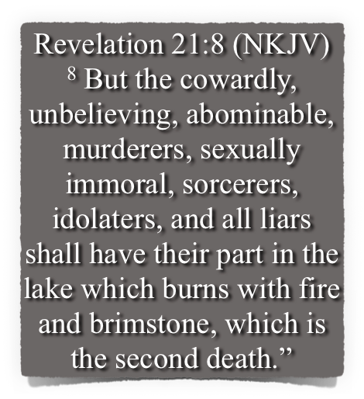
The Most
Dangerous Sin?
What Is The “Sin Unto Death?” 1 John 5:16
Fornicators,
Idolaters,
Adulterers,
Homosexuals,
Sodomites,
Thieves,
Covetous,
Drunkards,
Revilers,
Extortioners,
Unclean,
Lewdness,
Sorcery,
Hatred,
Contentions,
Jealousies,
Outbursts Of Wrath,
Selfish Ambitions,
Dissensions,
Heresies,
Envy,
Murders,
Revelries,
And The Like;

Slide 11
The Most
Dangerous Sin?
What Is The “Sin Unto Death?” 1 John 5:16
Not ANY particular sin, but rather the degree to which one has given himself / herself to a sin or sins — Romans 1:18-32
A warning against apostasy — 1 Cor. 10:1-13; Gal. 5:1-6; 2 Pet. 2:20-22
UNTO DEATH?

Slide 12
The Most
Dangerous Sin?
What Is The “Sin Unto Death?” 1 John 5:16
What About “Blaspheming the Holy Spirit?” — Mat. 12:31,32
Jesus had cast a demon out of a blind and mute man (Mat 12:22),
People confessed him to be the Christ (vs 23).
The Pharisees charged that Jesus cast out demons "by Beelzebub the ruler of the demons“ (vs 24).
Jesus demonstrated the absurdity of this charge (vs 25-30).

Slide 13
The Most
Dangerous Sin?
What Is The “Sin Unto Death?” 1 John 5:16
What About “Blaspheming the Holy Spirit?” — Mat. 12:31,32
By attributing the confirming work of the Holy Spirit to Satan, — (Jn 20:30-31; Mk 16:20; Ac 14:3; Heb 2:3,4).
Their heart was so hardened with prejudice they rejected the clear testimony of the Spirit – there is to be no more testimony! (John 5; 8:44; 12:37-40; 2 Thes. 2:10-12).

Slide 14
The Most
Dangerous Sin?
What Is The “Sin Unto Death?” 1 John 5:16
What About “Blaspheming the Holy Spirit?” — Mat. 12:31,32
Not a case of the unwillingness or inability of God to forgive.
BUT - a matter of the unwillingness and inability of those with hardened hearts to believe unto forgiveness.
Those who ridicule & reject the evidence God has given reject God’s provision of forgiveness –
They have NO HOPE? (Jn 14:6)

Slide 15
The Most
Dangerous Sin?
What Is The “Sin Unto Death?” 1 John 5:16
Other passages with comparative applications —
Philippians 3:17-19 — enemies of the cross / whose god is their belly / glory in their shame / set their mind on earthly things …
2 Thess. 2:10-12 — When we reject a love for the truth & love unrighteousness / God will send strong delusion that we believe a lie and be condemned …

Slide 16
The Most
Dangerous Sin?
What Is The “Sin Unto Death?” 1 John 5:16
Other passages with comparative applications —
Hebrews 3:7-4:13 — Israelites hardened their hearts and rebelled (cf. 1 Cor. 10:1-13)
Hebrews 6:4-8 — impossible to renew them to repentance …
Hebrews 10:26-31 — willful sin / no longer a sacrifice for sin …
Hebrews 12:7-17 — Esau sold his birthright - could not find repentance.

Slide 17
The Most
Dangerous Sin?
What Is The “Sin Unto Death?” 1 John 5:16
Other passages with comparative applications —
2 Peter 2:20–22 (NKJV)
²⁰ For if, after they have escaped the pollutions of the world through the knowledge of the Lord and Savior Jesus Christ, they are again entangled in them and overcome, the latter end is worse for them than the beginning. ²¹ For it would have been better for them not to have known the way of righteousness, than having known it, to turn from the holy commandment delivered to them. ²² But it has happened to them according to the true proverb: “A dog returns to his own vomit,” and, “a sow, having washed, to her wallowing in the mire.”

Slide 18
The Most
Dangerous Sin?
What Is The “Sin Unto Death?” 1 John 5:16
APPLICATIONS:
Christians today who reject the truth they once held, have hardened their hearts against it, and now fight against it may very well be guilty of the “sin unto death” — Romans 16:17; 2 Peter 2:1-19.
The possibility of apostasy is real, not an imagined or conjured up threat — 1 Cor. 10:1-13; Hebrews 3,4,6,10,12; Gal. 5:1-6

Slide 19
The Most
Dangerous Sin?
AVOIDING The “Sin Unto Death” 1 John 5:16
APPLICATIONS:
We need to constantly examine ourselves and keep our heart with all diligence — 2 Cor. 13:5; Prov. 4:23; 2 Tim 2:15; 2 Pet. 1:5-12
We need to keep our conscience tender to God’s word & correction — Heb 12:5-17; Acts 17:11,12
Confess our sins / turn away from sin / develop hatred for sin and a heart devoted to pleasing God — Gen 39:9

Slide 20
The Most
Dangerous Sin?
AVOIDING The “Sin Unto Death” 1 John 5:16

Slide 21
The Most
Dangerous Sin?
AVOIDING The “Sin Unto Death” 1 John 5:16

Slide 22
The Most
Dangerous Sin?
God is willing to forgive the vilest of sinners
“Though your sins be as scarlet” - Isaiah 1:18;
If the wicked turns - Ez 18:21-23;
Jesus came to call - Mat 9:13;
The chief of sinners - 1 Tim 1:15;
God’s longsuffering - 2 Pet 3:9
For which sin is the blood of Christ insufficient? – 1 John 1:2
Grace does NOT allow us to continue in sin! — Rom 6:1-24

Slide 23
The Most
Dangerous Sin?
God is willing to forgive the vilest of sinners
If you are not a Christian - PLEASE do not leave today without obeying the gospel! -- Rom. 10:17; John 8:24; Romans 10:9,10; Acts 2:38; 22:16
If you are a Christian, and there is present sin in your life - do not wait - confess your sin and repent NOW — 1 John 1:9.10; Acts 8:22

Slide 24
The Most
Dangerous Sin?
God is willing to forgive the vilest of sinners

Slide 26
The Most
Dangerous Sin
1 John 5:16
Charts by Don McClain
Prepared June 29-July 1, 2017 - Preached July 2, 2017
West 65th Street church of Christ P.O. Box 190062, Little Rock AR 72219 / 501-568-1062
Prepared using Keynote
Email – donmcclain@sbcglobal.net
http://w65stchurchofchrist.org/coc/sermons/

