Slide 1
Matthew 28:19–20 (NKJV)
¹⁹ Go therefore and make disciples of all the nations, baptizing them in the name of the Father and of the Son and of the Holy Spirit, ²⁰ teaching them to observe all things that I have commanded you; and lo, I am with you always, even to the end of the age.” Amen.

Slide 2
The Challenge of
The Desperate

Slide 3
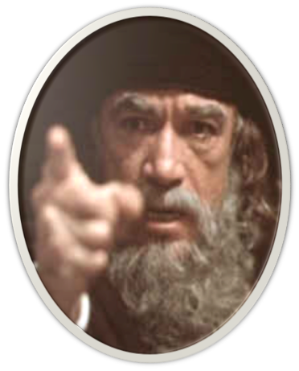
The Lost & Found Sheep, Coin & Son
Luke 15:1–2 (NKJV)
¹ Then all the tax collectors and the sinners drew near to Him to hear Him. ² And the Pharisees and scribes complained, saying, “This Man receives sinners and eats with them.”
Jesus responds with a parabolic triptych . . .

Slide 4
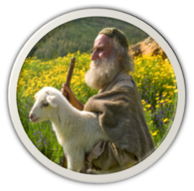
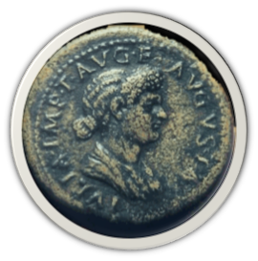
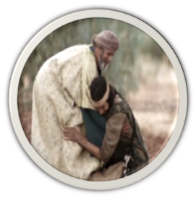
The Lost & Found Sheep, Coin & Son
Jesus responds with a parabolic triptych . . .

Slide 5
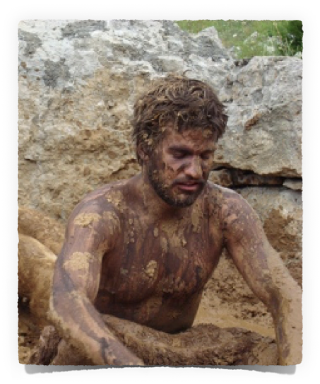
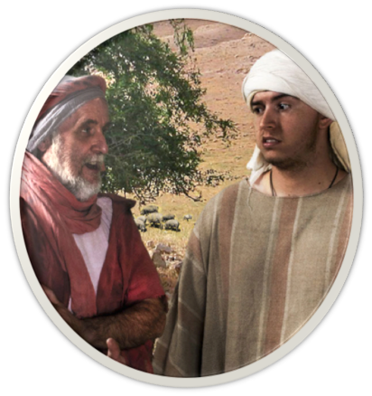
OUR ATTITUDE TOWARDS THE LOST?
Sinners NEVER lose their VALUE – Mat. 16:26
They lose their way -
They lose their usefulness –
They lose their relationship with God, His children & their blessedness -
They lose their souls -

Slide 6
OUR ATTITUDE TOWARDS THE LOST?
The State of The Lost - Eph 2:12; 1 Thes 4:13
The Value of The Lost – Mat 18:14; 1 Pet 1:18-21
The Love God Has For The Lost – Jn 3:16; Rom 5:8-10; 2 Cor 5:19-21
Our responsibility to the lost? – Rom 1:14,15; Jam 5:19,20; Mk 12:29-31

Slide 7
OUR ATTITUDE TOWARDS THE LOST?
Our ATTITUDE toward the LOST is manifested in what we do, not in what we say — Acts 8:4; Ro 9:1-5; 10:1; James 1:22; 2:14-26
Do we care enough?
Do we value the souls of others enough?
Do we truly desire to see the lost saved and the erring restored?

Slide 8
The Challenge of
THE GREATEST NEED – we all have — Rom 3:23; 1:16,17; Jn 14:6; Acts 4:12
The greatest SERVICE we can provide another — Mat. 28:19,20; Acts 8:4
Are We willing to do everything in our power to bring others to Jesus?

Slide 9
The Challenge of
Overcoming The

Slide 10
Things Working Against Us
There was a time when a vast majority of the people in our lives could be changed by Scripture.
But in the 21st Century, it has become very difficult to get people to listen

Slide 11
Things Working Against Us
Secular / Worldly
Religion / Man Made
Sec. Education
False Doctrine
NO absolute truth
Subjective Truth
Culture of Toleration
Diversity / Confusion
Materialism
Social In Focus
Wealth / Ease
Wealth / Ease / Busy
Self-Centered Focus
Self-Centered Focus

Slide 12
Things Working Against Us
Millennials leaving church in droves, study finds
By Daniel Burke, CNN Religion Editor
Updated 4:14 PM ET, Thu May 14, 2015
“… In the meantime, almost every major branch of Christianity in the United States has lost a significant number of members, Pew found, mainly because millennials are leaving the fold. More than one-third of millennials now say they are unaffiliated with any faith, up 10 percentage points since 2007.

Slide 13
Things Working Against Us
Christianity faces sharp decline as Americans are becoming even less affiliated with religion
Millennials are growing even less affiliated with religion as they get older - (Born 1981 to 1989) in 2007 - 25% — in 2014 - 34%
There are more religiously unaffiliated Americans than Catholic Americans (20.8%), or mainline Protestant Americans. (14.7%)
Those who are unaffiliated are becoming more secular
By Sarah Pulliam Bailey May 12, 2015
“The percentage of adults who describe themselves as Christians dropped by nearly eight percentage points in just seven years to about 71 percent, according to a survey conducted by the Pew Research Center. …”

Slide 14
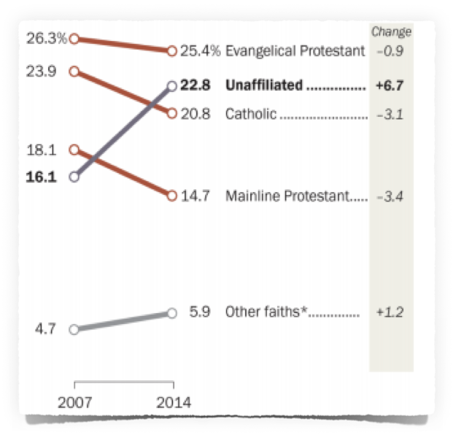
Things Working Against Us
Christianity faces sharp decline as Americans are becoming even less affiliated with religion
By Sarah Pulliam Bailey May 12, 2015
“The percentage of adults who describe themselves as Christians dropped by nearly eight percentage points in just seven years to about 71 percent, according to a survey conducted by the Pew Research Center. …”

Slide 15
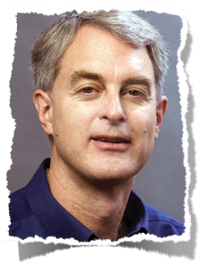
Things Working Against Us
“Bible reading has become the religious equivalent of sound-bite journalism. When people read from the Bible they typically open it, read a brief passage without much regard for the context, and consider the primary thought or feeling that the passage provided.
If they are comfortable with it, they accept it; otherwise, they deem it interesting but irrelevant to their life, and move on. There is shockingly little growth evident in people’s understanding of the fundamental themes of the scriptures and amazingly little interest in deepening their knowledge and application of biblical principles . . .
https://www.barna.org/barna-update/article/12-faithspirituality/325-barna-studies-the-research-offers-a-year-in-review-perspective#.UinrSRaTy0s

Slide 16
Things Working Against Us
A rejection of the reliability & absolute authority of the scriptures - (2 Tim 3:16,17; 2 Pet 1:19-21; Mat 24:35; Luke 21:33)
A belief that truth is subjective & relative - (no moral absolutes / doctrine & theology inconsequential) - (Judg 21:25; Jer. 6:16-19)
The emphasis of feelings & emotion over, & instead of, a “thus saith the Lord.” - (Prov 14:12; Jer. 6:16; 10:23)

Slide 17
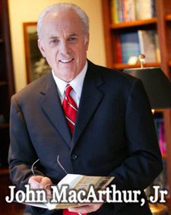
Things Working Against Us
^{2 Tim 3:5} having a form of godliness but denying its power.
“We have a society filled with people who want what they want when they want it. They are into their own lifestyle, recreation, and entertainment. They want comfort, happiness, and success. When churches appeal to those selfish desires, they only fuel fires that hinder true godliness.”
(Ashamed of The Gospel, When The Church Becomes Like The World, pg 85)

Slide 18
Things Working Against Us
Attendance / worship is a menu option
everyone expects to go to heaven
Balance scale salvation - Salvation by works: good outweighs bad
Doing the absolute minimum to be saved
very content with their religious traditions
very closed minded
no desire or need to search - TOO BUSY!!!!
Attendance / worship is a menu option
everyone expects to go to heaven
Balance scale salvation - Salvation by works: good outweighs bad
Doing the absolute minimum to be saved
very content with their religious traditions
very closed minded
no desire or need to search - TOO BUSY!!!!
You CANNOT get a person SAVED until you first CONVINCE them they are LOST!
You CANNOT get a person SAVED until you first CONVINCE them they are LOST!

Slide 19
Things Working Against Us
^{2 Tim 3:5} having a form of godliness but denying its power.
“That the Bible puts a very high premium on truth is indisputable. But sadly, the church today has largely downplayed and abandoned truth, content to follow the spirit of the age. That spirit is comprised of postmodernism, relativism, emotionalism and subjectivism. Truth cannot flourish in such poisoned soil.”
Truth Watch —- by Bill Muehlenberg
(Review of “THE TRUTH WAR” by John MacArthur)

Slide 20
The Challenge of
Overcoming The
But - It HAS ALWAYS BEEN THIS WAY!!
The Fields Are White!!!!

Slide 21
The Challenge of
Diligent In

Slide 22
The Challenge of
We can ONLY control what we do - not how others respond!
1 Corinthians 3:6 (NKJV)
I planted, Apollos watered, but God gave the increase.

Slide 23
The Challenge of
Are we STRIVING to maximize our influence & our abilities?
Matthew 5:13-16
Philippians 2:14-16
1 Thessalonians 1:6-10

Slide 24
We MUST be salty & shining -
Mat 5:13-16;
Phili 2:14-16

Slide 25
1 Thessalonians 1:6–10 (NKJV)
⁶ And you became followers of us and of the Lord, having received the word in much affliction, with joy of the Holy Spirit, ⁷ so that you became examples to all in Macedonia and Achaia who believe. ⁸ For from you the word of the Lord has sounded forth, not only in Macedonia and Achaia, but also in every place. Your faith toward God has gone out, so that we do not need to say anything.

Slide 26
1 Thessalonians 1:6–10 (NKJV)
⁹ For they themselves declare concerning us what manner of entry we had to you, and how you turned to God from idols to serve the living and true God, ¹⁰ and to wait for His Son from heaven, whom He raised from the dead, even Jesus who delivers us from the wrath to come.

Slide 27
1 Thessalonians 1:6–10 (NKJV)
True followers - 6
Tested & Joyful - 6
Living For Christ — 7
Teachers— 8
Devoted —9
Disciplined — 10

Slide 28
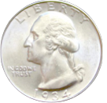
The Challenge of
Matthew 13
We will not teach another what we do not care about.
We cannot teach another what they don’t care about
We cannot teach another what we do not know.
We cannot teach another what they do NOT want …
We cannot teach another if we do not follow Christ.
We cannot teach one who is not willing follow Christ
Control What We Can / Plant & water
God will give the increase! - 1 Cor 3:6

Slide 29
The Challenge of
Matthew 13
All need the gospel – which is the only hope for the lost!
If we are truly converted to Christ – we WILL naturally want to tell others!

Slide 30
The Challenge of
Matthew 13
When Jesus means everything to ME, I WILL TRY to make Him mean something to someone else!

Slide 31
The Challenge of
3
4
Hear
2
Repent
1
Confess
Luke 8:11; Rom. 10:13-17
John 8:24; Heb 11:6
Luke 13:3,5; Acts 17:30
Mat. 10:32,33; Rom 10:9
Acts 2:38; 1 Pet 3:21
Believe
Be Baptized
5

Slide 32
Don McClain
W. 65th St. church of Christ - April 16,2006

Slide 33
The Challenge of
Charts by Don McClain
Preached July 29, 2018
West 65th Street church of Christ
P.O. Box 190062, Little Rock AR 72219 / 501-568-1062
Prepared using Keynote / Email – donmcclain@sbcglobal.net
More Keynote, PPT & Audio Sermons: http://w65stchurchofchrist.com

Slide 34
1 Thessalonians 1:6–10 (NKJV)
⁶ And you became followers of us and of the Lord, having received the word in much affliction, with joy of the Holy Spirit, ⁷ so that you became examples to all in Macedonia and Achaia who believe.

Slide 35
1 Thessalonians 1:6–10 (NKJV)
⁸ For from you the word of the Lord has sounded forth, not only in Macedonia and Achaia, but also in every place. Your faith toward God has gone out, so that we do not need to say anything.

Slide 36
1 Thessalonians 1:6–10 (NKJV)
⁹ For they themselves declare concerning us what manner of entry we had to you, and how you turned to God from idols to serve the living and true God, ¹⁰ and to wait for His Son from heaven, whom He raised from the dead, even Jesus who delivers us from the wrath to come.

