Slide 1
“Obedience To God Is Never Accidental”

Slide 2
“Obedience To God Is Never Accidental”
Dark Days For Judah …
The northern tribes had experienced captivity beginning in 721 B.C. because of their unfaithfulness
In 605 B.C., Judah, as God had stated through Jeremiah, had found itself un Babylonian control.
The first wave of captives are carried away to Babylon - including Daniel and his three friends, Hananiah, Mishael, and Azariah.

Slide 3
Nearly 900 miles (1,448 km) from Babylon to Jerusalem

Slide 4
“Obedience To God Is Never Accidental”
Strangers In A Foreign Land
Population estimated around 200,000
25’ thick walls / Art / 100 Bronze gates /

Slide 5
“Obedience To God Is Never Accidental”
Strangers In A Foreign Land
Population estimated around 200,000
25’ thick walls / Art / 100 Bronze gates /
“Babylon reached its greatest glory as a city during the reign of Nebuchadnezzar II," writes University of London professor Andrew George
Daniel, Hananiah, Mishael, and Azariah witnessed this incredible modern city during its best days.

Slide 7
At its heart was Esagila, a huge sanctuary complex which contained the temple of Marduk, and E-Temen-an-ki, the great ziggurat of Babylon

Slide 8
Daniel 1:1–2 (NKJV)
¹ In the third year of the reign of Jehoiakim king of Judah, Nebuchadnezzar king of Babylon came to Jerusalem and besieged it. ² And the Lord gave Jehoiakim king of Judah into his hand, with some of the articles of the house of God, which he carried into the land of Shinar to the house of his god; and he brought the articles into the treasure house of his god.
Dark Days For Judah …
Third year of Jehoiakim, the 17th king of Judah, eldest son of Josiah (cf. 2 Chron. 36:2 with 2 Chron. 36:5). cf(Jer 25:1; Jer 46:2) - reigned from 609-598 BC
The LORD gave Jerusalem to Nebuchadnezzar — vs 2; God’s judgment on His disobedient people (cf. Jer. 27:6; Hab. 1:6; Dt. 28:49–68)

Slide 9
Daniel 1:1–2 (NKJV)
¹ In the third year of the reign of Jehoiakim king of Judah, Nebuchadnezzar king of Babylon came to Jerusalem and besieged it. ² And the Lord gave Jehoiakim king of Judah into his hand, with some of the articles of the house of God, which he carried into the land of Shinar to the house of his god; and he brought the articles into the treasure house of his god.
Dark Days For Judah …
“Shinar” the old name of Babylonia (Gen 11:2; Gen 14:1; Isa 11:11; Zech 5:11). Nebuchadnezzar took only "part of the vessels,"
“His god” — Bel, also called Marduk, the chief god of the Babylonians

Slide 10
Daniel 1:3–4 (NKJV)
³ Then the king instructed Ashpenaz, the master of his eunuchs, to bring some of the children of Israel and some of the king’s descendants and some of the nobles, ⁴ young men in whom there was no blemish, but good-looking, gifted in all wisdom, possessing knowledge and quick to understand, who had ability to serve in the king’s palace, and whom they might teach the language and literature of the Chaldeans.
Dark Days For Judah …
“Shinar” the old name of Babylonia (Gen 11:2; Gen 14:1; Isa 11:11; Zech 5:11). Nebuchadnezzar took only "part of the vessels,"
“His god” — Bel, also called Marduk, the chief god of the Babylonians
Nebuchadnezzar had the best & brightest of Judah’s children taken to Babylon.

Slide 11
The Challenge
The intent was to assimilate them into the culture so they could serve in the kings court
They were to undergo a rigorous three-year course of training that they may learn both the language and the literature of the people among whom they now dwelt. - (Rom 12:1,2)
Daniel 1:5 (NKJV)
⁵ And the king appointed for them a daily provision of the king’s delicacies and of the wine which he drank, and three years of training for them, so that at the end of that time they might serve before the king.

Slide 12
The Challenge
⁶ Now from among those of the sons of Judah were Daniel, Hananiah, Mishael, and Azariah. ⁷ To them the chief of the eunuchs gave names:
V. 1-2 A New Home
V. 3 New Experiences
V. 4 New Duties
V. 5 New Regulations
V. 6 New Names
Daniel - Belteshazzar
Hananiah - Shadrach
Mishael - Meshach
Azariah - Abed-Nego
Notes:
Daniel, whose name means “God has judged” (or “God is my Judge”), was given the name Belteshazzar (Bēlet-šar-uṣur in Akk.), which means “Lady, protect the king.” Eight of the 10 times “Belteshazzar” occurs in the Old Testament are in the Aramaic section of the Book of Daniel (2:26; 4:8–9, 18–19 [3 times]; 5:12). The other 2 occurrences are in 1:7 and 10:1.
Hananiah (“Yahweh has been gracious”) became Shadrach probably from the Akkadian verb form šādurāku, meaning “I am fearful (of a god).”
Mishael (“Who is what God is?”) was given the name Meshach, which possibly was from the Akkadian verb mēšāku, meaning “I am despised, contemptible, humbled (before my god).”
Azariah (“Yahweh has helped”) was named Abednego, “Servant of Nebo” (Nego being a Heb. variation of the Babylonian name of the god Nebo). Nebo (cf. Isa. 46:1), son of Bel, was the Babylonian god of writing and vegetation. He was also known as Nabu (cf. comments on Dan. 1:1 on Nebuchadnezzar’s name).

Slide 13
V. 6 New Names
Daniel, =“God has judged” / Belteshazzar “bel will protect the king, or protect the prince.”
Hananiah (“Yahweh has been gracious”) / Shadrach -“I am fearful (of a god).”
Mishael (“Who is what God is”) / Meshach - “I am despised, contemptible, humbled (before my god).”
Azariah (“Yahweh has helped”) / Abednego, “Servant of Nebo” (Nego being a Heb. variation of the Babylonian name of the god Nebo). Nebo (cf. Isa. 46:1), son of Bel, was the Babylonian god of writing and vegetation. …
Notes:
Daniel, whose name means “God has judged” (or “God is my Judge”), was given the name Belteshazzar (Bēlet-šar-uṣur in Akk.), which means “Lady, protect the king.” Eight of the 10 times “Belteshazzar” occurs in the Old Testament are in the Aramaic section of the Book of Daniel (2:26; 4:8–9, 18–19 [3 times]; 5:12). The other 2 occurrences are in 1:7 and 10:1.
Hananiah (“Yahweh has been gracious”) became Shadrach probably from the Akkadian verb form šādurāku, meaning “I am fearful (of a god).”
Mishael (“Who is what God is?”) was given the name Meshach, which possibly was from the Akkadian verb mēšāku, meaning “I am despised, contemptible, humbled (before my god).”
Azariah (“Yahweh has helped”) was named Abednego, “Servant of Nebo” (Nego being a Heb. variation of the Babylonian name of the god Nebo). Nebo (cf. Isa. 46:1), son of Bel, was the Babylonian god of writing and vegetation. He was also known as Nabu (cf. comments on Dan. 1:1 on Nebuchadnezzar’s name).

Slide 14
Daniel’s Commitment
V. 8 He purposed in his heart - I.e., he made a commitment
Not to “defile himself with the king’s food” - more than likely unclean food according to Levitical restrictions — Lev. 11:47; Deut. 32:38;
Daniel 1:8 (NKJV)
⁸ But Daniel purposed in his heart that he would not defile himself with the portion of the king’s delicacies, nor with the wine which he drank; therefore he requested of the chief of the eunuchs that he might not defile himself.

Slide 15
Daniel’s Commitment
God was setting Daniel up for success - notice verse 9,10
Notice Daniel’s appeal in verses 11-14 - ¹² “Please test your servants for ten days, and let them give us vegetables to eat and water to drink.”
Daniel 1:8 (NKJV)
⁸ But Daniel purposed in his heart that he would not defile himself with the portion of the king’s delicacies, nor with the wine which he drank; therefore he requested of the chief of the eunuchs that he might not defile himself.

Slide 16
God Gives Victory
God helps - 1:9
Through persistence - Dan 1:10-11
Through trust in God - Dan 1:12-15
With the help of others - Dan 1:13
God blesses the faithful — 15-21
Daniel 1:8 (NKJV)
⁸ But Daniel purposed in his heart that he would not defile himself with the portion of the king’s delicacies, nor with the wine which he drank; therefore he requested of the chief of the eunuchs that he might not defile himself.

Slide 17
God Gives Victory
The Value Of Such Faith Seen In Its Results...
It affected the lives of others! - Dan 1:15-16; 3
It brings God’s help & strength! - Dan 1:17-20
Their faith had a profound affect on all those they come in contact with - 2; 3; 5; 6
Daniel 1:17 (NKJV)
¹⁷ As for these four young men, God gave them knowledge and skill in all literature and wisdom; and Daniel had understanding in all visions and dreams.

Slide 18
Applications
The commitment must BE MADE! - Acts 11:23
Be humble -& trusting - Pro 15:1 ; Ps 127:1-2
Be persistent - Mt 7:7-11; Lk 18:1-8
Trust God's word - Rom. 4:21; Rom 3:4
Seek the help of others with the same type of faith - Ecclesiastes 4:12
Daniel 1:8 (NKJV)
⁸ But Daniel purposed in his heart that he would not defile himself with the portion of the king’s delicacies, nor with the wine which he drank; therefore he requested of the chief of the eunuchs that he might not defile himself.

Slide 19
Applications
Are we dedicated enough to the Lord that we refuse to compromise? (even in areas we may deem small?)
Satan is fine with small victories - but remember if you give him an inch … Romans 13:14
Daniel 1:20–21 (NKJV)
²⁰ And in all matters of wisdom and understanding about which the king examined them, he found them ten times better than all the magicians and astrologers who were in all his realm. ²¹ Thus Daniel continued until the first year of King Cyrus.

Slide 20
Applications
What about us,?
Do we have that same level of resolve and commitment to the Lord and His work?
Would you be willing to die before compromising with the enemy?
Daniel 1:20–21 (NKJV)
²⁰ And in all matters of wisdom and understanding about which the king examined them, he found them ten times better than all the magicians and astrologers who were in all his realm. ²¹ Thus Daniel continued until the first year of King Cyrus.

Slide 21
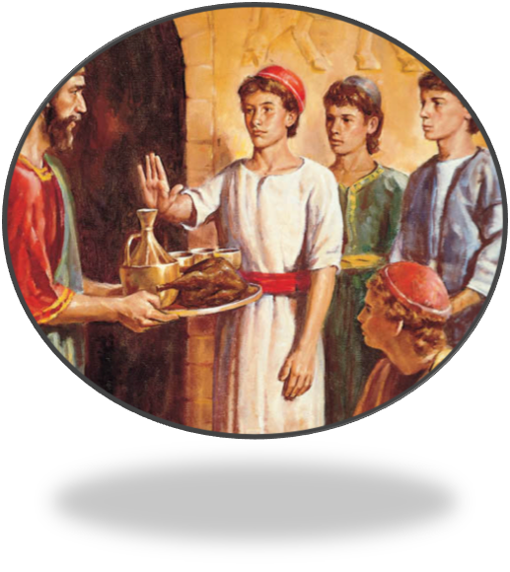
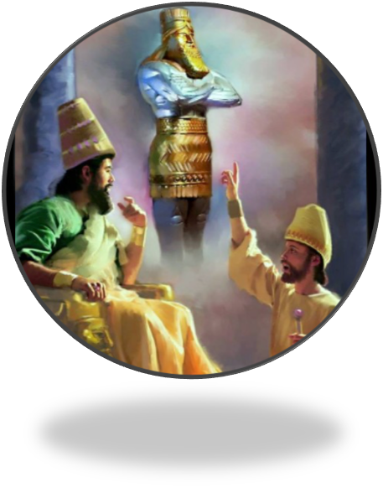
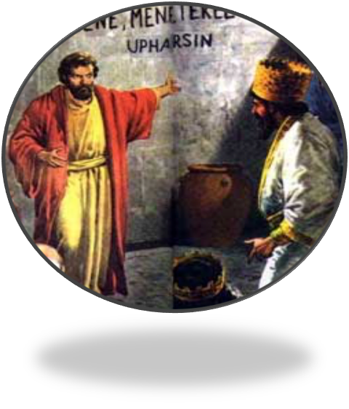
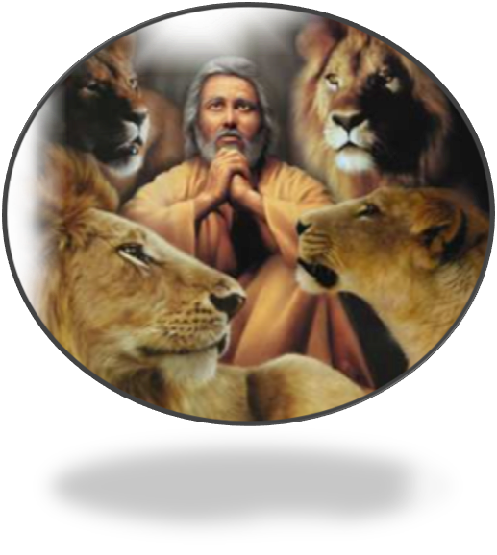
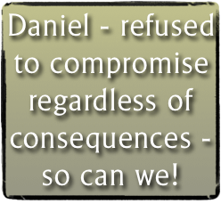
Purpose / Persistence / Principle / Prayer

Slide 23
Introduction
Charts by Don McClain
Preached May 20, 2018 PM
West 65th Street church of Christ / P.O. Box 190062 / Little Rock AR 72219 / 501-568-1062
Email – donmcclain@sbcglobal.net
More Keynote, PPT & Audio Sermons:
http://w65stchurchofchrist.org/coc/sermons/

Slide 24
Psalm 119:105–112 (NKJV)
¹⁰⁵ Your word is a lamp to my feet And a light to my path. ¹⁰⁶ I have sworn and confirmed That I will keep Your righteous judgments. ¹⁰⁷ I am afflicted very much; Revive me, O Lord, according to Your word. ¹⁰⁸ Accept, I pray, the freewill offerings of my mouth, O Lord, And teach me Your judgments.

Slide 25
Psalm 119:105–112 (NKJV)
¹⁰⁹ My life is continually in my hand, Yet I do not forget Your law. ¹¹⁰ The wicked have laid a snare for me, Yet I have not strayed from Your precepts. ¹¹¹ Your testimonies I have taken as a heritage forever, For they are the rejoicing of my heart. ¹¹² I have inclined my heart to perform Your statutes Forever, to the very end.

