Slide 1
Matthew 28:19–20 (NKJV)
¹⁹ Go therefore and make disciples of all the nations, baptizing them in the name of the Father and of the Son and of the Holy Spirit, ²⁰ teaching them to observe all things that I have commanded you; and lo, I am with you always, even to the end of the age.” Amen.
Being A Follower of Jesus

Slide 2
The Challenge of
The Desperate

Slide 3
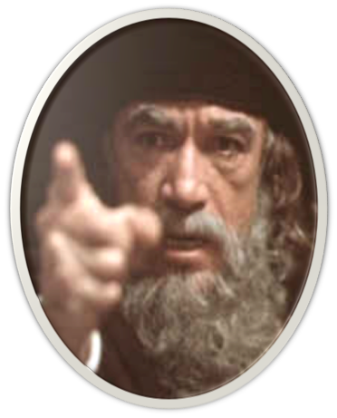
The Lost & Found Sheep, Coin & Son
Luke 15:1–2 (NKJV)
¹ Then all the tax collectors and the sinners drew near to Him to hear Him. ² And the Pharisees and scribes complained, saying, “This Man receives sinners and eats with them.”
Jesus responds with a parabolic triptych . . .

Slide 4
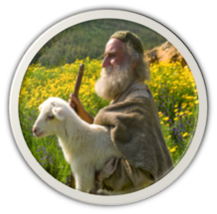
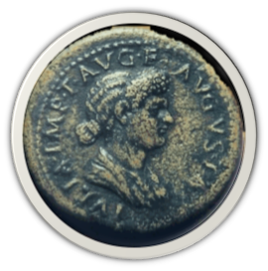
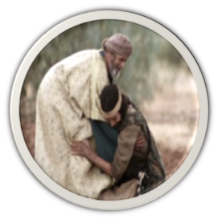
The Lost & Found Sheep, Coin & Son
Jesus responds with a parabolic triptych . . .

Slide 5
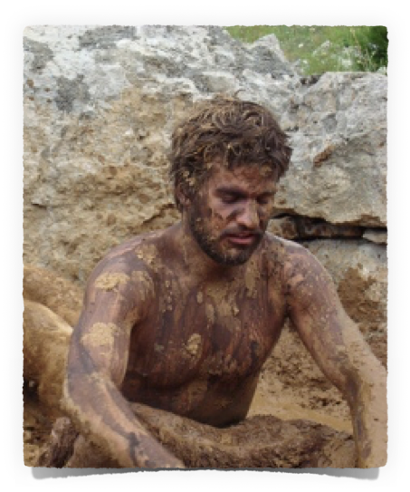
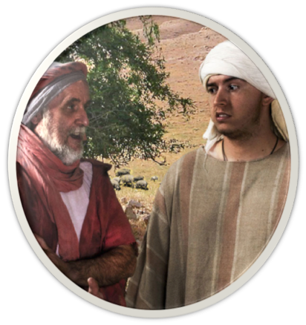
OUR ATTITUDE TOWARDS THE LOST?
The State of The Lost - Eph 2:12; 1 Thes 4:13
The Value of The Lost – Mat 18:14; 1 Pet 1:18-21
The Love God Has For The Lost – Jn 3:16; Rom 5:8-10; 2 Cor 5:19-21
Our responsibility to the lost? – Rom 1:14,15; Jam 5:19,20; Mk 12:29-31

Slide 6
The Challenge of
THE GREATEST NEED – we all have — Rom 3:23; 1:16,17; Jn 14:6; Acts 4:12
The greatest SERVICE we can provide another — Mat. 28:19,20; Acts 8:4
Are We willing to do everything in our power to bring others to Jesus?

Slide 7
The Challenge of
The Example of

Slide 8
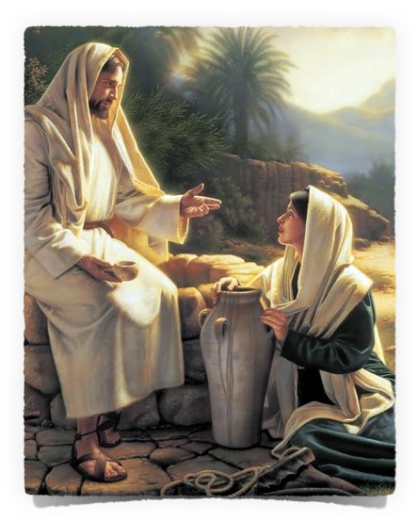
Being A Follower of JESUS
COMPASSION for the LOST
Matthew 9:36 (NKJV)
³⁶ But when He saw the multitudes, He was moved with compassion for them, because they were weary and scattered, like sheep having no shepherd.
cf. Mark 6:34

Slide 9
Being A Follower of JESUS
SEEKING TO SAVE the LOST
Luke 19:10 (NKJV)
¹⁰ for the Son of Man has come to seek and to save that which was lost.”
cf. John 1:14; Phili 2:5-7; Heb 2:9

Slide 10
Being A Follower of JESUS
SEEKING TO SAVE the LOST
Luke 15:4 (NKJV)
⁴ “What man of you, having a hundred sheep, if he loses one of them, does not leave the ninety-nine in the wilderness, and go after the one which is lost until he finds it?

Slide 11
Being A Follower of JESUS
SEEKING TO SAVE the LOST
Luke 5:30–32 (NKJV)
³⁰ And their scribes and the Pharisees complained against His disciples, saying, “Why do You eat and drink with tax collectors and sinners?” ³¹ Jesus answered and said to them, “Those who are well have no need of a physician, but those who are sick. ³² I have not come to call the righteous, but sinners, to repentance.”

Slide 12
Being A Follower of JESUS
SACRIFICING for the LOST
John 15:13 (NKJV)
¹³ Greater love has no one than this, than to lay down one’s life for his friends.
cf. Luke 19:26-37 … The good Samaritan
While sinners … Rom 5:8-10; 1 Jno. 4:9, 10;
Shouldn’t we also … 1 Jno. 3:16; Rom 1:14
Are we doing right? … 2 Kings 7:9

Slide 13
Being A Follower of JESUS
O To Be LIKE THEE … # 97
^{2nd verse} . . . full of compassion, Loving, forgiving, tender and kind, Helping the helpless, cheering the fainting, Seeking the wand’ring sinner to find.”
^{3rd verse} . . . Lowly in spirit, holy and harmless, patient and brave; Meekly enduring cruel reproaches, Willing to suffer, others to save . . .
^{Chorus: …} Stamp Thine own image deep on my heart.
CARING
ACTIVE
SACRIFICIAL
FOLLOWERS

Slide 14
Being A Follower of JESUS
O To Be LIKE THEE … # 97
Matthew 10:24–25 (NKJV)
²⁴ “A disciple is not above his teacher, nor a servant above his master. ²⁵ It is enough for a disciple that he be like his teacher, and a servant like his master.
(cf. 1 Peter 2:21)

Slide 15
Being A Follower of JESUS
O To Be LIKE THEE … John 4
Why the Lord NEEDED to pass through Samaritan territory (1-4).
The actual exchange between Jesus and this woman (5-26).
The effect that ultimately was produced as a result of this incident (27-42).

Slide 16
Being A Follower of JESUS
O To Be LIKE THEE … John 4
A Samaritan woman well aware of the prejudices - 9
Aware of Jacob & the scriptures - 12
She was a sinner - 17-18
Had some knowledge of religion - 19,20
Expected the Messiah & had knowledge of Him - 25

Slide 17
Being A Follower of JESUS
O To Be LIKE THEE … John 4
Took advantage of the occasion - 7
Began from established common interest - 7,10
Used occasion to discuss spiritual things - 10,13,14
Gently confronted her sin & error - 16-18, 21-24
Was direct - 25,26

Slide 18
Being A Follower of JESUS
O To Be LIKE THEE … John 4
John 4:28–42 (NKJV)
²⁸ The woman then left her waterpot, went her way into the city, and said to the men, ²⁹ “Come, see a Man who told me all things that I ever did. Could this be the Christ?” ³⁰ Then they went out of the city and came to Him. …
The Result

Slide 19
Being A Follower of JESUS
O To Be LIKE THEE … John 4
John 4:28–42 (NKJV)
³⁹ And many of the Samaritans of that city believed in Him because of the word of the woman who testified, “He told me all that I ever did.” ⁴⁰ So when the Samaritans had come to Him, they urged Him to stay with them; and He stayed there two days. …
The Result

Slide 20
Being A Follower of JESUS
O To Be LIKE THEE … John 4
John 4:28–42 (NKJV)
⁴¹ And many more believed because of His own word. ⁴² Then they said to the woman, “Now we believe, not because of what you said, for we ourselves have heard Him and we know that this is indeed the Christ, the Savior of the world.”
The Result

Slide 21
Being A Follower of JESUS
O To Be LIKE THEE … John 4
The disciples marveled that Jesus was speaking with a woman — 27
The disciples were more concerned with carnal things — 31-33
The disciples needed to learn what is truly important — 34-38

Slide 22
Being A Follower of JESUS
O To Be LIKE THEE … John 4
John 4:34–35 (NKJV)
³⁴ Jesus said to them, “My food is to do the will of Him who sent Me, and to finish His work. ³⁵ Do you not say, ‘There are still four months and then comes the harvest’? Behold, I say to you, lift up your eyes and look at the fields, for they are already white for harvest!

Slide 23
Being A Follower of JESUS
Being “Sowers of God’s Word”
Luke 8:4–8 (NKJV)
⁴ And when a great multitude had gathered, and they had come to Him from every city, He spoke by a parable: ⁵ “A sower went out to sow his seed. And as he sowed, some fell by the wayside; and it was trampled down, and the birds of the air devoured it. ⁶ Some fell on rock; and as soon as it sprang up, it withered away because it lacked moisture. ⁷ And some fell among thorns, and the thorns sprang up with it and choked it. ⁸ But others fell on good ground, sprang up, and yielded a crop a hundredfold.” When He had said these things He cried, “He who has ears to hear, let him hear!”

Slide 24
Being A Follower of JESUS
Being “Fisher’s of MEN”
Matthew 4:18–20 (NKJV)
¹⁸ And Jesus, walking by the Sea of Galilee, saw two brothers, Simon called Peter, and Andrew his brother, casting a net into the sea; for they were fishermen. ¹⁹ Then He said to them, “Follow Me, and I will make you fishers of men.” ²⁰ They immediately left their nets and followed Him.

Slide 25
The Challenge of
Some Questions To Ponder …
Do I know enough Scripture to help one become a Christian? __________
Do I honestly feel that I am my brother's keeper, and that his salvation may depend LARGELY upon me? __________________
Have I offered the excuse, "I DON'T KNOW HOW," for not doing personal work? _______
Do I think I can ever really learn how until I try? ________
Do I plan to begin? ______________

Slide 26
The Challenge of
Some Questions To Ponder …
How many people do I NOW have my heart set on to teach? _______
To what extent have I gone to try & teach these people? ________
Do I ever pray FERVENTLY that I might become a better soul winner?_____
DO I SINCERELY TRY to help that prayer be answered? _________

Slide 27
The Challenge of
Am I interested enough in Heaven, and does it mean enough to me that I earnestly desire others to go with me? ___________
We can’t save everyone, but will we allow those close to us to stand before God unprepared & will we hear them say “you never mentioned Him to me”? _____________
Some Questions To Ponder …

Slide 28
The Challenge of
Matthew 13
All need the gospel – which is the only hope for the lost!
If we are truly converted to Christ – we WILL naturally try to tell others!

Slide 29
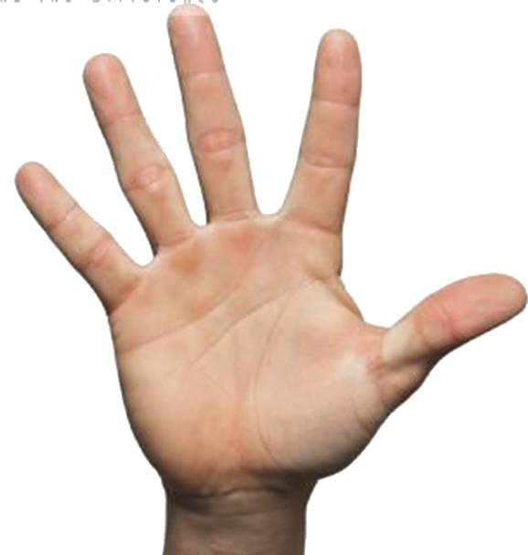
The Challenge of
3
4
Hear
2
Repent
1
Confess
Luke 8:11; Rom. 10:13-17
John 8:24; Heb 11:6
Luke 13:3,5; Acts 17:30
Mat. 10:32,33; Rom 10:9
Acts 2:38; 1 Pet 3:21
Believe
Be Baptized
5

Slide 30
Don McClain
W. 65th St. church of Christ - April 16,2006

Slide 31
The Challenge of
Charts by Don McClain
Preached August 12, 2018
West 65th Street church of Christ
P.O. Box 190062, Little Rock AR 72219 / 501-568-1062
Prepared using Keynote / Email – donmcclain@sbcglobal.net
More Keynote, PPT & Audio Sermons: http://w65stchurchofchrist.com

Slide 32
Matthew 13:3–9 (NKJV)
³ Then He spoke many things to them in parables, saying: “Behold, a sower went out to sow. ⁴ And as he sowed, some seed fell by the wayside; and the birds came and devoured them.

Slide 33
Matthew 13:3–9 (NKJV)
⁵ Some fell on stony places, where they did not have much earth; and they immediately sprang up because they had no depth of earth. ⁶ But when the sun was up they were scorched, and because they had no root they withered away.

Slide 34
Matthew 13:3–9 (NKJV)
⁷ And some fell among thorns, and the thorns sprang up and choked them. ⁸ But others fell on good ground and yielded a crop: some a hundredfold, some sixty, some thirty. ⁹ He who has ears to hear, let him hear!”

