Slide 1
Facing The
THE DANGER OF FORMALISM
THE WORLD
PRIDE / SELFISHNESS
ERROR / DIVISION
STUFF / MATERIALISM
APATHY / COMPROMISE

Slide 2
Facing The
THE WORLD
The church (people of God) has always faced DANGER!
Persecution / temptation – Mark 13:9 / 1 Cor. 10:1-13; 1 John 2:15-17; Mt 6:24
Carnality – 1 Cor. 3:1ff; Jam 3:14ff
Drifting away from the truth – Heb. 2:1; Gal. 1:6-9
Lukewarmness – Rev 3:14 ff
Deception – Mat. 24:4; 2 Pet 2:1-22
PRIDE / SELFISHNESS
ERROR / DIVISION
STUFF / MATERIALISM
APATHY / COMPROMISE

Slide 3
Dangers Facing The

Slide 4
Revelation 2:1–7 (NKJV)
¹ “To the angel of the church of Ephesus write, ‘These things says He who holds the seven stars in His right hand, who walks in the midst of the seven golden lampstands: ² “I know your works, your labor, your patience, and that you cannot bear those who are evil. And you have tested those who say they are apostles and are not, and have found them liars; ³ and you have persevered and have patience, and have labored for My name’s sake and have not become weary.

Slide 5
Revelation 2:1–7 (NKJV)
⁴ Nevertheless I have this against you, that you have left your first love. ⁵ Remember therefore from where you have fallen; repent and do the first works, or else I will come to you quickly and remove your lampstand from its place—unless you repent. ⁶ But this you have, that you hate the deeds of the Nicolaitans, which I also hate. ⁷ “He who has an ear, let him hear what the Spirit says to the churches. To him who overcomes I will give to eat from the tree of life, which is in the midst of the Paradise of God.” ’

Slide 6
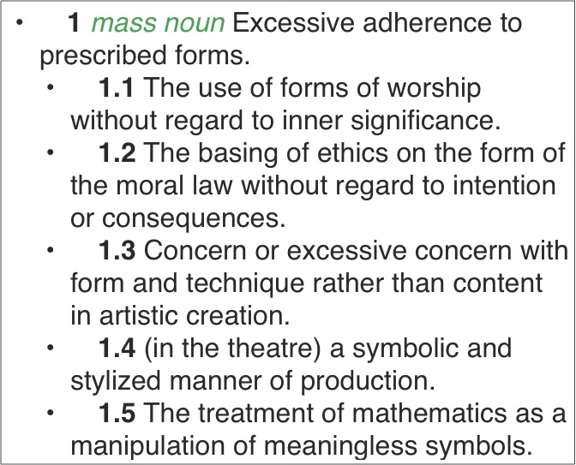
THE DANGER OF FORMALISM
To Define “Formalism”

Slide 7
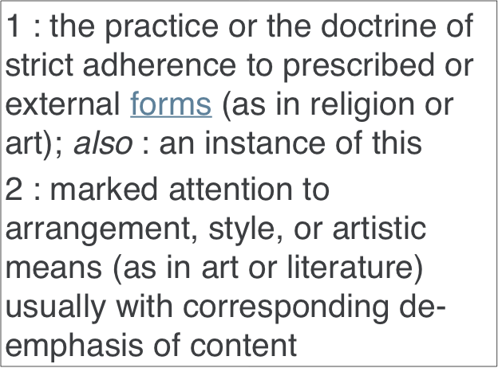
THE DANGER OF FORMALISM
To Define “Formalism”

Slide 8
THE DANGER OF FORMALISM
To Define “Formalism”
PLEASE DO NOT MISUNDERSTAND!
NOT even remotely suggesting the abandonment of implied, exemplified and commanded “FORMS” —
Beware of extremes. The misuse of a thing is no argument against the right use of it.

Slide 9
THE DANGER OF FORMALISM
We MUST Follow NT PATTERN / FORM
2 Timothy 1:13 (NKJV)
¹³ Hold fast the pattern of sound words which you have heard from me, in faith and love which are in Christ Jesus.

Slide 10
THE DANGER OF FORMALISM
We MUST Follow NT PATTERN / FORM
1 Corinthians 11:2 (NKJV)
² Now I praise you, brethren, that you remember me in all things and keep the traditions just as I delivered them to you.

Slide 11
THE DANGER OF FORMALISM
We MUST Follow NT PATTERN / FORM
2 Thessalonians 2:15 (NKJV)
¹⁵ Therefore, brethren, stand fast and hold the traditions which you were taught, whether by word or our epistle.

Slide 12
THE DANGER OF FORMALISM
We MUST Follow NT PATTERN / FORM
2 Thessalonians 3:6 (NKJV)
⁶ But we command you, brethren, in the name of our Lord Jesus Christ, that you withdraw from every brother who walks disorderly and not according to the tradition which he received from us.

Slide 13
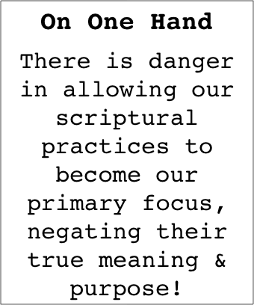
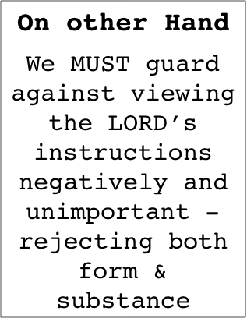
THE DANGER OF FORMALISM
We MUST Follow NT PATTERN / FORM

Slide 14
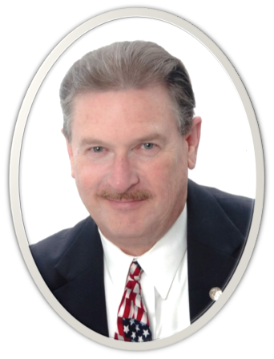
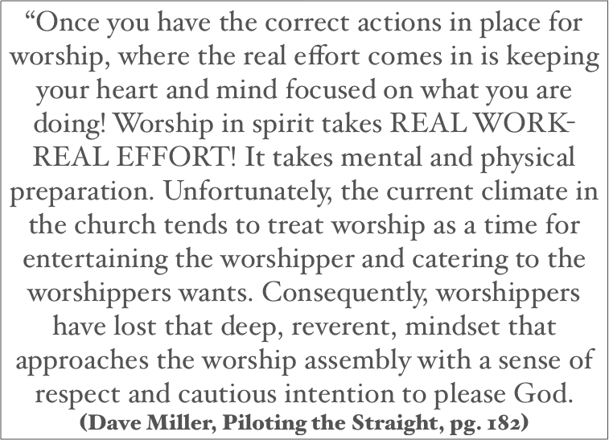
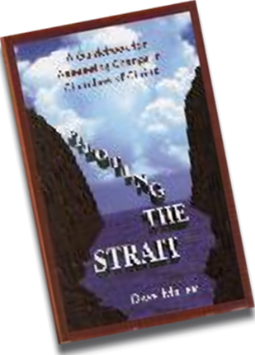
THE DANGER OF FORMALISM
We MUST Follow NT PATTERN / FORM

Slide 15
THE DANGER OF FORMALISM
The Israelites Were Rebuked …
Isaiah 1:11–17 (NKJV)
¹¹ “To what purpose is the multitude of your sacrifices to Me?” Says the Lord. “I have had enough of burnt offerings of rams And the fat of fed cattle. I do not delight in the blood of bulls, Or of lambs or goats. ¹² “When you come to appear before Me, Who has required this from your hand, To trample My courts?

Slide 16
THE DANGER OF FORMALISM
The Israelites Were Rebuked …
Isaiah 1:11–17 (NKJV)
¹³ Bring no more futile sacrifices; Incense is an abomination to Me. The New Moons, the Sabbaths, and the calling of assemblies— I cannot endure iniquity and the sacred meeting. ¹⁴ Your New Moons and your appointed feasts My soul hates; They are a trouble to Me, I am weary of bearing them. ¹⁵ When you spread out your hands, I will hide My eyes from you; Even though you make many prayers, I will not hear. Your hands are full of blood.

Slide 17
THE DANGER OF FORMALISM
The Israelites Were Rebuked …
Isaiah 1:11–17 (NKJV)
¹⁶ “Wash yourselves, make yourselves clean; Put away the evil of your doings from before My eyes. Cease to do evil, ¹⁷ Learn to do good; Seek justice, Rebuke the oppressor; Defend the fatherless, Plead for the widow.

Slide 18
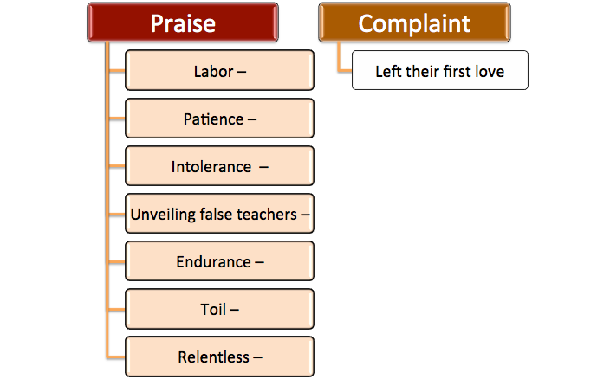
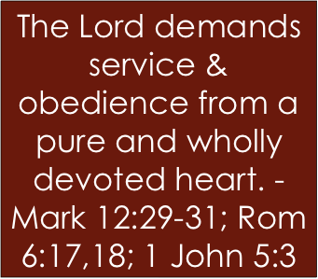
THE DANGER OF FORMALISM
The Early Church Was Warned & Instructed
The church in Ephesus had left its “first love.” — Rev. 2:1-7

Slide 19
THE DANGER OF FORMALISM
The Early Church Was Warned & Instructed
The church in Ephesus had left its “first love.” — Rev. 2:1-7

Slide 20
THE DANGER OF FORMALISM
The Early Church Was Warned & Instructed
The church in Ephesus had left its “first love.” — Rev. 2:1-7
The Pharisees were guilty— Mat 23:23
Matthew 23:23–33 (NKJV)
²³ “Woe to you, scribes and Pharisees, hypocrites! For you pay tithe of mint and anise and cummin, and have neglected the weightier matters of the law: justice and mercy and faith. These you ought to have done, without leaving the others undone. ²⁴ Blind guides, who strain out a gnat and swallow a camel!

Slide 21
THE DANGER OF FORMALISM
The Early Church Was Warned & Instructed
The church in Ephesus had left its “first love.” — Rev. 2:1-7
The Pharisees were guilty— Mat 23:23
Matthew 23:23–33 (NKJV)
²⁵ “Woe to you, scribes and Pharisees, hypocrites! For you cleanse the outside of the cup and dish, but inside they are full of extortion and self-indulgence. ²⁶ Blind Pharisee, first cleanse the inside of the cup and dish, that the outside of them may be clean also.

Slide 22
THE DANGER OF FORMALISM
The Early Church Was Warned & Instructed
The church in Ephesus had left its “first love.” — Rev. 2:1-7
The Pharisees were guilty— Mat 23:23
Matthew 23:23–33 (NKJV)
²⁷ “Woe to you, scribes and Pharisees, hypocrites! For you are like whitewashed tombs which indeed appear beautiful outwardly, but inside are full of dead men’s bones and all uncleanness. ²⁸ Even so you also outwardly appear righteous to men, but inside you are full of hypocrisy and lawlessness.

Slide 23
THE DANGER OF FORMALISM
The Early Church Was Warned & Instructed
The church in Ephesus had left its “first love.” — Rev. 2:1-7
The Pharisees were guilty— Mat 23:23
Matthew 23:23–33 (NKJV)
²⁹ “Woe to you, scribes and Pharisees, hypocrites! Because you build the tombs of the prophets and adorn the monuments of the righteous, ³⁰ and say, ‘If we had lived in the days of our fathers, we would not have been partakers with them in the blood of the prophets.’

Slide 24
THE DANGER OF FORMALISM
The Early Church Was Warned & Instructed
The church in Ephesus had left its “first love.” — Rev. 2:1-7
The Pharisees were guilty— Mat 23:23
Matthew 23:23–33 (NKJV)
³¹ “Therefore you are witnesses against yourselves that you are sons of those who murdered the prophets. ³² Fill up, then, the measure of your fathers’ guilt. ³³ Serpents, brood of vipers! How can you escape the condemnation of hell?

Slide 25
THE DANGER OF FORMALISM
The Early Church Was Warned & Instructed
The church in Ephesus had left its “first love.” — Rev. 2:1-7
The Pharisees were guilty— Mat 23:23
Any act, regardless of how “good” or “needed,” if done without love, profits one nothing — 1 Cor. 13:1-3
In the latter days men would have ”a form of godliness but deny its power … always learning and never able to come to the knowledge of the truth.” — 2 Tim 3:5,7
Worship & service MUST be in BOTH Spirit & Truth — John 4:24; Rom 12:1-2

Slide 26
THE DANGER OF FORMALISM
Why IS FORMALISM Such A Threat?
It appeals to the carnal mind (self centered, arrogant, materialistic, unregenerate) — 1 Cor. 3:1-3; James 3:14-4:6
It appeals to the self-righteous (religious but proud, self-sufficient) — Luke 18:9-14, 18-23
It appeals to the hypocrite — (they love the praises of men) — Mt. 6:1-18; 23

Slide 27
THE DANGER OF FORMALISM
HEED The Warning / Take Necessary ACTION
Remember - Virtue of Recall – Luke 15:17-21; Eph 1:3-14
Honesty - self investigation – 2 Cor. 13:5; Heb 12:15
Repent & Return Change of mind, heart / put the Lord first / His will / His work / His purposes – FOR HIM!
Only ONE thing put them in danger / only one thing could restore them — Mat 6:19-33
Revelation 2:5 ^{(NKJV)}
⁵ Remember therefore from where you have fallen; repent and do the first works, or else I will come to you quickly and remove your lampstand from its place--unless you repent.

Slide 28
THE DANGER OF FORMALISM
Let us be TRUE Christians In BOTH FORM & SUBSTANCE
Worshipping in Spirit & Truth!
Seeking to obey the Lord in ALL things & for the right reasons!
Being faithful and dependable in the Lord’s service while always keeping our motives genuine, heartfelt & humble.

Slide 29
THE DANGER OF FORMALISM
Let us be TRUE Christians In BOTH FORM & SUBSTANCE
Romans 6:16–18 (NKJV)
¹⁶ Do you not know that to whom you present yourselves slaves to obey, you are that one’s slaves whom you obey, whether of sin leading to death, or of obedience leading to righteousness? ¹⁷ But God be thanked that though you were slaves of sin, yet you obeyed from the heart that form of doctrine to which you were delivered. ¹⁸ And having been set free from sin, you became slaves of righteousness.

Slide 31
Dangers Facing The
Revelation 2:1–7 (NKJV)
Charts by Don McClain
Preached June 10, 2018
West 65th Street church of Christ / P.O. Box 190062 / Little Rock AR 72219 / 501-568-1062
Email – donmcclain@sbcglobal.net
More Keynote, PPT & Audio Sermons:
http://w65stchurchofchrist.org/coc/sermons/

Slide 32
Matthew 13:43–46 (NKJV)
⁴³ Then the righteous will shine forth as the sun in the kingdom of their Father. He who has ears to hear, let him hear! ⁴⁴ “Again, the kingdom of heaven is like treasure hidden in a field, which a man found and hid; and for joy over it he goes and sells all that he has and buys that field. ⁴⁵ “Again, the kingdom of heaven is like a merchant seeking beautiful pearls, ⁴⁶ who, when he had found one pearl of great price, went and sold all that he had and bought it.

