Slide 1
“The Hand Writing On The Wall”
Weighed In The Balances
5:1-31

Slide 2
“The Hand Writing On The Wall”
Timeline
605 B.C., Judah under Babylonian control. The first wave of captives are carried away to Babylon - including Daniel, Hananiah, Mishael, and Azariah. (Daniel 1)
603 B.C. Nebuchadnezzar’s dream of the Great Image and Daniel’s giving of the interpretation — (Daniel 2)
587 B.C. Nebuchadnezzar’s 18th year, he makes an image of gold and demands all bow before it - Hananiah, Mishael, and Azariah refuse and are thrown into the fiery furnace - (Daniel 3)
Chapter 4 takes place at some point after 587 BC …

Slide 3
“The Hand Writing On The Wall”
Timeline
Nebuchadnezzar died in 562 b.c. after ruling 43 years.& succeeded by his son, Evil-Merodach.... (Jeremiah 52:31; II Kings 25:27-30)
Evil-Merodach ruled for two years (562-560 b.c., 2 Kings 25:27-30; Jer. 52:31-34) & was murdered in August 560 by Neriglissar, Nebuchadnezzar’s son-in-law and Evil-Merodach’s brother-in-law.
Neriglissar then ruled four years (560-556 b.c.). [He is the Nergal-Sharezer mentioned in Jer 39:3, 13]. At his death, succeeded by his young son Labashi-Marduk, who ruled two months (May and June 556)

Slide 4
“The Hand Writing On The Wall”
Timeline
Labashi-Marduk, was assassinated and succeeded by Nabonidus, who reigned 17 years (556-539 b.c.).
553 B.C. Nabonidus went to the oasis of Tayma & devoted himself to the worship of the moon god, Sin.
He appointed his son, Belshazzar, as ruler of Babylon in his place.

Slide 5
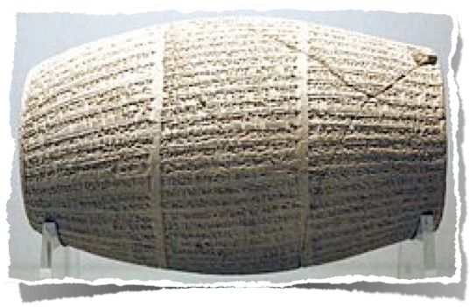
“The Hand Writing On The Wall”
For years, historians knew nothing about Belshazzar, so many Biblical critics pointed to Daniel 5 as evidence against the accuracy Bible.
In 1853 inscriptions in stone were unearthed by archaeologists which reveal that Nabonidus, much of the time, was in retirement outside of Babylon, and that Belshazzar, his son, was co-regent.
The Nabonidus Cylinder

Slide 6
“The Hand Writing On The Wall”
"And as for Belshazzar my firstborn son, my own child, let the fear of your great divinity be in his heart, and may he commit no sin; may he enjoy happiness in life".
"[Nabonidus] entrusted the army to his oldest son, his first born, the troops in the country he ordered under his command. He let everything go, entrusted the kingship to him, and, himself, he started out for a long journey. The military forces of Akkad marching with him, he turned to Temâ deep in the west" (Col. II, lines 18 - 29. 18).
The Nabonidus Cylinder
http://en.wikipedia.org/wiki/Belshazzar

Slide 7
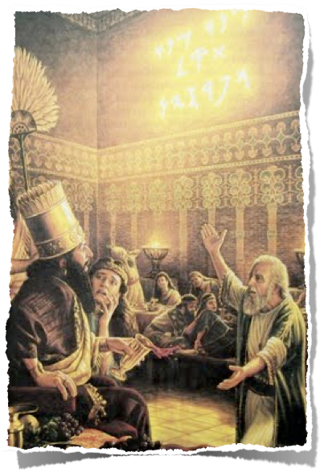
“The Hand Writing On The Wall”
Nabonidus returned 540 B.C. to defend against the Persians. In 539 B.C. Belshazzar was positioned in the city of Babylon to hold the capital, while Nabonidus, marched his troops north to meet Cyrus.
October 10, 539 B.C. Nabonidus surrendered to Cyrus & exiled.
Two days later, October 12, 539 B.C., the Persian armies overthrew the city of Babylon.

Slide 8
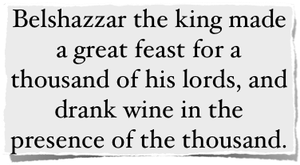
“The Hand Writing On The Wall”
The Revelry of the King - (5:1–4)
Belshazzar throws a feast for 1,000 of his nobles - (1)
Babylon was at that moment being besieged by Cyrus’ army
Belshazzar’s name means “Bel (i.e., Marduk) has protected the king.” - This feast was in honor of his god’s in a time of war.
Belshazzar felt safe within the massive walls (85’ x 350’) with supplies to last 20 years.

Slide 9
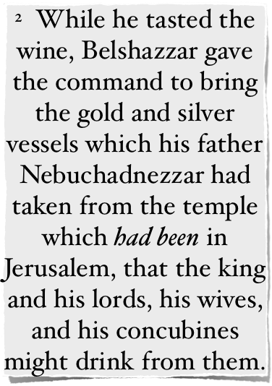
“The Hand Writing On The Wall”
The Revelry of the King - (5:1–4)
Things Of The Temple Desecrated - (2,3)
Belshazzar orders vessels taken from the temple in Jerusalem, (2 Chr 36:10), be brought that they may drink wine from them in honor his god - (2)
Nabonidus (Belshazzar's father) was probably Nebuchadnezzar's son-in-law, making him Belshazzar’s "grand-father"

Slide 10
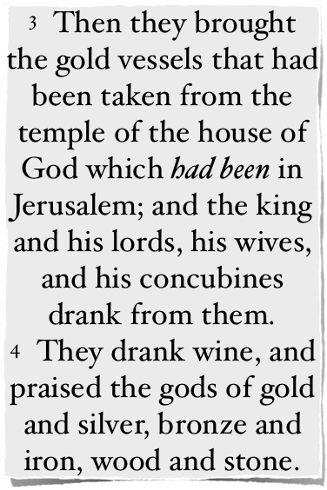
“The Hand Writing On The Wall”
The Revelry of the King - (5:1–4)
Things Of The Temple Desecrated - (2,3)
Belshazzar took that which was sanctified for a divine use and prostituted it to a common and debased use (Exodus 40:9–10; 1 Kings 8:14; Ezra 8:28).
He used them to honor the name of “his gods” further insulting the one and only true God - (vs. 4; Hab 1:5-11; Isa 42:8; 48:11).

Slide 11
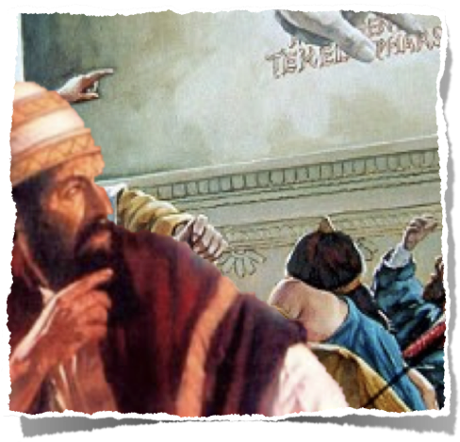
“The Hand Writing On The Wall”
The Trembling King - (5:5-9)
The fingers of a man’s hand writes a message on the wall - (5)
The king is terrified - (6)
Belshazzar summons the wise men, enchanters, astrologers, and diviners, promising to reward whoever could interpret the meaning of this strange phenomenon. NONE COULD! (7-9)

Slide 12
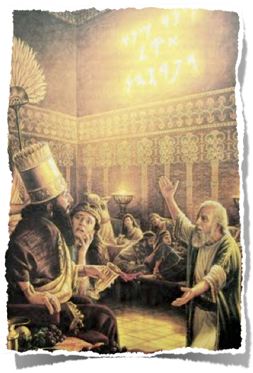
“The Hand Writing On The Wall”
Daniel Is Summoned - (5:10-16)
Arrival of the Queen - (10-12)
Probably Belshazzar’s mother, Nitrocis, Nebuchadnezzar’s daughter (cf. 5:1–2; 2 Chro 15:16).
She knew Daniel — “he has the spirit of the holy God” (11; cf. 4:8-9, 18; 5:14).
She knew of his insight, intelligence, wisdom (v. 11), knowledge, understanding & ability to interpret dreams (v. 12).
Daniel can interpret! - (12)

Slide 13
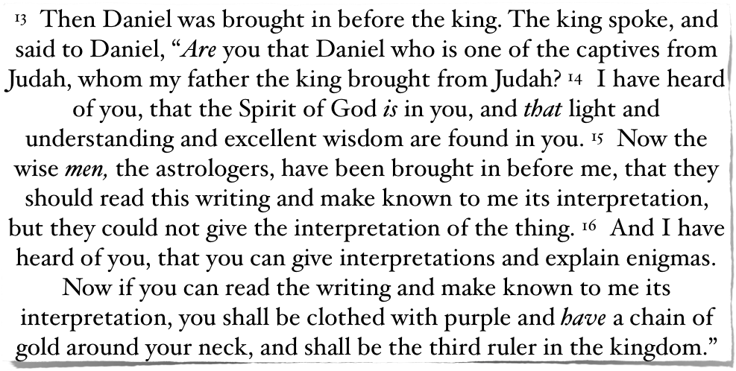
“The Hand Writing On The Wall”
Daniel Is Summoned - (5:10-16)
Arrival of Daniel - (13-16)

Slide 14
“The Hand Writing On The Wall”
Daniel Rebukes The King - (5:17-24)
Daniel rejects the kings offer - but will “read & interpret” for free - (17)
Daniel summarizes God’s dealing with Belshazzar’s predecessor Nebuchadnezzar - (18-21)
Given his position by “The Most High God” - (18,19; 3:26),
He became arrogant and proud (cf. 4:30), so God humbled him, stripping him of his throne - (20; 4:31-33)
Learned his lesson and praised God (21; 4:34-37)

Slide 15
“The Hand Writing On The Wall”
Daniel Rebukes The King - (5:17-24)
The pride of Belshazzar (5:22-24)
Knew of Nebuchadnezzar’s story, and should have learned from it - but instead did even worse - (22,23 a)
Openly challenged the Lord of heaven (cf. “the King of heaven,” 4:37) by drinking from the vessels taken from the temple in Jerusalem (5:2-3) and praised his false gods (v. 4) - (23)
They have no life, but by contrast the true and living God held Belshazzar’s life in His hand - (23,24; Act 17:24-31)

Slide 16
“The Hand Writing On The Wall”
Daniel Rebukes The King - (5:17-24)
Daniel 5:23 (NKJV)
And you have lifted yourself up against the Lord of heaven. They have brought the vessels of His house before you, and you and your lords, your wives and your concubines, have drunk wine from them. And you have praised the gods of silver and gold, bronze and iron, wood and stone, which do not see or hear or know; and the God who holds your breath in His hand and owns all your ways, you have not glorified.

Slide 17
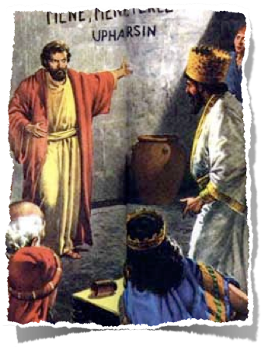
“The Hand Writing On The Wall”
Interpretation of the Writing (5:24–28)
²⁵ "And this is the inscription that was written: MENE, MENE, TEKEL, UPHARSIN.
God’s judgment - (5:25-28)
Mene – “God has numbered your kingdom and finished it” (5:26).
Tekel – “You have been weighed in the balances and found wanting” (5:27; Job 31:6; Psa. 62:9-10).
Upharsin (peras) – “Your kingdom has been divided and given to the Medes and Persians.”

Slide 18
“The Hand Writing On The Wall”
Interpretation of the Writing (5:24–28)
²⁵ "And this is the inscription that was written: MENE, MENE, TEKEL, UPHARSIN.
God’s judgment - (5:25-28)
God had set limits on Belshazzar's kingdom - (Acts 17:26-29)
Belshazzar’s moral and spiritual character did not measure up to the standard of God’s righteousness so he was rejected. “By Him [God] deeds are weighed (1 Sam. 2:3; Acts 17:30).

Slide 19
“The Hand Writing On The Wall”
Interpretation of the Writing (5:24–28)
²⁵ "And this is the inscription that was written: MENE, MENE, TEKEL, UPHARSIN.
God’s judgment - (5:25-28)
Because of the degradation of the king and his kingdom, God would terminate the Babylonian Empire and give it to the Medes and Persians - (Prov 14:34)

Slide 20
“The Hand Writing On The Wall”
The Writing Fulfilled - (5:29–31)
Daniel received 1/3 of nothing – (29)
Belshazzar lost his life & kingdom that very night – (30)
His kingdom was divided between the Medes & the Persians – (31)

Slide 21
“The Hand Writing On The Wall”
Lessons For Us (Will We Learn?)
God’s word is true - John17:17
Folly of Idolatry - False God’s can’t save or protect - Daniel 5:23; Isaiah 44:9!
The Danger of Misusing things which belong to God - Lev 10:1-4; 1 Cor. 6:19,20

Slide 22
“The Hand Writing On The Wall”
Lessons For Us (Will We Learn?)
Danger of Overconfidence - 1 Cor 10:12
The Importance of Knowing and Applying, the Lessons of History - Daniel 5:18-22; 1 Cor. 10:1-12
God weighs the nations as well as the hearts of each one of us - Prov 14:34; Acts 17:29-31; 2 Cor. 5:10; Rom 2:5-11

Slide 23
“The Hand Writing On The Wall”
Lessons For Us (Will We Learn?)
One may have everything this world has to offer - but if we fail to honor God with all we have been blessed with, with our words, with our deeds, our bodies - we have nothing and will receive nothing but eternal loss! - Mat 16:24-27; Lk 12:15-21

Slide 24
“The Hand Writing On The Wall”
Lessons For Us (Will We Learn?)
Let's not wait for "The Hand Writing On The Wall" to tell us it is too late, that judgment has been passed and the sentence is final.
Humble yourself before God and obey Him TODAY!! - Mark 16:16

Slide 26
“The Hand Writing On The Wall”
Charts by Don McClain
Preached July 15, 2018 PM
West 65th Street church of Christ / P.O. Box 190062 / Little Rock AR 72219 / 501-568-1062
Email – donmcclain@sbcglobal.net
More Keynote, PPT & Audio Sermons:
http://w65stchurchofchrist.org/coc/sermons/

Slide 27
2 Corinthians 5:6–11 (NKJV)
⁶ So we are always confident, knowing that while we are at home in the body we are absent from the Lord. ⁷ For we walk by faith, not by sight. ⁸ We are confident, yes, well pleased rather to be absent from the body and to be present with the Lord. ⁹ Therefore we make it our aim, whether present or absent, to be well pleasing to Him.

Slide 28
2 Corinthians 5:6–11 (NKJV)
¹⁰ For we must all appear before the judgment seat of Christ, that each one may receive the things done in the body, according to what he has done, whether good or bad. ¹¹ Knowing, therefore, the terror of the Lord, we persuade men; but we are well known to God, and I also trust are well known in your consciences.

