Slide 1
Dangers Facing The
Revelation 2:18–29

Slide 2
Revelation 2:18–29 (NKJV)
¹⁸ “And to the angel of the church in Thyatira write, ‘These things says the Son of God, who has eyes like a flame of fire, and His feet like fine brass: ¹⁹ “I know your works, love, service, faith, and your patience; and as for your works, the last are more than the first. ²⁰ Nevertheless I have a few things against you, because you allow that woman Jezebel, who calls herself a prophetess, to teach and seduce My servants to commit sexual immorality and eat things sacrificed to idols. ²¹ And I gave her time to repent of her sexual immorality, and she did not repent.

Slide 3
Revelation 2:18–29 (NKJV)
²² Indeed I will cast her into a sickbed, and those who commit adultery with her into great tribulation, unless they repent of their deeds. ²³ I will kill her children with death, and all the churches shall know that I am He who searches the minds and hearts. And I will give to each one of you according to your works. ²⁴ “Now to you I say, and to the rest in Thyatira, as many as do not have this doctrine, who have not known the depths of Satan, as they say, I will put on you no other burden. ²⁵ But hold fast what you have till I come.

Slide 4
Revelation 2:18–29 (NKJV)
²⁶ And he who overcomes, and keeps My works until the end, to him I will give power over the nations— ²⁷ ‘He shall rule them with a rod of iron; They shall be dashed to pieces like the potter’s vessels’— as I also have received from My Father; ²⁸ and I will give him the morning star. ²⁹ “He who has an ear, let him hear what the Spirit says to the churches.” ’

Slide 5
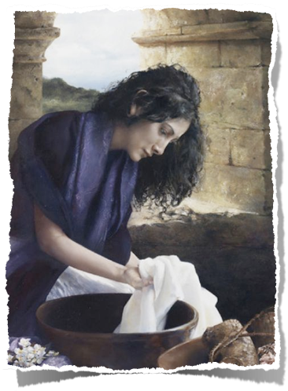
THE DANGER OF The WORLD’s LEAVEN
"And to the angel of the church in Thyatira …” Rev 2:18
A small, but wealthy city known for its purple dye used in coloring clothing for royalty and the wealthy, (cf. Acts 16:14).
Contained a number of trade guilds (wool, leather, linen, bronze, garments, dyers, potters, bakers, slaves, etc.) which tied to pagan religion immoral practices.
A Christian’s livelihood was affected by the issues involved in membership in these associations.
“Lydia, a seller of purple , of the city of Thyatira”
(Acts 16:14-15)

Slide 6
THE DANGER OF The WORLD’s LEAVEN
"And to the angel of the church in Thyatira …” Rev 2:18
Jezebel is still at work.
She asks us not to believe in absolutes.
She asks us to tolerate that which God says is evil –
She asks us to give in, just a little at a time, until there is no real noticeable difference between us and the world.

Slide 7
THE DANGER OF The WORLD’s LEAVEN
John 17:15–19 (NKJV)
¹⁵ I do not pray that You should take them out of the world, but that You should keep them from the evil one. ¹⁶ They are not of the world, just as I am not of the world. ¹⁷ Sanctify them by Your truth. Your word is truth. ¹⁸ As You sent Me into the world, I also have sent them into the world. ¹⁹ And for their sakes I sanctify Myself, that they also may be sanctified by the truth.

Slide 8
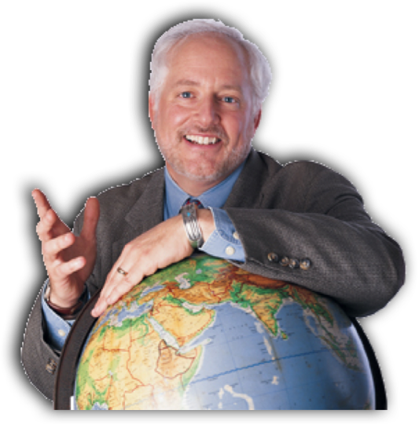
THE DANGER OF The WORLD’s LEAVEN
1 John 2:15–17 (NKJV)
¹⁵ Do not love the world or the things in the world. If anyone loves the world, the love of the Father is not in him. ¹⁶ For all that is in the world—the lust of the flesh, the lust of the eyes, and the pride of life—is not of the Father but is of the world. ¹⁷ And the world is passing away, and the lust of it; but he who does the will of God abides forever.

Slide 9
THE DANGER OF The WORLD’s LEAVEN
Lust of the Flesh – Mat 4:3,4
Seeking to fulfill the appetites of the natural body apart from God’s law.
Lust of the Eyes – Mat. 4:8
Seeking to obtain the temporal things our carnal mind desires.
The Pride of Life – Mat. 4:6
Self reliance, selfish-interest, authoritative control -

Slide 10
THE DANGER OF The WORLD’s LEAVEN
Galatians 5:19–21 (NKJV)
¹⁹ Now the works of the flesh . . . adultery, fornication, uncleanness, lewdness, ²⁰ idolatry, sorcery, hatred, contentions, jealousies, outbursts of wrath, selfish ambitions, dissensions, heresies, ²¹ envy, murders, drunkenness, revelries, and the like; . . .

Slide 11
THE DANGER OF The WORLD’s LEAVEN
1 Corinthians 6:9–11 (NKJV)
⁹ . . . fornicators, nor idolaters, nor adulterers, nor homosexuals, nor sodomites, ¹⁰ nor thieves, nor covetous, nor drunkards, nor revilers, nor extortioners will inherit the kingdom of God.

Slide 12
THE DANGER OF The WORLD’s LEAVEN
Ephesians 2:1–3 (NKJV)
¹ . . . who were dead in trespasses and sins, ² in which you once walked according to the course of this world, according to the prince of the power of the air, the spirit who now works in the sons of disobedience, ³ among whom also we all once conducted ourselves in the lusts of our flesh, fulfilling the desires of the flesh and of the mind, and were by nature children of wrath, just as the others.

Slide 13
THE DANGER OF The WORLD’s LEAVEN
Romans 12:2 (NKJV)
² And do not be conformed to this world, but be transformed by the renewing of your mind, that you may prove what is that good and acceptable and perfect will of God

Slide 14
THE DANGER OF The WORLD’s LEAVEN
Colossians 3:1–2 (NKJV)
¹ If then you were raised with Christ, seek those things which are above, where Christ is, sitting at the right hand of God. ² Set your mind on things above, not on things on the earth.

Slide 15
THE DANGER OF The WORLD’s LEAVEN
Matthew 6:19–24 (NKJV)
¹⁹ “Do not lay up for yourselves treasures on earth, where moth and rust destroy and where thieves break in and steal; ²⁰ but lay up for yourselves treasures in heaven, where neither moth nor rust destroys and where thieves do not break in and steal. ²¹ For where your treasure is, there your heart will be also.
Our Values

Slide 16
THE DANGER OF The WORLD’s LEAVEN
Matthew 6:19–24 (NKJV)
²² “The lamp of the body is the eye. If therefore your eye is good, your whole body will be full of light. ²³ But if your eye is bad, your whole body will be full of darkness. If therefore the light that is in you is darkness, how great is that darkness!
Our Values
Our Focus

Slide 17
THE DANGER OF The WORLD’s LEAVEN
Matthew 6:19–24 (NKJV)
²⁴ “No one can serve two masters; for either he will hate the one and love the other, or else he will be loyal to the one and despise the other. You cannot serve God and mammon.
Our Values
Our Focus
Our Effort

Slide 18
THE DANGER OF The WORLD’s LEAVEN
A Person Who Drinks, uses drugs, Curses, goes clubbing, & wears immodest clothing, etc. Is Worldly …
A Person Can Be Worldly but not Drink & Curse … etc.

Slide 19
2 Corinthians 6:14–7:1 ^{(NKJV)}
¹⁴ Do not be unequally yoked together with unbelievers. For what fellowship has righteousness with lawlessness? And what communion has light with darkness? ¹⁵ And what accord has Christ with Belial? Or what part has a believer with an unbeliever?

Slide 20
2 Corinthians 6:14–7:1 ^{(NKJV)}
¹⁶ And what agreement has the temple of God with idols? For you are the temple of the living God. As God has said: “I will dwell in them And walk among them. I will be their God, And they shall be My people.”

Slide 21
2 Corinthians 6:14–7:1 ^{(NKJV)}
¹⁷ Therefore “Come out from among them And be separate, says the Lord. Do not touch what is unclean, And I will receive you.” ¹⁸ “I will be a Father to you, And you shall be My sons and daughters, Says the Lord Almighty.”

Slide 22
2 Corinthians 6:14–7:1 ^{(NKJV)}
7:1 ¹ Therefore, having these promises, beloved, let us cleanse ourselves from all filthiness of the flesh and spirit, perfecting holiness in the fear of God.

Slide 23
THE DANGER OF The WORLD’s LEAVEN
Separates from God – (Isa. 59:1-2; Rom. 8:7,8; Jam 4:4)
Desensitizes to sin - (2 Pet 2:20; Luke 11:26; Eph 4:18,19)
Heart becomes hardened - (Mat. 13:15; Heb. 3:8,13)
Makes this life hard - (Prov. 13:15; Jer. 2:19; Rom. 6:21)
Eternal Condemnation - (Rom. 6:23; Gal. 5:19-21; Rev. 21:8)

Slide 24
THE DANGER OF The WORLD’s LEAVEN
Destroys my influence - (Mt. 5:13,14; Rom. 2:24; Phili 2:15)
Makes my worship vain – (Prov. 1:28,29; Mic. 3:4; Mat 15:7-9; Jn 9:31)
Hinders my race and growth - (Heb. 12:1-ff)
Defiles the church - (Josh. 7; 1 Cor. 5:1-13; 2 Thess. 3:6-15)

Slide 25
THE DANGER OF The WORLD’s LEAVEN
We Are Bombarded With It Everyday – (John 17:15-19)
Some brethren ARE Worldly – (Rev 2:18-3:6, 14-22; 1 Cor. 3:1)
More Toleration, (i.e. less preaching & teaching on it; less discipline) — (1 Cor. 3:1; 5:1-6)
Destroys our influence & our souls!! — (Phili 2:14-16)

Slide 26
THE DANGER OF The WORLD’s LEAVEN
The preaching emphasis is on what is socially “relevant” rather than what is TRUE doctrine and how we are to please and obey God — (2 Tim 3:1-5; 4:1-4)
Toleration of immorality, but intolerant of those who teach against it — (John 3:19.20)
When style, entertainment & pragmatism replaces what is Biblical & RIGHT — (John 4:24)

Slide 27
THE DANGER OF The WORLD’s LEAVEN
Keep our thoughts pure!! – Col. 3:1,2; Rom 12:1,2; Phil 4:8
Keep our conscience sensitive – 2 Peter 2:6-8
Keep a safe distance – 1 Thes. 5:22; 2 Cor. 6:17; Prov 23:31
Retain fear & love for God & be filled with His word — Ps 119:11; Mk 12:29-31; Ec 12:13

Slide 28
THE DANGER OF The WORLD’s LEAVEN
Always be mindful of potential consequences — where can “THIS” lead — Prov 2:11-19
Always be mindful of the influence “THIS” can have — Rom 14:21; 1 Cor. 8:13
Always be certain that “THIS” is RIGHT! — Col. 3:16; 1 Thes. 5:21; 1 John 4:1

Slide 29
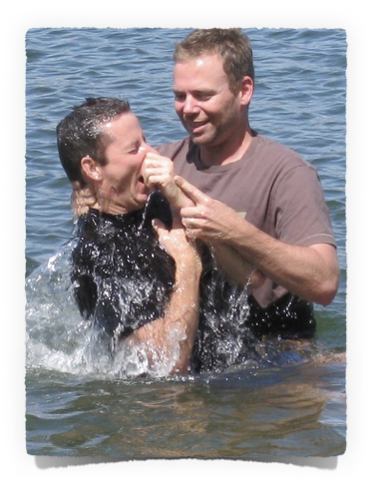
THE DANGER OF The WORLD’s LEAVEN
Obey the gospel - Rom 6:3-6, 16-18; 2 Thes 1:7-9; Col 1:13; 2:12
Put on Christ - Col 3:12-17; Phil 2:1-5
Grow in knowledge of Christ - 2 Pt 1:5-10; 3:16-18

Slide 30
THE DANGER OF The WORLD’s LEAVEN
NOT to continue to sin - (Ps. 119:11; Rom. 6; 1 Jn 3:1-10)
Abstain from every form of evil - (1 Thes. 5:21,22)
Holy / Pure / Godly - (1 Pet. 1:15-16; 4:1-3; 2 Cor. 6:14-17; 1 John 3:3; 1 Tim. 2:9; 4:8; James 1:27)

Slide 31
THE DANGER OF The WORLD’s LEAVEN
1 John 5:2–5 (NKJV)
² By this we know that we love the children of God, when we love God and keep His commandments. ³ For this is the love of God, that we keep His commandments. And His commandments are not burdensome.

Slide 32
THE DANGER OF The WORLD’s LEAVEN
1 John 5:2–5 (NKJV)
⁴ For whatever is born of God overcomes the world. And this is the victory that has overcome the world—our faith. ⁵ Who is he who overcomes the world, but he who believes that Jesus is the Son of God?

Slide 33
THE DANGER OF The WORLD’s LEAVEN
There is NOT ONE THING that this world has to offer that is worth losing your soul over!! (Mat 16:26)

Slide 35
Dangers Facing The
Revelation 2:18–29
Charts by Don McClain
Preached June 24, 2018
West 65th Street church of Christ / P.O. Box 190062 / Little Rock AR 72219 / 501-568-1062
Email – donmcclain@sbcglobal.net
More Keynote, PPT & Audio Sermons:
http://w65stchurchofchrist.org/coc/sermons/

Slide 36
1 Peter 1:13–21 (NKJV)
¹³ Therefore gird up the loins of your mind, be sober, and rest your hope fully upon the grace that is to be brought to you at the revelation of Jesus Christ; ¹⁴ as obedient children, not conforming yourselves to the former lusts, as in your ignorance; ¹⁵ but as He who called you is holy, you also be holy in all your conduct, ¹⁶ because it is written, “Be holy, for I am holy.” ¹⁷ And if you call on the Father, who without partiality judges according to each one’s work, conduct yourselves throughout the time of your stay here in fear;

Slide 37
1 Peter 1:13–21 (NKJV)
¹⁸ knowing that you were not redeemed with corruptible things, like silver or gold, from your aimless conduct received by tradition from your fathers, ¹⁹ but with the precious blood of Christ, as of a lamb without blemish and without spot. ²⁰ He indeed was foreordained before the foundation of the world, but was manifest in these last times for you ²¹ who through Him believe in God, who raised Him from the dead and gave Him glory, so that your faith and hope are in God.

