Slide 1
“Choosing The Lions”
6:1-28

Slide 2
“Choosing The Lions”
Timeline
605 B.C., First wave of captives carried away to Babylon - including Daniel, Hananiah, Mishael, and Azariah. (Daniel 1)
603 B.C. Nebuchadnezzar’s dream — (Daniel 2)
587 B.C. Nebuchadnezzar’s 18th year, the image of gold - Hananiah, Mishael, and Azariah refuse and are thrown into the fiery furnace - (Daniel 3)
Chapter 4 takes place after 587 BC …

Slide 3
“Choosing The Lions”
Timeline
Nebuchadnezzar died 562 b.c. after ruling 43 years.& succeeded by his son, Evil-Merodach.... (Jer 52:31; II Kings 25:27-30)
Evil-Merodach ruled for two years (562-560 b.c., 2 Kings 25:27-30; Jer. 52:31-34) & was murdered in August 560 by Neriglissar, his brother-in-law.
Neriglissar ruled 4 years (560-556 b.c.). [Jer 39:3, 13]. At his death, succeeded by his young son Labashi-Marduk, who ruled two months (May and June 556)

Slide 4
“Choosing The Lions”
Timeline
Labashi-Marduk, was assassinated and succeeded by Nabonidus, who reigned 17 years (556-539 b.c.).
553 B.C. Nabonidus went to the oasis of Tayma & devoted himself to the worship of the moon god, Sin.
He appointed his son, Belshazzar, as ruler of Babylon in his place.

Slide 5
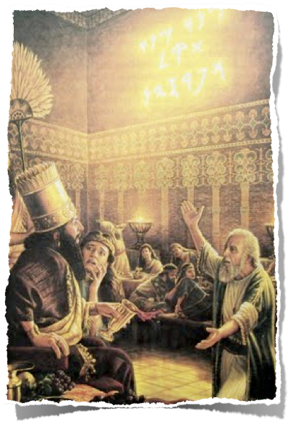
“Choosing The Lions”
Nabonidus returned 540 B.C. to defend against the Persians. In 539 B.C. Belshazzar was positioned in the city of Babylon to hold the capital, while Nabonidus, marched his troops north to meet Cyrus.
October 10, 539 B.C. Nabonidus surrendered to Cyrus & exiled.
Two days later, October 12, 539 B.C., the Persian armies overthrew the city of Babylon.

Slide 6
“Choosing The Lions”
Daniel 5:30–31 (NKJV)
³⁰ That very night Belshazzar, king of the Chaldeans, was slain. ³¹ And Darius the Mede received the kingdom, being about sixty-two years old.

Slide 7
Daniel 6:1–9 (NKJV)
¹ It pleased Darius to set over the kingdom one hundred and twenty satraps, to be over the whole kingdom; ² and over these, three governors, of whom Daniel was one, that the satraps might give account to them, so that the king would suffer no loss. ³ Then this Daniel distinguished himself above the governors and satraps, because an excellent spirit was in him; and the king gave thought to setting him over the whole realm.

Slide 8
Daniel 6:1–9 (NKJV)
⁴ So the governors and satraps sought to find some charge against Daniel concerning the kingdom; but they could find no charge or fault, because he was faithful; nor was there any error or fault found in him. ⁵ Then these men said, “We shall not find any charge against this Daniel unless we find it against him concerning the law of his God.” ⁶ So these governors and satraps thronged before the king, and said thus to him: “King Darius, live forever!

Slide 9
Daniel 6:1–9 (NKJV)
⁷ All the governors of the kingdom, the administrators and satraps, the counselors and advisors, have consulted together to establish a royal statute and to make a firm decree, that whoever petitions any god or man for thirty days, except you, O king, shall be cast into the den of lions. ⁸ Now, O king, establish the decree and sign the writing, so that it cannot be changed, according to the law of the Medes and Persians, which does not alter.” ⁹ Therefore King Darius signed the written decree.

Slide 10
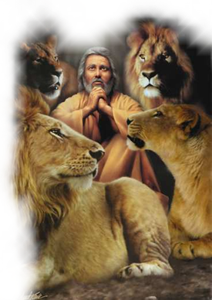
“Choosing The Lions”
The Plot Against Daniel - (5:31-6:9)
DANIEL’s RISE — 5:31-6:3
Darius Receives The Kingdom - 5:30-31
He is appointed one of three governors over the kingdom - Dan 6:1-2
Daniel "distinguished" himself above the others because of his EXCELLENT spirit - Dan 6:3
Daniel 6:3 (NKJV)
³ Then this Daniel distinguished himself above the governors and satraps, because an excellent spirit was in him; and the king gave thought to setting him over the whole realm.

Slide 11
“Choosing The Lions”
The Plot Against Daniel - (5:31-6:9)
DANIEL IS ENVIED — 6:4,5
His success leads to envy by others - Dan 6:4
His noble character is attested to by his enemies - Dan 6:4
Daniel 6:4–5 (NKJV)
⁴ So the governors and satraps sought to find some charge against Daniel concerning the kingdom; but they could find no charge or fault, because he was faithful; nor was there any error or fault found in him.

Slide 12
“Choosing The Lions”
The Plot Against Daniel - (5:31-6:9)
DANIEL IS ENVIED — 6:4,5
His success leads to envy by others - Dan 6:4
His noble character is attested to by his enemies - Dan 6:4
His enemies determine there is only one way to defeat him - Dan 6:5
Daniel 6:4–5 (NKJV)
⁵ Then these men said, “We shall not find any charge against this Daniel unless we find it against him concerning the law of his God.”

Slide 13
“Choosing The Lions”
The Plot Against Daniel - (5:31-6:9)
DANIEL IS TARGETED — 6:6-9
The king is approached by Daniel's enemies - Dan 6:6
They propose a royal statute, a firm decree - Dan 6:7
The king is encouraged to establish the decree - Dan 6:8-9
Daniel 6:7 (NKJV)
⁷ All the governors of the kingdom, the administrators and satraps, the counselors and advisors, have consulted together to establish a royal statute and to make a firm decree, that whoever petitions any god or man for thirty days, except you, O king, shall be cast into the den of lions.

Slide 14
“Choosing The Lions”
The Plot Executed - (6:10-17)
DANIEL KEEPS PRAYING Knowing full well the decree had been signed - Dan 6:10
3 times a day - cf. Ps 55:17
Toward Jerusalem - cf. 1Ki 8:27-30
On his knees - 1Ki 8:54
With thankfulness to God - 2:23; Php 4:6
His own custom since "early days" - Dan 6:10; Ecc. 12:1
Daniel 6:10 (NKJV)
¹⁰ Now when Daniel knew that the writing was signed, he went home. And in his upper room, with his windows open toward Jerusalem, he knelt down on his knees three times that day, and prayed and gave thanks before his God, as was his custom since early days.

Slide 15
“Choosing The Lions”
The Plot Executed - (6:10-17)
DANIEL KEEPS PRAYING Knowing full well the decree had been signed - Dan 6:10
Daniel knew praying to God could cost him his life! 6:10; Acts 4:17-19; 5:29
He sought God’s help – Dan 6:11; Psa 119:170; Eph 6:18
Daniel 6:13 (NKJV)
¹³ So they answered and said before the king, “That Daniel, who is one of the captives from Judah, does not show due regard for you, O king, or for the decree that you have signed, but makes his petition three times a day.”

Slide 16
“Choosing The Lions”
The Plot Executed - (6:10-17)
Daniel is caught praying to God - 6:11
Reported to the king - 6:12-13
Darius reminded of the unalterable decree - 6:14-15
The king, upset w/ himself, tries to deliver Daniel - 6:14,15
The king fails, but expresses confidence in Daniel’s God to deliver him / has him thrown into the lions den - 6:16,17
Daniel 6:16 (NKJV)
¹⁶ So the king gave the command, and they brought Daniel and cast him into the den of lions. But the king spoke, saying to Daniel, “Your God, whom you serve continually, He will deliver you.”

Slide 17
“Choosing The Lions”
The Plot Executed - (6:10-17)
Daniel 6:18–20 (NKJV)
¹⁸ Now the king went to his palace and spent the night fasting; and no musicians were brought before him. Also his sleep went from him. ¹⁹ Then the king arose very early in the morning and went in haste to the den of lions. ²⁰ And when he came to the den, he cried out with a lamenting voice to Daniel. The king spoke, saying to Daniel, “Daniel, servant of the living God, has your God, whom you serve continually, been able to deliver you from the lions?”

Slide 18
“Choosing The Lions”
DANIEL IS DELIVERED & Vindicated - 6:21-23
Daniel answers the king - Dan 6:21-22
God sent His angel …
Because of his innocence
Daniel 6:21–22 (NKJV)
²¹ Then Daniel said to the king, “O king, live forever! ²² My God sent His angel and shut the lions’ mouths, so that they have not hurt me, because I was found innocent before Him; and also, O king, I have done no wrong before you.”

Slide 19
“Choosing The Lions”
DANIEL IS DELIVERED & Vindicated - 6:21-23
Daniel answers the king - Dan 6:21-22
God sent His angel …
Because of his innocence
Darius removes Daniel from the den - Dan 6:23
The king is exceedingly glad
No harm - (3:26)
Daniel is delivered from the lions, because he believed in His God (by faith! - 3:27)
Daniel 6:23 (NKJV)
²³ Now the king was exceedingly glad for him, and commanded that they should take Daniel up out of the den. So Daniel was taken up out of the den, and no injury whatever was found on him, because he believed in his God.

Slide 20
“Choosing The Lions”
THE CONSPIRATORS ARE EXECUTED
Daniel 6:24 (NKJV)
²⁴ And the king gave the command, and they brought those men who had accused Daniel, and they cast them into the den of lions—them, their children, and their wives; and the lions overpowered them, and broke all their bones in pieces before they ever came to the bottom of the den.

Slide 21
“Choosing The Lions”
Darius decrees the God of Daniel be feared - 6:25-27
Daniel 6:25–28 (NKJV)
²⁵ Then King Darius wrote: To all peoples, nations, and languages that dwell in all the earth: Peace be multiplied to you. ²⁶ I make a decree that in every dominion of my kingdom men must tremble and fear before the God of Daniel. For He is the living God, And steadfast forever; His kingdom is the one which shall not be destroyed, And His dominion shall endure to the end. ²⁷ He delivers and rescues, And He works signs and wonders In heaven and on earth, Who has delivered Daniel from the power of the lions. ²⁸ So this Daniel prospered in the reign of Darius and in the reign of Cyrus the Persian.
Daniel 6:25–28 (NKJV)
²⁵ Then King Darius wrote: To all peoples, nations, and languages that dwell in all the earth: Peace be multiplied to you. ²⁶ I make a decree that in every dominion of my kingdom men must tremble and fear before the God of Daniel. For He is the living God, And steadfast forever; His kingdom is the one which shall not be destroyed, And His dominion shall endure to the end. ²⁷ He delivers and rescues, And He works signs and wonders In heaven and on earth, Who has delivered Daniel from the power of the lions. ²⁸ So this Daniel prospered in the reign of Darius and in the reign of Cyrus the Persian.

Slide 22
“Choosing The Lions”
Dare to Be Like Daniel
Refused to eat the king's meat or drink his wine - Dan 1:8
Refused the gifts of Belshazzar & boldly spoke of the kings sin & his doom - Dan 5:13-17
Refused to obey the decree of Darius knowing the threats against him - Dan 6:10

Slide 23
“Choosing The Lions”
Dare to Be Like Daniel
Was hated by his enemies - Dan 6:3-5
His uncompromising spirit was used against him - Dan 6:5-13
In the end – Daniel’s uncompromising spirit brought him respect - Dan 6:14-28

Slide 24
“Choosing The Lions”
Dare to Be Like Daniel
Refusing To Compromise Our Convictions...
Moral purity – Gen 39:9-12; 1Co 6:18; Eph. 5:1-12; etc
Sound doctrine – 1 Tim 4:16; 2 Tim 1:13; 2 Jn 1:9
Scriptural worship – Jn 4:24; Eph 5:19
Serving the Lord – Col 3:17; Mat 6:33; Heb 10:24,25
Even if we suffer for it - 1 Peter 4:12-19

Slide 25
“Choosing The Lions”
Dare to Be Like Daniel
We Should Be A People of Prayer!
Even when not convenient – Rom 8:26;
According to His will – Mt 6:5-15; 1 John 5:14
With humility – Luke 18:13
Regularly – A custom! – 1 Thes. 5:17; Rm 12:12; Col. 4:2
With thanksgiving - Phil. 4:6; Col. 3:17; 1 Thes. 5:17-18; etc
Seeking God’s help – Phi 4:6; Eph 6:18

Slide 26
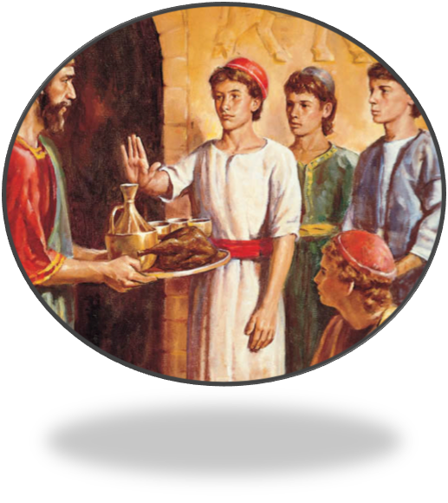
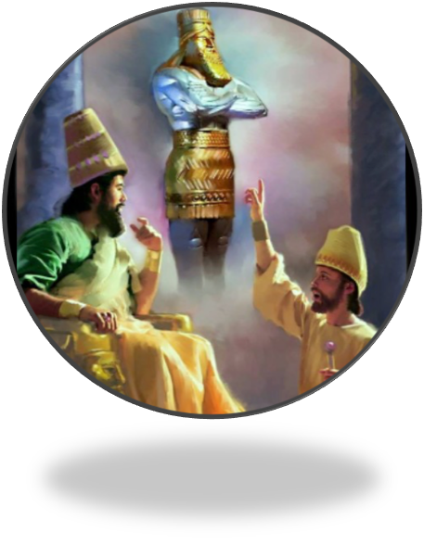
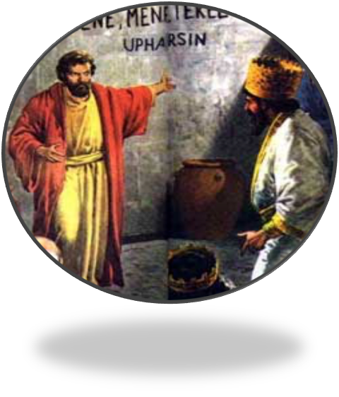
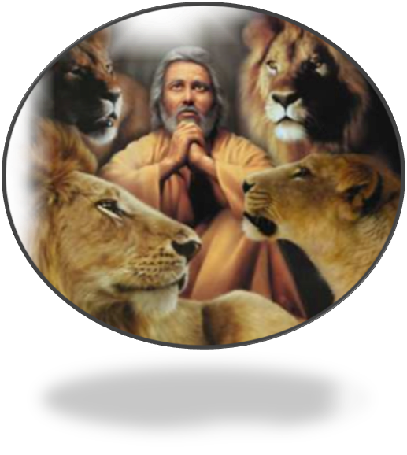
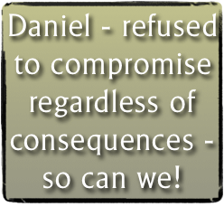
“Choosing The Lions”
Dare to Be Like Daniel
Purpose / Persistence / Principle / Prayer

Slide 27
6:1-28
Would we have enough faith to choose the lions?

Slide 29
“The Hand Writing On The Wall”
Charts by Don McClain
Preached July 22, 2018 PM
West 65th Street church of Christ / P.O. Box 190062 / Little Rock AR 72219 / 501-568-1062
Email – donmcclain@sbcglobal.net
More Keynote, PPT & Audio Sermons:
http://w65stchurchofchrist.org/coc/sermons/

Slide 30
Hebrews 11:32–40 (NKJV)
³² And what more shall I say? For the time would fail me to tell of Gideon and Barak and Samson and Jephthah, also of David and Samuel and the prophets: ³³ who through faith subdued kingdoms, worked righteousness, obtained promises, stopped the mouths of lions, ³⁴ quenched the violence of fire, escaped the edge of the sword, out of weakness were made strong, became valiant in battle, turned to flight the armies of the aliens.

Slide 31
Hebrews 11:32–40 (NKJV)
³⁵ Women received their dead raised to life again. Others were tortured, not accepting deliverance, that they might obtain a better resurrection. ³⁶ Still others had trial of mockings and scourgings, yes, and of chains and imprisonment. ³⁷ They were stoned, they were sawn in two, were tempted, were slain with the sword. They wandered about in sheepskins and goatskins, being destitute, afflicted, tormented—

Slide 32
Hebrews 11:32–40 (NKJV)
³⁸ of whom the world was not worthy. They wandered in deserts and mountains, in dens and caves of the earth. ³⁹ And all these, having obtained a good testimony through faith, did not receive the promise, ⁴⁰ God having provided something better for us, that they should not be made perfect apart from us.

