Slide 1
7:1-28
“Four Beast Will Give Way To Our Mighty King”

Slide 2
Four Beasts & Our Mighty King
Timeline
605 B.C., First wave of captives carried away to Babylon - including Daniel, Hananiah, Mishael, and Azariah. (Daniel 1)
603 B.C. Nebuchadnezzar’s dream — (Daniel 2)
587 B.C. Nebuchadnezzar’s 18th year, the image of gold - Hananiah, Mishael, and Azariah refuse and are thrown into the fiery furnace - (Daniel 3)
Chapter 4 takes place after 587 BC …

Slide 3
Four Beasts & Our Mighty King
Timeline
Nebuchadnezzar died 562 b.c. after ruling 43 years.& succeeded by his son, Evil-Merodach.... (Jer 52:31; II Kings 25:27-30)
Evil-Merodach ruled for two years (562-560 b.c., 2 Kings 25:27-30; Jer. 52:31-34) & was murdered in August 560 by Neriglissar, his brother-in-law.
Neriglissar ruled 4 years (560-556 b.c.). [Jer 39:3, 13]. At his death, succeeded by his young son Labashi-Marduk, who ruled two months (May and June 556)

Slide 4
Four Beasts & Our Mighty King
Timeline
Labashi-Marduk, was assassinated and succeeded by Nabonidus, who reigned 17 years (556-539 b.c.).
553 B.C. Nabonidus went to the oasis of Tayma & devoted himself to the worship of the moon god, Sin.
He appointed his son, Belshazzar, as ruler of Babylon in his place. 554-553 BC
October 12, 539 B.C., the Persian armies overthrew the city of Babylon.

Slide 5
Four Beasts & Our Mighty King
Chapter 7 - Daniels Vision 553-554 BC
Daniel naturally divides itself into two parts...
Personal history of Daniel – 1:1-6:28
Visions and prophecies of Daniel - 7:1-12:13
The second half of the book contains four visions seen by Daniel...
The vision of the four beasts - 7:1-28
The vision of the ram and the goat - 8:1-27
The vision of the seventy weeks - 9:1-27
The vision of the time of the end - 10:1-12:13
God reveals many things about His purpose and plan in history, specifically about the nation of Israel and the everlasting kingdom to come.

Slide 6
Four Beasts & Our Mighty King
Chapter 7 - Daniels Vision 553-554 BC
Daniel 7:1 (NKJV)
¹ In the first year of Belshazzar king of Babylon, Daniel had a dream and visions of his head while on his bed. Then he wrote down the dream, telling the main facts.
The vision recorded by the Prophet Daniel in this chapter was revealed to him in the first year of Belshazzar’s reign, 553 b.c.,
Daniel’s dream predated by 14 years his experience in the lions’ den (6) - 539.
Daniel was about 68 years of age, for he was taken captive (at about the age of 16) 52 years earlier in 605 b.c.

Slide 7
Four Beasts & Our Mighty King
Chapter 7 - Daniels Vision 553-554 BC
The vision of the four beast - 2-8
The Ancient of days — 9,10
The destruction of the fourth beast — 11,12
The one “like the son of man” — 13,14
The prophets reaction — 15,16
The four beast and the gift of the eternal kingdom —17,18
Daniel requests and is given an explanation of the fourth beast — 19-27
The affect of the vision on Daniel — 28

Slide 8
Daniel 7:2–8 (NKJV)
² Daniel spoke, saying, “I saw in my vision by night, and behold, the four winds of heaven were stirring up the Great Sea. ³ And four great beasts came up from the sea, each different from the other. ⁴ The first was like a lion, and had eagle’s wings. I watched till its wings were plucked off; and it was lifted up from the earth and made to stand on two feet like a man, and a man’s heart was given to it. ⁵ “And suddenly another beast, a second, like a bear. It was raised up on one side, and had three ribs in its mouth between its teeth. And they said thus to it: ‘Arise, devour much flesh!’

Slide 9
Daniel 7:2–8 (NKJV)
⁶ “After this I looked, and there was another, like a leopard, which had on its back four wings of a bird. The beast also had four heads, and dominion was given to it. ⁷ “After this I saw in the night visions, and behold, a fourth beast, dreadful and terrible, exceedingly strong. It had huge iron teeth; it was devouring, breaking in pieces, and trampling the residue with its feet. It was different from all the beasts that were before it, and it had ten horns. ⁸ I was considering the horns, and there was another horn, a little one, coming up among them, before whom three of the first horns were plucked out by the roots. And there, in this horn, were eyes like the eyes of a man, and a mouth speaking pompous words.

Slide 10
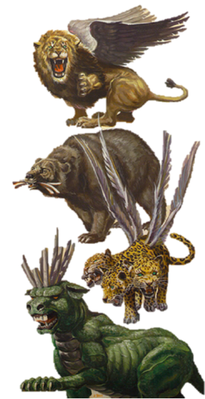
Four Beasts & Our Mighty King
The vision of the four beast - 2-8
The "sea" symbolizes the mass of humanity - cf. Is 17:12; Re 17:15
The lion w/ eagle's wings - 4
The bear w/ ribs in its mouth - 5
The leopard w/ 4 wings & 4-heads — 6
The dreadful and terrible beast w/ iron teeth; devouring, destroying everything with its feet. “It was different from all the beasts that were before it, and it had ten horns” — 7

Slide 11
Four Beasts & Our Mighty King
The vision of the four beast - 2-8
Connection with Nebuchadnezzars vision in Chapter 2
Babylon
Daniel 7:17 (NKJV)
¹⁷ ‘Those great beasts, which are four, are four kings which arise out of the earth.
Medes & Persians
Greece
Rome

Slide 12
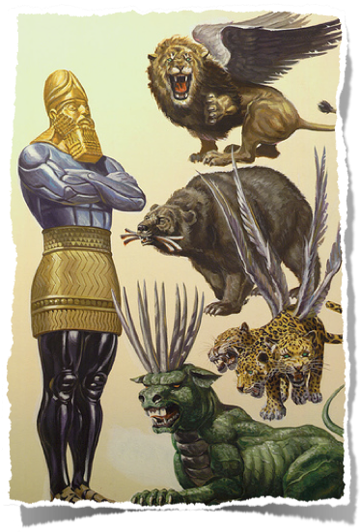
Four Beasts & Our Mighty King
The vision of the four beast - 2-8
Connection with Nebuchadnezzars vision in Chapter 2
The lion = Babylon; the wings plucked probably a reference to Nebuchadnezzars rise. humiliation & restoration.
The bear with ribs in its mouth = Medo-Persian empire & its victories over Egypt, Syria, and Babylon.
Leopard with 4 wings & 4 heads = Greek empire of Alexander the Great / its rapid conquest, 4 heads prophetic of its division by 4 generals after Alexander's death

Slide 13
Four Beasts & Our Mighty King
The vision of the four beast - 2-8
Connection with Nebuchadnezzars vision in Chapter 2
The dreadful & terrible beast = ROME
Exceedingly strong, with huge iron teeth / Devouring, breaking in pieces, trampling with its feet
Different from all the beasts before it / (Rev., was a conglomeration of a lion, bear and leopard - Re 13:1-2)
The ten horns and little horn represents emperors or kings who ruled during events involving the establishment of God's kingdom - cf. Dan 2:44

Slide 14
Four Beasts & Our Mighty King
destruction of the 4th beast —9-12
Daniel 7:9 (NKJV)
⁹ “I watched till thrones were put in place, And the Ancient of Days was seated; His garment was white as snow, And the hair of His head was like pure wool. His throne was a fiery flame, Its wheels a burning fire;
books are opened (LIKE final judgment scene in Rev. 20:12, but NOT FINAL)
4th beast (with little horn) is slain and burned; other beasts lose dominion
With the judgment against Rome, the world empires are put to an end. No world empire arose again after the destruction of the Roman Empire. I believe this is what John sees in Revelation 20:2-3.

Slide 15
Four Beasts & Our Mighty King
The coronation of the Son of Man - 7:13-14
Daniel 7:13–14 (NKJV)
¹³ “I was watching in the night visions, And behold, One like the Son of Man, Coming with the clouds of heaven! He came to the Ancient of Days, And they brought Him near before Him. ¹⁴ Then to Him was given dominion and glory and a kingdom, That all peoples, nations, and languages should serve Him. His dominion is an everlasting dominion, Which shall not pass away, And His kingdom the one Which shall not be destroyed.
Son of Man receives kingdom / ascension of Jesus seen from a heavenly view (cf. Acts 1:9)
Dominion (authority) over all peoples (cf. Matt. 28:18; Eph. 1:20-23)
Everlasting kingdom – will never be destroyed (cf. Heb. 12:28)
This everlasting kingdom is established “in the days of these kings” (Dan. 2:44).

Slide 16
Four Beasts & Our Mighty King
vision of the 4th beast Explained- 15-27
The overall meaning (15-18)
the beasts are four kings
the saints will be delivered from persecutions and possess the everlasting kingdom forever
This is the primary interpretation – all other details are secondary.

Slide 17
Four Beasts & Our Mighty King
vision of the 4th beast Explained- 15-27
The details (19-28)
v. 23 – fourth beast will devour whole earth (ROME)
v. 24 – ten horns are ten kings, and another horn will arise after them
vs. 24-25 – little horn is different; subdues 3 kings, speaks out against the Most High, wears down saints, tries to change times and laws, saints given into his hand for time, times, and half a time

Slide 18
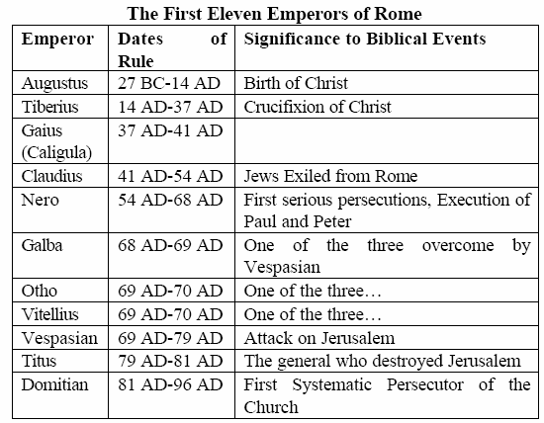

Slide 19
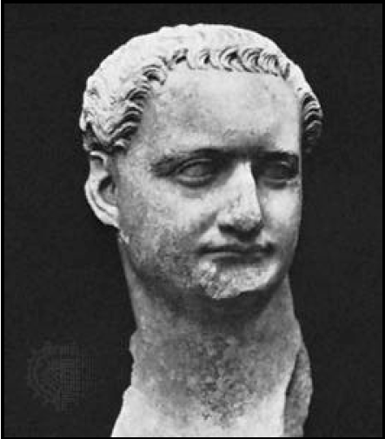
Domitian
Emperor worship began under Augustus in the eastern part of the Roman empire, but no record exists of him promoting the practice.
Although Caligula was the first emperor to encourage people to worship him as a god, Domitian was the first to actively demand that his subjects worship him.
Domitian “signed documents dominus et deus (‘Lord and God’) and required people to address him similarly. Coins of the period represent him enthroned as ‘father of the gods’.”

Slide 20
Domitian
The “little horn” would “try to change the set times and the laws” (v. 25).
Domitian had the names of two months changed from September and October to Germanicus (his surname) and Domitianus (months of his accession and birth).
The calendar went back to the old names immediately after Domitian’s death.

Slide 21
Domitian
Domitian also changed many laws. He even changed the law about the election of senators, giving himself the right to choose every senator.
His tyrannical and cruel reign was so resented that upon his assassination, all his laws and decrees were declared void, and all images of him were destroyed.

Slide 22
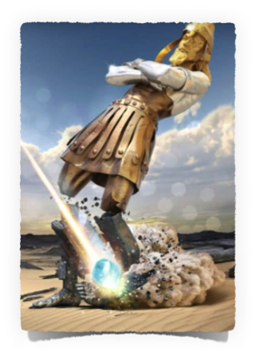
Four Beasts & Our Mighty King
Kingdom Would Be Established
Babylonian Empire 605 B.C. - 536 B.C.
Medo-Persian Empire 536 B.C. - 330 B.C.
Grecian Empire 330 B.C. - 30 B.C.
Roman Empire 30 B.C. - 337 A.D.
“The days of these kings,” Daniel 2:44
a stone was cut out without hands

Slide 23
Four Beasts & Our Mighty King
NT Presence
When:
Days of Roman kings – Dan. 2:44
“At hand” in Jesus’ day – Mt. 4:17
In Jesus’ generation – Mk. 9:1
Where:
Law going from Jerusalem – Isa. 2:3
King coming to Jerusalem – Zec. 9:9
Tarry in Jerusalem – Lk. 24:49
Not depart from Jerusalem – Ac. 1:4
Established
First Pentecost after the resurrection of Jesus Christ from the dead
Acts 2
The right time & place
After Acts 2 the language changes from “AT HAND” to “The kingdom is preached”
David prophesied God “would raise up the Christ to sit on his throne” (Acts 2:25-31).
“This Jesus God has raised up…being exalted…has made this Jesus…Lord” (2:32-36)

Slide 24
God’s Indestructible
The kingdom was prophesied for thousands of years — Gen. 49:10; 2 Sam. 7:12-16; Dan. 2:44; 7:13-14; Isa. 9:7; Ezek. 21:25-27; Zech. 9:9
The kingdom was established on Pentecost in Acts 2
There is one kingdom in existence today w/ one King — Acts 2:36; 1 Pet. 3:22; Rev. 19:16
The kingdom will be delivered to the Father in the end — 1 Cor. 15:24-26;

Slide 25
Four Beasts & Our Mighty King
Accuracy of prophecy
God is indeed in control
Jesus is NOW King - will we obey Him?

Slide 27
Four Beasts & Our Mighty King
Charts by Don McClain
Preached August 12, 2018 PM
West 65th Street church of Christ / P.O. Box 190062 / Little Rock AR 72219 / 501-568-1062
Email – donmcclain@sbcglobal.net
More Keynote, PPT & Audio Sermons:
http://w65stchurchofchrist.org/coc/sermons/

Slide 28
Daniel 2:37–45 (NKJV)
³⁷ You, O king, are a king of kings. For the God of heaven has given you a kingdom, power, strength, and glory; ³⁸ and wherever the children of men dwell, or the beasts of the field and the birds of the heaven, He has given them into your hand, and has made you ruler over them all—you are this head of gold. ³⁹ But after you shall arise another kingdom inferior to yours; then another, a third kingdom of bronze, which shall rule over all the earth.

Slide 29
Daniel 2:37–45 (NKJV)
⁴⁰ And the fourth kingdom shall be as strong as iron, inasmuch as iron breaks in pieces and shatters everything; and like iron that crushes, that kingdom will break in pieces and crush all the others. ⁴¹ Whereas you saw the feet and toes, partly of potter’s clay and partly of iron, the kingdom shall be divided; yet the strength of the iron shall be in it, just as you saw the iron mixed with ceramic clay.

Slide 30
Daniel 2:37–45 (NKJV)
⁴² And as the toes of the feet were partly of iron and partly of clay, so the kingdom shall be partly strong and partly fragile. ⁴³ As you saw iron mixed with ceramic clay, they will mingle with the seed of men; but they will not adhere to one another, just as iron does not mix with clay. ⁴⁴ And in the days of these kings the God of heaven will set up a kingdom which shall never be destroyed; and the kingdom shall not be left to other people;

Slide 31
Daniel 2:37–45 (NKJV)
it shall break in pieces and consume all these kingdoms, and it shall stand forever. ⁴⁵ Inasmuch as you saw that the stone was cut out of the mountain without hands, and that it broke in pieces the iron, the bronze, the clay, the silver, and the gold—the great God has made known to the king what will come to pass after this. The dream is certain, and its interpretation is sure.”

