Slide 1
Lesson 8
“Hold Such Men In Esteem”
(Philippians 2:19-30)

Slide 2
Philippians
Joy No Matter What
Those IN CHRIST can HAVE TRUE JOY & PEACE:
Regardless of our past - (our sins or what others have done to us)
Regardless of our circumstances - (Our physical or material condition or how others are mistreating us)

Slide 3
“Hold Such Men In Esteem”
“Paul’s Prayer For The Brethren In Philippi” - (1:3-11)
“Making The Most of Our Circumstances” - (1:12-26)
“Conduct Worthy of The Gospel” — (1:21-30)
“Joyful Unity In Christ” — (Philippians 2:1-5) —
“The Humbled & Exalted Christ” — (2:5-11) —
“Working Out Our Own Salvation” — (2:12-18)

Slide 4
“Hold Such Men In Esteem”
This lesson focuses on Paul's remarks concerning two men; one described as a “son,” the other as a "brother" (Php 2:19-30)
These two men demonstrated the type of “humility & sacrificial service" expected of the disciple of Jesus Christ.

Slide 5
Philippians 2:19–30 (NKJV)
¹⁹ But I trust in the Lord Jesus to send Timothy to you shortly, that I also may be encouraged when I know your state. ²⁰ For I have no one like-minded, who will sincerely care for your state. ²¹ For all seek their own, not the things which are of Christ Jesus. ²² But you know his proven character, that as a son with his father he served with me in the gospel.

Slide 6
Philippians 2:19–30 (NKJV)
²³ Therefore I hope to send him at once, as soon as I see how it goes with me. ²⁴ But I trust in the Lord that I myself shall also come shortly. ²⁵ Yet I considered it necessary to send to you Epaphroditus, my brother, fellow worker, and fellow soldier, but your messenger and the one who ministered to my need;

Slide 7
Philippians 2:19–30 (NKJV)
²⁶ since he was longing for you all, and was distressed because you had heard that he was sick. ²⁷ For indeed he was sick almost unto death; but God had mercy on him, and not only on him but on me also, lest I should have sorrow upon sorrow. ²⁸ Therefore I sent him the more eagerly, that when you see him again you may rejoice, and I may be less sorrowful.

Slide 8
Philippians 2:19–30 (NKJV)
²⁹ Receive him therefore in the Lord with all gladness, and hold such men in esteem; ³⁰ because for the work of Christ he came close to death, not regarding his life, to supply what was lacking in your service toward me.

Slide 9
“Hold Such Men In Esteem”
TIMOTHY, PAUL'S "SON" (19-24)
Paul planned to send Timothy to Philippi — 19,23
“I trust in the Lord” i.e., ”If the Lord wills" (19a cf. Jm 4:15)
Paul desired to be encouraged by their faith (19b)
Would be delayed until Paul's condition was known (23b)
Philippians 2:19 (NKJV)
¹⁹ But I trust in the Lord Jesus to send Timothy to you shortly, that I also may be encouraged when I know your state.

Slide 10
“Hold Such Men In Esteem”
TIMOTHY, PAUL'S "SON" (19-24)
Timothy’s character
Paul & Timothy were likeminded i.e., truly "united in spirit” - 2:2
Timothy was the best "alternate" Who would "sincerely care for your state" (20b, 21b)
Timothy had first joined Paul just before going to Philippi - they knew him well — (22; cf. Ac 16:1-12; Acts 19:21, 22; 20:3-6; II Cor. 1:1).
Philippians 2:20–22 (NKJV)
²⁰ For I have no one like-minded, who will sincerely care for your state. ²¹ For all seek their own, not the things which are of Christ Jesus. ²² But you know his proven character, that as a son with his father he served with me in the gospel.

Slide 11
“Hold Such Men In Esteem”
TIMOTHY, PAUL'S "SON" (19-24)
All Others Seek Their Own - 21
Indicative of the keen disappointment which the apostle had in some others. cf. Phil. 1:15, 17; 2 Tim 4:10.16
All others with Paul at the time were spiritually unqualified — (Luke, Aristarchus, Tychicus, Crescens, and Titus were not in Rome at the time)
Philippians 2:20–22 (NKJV)
²⁰ For I have no one like-minded, who will sincerely care for your state. ²¹ For all seek their own, not the things which are of Christ Jesus. ²² But you know his proven character, that as a son with his father he served with me in the gospel.

Slide 12
“Hold Such Men In Esteem”
EPAPHRODITUS, My "BROTHER" (25-30)
"My brother" - in Christ
"Fellow-worker" - of spreading the gospel
"Fellow-soldier" - shared in the conflicts with the enemies of Christ
"Your messenger" - bore the gift from Philippi to Paul (600 miles)- cf. Php 4:18
"Who ministered to my needs" - he offered himself in service to Paul
Philippians 2:25 (NKJV)
²⁵ Yet I considered it necessary to send to you Epaphroditus, my brother, fellow worker, and fellow soldier, but your messenger and the one who ministered to my need;

Slide 13
“Hold Such Men In Esteem”
EPAPHRODITUS, My "BROTHER" (25-30)
Philippians 2:26–28 (NKJV)
²⁶ since he was longing for you all, and was distressed because you had heard that he was sick. ²⁷ For indeed he was sick almost unto death; but God had mercy on him, and not only on him but on me also, lest I should have sorrow upon sorrow. ²⁸ Therefore I sent him the more eagerly, that when you see him again you may rejoice, and I may be less sorrowful.
Trustworthy - (The church in Philippi trusted him with their gift - 4:18)
Dearly loved - (by Paul & the church in Philippi — 2:26,27,28)
A hard worker - (almost worked himself to death for the Lord — 2:25,30)
Brave & devoted - (he risked his life for the cause of Christ in service to his brethren — 2:26,30)

Slide 14
“Hold Such Men In Esteem”
EPAPHRODITUS, My "BROTHER" (25-30)
This faithful minister must be received with deep gratitude to the Lord —
Such sacrificial service for the Lord should be respected, encouraged and supported!
He was NOT an elder, or famous preacher / he was a servant, as all of us should be in whatever capacity we are able! — Rom 12:6-8
Philippians 2:29–30 (NKJV)
²⁹ Receive him therefore in the Lord with all gladness, and hold such men in esteem; ³⁰ because for the work of Christ he came close to death, not regarding his life, to supply what was lacking in your service toward me.

Slide 15
“Hold Such Men In Esteem”
hold in high esteem
The church today needs more people like these two men, (Preachers like Timothy & Ministers like Epaphroditus)
Not only do we need to be sacrificial servants - we need to encourage others as well — our elders, our deacons, Bible class teachers, song leaders, those who LABOR behind the scenes!

Slide 16
1 Corinthians 16:13–18 (NKJV)
¹³ Watch, stand fast in the faith, be brave, be strong. ¹⁴ Let all that you do be done with love. ¹⁵ I urge you, brethren—you know the household of Stephanas, that it is the firstfruits of Achaia, and that they have devoted themselves to the ministry of the saints—¹⁶ that you also submit to such, and to everyone who works and labors with us.

Slide 17
1 Corinthians 16:13–18 (NKJV)
¹⁷ I am glad about the coming of Stephanas, Fortunatus, and Achaicus, for what was lacking on your part they supplied. ¹⁸ For they refreshed my spirit and yours. Therefore acknowledge such men.

Slide 18
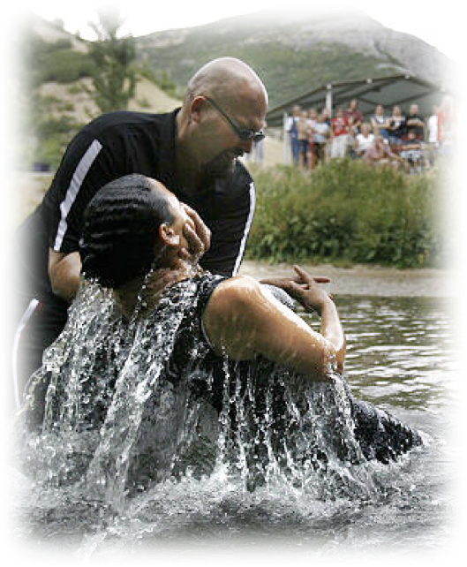
“Hold Such Men In Esteem”
hold in high esteem
Real, genuine joy can ONLY be found in real, genuine sacrificial service in God’s cause …
First must obey the gospel — Heb 5:8,9; Mk 16:16
Growing in faith, diligently serving the Lord — 2 Pet 1:5-10
Eternal joy awaits — (Rom 8:18; 1 Cor 15:58)
Don McClain
W. 65th St church of Christ - 9/16/2007

Slide 20
Philippians — Joy No Matter What
“Hold Such Men In Esteem”
Charts by Don McClain
Preached March 11, 2018
West 65th Street church of Christ / P.O. Box 190062 / Little Rock AR 72219 / 501-568-1062
Email – donmcclain@sbcglobal.net
More Keynote, PPT & Audio Sermons:
http://w65stchurchofchrist.org/coc/sermons/

Slide 21
1 Corinthians 16:13–18 (NKJV)
¹³ Watch, stand fast in the faith, be brave, be strong. ¹⁴ Let all that you do be done with love. ¹⁵ I urge you, brethren—you know the household of Stephanas, that it is the firstfruits of Achaia, and that they have devoted themselves to the ministry of the saints—¹⁶ that you also submit to such, and to everyone who works and labors with us.

Slide 22
1 Corinthians 16:13–18 (NKJV)
¹⁷ I am glad about the coming of Stephanas, Fortunatus, and Achaicus, for what was lacking on your part they supplied. ¹⁸ For they refreshed my spirit and yours. Therefore acknowledge such men.

