Slide 1
Lesson 11
“Are We Enemies OR Proponents of The Cross”
(Philippians 3:17-4:1)

Slide 2
Philippians — Joy No Matter What
Regardless of our past - (our sins or what others have done to us)
Regardless of our circumstances - (Our physical or material condition or how others are mistreating us)

Slide 3
“The Mind of Paul - Focussed & Determined”
How would you describe Paul’s frame of mind?
Aware of his current state & his need … 12a
Determined to faithfully serve Christ … 12b
Focussed on the task of progression …13
Diligent, continuous effort to gain the prize … 14
His plea for them, (us) to be likeminded … 15,16
(Philippians 3:12-16)

Slide 4
Philippians 3:17–4:1 (NKJV)
¹⁷ Brethren, join in following my example, and note those who so walk, as you have us for a pattern. ¹⁸ For many walk, of whom I have told you often, and now tell you even weeping, that they are the enemies of the cross of Christ: ¹⁹ whose end is destruction, whose god is their belly, and whose glory is in their shame—who set their mind on earthly things.

Slide 5
Philippians 3:17–4:1 (NKJV)
²⁰ For our citizenship is in heaven, from which we also eagerly wait for the Savior, the Lord Jesus Christ, ²¹ who will transform our lowly body that it may be conformed to His glorious body, according to the working by which He is able even to subdue all things to Himself. ¹ Therefore, my beloved and longed-for brethren, my joy and crown, so stand fast in the Lord, beloved.

Slide 6
“Are We Enemies OR Proponents of The Cross?”
Follow The Approved Pattern - 17
Brethren: Paul counsels the Philippian Christians to imitate him and others like him (19-30), rather than the “dogs and “evil doers” (3:2)
Paul often admonished others to “imitate” him — 4:9; 1 Co. 4:16; 10:32, 33; 11:1; 1 Th. 1:6; 2:10–14; 2 Th. 3:7, 9; 1 Ti. 4:12.
Philippians 3:17 (NKJV)
¹⁷ Brethren, join in following my example, and note those who so walk, as you have us for a pattern.

Slide 7
“Are We Enemies OR Proponents of The Cross?”
Follow The Approved Pattern - 17
Specifically: His plea for them, (us) to be likeminded … 12-16
Aware of YOUR current state & need … 12a
Determined to faithfully serve Christ … 12b
Focussed on the task of progression …13
Diligent, continuous effort to gain the prize … 14
Philippians 3:17 (NKJV)
¹⁷ Brethren, join in following my example, and note those who so walk, as you have us for a pattern.

Slide 8
“Are We Enemies OR Proponents of The Cross?”
Follow The Approved Pattern - 17
WE SHOULD NOT ONLY BE GOOD IMITATORS, BUT ALSO GOOD EXAMPLES!
Preachers & teachers of God’s word — 1 Tim 4:12; Ti 2:7-8; Heb 13:7
Elders - 1 Pe 5:1-3
Parents - Eph. 6:4
Generally: Mt 5:13-16; Phili 2:15; 1 Pet 3:1,2
Philippians 3:17 (NKJV)
¹⁷ Brethren, join in following my example, and note those who so walk, as you have us for a pattern.

Slide 9
“Are We Enemies OR Proponents of The Cross?”
Reject The Ways of False Teachers - 18,19
They walk as ENEMIES -
Probably referencing the Judaizers of vs. 2
They denied the cross — Gal 2:21; 5:2,4,12
Why weep over false teachers?
Because of the harm they cause - Gal. 5:1-6; 2 Pet 2:1-3, 18,19
Compassion for them because they are lost — Mat 5:44; Rom 12:14
Philippians 3:18–19 (NKJV)
¹⁸ For many walk, of whom I have told you often, and now tell you even weeping, that they are the enemies of the cross of Christ: ¹⁹ whose end is destruction, whose god is their belly, and whose glory is in their shame—who set their mind on earthly things.

Slide 10
“Are We Enemies OR Proponents of The Cross?”
Reject The Ways of False Teachers - 18,19
They are MANY - “For many walk" — Mt 7:13-14
Their END - “whose end is destruction" - cf. 2 Th 1:7-9
Their god - “"whose god is their belly” - Rom 16:18; 1 Tim 6:5; 2 Tim 3:4
Their PRIDE - “whose glory is in their shame” — pride in shameful things - Gal 6:13; 1 Cor. 5:2
Their FOCUS — "who set their mind on earthly things” —1 Jn 2:15-17
Philippians 3:18–19 (NKJV)
¹⁸ For many walk, of whom I have told you often, and now tell you even weeping, that they are the enemies of the cross of Christ: ¹⁹ whose end is destruction, whose god is their belly, and whose glory is in their shame—who set their mind on earthly things.

Slide 11
“Are We Enemies OR Proponents of The Cross?”
Reject The Ways of False Teachers - 18,19
Christians, while living on earth, have their citizenship elsewhere—in heaven. — 2 Co. 4:18; 5:1, 8; Ep. 2:6, 19; Col. 1:5; 3:1–3; 1 Pe. 1:3, 4.
This contrasts with those in verse 19 whose minds are exclusively on earthly things.
We should view ourselves as PILGRIMS while here — (Heb. 11:13; I Peter 2:11).
Philippians 3:20 (NKJV)
²⁰ For our citizenship is in heaven, from which we also eagerly wait for the Savior, the Lord Jesus Christ,

Slide 12
“Are We Enemies OR Proponents of The Cross?”
Reject The Ways of False Teachers - 18,19
For Which We Eagerly Wait:
No room for apathy - Rev 3:14ff
We await his manifestation in glory - (I Cor. 1:7; Col. 3:4).
Waiting in faith (Gal. 5:5), with patient endurance (Rom. 8:25), unto salvation (Heb. 9:28; 10:36-39).
Cf. 2 Cor. 4:16-5:5
Philippians 3:20 (NKJV)
²⁰ For our citizenship is in heaven, from which we also eagerly wait for the Savior, the Lord Jesus Christ,

Slide 13
“Are We Enemies OR Proponents of The Cross?”
Reject The Ways of False Teachers - 18,19
We shall be "conformed to the image the Son” -(Rom. 8:29).
We shall "bear the image of the heavenly" (I Cor. 15:49).
"When he will be manifested, we shall be like him, for we shall see him even as he is" (I John 3:2).
The nature of this great change is detailed in I Cor. 15:42-44, 50-58.
Philippians 3:21 (NKJV)
²¹ who will transform our lowly body that it may be conformed to His glorious body, according to the working by which He is able even to subdue all things to Himself.

Slide 14
“Are We Enemies OR Proponents of The Cross?”
The Two WAYS Have Two Very Different Destinies!
Philippians 4:1 (NKJV)
¹ Therefore, my beloved and longed-for brethren, my joy and crown, so stand fast in the Lord, beloved.

Slide 15
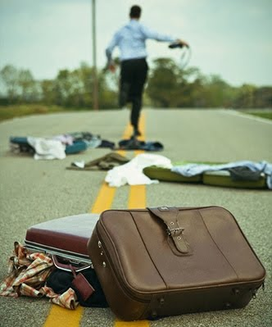
“Are We Enemies OR Proponents of The Cross?”
Will Heaven Be Your Home?
Are we following the approved pattern?
Are we rejecting false teachers - Refusing to follow their destructive ways?
Are we living for HEAVEN? - Eagerly waiting for our Lord’s return?

Slide 16
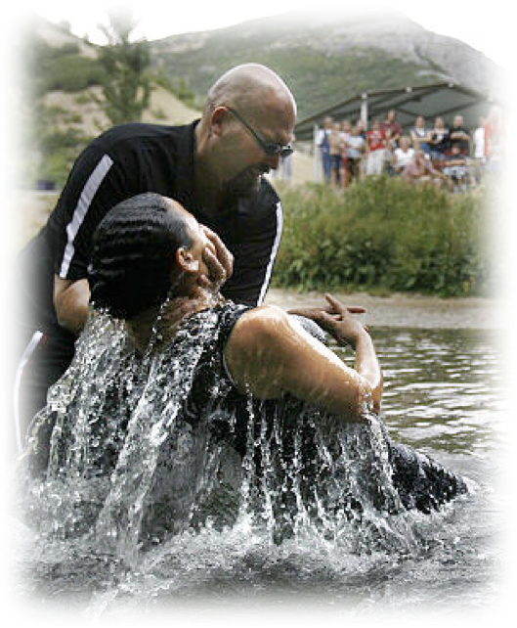
“Are We Enemies OR Proponents of The Cross?”
Will Heaven Be Your Home?
It starts with doing what you know to be true - then growing in knowledge & service?
First must obey the gospel — Heb 5:8,9; Mk 16:16
Growing in faith, diligently serving the Lord — 2 Pet 1:5-10
Eternal joy awaits — (Rom 8:18; 1 Cor 15:58)
Don McClain
W. 65th St church of Christ - 9/16/2007

Slide 18
“Are We Enemies OR Proponents of The Cross?”
Charts by Don McClain
Preached April 8, 2018
West 65th Street church of Christ / P.O. Box 190062 / Little Rock AR 72219 / 501-568-1062
Email – donmcclain@sbcglobal.net
More Keynote, PPT & Audio Sermons:
http://w65stchurchofchrist.org/coc/sermons/

Slide 19
Colossians 3:1–11 (NKJV)
¹ If then you were raised with Christ, seek those things which are above, where Christ is, sitting at the right hand of God. ² Set your mind on things above, not on things on the earth. ³ For you died, and your life is hidden with Christ in God. ⁴ When Christ who is our life appears, then you also will appear with Him in glory.

Slide 20
Colossians 3:1–11 (NKJV)
⁵ Therefore put to death your members which are on the earth: fornication, uncleanness, passion, evil desire, and covetousness, which is idolatry. ⁶ Because of these things the wrath of God is coming upon the sons of disobedience, ⁷ in which you yourselves once walked when you lived in them. ⁸ But now you yourselves are to put off all these: anger, wrath, malice, blasphemy, filthy language out of your mouth.

Slide 21
Colossians 3:1–11 (NKJV)
⁹ Do not lie to one another, since you have put off the old man with his deeds, ¹⁰ and have put on the new man who is renewed in knowledge according to the image of Him who created him, ¹¹ where there is neither Greek nor Jew, circumcised nor uncircumcised, barbarian, Scythian, slave nor free, but Christ is all and in all.

