Slide 1
Lesson 14
“Learning How To Be Content” —
(Philippians 4:8-23)

Slide 2
Philippians — Joy No Matter What
Regardless of our past - (our sins or what others have done to us)
Regardless of our circumstances - (Our physical or material condition or how others are mistreating us)

Slide 3
Philippians 4:10–23 (NKJV)
¹⁰ But I rejoiced in the Lord greatly that now at last your care for me has flourished again; though you surely did care, but you lacked opportunity. ¹¹ Not that I speak in regard to need, for I have learned in whatever state I am, to be content: ¹² I know how to be abased, and I know how to abound. Everywhere and in all things I have learned both to be full and to be hungry, both to abound and to suffer need.

Slide 4
Philippians 4:10–23 (NKJV)
¹³ I can do all things through Christ who strengthens me. ¹⁴ Nevertheless you have done well that you shared in my distress. ¹⁵ Now you Philippians know also that in the beginning of the gospel, when I departed from Macedonia, no church shared with me concerning giving and receiving but you only. ¹⁶ For even in Thessalonica you sent aid once and again for my necessities.

Slide 5
Philippians 4:10–23 (NKJV)
¹⁷ Not that I seek the gift, but I seek the fruit that abounds to your account. ¹⁸ Indeed I have all and abound. I am full, having received from Epaphroditus the things sent from you, a sweet-smelling aroma, an acceptable sacrifice, well pleasing to God. ¹⁹ And my God shall supply all your need according to His riches in glory by Christ Jesus.

Slide 6
Philippians 4:10–23 (NKJV)
²⁰ Now to our God and Father be glory forever and ever. Amen. ²¹ Greet every saint in Christ Jesus. The brethren who are with me greet you. ²² All the saints greet you, but especially those who are of Caesar’s household. ²³ The grace of our Lord Jesus Christ be with you all. Amen.

Slide 7
“Learning How To Be Content”
Stand Fast In The Lord Beloved
SEEK unity - 2,3
Rejoice In The Lord Always - 4
BE Patient With All - 5
BE Anxious for nothing - 6
The PEACE of God Will Guard US - 7
Meditate On These Things - 8,9
Philippians 4:1 (NKJV)
¹ Therefore, my beloved and longed-for brethren, my joy and crown, so stand fast in the Lord, beloved.

Slide 8
“Learning How To Be Content”
THE PHILIPPIANS' GENEROSITY
Their support for Paul was “on-going” - see vss. 14-18
When Paul first departed from Macedonia, they shared with him - 15; 2 Cor. 11:8,9
While still in Thessalonica, they sent aid on several occasions - 16; Act 16;17
Now, while in Rome, they sent a gift by the hands of Epaphroditus - vs 18; 2:30
Philippians 4:10 (NKJV)
¹⁰ But I rejoiced in the Lord greatly that now at last your care for me has flourished again; though you surely did care, but you lacked opportunity.

Slide 9
“Learning How To Be Content”
THE PHILIPPIANS' GENEROSITY
Paul was more appreciative for the fruit than the actual gift — ^{17 “}Not that I seek the gift, but I seek the fruit that abounds to your account.”
The support given for the furtherance of the truth is a “sacrifice, well pleasing to the Lord” — 18
It is more blessed to give than receive — 19; cf Acts 20: 35; 2 Cor. 9:8
Philippians 4:18–19 (NKJV)
¹⁸ Indeed I have all and abound. I am full, having received from Epaphroditus the things sent from you, a sweet-smelling aroma, an acceptable sacrifice, well pleasing to God. ¹⁹ And my God shall supply all your need according to His riches in glory by Christ Jesus.

Slide 10
“Learning How To Be Content”
Paul Had Learned Contentment
CONTENT: αὐτάρκης, ες: (autarkēs) pertaining to being happy or content with what one has—‘content with what one has, content with the circumstances in which one exists. (Lou-Nida)
A calm acceptance of life’s pressures which flow from faith in Christ — 2 Cor. 9:8; 1 Tim 6:6,8; Heb. 13:5; Mat 6:25-33
Philippians 4:11 (NKJV)
¹¹ Not that I speak in regard to need, for I have learned in whatever state I am, to be content:

Slide 11
“Learning How To Be Content”
Paul Had Learned Contentment
1 Timothy 6:6–8 (NKJV)
⁶ Now godliness with contentment is great gain. ⁷ For we brought nothing into this world, and it is certain we can carry nothing out. ⁸ And having food and clothing, with these we shall be content.
Philippians 4:11 (NKJV)
¹¹ Not that I speak in regard to need, for I have learned in whatever state I am, to be content:

Slide 12
“Learning How To Be Content”
Paul Had Learned Contentment
Hebrews 13:5–6 (NKJV)
⁵ Let your conduct be without covetousness; be content with such things as you have. For He Himself has said, “I will never leave you nor forsake you.” ⁶ So we may boldly say: “The Lord is my helper; I will not fear. What can man do to me?”
Philippians 4:11 (NKJV)
¹¹ Not that I speak in regard to need, for I have learned in whatever state I am, to be content:

Slide 13
“Learning How To Be Content”
Paul Had Learned Contentment
Paul’s experiences had taught him how to be “sufficient” regardless of his circumstances — 2 Cor. 4:11; 11:27
“I know how to be abased, and I know how to abound.” —
“Everywhere and in all things I have learned both to be full and to be hungry,” —
“Both to abound and to suffer need.” —
Philippians 4:11 (NKJV)
¹¹ Not that I speak in regard to need, for I have learned in whatever state I am, to be content:

Slide 14
“Learning How To Be Content”
Paul Had Learned Contentment
Paul’s experiences had taught him how to be “sufficient” regardless of his circumstances — 2 Cor. 4:11; 11:27
Viewed his imprisonment as opportunity — 1:12-14
He trusted God to supply all of his needs — 4:19; 2 Cor. 4:7-18
He trusted God when facing death — 2 Tim 4:6-8,18
Philippians 4:11 (NKJV)
¹¹ Not that I speak in regard to need, for I have learned in whatever state I am, to be content:

Slide 15
“Learning How To Be Content”
Paul’s Sufficiency Was In Christ
The Lord enables one to do all things necessary in serving Him - Php 4:13;
Overcome temptation — 1 Cor. 10:13; Eph 6:10-18
Opportunities for service — Mat 13:12; 25:29; John 15:2
Causing us to grow and bear fruit — John 15:5; Rev 3:8; Eph. 20,21; Col. 1:29
Philippians 4:13 (NKJV)
¹³ I can do all things through Christ who strengthens me.

Slide 16
“Learning How To Be Content”
Paul’s Sufficiency Was In Christ
Philippians 4:19–20 (NKJV)
¹⁹ And my God shall supply all your need according to His riches in glory by Christ Jesus. ²⁰ Now to our God and Father be glory forever and ever. Amen.
Philippians 4:13 (NKJV)
¹³ I can do all things through Christ who strengthens me.

Slide 17
“Learning How To Be Content”
Will Heaven Be Your Home?
Right & godly living is predicated on right & godly thinking — Rom. 12:1,2; Col. 3:1-3
"Contentment is not the fulfillment of what you want, but the realization of how much you already have.”
Let us dwell on what we have in Christ — Ep 1:3-14

Slide 18
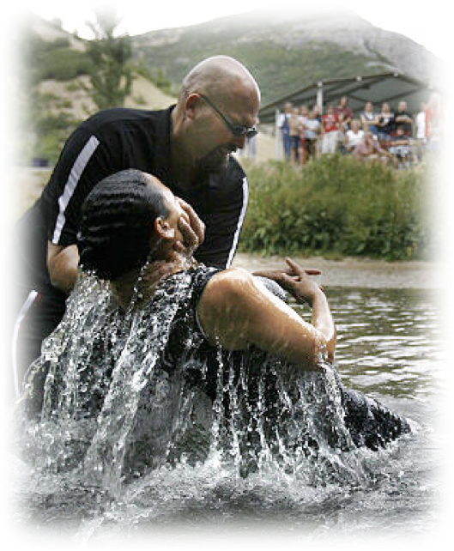
“Learning How To Be Content”
Will Heaven Be Your Home?
It starts with doing what you know to be true - then growing in knowledge & service?
First must obey the gospel — Heb 5:8,9; Mk 16:16
Growing in faith, diligently serving the Lord — 2 Pet 1:5-10
Eternal joy awaits — (Rom 8:18; 1 Cor 15:58)
Don McClain
W. 65th St church of Christ - 9/16/2007

Slide 20
“Learning How To Be Content” —
(Philippians 4:8-23)
Charts by Don McClain
Preached April 29, 2018
West 65th Street church of Christ / P.O. Box 190062 / Little Rock AR 72219 / 501-568-1062
Email – donmcclain@sbcglobal.net
More Keynote, PPT & Audio Sermons:
http://w65stchurchofchrist.org/coc/sermons/

Slide 21
1 Timothy 6:6–16 (NKJV)
⁶ Now godliness with contentment is great gain. ⁷ For we brought nothing into this world, and it is certain we can carry nothing out. ⁸ And having food and clothing, with these we shall be content. ⁹ But those who desire to be rich fall into temptation and a snare, and into many foolish and harmful lusts which drown men in destruction and perdition. ¹⁰ For the love of money is a root of all kinds of evil, for which some have strayed from the faith in their greediness, and pierced themselves through with many sorrows.

Slide 22
1 Timothy 6:6–16 (NKJV)
¹¹ But you, O man of God, flee these things and pursue righteousness, godliness, faith, love, patience, gentleness. ¹² Fight the good fight of faith, lay hold on eternal life, to which you were also called and have confessed the good confession in the presence of many witnesses. ¹³ I urge you in the sight of God who gives life to all things, and before Christ Jesus who witnessed the good confession before Pontius Pilate, ¹⁴ that you keep this commandment without spot, blameless until our Lord Jesus Christ’s appearing, ¹⁵ which He will manifest in His own time, He who is the blessed and only Potentate, the King of kings and Lord of lords, ¹⁶ who alone has immortality, dwelling in unapproachable light, whom no man has seen or can see, to whom be honor and everlasting power. Amen.

