Slide 1
Is It From Heaven or Men?
Always Verify The Source
Matthew 21:23-27; Mark 11:27–33; Luke 20:1–8

Slide 2
Luke 20:1–8 (NKJV)
¹ Now it happened on one of those days, as He taught the people in the temple and preached the gospel, that the chief priests and the scribes, together with the elders, confronted Him ² and spoke to Him, saying, “Tell us, by what authority are You doing these things? Or who is he who gave You this authority?” ³ But He answered and said to them, “I also will ask you one thing, and answer Me:

Slide 3
Luke 20:1–8 (NKJV)
⁴ The baptism of John—was it from heaven or from men?” ⁵ And they reasoned among themselves, saying, “If we say, ‘From heaven,’ He will say, ‘Why then did you not believe him?’ ⁶ But if we say, ‘From men,’ all the people will stone us, for they are persuaded that John was a prophet.” ⁷ So they answered that they did not know where it was from. ⁸ And Jesus said to them, “Neither will I tell you by what authority I do these things.”

Slide 4
NEVER give out private information over the phone, by email, or online to an unverified person or company - CHECK THE SOURCE!
Never follow links in an email, text or private message unless you are sure of the source …

Slide 5
Something Is NOT True …
Just because it is on Facebook, Twitter, Instagram, etc …
Just because you trust the person who said it … (Gal. 1:6-9)
Just because it makes sense … (Prov. 14:12)

Slide 6
Something Is NOT True …
Just because a teacher uses the Bible - Mat. 4:5-11
If it contradicts the teaching of other scriptures -
If it is taken out of context & misapplied -

Slide 7
Never believe a statement as the truth of God unless you can verify that the Bible indeed teaches it!
Acts 17:11 (NKJV)
¹¹ These were more fair-minded than those in Thessalonica, in that they received the word with all readiness, and searched the Scriptures daily to find out whether these things were so.

Slide 8
Never believe a statement as the truth of God unless you can verify that the Bible indeed teaches it!
1 John 4:1 (NKJV)
¹ Beloved, do not believe every spirit, but test the spirits, whether they are of God; because many false prophets have gone out into the world.

Slide 9
Never believe a statement as the truth of God unless you can verify that the Bible indeed teaches it!
2 Timothy 2:15 (NKJV)
¹⁵ Be diligent to present yourself approved to God, a worker who does not need to be ashamed, rightly dividing the word of truth.

Slide 10
Never believe a statement as the truth of God unless you can verify that the Bible indeed teaches it!
2 Timothy 2:16–18 (NKJV)
¹⁶ But shun profane and idle babblings, for they will increase to more ungodliness. ¹⁷ And their message will spread like cancer. Hymenaeus and Philetus are of this sort, ¹⁸ who have strayed concerning the truth, saying that the resurrection is already past; and they overthrow the faith of some.

Slide 11
MANY PEOPLE TODAY MISHANDLE the Word of God
They ADD to God’s words - Prov 30:6; Rev 22:18
They SUBTRACT from God’s words - Rev 22:19
They TWIST God’s words - 2 Pet. 3:16
They REARRANGE God’s words - Mat. 15:1-9; 23:23,24

Slide 12
Always Verify The Source
Matthew 21:23-27; Mark 11:27–33; Luke 20:1–8
Psalm 119:160 (NKJV)
¹⁶⁰ The entirety of Your word is truth, And every one of Your righteous judgments endures forever.

Slide 13
Always Verify The Source
Matthew 21:23-27; Mark 11:27–33; Luke 20:1–8
The totality of information revealed in the Bible is the totality of God’s revealed truth.
ABOUT HIMSELF / ABOUT US / FOR US - Deut 29:29

Slide 14
Always Verify The Source
Matthew 21:23-27; Mark 11:27–33; Luke 20:1–8
John 17:17 (NKJV)
¹⁷ Sanctify them by Your truth. Your word is truth.

Slide 15
Always Verify The Source
Matthew 21:23-27; Mark 11:27–33; Luke 20:1–8
2 Timothy 3:16–17 (NKJV)
¹⁶ All Scripture is given by inspiration of God, and is profitable for doctrine, for reproof, for correction, for instruction in righteousness, ¹⁷ that the man of God may be complete, thoroughly equipped for every good work.

Slide 16
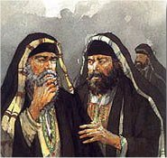
Always Verify The Source
From Heaven or Men?
From Heaven
Mt. 21:23-27
1 John 4:4-6
Gal. 1:6-9
Col. 2:6-10
2 Thess. 2:15
Matthew 21:25-26
Only Two Possible Sources
From Men
Mt. 15:1-9
1 Cor. 4:6
Gal. 1:10-17
Col. 2:8
2 Thess. 2:2-4

Slide 17
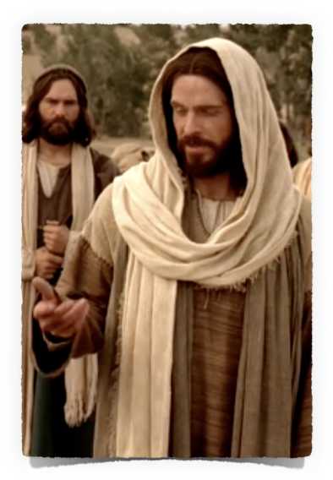
Always Verify The Source
Submitting to The Authority of Jesus Christ
God’s FINAL Spokesman - HIS OWN SON
Hebrews 1:1–2 (NKJV)
¹ God, who at various times and in various ways spoke in time past to the fathers by the prophets, ² has in these last days spoken to us by His Son, whom He has appointed heir of all things, through whom also He made the worlds;
Mat. 17:5; Heb 12:1-3; Rev 2,3

Slide 18
Always Verify The Source
Submitting to The Authority of Jesus Christ
All should BOW to THE NAME OF JESUS
Philippians 2:9–11 (NKJV)
⁹ Therefore God also has highly exalted Him and given Him the name which is above every name, ¹⁰ that at the name of Jesus every knee should bow, of those in heaven, and of those on earth, and of those under the earth, ¹¹ and that every tongue should confess that Jesus Christ is Lord, to the glory of God the Father.
Mat. 28:18-20; Eph 1:21,22; 1 Pet 3:22

Slide 19
Always Verify The Source
Submitting to The Authority of Jesus Christ
Do ALL In The NAME of the LORD Jesus
Colossians 3:17 (NKJV)
¹⁷ And whatever you do in word or deed, do all in the name of the Lord Jesus, giving thanks to God the Father through Him.
Mat. 17:5; Luke 6:46; Acts 2:36

Slide 20
Always Verify The Source
Submitting to The Authority of Jesus Christ
No Other NAME by which we must be SAVED.”
Acts 4:12 (NKJV)
¹² Nor is there salvation in any other, for there is no other name under heaven given among men by which we must be saved.”
Acts 2:38; 10:43, 47,48; 19:5

Slide 21
Always Verify The Source
Submitting to The Authority of Jesus Christ
A Matter of Humility – (Mat 5:3; cf. Deut. 8:2; James 4:6-10 )
A Matter of Respect - (Isaiah 66:2; Luke 6:46-47)
A Matter of Desire – (Psalm 112:1; 2 Cor. 5:9; Ephes. 5:8-15)
A Matter of Love – (John 14:15, 21, 23-24; 1 John 5:2,3)

Slide 22
Always Verify The Source
Submitting to The Authority of Jesus Christ
Stay In Bounds
2 John 9–11 (NKJV)
⁹ Whoever transgresses and does not abide in the doctrine of Christ does not have God. He who abides in the doctrine of Christ has both the Father and the Son. ¹⁰ If anyone comes to you and does not bring this doctrine, do not receive him into your house nor greet him; ¹¹ for he who greets him shares in his evil deeds.
We cannot “go beyond” or fail to “walk” according to the teaching of Christ & still have God
(If He hasn’t authorized it, can we do it?)

Slide 23
Always Verify The Source
Submitting to The Authority of Jesus Christ
Stay In Bounds
1 Corinthians 4:6 (NKJV)
⁶ Now these things, brethren, I have figuratively transferred to myself and Apollos for your sakes, that you may learn in us not to think beyond what is written, that none of you may be puffed up on behalf of one against the other.
Cannot go beyond that which is written -(If God has NOT authorized it WITHIN what He has revealed, can we do it by faith?)
2 Cor. 5:7; Rom 10:17

Slide 24
Always Verify The Source
Submitting to The Authority of Jesus Christ
Stay In Bounds
Revelation 22:18–19 (NKJV)
¹⁸ For I testify to everyone who hears the words of the prophecy of this book: If anyone adds to these things, God will add to him the plagues that are written in this book; ¹⁹ and if anyone takes away from the words of the book of this prophecy, God shall take away his part from the Book of Life, from the holy city, and from the things which are written in this book.
Cannot go beyond that which is written -(If God has NOT authorized it WITHIN what He has revealed, can we do it by faith?)
2 Cor. 5:7; Rom 10:17

Slide 25
Always Verify The Source
Submitting to The Authority of Jesus Christ
Stay In Bounds
Revelation 22:18–19 (NKJV)
¹⁸ For I testify to everyone who hears the words of the prophecy of this book: If anyone adds to these things, God will add to him the plagues that are written in this book; ¹⁹ and if anyone takes away from the words of the book of this prophecy, God shall take away his part from the Book of Life, from the holy city, and from the things which are written in this book.
We can’t do less than what Jesus requires of us through His word

Slide 26
Always Verify The Source
Submitting to The Authority of Jesus Christ
To observe “ALL THINGS” that Jesus commands — (Mat 28:19,20; Acts 2:42)
We can’t do less than what Jesus requires of us through His word
King Agrippa – (Acts 26:28)
The unprofitable servant – (Matt. 25:14-30)
The church of Christ in Laodicea – (Rev. 3:14-22)

Slide 27
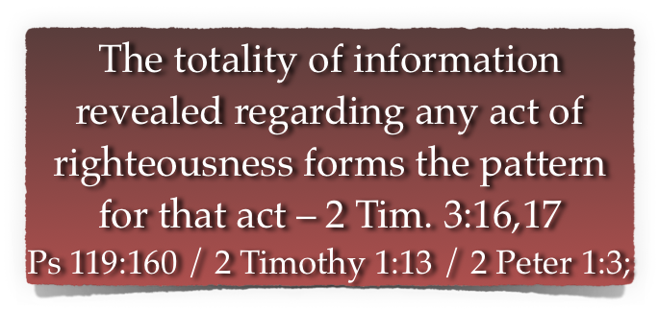
Always Verify The Source
Submitting to The Authority of Jesus Christ
To observe “ALL THINGS” that Jesus commands — (Mat 28:19,20; Acts 2:42)

Slide 28
Always Verify The Source
From Heaven or Men?
From Heaven
Mt. 21:23-27
1 John 4:4-6
Gal. 1:6-9
Col. 2:6-10
2 Thess. 2:15
Matthew 21:25-26
Only Two Possible Sources
From Men
Mt. 15:1-9
1 Cor. 4:6
Gal. 1:10-17
Col. 2:8
2 Thess. 2:2-4

Slide 29
Always Verify The Source
From Heaven or Men?
From Heaven
Hear, believe, repent, confess & be baptized
Matthew 21:25-26
From Men
By faith ONLY - no action required!
What MUST I DO TO BE SAVED?
H. — Romans 10:17;
B. — John 8:24
R. — Acts 17:30;
C. — Romans 10:9,10;
B. — Mark 16:16;
Nothing …
Only believe …
Pray …
Just receive …
No baptism …

Slide 30
Always Verify The Source
From Heaven or Men?
From Heaven
Matthew 21:25-26
From Men
What MUST I DO TO BE SAVED?
Which CHURCH should I join?
It doesn’t matter -
One is just as good as the other -
Whichever one fits what you want -
Just NOT one that believes it is RIGHT!
The Lord Adds the saved — Acts 2:47
A sound L.C. following the NT in org., doc., worship & work — Act 9:26-28

Slide 31
Always Verify The Source
From Heaven or Men?
From Heaven
Matthew 21:25-26
From Men
What MUST I DO TO BE SAVED?
Which CHURCH should I join?
MUSIC in worship?
Singing, melody in heart - Eph. 5:19
Singing - Col. 3:16
Fruit of our lips - Heb 13:15
Sing - James 5:13
It doesn’t matter …
Piano / organ, but no guitars or drums …
Worshipful music - no Rock-n-Roll …
Anything goes …

Slide 32
Always Verify The Source
From Heaven or Men?
From Heaven
Matthew 21:25-26
From Men
What MUST I DO TO BE SAVED?
Which CHURCH should I join?
MUSIC in worship?
The day to observe the Lord's Supper?
We are to remember the Lord’s death by observing the Lord’s supper - Mat 26:26-29; 1 Cor. 11:23-26
Each first day of the week - Acts 20:7
It doesn’t matter …
Every time we come together - Catholic church …
Once a month …
Once a quarter …
Once a year …

Slide 33
Always Verify The Source
Submitting to The Authority of Jesus Christ
His teachings have “once and for all been delivered” — Jude 3
His teaching CANNOT be changed — Gal. 1:6-9
Are we abiding in His teaching - 2 John 9-11
WE will be judged by His words - John 12:48

Slide 34
Don McClain
W 65th St church of Christ / September 7, 2008

Slide 35
Is It From Heaven or Men?
Always Verify The Source
Matthew 21:23-27; Mark 11:27–33; Luke 20:1–8

Slide 36
Matthew 15:3–14 (NKJV)
³ He answered and said to them, “Why do you also transgress the commandment of God because of your tradition? ⁴ For God commanded, saying, ‘Honor your father and your mother’; and, ‘He who curses father or mother, let him be put to death.’ ⁵ But you say, ‘Whoever says to his father or mother, “Whatever profit you might have received from me is a gift to God”— ⁶ then he need not honor his father or mother.’ Thus you have made the commandment of God of no effect by your tradition.

Slide 37
Matthew 15:3–14 (NKJV)
⁷ Hypocrites! Well did Isaiah prophesy about you, saying: ⁸ ‘These people draw near to Me with their mouth, And honor Me with their lips, But their heart is far from Me. ⁹ And in vain they worship Me, Teaching as doctrines the commandments of men.’ ” ¹⁰ When He had called the multitude to Himself, He said to them, “Hear and understand: ¹¹ Not what goes into the mouth defiles a man; but what comes out of the mouth, this defiles a man.”

Slide 38
Matthew 15:3–14 (NKJV)
¹² Then His disciples came and said to Him, “Do You know that the Pharisees were offended when they heard this saying?” ¹³ But He answered and said, “Every plant which My heavenly Father has not planted will be uprooted. ¹⁴ Let them alone. They are blind leaders of the blind. And if the blind leads the blind, both will fall into a ditch.”

