Slide 1
Give Me That
Old Time Religion
Jeremiah 6:16 (NKJV)
¹⁶ Thus says the Lord: “Stand in the ways and see, And ask for the old paths, where the good way is, And walk in it; Then you will find rest for your souls. But they said, ‘We will not walk in it.’
Type to enter a caption.

Slide 2
Give Me That
Old Time Religion
“Show”
Jeremiah 6:16 (NKJV)
¹⁶ Thus says the Lord: “Stand in the ways and see, And ask for the old paths, where the good way is, And walk in it; Then you will find rest for your souls. But they said, ‘We will not walk in it.’
Type to enter a caption.

Slide 3
Deuteronomy 12:29–32 (NKJV)
²⁹ “When the Lord your God cuts off from before you the nations which you go to dispossess, and you displace them and dwell in their land, ³⁰ take heed to yourself that you are not ensnared to follow them, after they are destroyed from before you, and that you do not inquire after their gods, saying, ‘How did these nations serve their gods? I also will do likewise.’ ³¹ You shall not worship the Lord your God in that way; for every abomination to the Lord which He hates they have done to their gods; for they burn even their sons and daughters in the fire to their gods. ³² “Whatever I command you, be careful to observe it; you shall not add to it nor take away from it.

Slide 4
2 Timothy 4:1–5 (NKJV)
¹ I charge you therefore before God and the Lord Jesus Christ, who will judge the living and the dead at His appearing and His kingdom: ² Preach the word! Be ready in season and out of season. Convince, rebuke, exhort, with all longsuffering and teaching.

Slide 5
2 Timothy 4:1–5 (NKJV)
³ For the time will come when they will not endure sound doctrine, but according to their own desires, because they have itching ears, they will heap up for themselves teachers; ⁴ and they will turn their ears away from the truth, and be turned aside to fables. ⁵ But you be watchful in all things, endure afflictions, do the work of an evangelist, fulfill your ministry.

Slide 6
What Is Missing In Our Contemporary Worship?
BY DAVID SANTISTEVAN
Since my days of being a young child, I’ve been raised in “contemporary” worship.
New songs, upbeat music, and exuberant participation from the congregation in the forms of singing, hand-raising, dancing, and shouting is all I’ve known. … The more I grow in Christ, the longer I’m in ministry, the more I see that contemporary doesn’t always mean better. Truth is, the greatest realities in life are old. The gospel is old news – but has more relevance today than anything.
New isn’t always novel. Most of the time it’s better to look back and learn. — What Are We Missing? — Sometimes I wonder if our emphasis on contemporary worship is clouding our perspective and causing us to miss elements of Christian worship that are essential to our formation and development as the people of God.
Louise says
Many youth today are absolutely flocking to churches that have great music (purely from a musical point of view) But the doctrine being taught in those churches is so off the wall and unbiblical! In fact I honestly believe the devil is using music to draw young naive youth into such churches. … I know some will fiercely disagree with me but see, we’ve put too much value in STYLE instead of content. We should go where we grow the most, where the Word of God and truth are saturated in all the church does
http://www.davidsantistevan.com/contemporary-worship/

Slide 7
What IS Meant By

Slide 8
What IS Meant By
CONTEMORARY WORSHIP?
Contemporary merely means “occurring in the modern” or “of the day.”
WORSHIP — 1:: reverence offered a divine being or supernatural power; also : an act of expressing such reverence
Defining “Contemporary Worship”
By Steve Newman -
September 25, 2017
“If your church has a band, you would be considered contemporary. If your instrumentation consists of the piano and organ, you would probably fall into the traditional model.”

Slide 9
What IS Meant By
CONTEMORARY WORSHIP?
Contemporary merely means “occurring in the modern” or “of the day.”
WORSHIP — 1:: reverence offered a divine being or supernatural power; also : an act of expressing such reverence
There is only one style of worship that honors God and pleases Him, that which is in accordance with His stated will and proceeds from a humble, submissive and sincere heart. (John 4:24)

Slide 10
What Is Your Problem With “Contemporary Worship?”
"Sacred Cow"
A person or thing immune to criticism or questioning, as in The rules governing the press conference have become a sacred cow in this administration. This term alludes to the honored status of cows in Hinduism, where they are a symbol of God's generosity to humankind. It has been used figuratively since about 1900.
If You WANT TO STIR THE POT, talk about:
FAITH ALONE?
ONCE SAVED ALWAYS SAVED?
ANY CHURCH WILL DO?
INSTRUMENTAL MUSIC? i.e., — CONTEMPORARY WORSHIP EXPERIENCE?

Slide 11
What Is Your Problem With “Contemporary Worship?”
Post Wednesday on A
Facebook Group of coC Preachers
Don McClain
I am planning to present a lesson on "contemporary worship" this Sunday. I have preached on this before and was curious if some here would mind sharing their thoughts.
Some responses …
Questioned why preach such a sermon - a wasted sermon.
Might as well preach on snake handling - not a problem to warn about …
“I have never heard a sermon about this, don’t know what ya’ll are talking about …”
Rock / pop music is not the same as entertainment …
What would “contemporary worship look like in a coC?

Slide 12
PHILIPPI CHURCH OF CHRIST - CRESWELL, NC
Are You Looking For.......

Slide 13
PHILIPPI CHURCH OF CHRIST - CRESWELL, NC
We traditionally use the piano, organ, flute, and percussion every Sunday morning

Slide 14
PHILIPPI CHURCH OF CHRIST - CRESWELL, NC
http://www.philippicoc.org/contemporary-worship-service.html

Slide 15
PHILIPPI CHURCH OF CHRIST - CRESWELL, NC
A Live Band? Our live band, Committed,
leads us in worship on stage each Sunday morning.

Slide 16
PHILIPPI CHURCH OF CHRIST - CRESWELL, NC
Committed plays the most up to date Contemporary Christian Music.
Many of the songs can be found on Klove.com.

Slide 17
PHILIPPI CHURCH OF CHRIST - CRESWELL, NC
Breakfast - 8am to 8:25am / Communion … while organ music is played softly in the background.

Slide 18
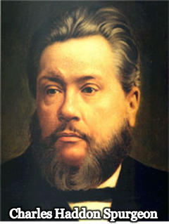
What Is Your Problem With “Contemporary Worship?”
“The fact is, that many would like to unite church and stage, cards and prayer, dancing and sacraments. If we are powerless to stem this torrent, we can at least warn men of its existence, and entreat them to keep out of it. When the old faith is gone, and enthusiasm for the gospel is extinct, it is no wonder that people seek something else in the way of delight. Lacking bread, they feed on ashes; rejecting the way of the Lord, they run greedily in the path of folly.”
[“Another Word Concerning The Downgrade” – The Sword and The Trowel (Aug. 1887), 398]
“The fact is, that many would like to unite church and stage, cards and prayer, dancing and sacraments. If we are powerless to stem this torrent, we can at least warn men of its existence, and entreat them to keep out of it. When the old faith is gone, and enthusiasm for the gospel is extinct, it is no wonder that people seek something else in the way of delight. Lacking bread, they feed on ashes; rejecting the way of the Lord, they run greedily in the path of folly.”
[“Another Word Concerning The Downgrade” – The Sword and The Trowel (Aug. 1887), 398]

Slide 19
Give Me That SHOW Time Religion
There Is A MAJOR Problem With “Contemporary Worship”

Slide 21
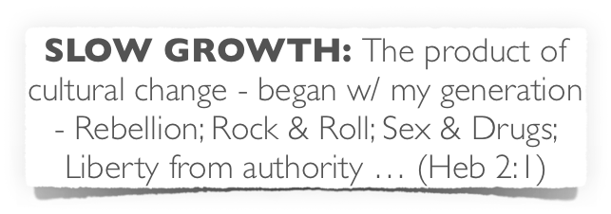
What Is Your Problem With “Contemporary Worship?”
Hebrews 2:1 (NKJV)
¹ Therefore we must give the more earnest heed to the things we have heard, lest we drift away.

Slide 22
What Is Your Problem With “Contemporary Worship?”
Judges 21:25 (NKJV)
²⁵ In those days there was no king in Israel; everyone did what was right in his own eyes.
cf. Judges 2:7

Slide 23
What Is Your Problem With “Contemporary Worship?”
Jeremiah 2:13 (NKJV)
¹³ "For My people have committed two evils: They have forsaken Me, the fountain of living waters, And hewn themselves cisterns--broken cisterns that can hold no water.

Slide 24
What Is Your Problem With “Contemporary Worship?”
Apostasy begins with a change in attitude towards God & His word – Ps. 95:8; 101:4; Prov 4:23; Rom 1:21,22
Convictions change resulting in a change in practice – Ps. 10:11,13; Heb 3:12; Rom 1:23
Results in changing the way we apply scripture – 2 Pet 3:16; Rom 1:24,25

Slide 25
What Is Your Problem With “Contemporary Worship?”
Emphasis of style over substance – Rom. 16:17,18; Mat. 7:15; 2 Cor. 11:14,15; 1 Cor. 4:6
De-emphasis of Biblical authority –(“coC traditionalists; legalists; etc) 2 John 1:9; Col. 3:17; Lev. 10:1,2
Critical of those who “contend earnestly for the faith” & apostolic “tradition” – Jude 1:3; 2 Thes 2:15

Slide 26
What Is Your Problem With “Contemporary Worship?”
Start to measure what we will do by what we have done –
We will move further and further away from God –
We set a course for complete apostasy –

Slide 27
Give Me That SHOW Time Religion
There Is A MAJOR Problem With “Contemporary Worship”

Slide 28
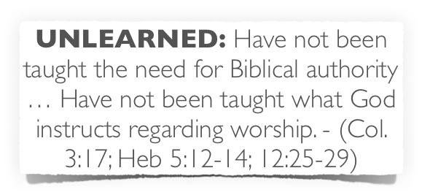
What Is Your Problem With “Contemporary Worship?”
1 Peter 4:11 (NKJV)
¹¹ If anyone speaks, let him speak as the oracles of God. …

Slide 29
What Is Your Problem With “Contemporary Worship?”
Comprehensive Nature of The NT Scriptures
Comprehensive Nature of The NT Scriptures
We cannot know the mind of God except through revelation
1 Cor 2:10, 11,14
Eph 3:3-5
Isaiah 55:8,9
Faith comes by hearing the word of CHRIST
God has revealed everything He wants us to know & do –
2 Pet 1:3;
2 Tim 3:16,17
Jude 3
ROMANS 10:17
Walking by faith means walking by what God has said
2 Cor. 5:7; 1 Cor. 4:6; Gal. 1:6-9

Slide 30
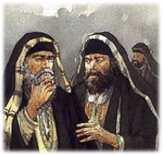
What Is Your Problem With “Contemporary Worship?”
From Heaven or Men?
From Heaven or Men?
From Heaven
Mt. 21:23-27
1 John 4:4-6
Gal. 1:6-9
Col. 2:6-10; 3:17
2 Thess. 2:15
From Men
Mt. 15:1-9
1 Cor. 4:6
Gal. 1:10-17
Col. 2:8
2 Thess. 2:2-4
Walking by faith means walking by what God has said
2 Cor. 5:7; 1 Cor. 4:6; Gal. 1:6-9

Slide 31
What Is Your Problem With “Contemporary Worship?”
From Heaven or Men?
From Heaven or Men?
Playing
& making melody with a guitar,
Walking by faith means walking by what God has said
2 Cor. 5:7; 1 Cor. 4:6; Gal. 1:6-9

Slide 32
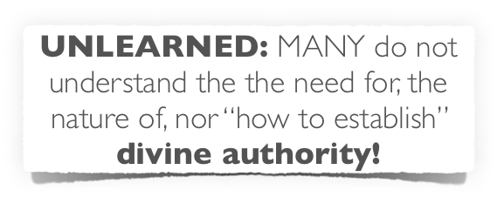
What Is Your Problem With “Contemporary Worship?”
Recently a discussion of Facebook I was informed that we do not have authority for:
Song books,
Buildings,
Lights,
HVAC,
Pews,
Windows,
Doors, etc.
Was told these things do not aide in our worship, they are added for our pleasure …
This person does not understand the nature of authority!
Was told these things do not aide in our worship, they are added for our pleasure …
This person does not understand the nature of authority!
These are Aides & Expedients!
NOT Additions!

Slide 33
What Is Your Problem With “Contemporary Worship?”
Commands | Aids | Expedients | Additions
Baptize (Mt. 28:18-20) | Pool, River, Baptistery, Etc. | Waders, “baptismal" clothing, water heated | Basin to Sprinkle – Cup for Pouring
Assemble (Heb. 10:24-25) | House, Hall, Church Building, | Time on Sunday, , own, rent, how often … | Family Life Center, Gymnasium, Etc.
Lord’s Supper (1 Cor. 11:23-29) | Cups, Plates, Table, Etc. | AM or PM, Homemade? Bought? | Social Meal (1 Co. 11:17-22, 34)
Give (1 Cor. 16:1-2) | Collection Baskets | Order in service, cash, checks, … | Raffles, Chili Suppers, Cake Walks, Etc.
Preaching (Acts 20:7) | Mics, projectors, chalk boards … | Which Biblical subject, order in service … | Politics / Bind Opinions Comedian / entertainer -
Sing (Eph. 5:19; etc.) | Song Book, PPT Leader, Pitch Pipe, | # of songs, which songs, On screen, book, memory / stand, sit … | Man made instruments / Praise bands / Clapping

Slide 34
What Is Your Problem With “Contemporary Worship?”
Commands | Aids | Expedients | Additions
Baptize (Mt. 28:18-20) | Pool, River, Baptistery, Etc. | Waders, “baptismal" clothing, water heated | Basin to Sprinkle – Cup for Pouring
Assemble (Heb. 10:24-25) | House, Hall, Church Building, | Time on Sunday, , own, rent, how often … | Family Life Center, Gymnasium, Etc.
Lord’s Supper (1 Cor. 11:23-29) | Cups, Plates, Table, Etc. | AM or PM, Homemade? Bought? | Social Meal (1 Co. 11:17-22, 34)
Give (1 Cor. 16:1-2) | Collection Baskets | Order in service, cash, checks, … | Raffles, Chili Suppers, Cake Walks, Etc.
Preaching (Acts 20:7) | Mics, projectors, chalk boards … | Which Biblical subject, order in service … | Politics / Bind Opinions Comedian / entertainer -
Sing (Eph. 5:19; etc.) | Song Book, PPT Leader, Pitch Pipe, | # of songs, which songs, On screen, book, memory / stand, sit … | Man made instruments / Praise bands / Clapping
Aids & Expedients do not change, by either addition or subtraction, that which God commands! Additions do!
Tools to build ark - Gen 6
Ox cart to move ark - 1 Chron 13
In order for a thing to be an aide or expedient it must first be lawful!
X

Slide 35
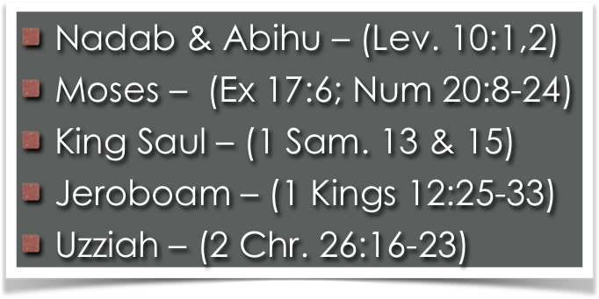
What Is Your Problem With “Contemporary Worship?”
“BECAUSE YOU BELIEVED ME NOT!” — Num. 20:12
When God specifies - we CANNOT substitute — (1 Chron 13:5-8; Heb. 7:11-14)

Slide 36
What Is Your Problem With “Contemporary Worship?”
“BECAUSE YOU BELIEVED ME NOT!” — Num. 20:12
When God specifies - we CANNOT substitute — (1 Chron 13:5-8; Heb. 7:11-14)
Ephesians 5:19 (NKJV)
¹⁹ speaking to one another in psalms and hymns and spiritual songs, singing and making melody in your heart to the Lord,

Slide 37
What Is Your Problem With “Contemporary Worship?”
“BECAUSE YOU BELIEVED ME NOT!” — Num. 20:12
When God specifies - we CANNOT substitute — (1 Chron 13:5-8; Heb. 7:11-14)

Slide 38
Give Me That SHOW Time Religion
There Is A MAJOR Problem With “Contemporary Worship”

Slide 39
What Is Your Problem With “Contemporary Worship?”
“Take your sandals off your feet, for the place where you stand is holy ground.!” — Exodus 3:5

Slide 40
What Is Your Problem With “Contemporary Worship?”
“Take your sandals off your feet, for the place where you stand is holy ground.!” — Exodus 3:5
Hebrews 12:28–29 (NKJV)
²⁸ Therefore, since we are receiving a kingdom which cannot be shaken, let us have grace, by which we may serve God acceptably with reverence and godly fear. ²⁹ For our God is a consuming fire.
Hebrews 12:28–29 (NKJV)
²⁸ Therefore, since we are receiving a kingdom which cannot be shaken, let us have grace, by which we may serve God acceptably with reverence and godly fear. ²⁹ For our God is a consuming fire.

Slide 41
What Is Your Problem With “Contemporary Worship?”
Exodus 20:25 (NKJV) And if you make Me an altar of stone, you shall not build it of hewn stone; for if you use your tool on it, you have profaned it.

Slide 42
What Is Your Problem With “Contemporary Worship?”
Acts 17:25 “Nor is He worshiped with men’s hands, as though He needed anything, …”

Slide 43
What Is Your Problem With “Contemporary Worship?”
John 4:23–24 (NKJV)
²³ But the hour is coming, and now is, when the true worshipers will worship the Father in spirit and truth; for the Father is seeking such to worship Him. ²⁴ God is Spirit, and those who worship Him must worship in spirit and truth.”

Slide 44
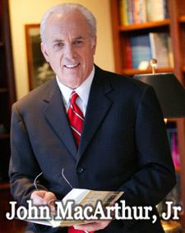
What Is Your Problem With “Contemporary Worship?”
“We have a society filled with people who want what they want when they want it. They are into their own lifestyle, recreation, and entertainment. They want comfort, happiness, and success. When churches appeal to those selfish desires, they only fuel fires that hinder true godliness.”
(Ashamed of The Gospel, When The Church Becomes Like The World, pg 85)

Slide 45
What Is Your Problem With “Contemporary Worship?”
A deeper spiritual problem is revealed and perpetuated by the “ENTERTAINMENT” atmosphere.
Many incorrectly associate emotionalism with spirituality. - (Prov. 4:24)
Could it be that many are actually seeking what they WANT rather than seeking to please God? - (Phil 3:18,19; Rom 1:25; 2 Tim 3:1-5)

Slide 46
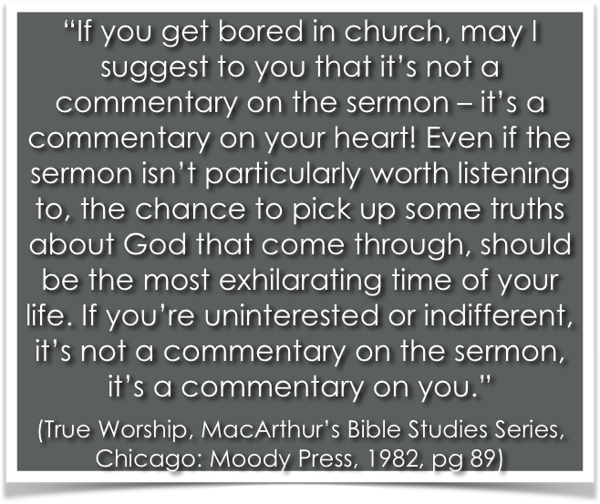
What Is Your Problem With “Contemporary Worship?”

Slide 47
What Is Your Problem With “Contemporary Worship?”
Has NO New Testament or Historical Precedent – (1 Cor 14; Heb 12:28; John 4:24)
Diminishes Sense of Awe and Reverence That Should Be Present When Approaching God – (Heb 12:28)
Reflects and Promotes A Lack of Confidence in the Power of the Gospel!! – (Rom 1:16)

Slide 48
What Is Your Problem With “Contemporary Worship?”
The BIG business of “CONTEMPORARY CHURCH” is a SELF CONSUMING practice, (The more money you pour in, the more money it takes)
Engenders the desire for brighter, faster, and more exciting experiences - taking them further from God …
Reinforces a “Man Centered” and a “Self Serving” View of Worship – [Idolatry] - (Rom 1:25)

Slide 49
What Is Your Problem With “Contemporary Worship?”
Entertained people – NOT converted people!
Unlearned People – NOT a people growing in the grace and knowledge of Jesus!
A Compromising people – NOT a steadfast unmovable people.
Carnally minded people – NOT spiritually minded people!

Slide 50
What Is Your Problem With “Contemporary Worship?”
Conversion – (Acts 2:36-38; 2 Cor 5:17; 1 Pet 1:22,23)
Submission to God!! - (Eccl 12:13; Mat 7:21-23; Col 3:17)
Transformation – (Ro 12:1,2)
Unity in truth – (Eph 4:1-6)
Edification , (Eph. 4:11-16)
Holiness – (Eph 4:17-5:17)
Maturity – (Col. 1:28;2 Pet 1:3-10; Heb 5:12,13; 10:24,25)

Slide 51
What Is Your Problem With “Contemporary Worship?”
The OLD TIME religion IS SUFFICIENT TO FULFILL GOD’S PURPOSE & PLEASE HIM!– (Jer 6:16; Heb 1:1; Mat 7:21; 17:5; 2 Tim 4:1-4; 1 Cor 3:6)
We are dedicated to finding the pattern revealed in the New Testament - and following that pattern! - (2 Tim 1:13)

Slide 52
Don McClain

Slide 53
Give Me That SHOW Time Religion
There Is A MAJOR Problem With “Contemporary Worship”
Charts by Don McClain
Preached September 2, 2018 PM
West 65th Street church of Christ / P.O. Box 190062 / Little Rock AR 72219 / 501-568-1062
Email – donmcclain@sbcglobal.net
More Keynote, PPT & Audio Sermons: http://w65stchurchofchrist.com

