Slide 1
Don’t Gamble
With Your Soul!

Slide 2
1 Timothy 6:6–10 (NKJV)
⁶ Now godliness with contentment is great gain. ⁷ For we brought nothing into this world, and it is certain we can carry nothing out. ⁸ And having food and clothing, with these we shall be content. ⁹ But those who desire to be rich fall into temptation and a snare, and into many foolish and harmful lusts which drown men in destruction and perdition. ¹⁰ For the love of money is a root of all kinds of evil, for which some have strayed from the faith in their greediness, and pierced themselves through with many sorrows.

Slide 3
Don’t Gamble With Your Soul!
Arkansas Casino Legalization Proposal Approved For Ballot
POSTED 10:59 AM, SEPTEMBER 5, 2018, BY 5NEWS WEB STAFF, UPDATED AT 03:06PM, SEPTEMBER 5, 2018
“The group behind the measure, Driving Arkansas Forward, turned in more than 138,000 signatures.
The proposal would allow casino gambling at Oaklawn, a Hot Springs horse track, and Southland, a greyhound track in West Memphis. The tracks currently offer video poker and other forms of electronic gambling. The proposal would also allow casinos in Pope and Jefferson counties.”

Slide 4
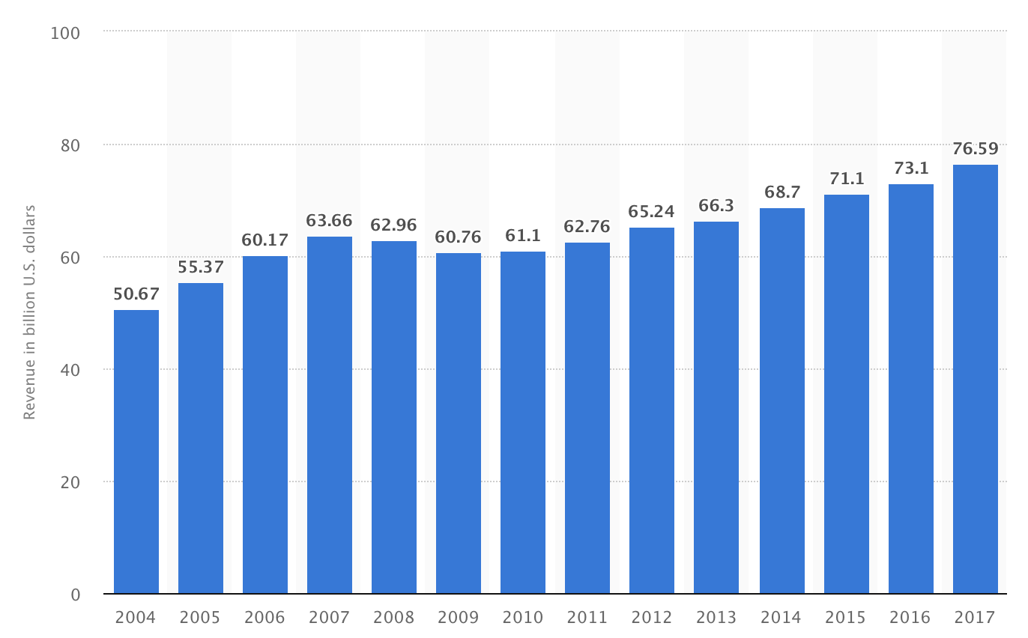
Don’t Gamble With Your Soul!
U.S. casino gaming market revenue from 2004 to 2017 (in billion U.S. dollars)

Slide 5
Don’t Gamble With Your Soul!

Slide 6
Don’t Gamble With Your Soul!
“Until the late 1980s, casino gambling was illegal almost everywhere in the country. Today, casinos are allowed in 23 states . …
The industry as a whole targets precisely those who can least afford to lose … The impact of casinos on local property values is "unambiguously" negative, according to the National Association of Realtors. Casinos do not revive local economies. They act as parasites upon them. Communities located within 10 miles of a casino exhibit double the rate of problem gambling. Unsurprisingly, such communities also suffer higher rates of home foreclosure and other forms of economic distress and domestic violence.
Is this really OK? Are Americans content to allow the growth of an industry that consciously exploits the predictable weakness of the most vulnerable people? 27 states still say "no." If yours is one such state, fight to keep it that way.

Slide 7
Don’t Gamble With Your Soul!
The HARM CASINOS DO
Bankruptcy rates average approximately 18% higher in casino communities.
Local business, especially restaurants, will show a significant decrease in sales.
Gambling addictions will increase by approximately 10% within a 50 mile radius of casinos.
Social costs of gambling consume at least $3 for every $1 generated by a casino.

Slide 8
Don’t Gamble With Your Soul!
The HARM GAMBLING DOES
Addiction
Poverty
Crime
Dishonesty
Family strife / divorce
Escape into alcoholism
Exploitation of the poor

Slide 9
Don’t Gamble With Your Soul!
DRIVING FORCES of GAMBLING
Materialism
Greed
Discontentment
Exploitation
Laziness vs. working
Thwarting of charity
Seeking to gain from the loss of others

Slide 10
Don’t Gamble With Your Soul!
GAMBLING DEFINED
Merriam-Webster, - to play a game for money or property
American Heritage® Dictionary - To bet on an uncertain outcome, as of a contest. - To play a game of chance for stakes. - To take a risk in the hope of gaining an advantage or a benefit.
World Book Encyclopedia: "Gamblers usually bet money or something else of value as a stake on the outcome they predict. When the outcome is settled, the winner collects the loser's stakes."

Slide 11
Don’t Gamble With Your Soul!
Three Elements Of Gambling
1. The Uncertain Event - It is arbitrarily determined.
2. The Stake - Wager or bet that is deliberately chanced.
3. A Winner And Loser – one loses a possession wagered while the winner takes it from him!

Slide 12
Don’t Gamble With Your Soul!
The casting of lots - was not gambling, but a means of making a decision. - Acts 1:26.
Taking a risk – To cross a street - The farmer is not seeking to gain at the loss of another.
Buying and selling stock - an investment, not gambling.
Buying insurance - A honest business transaction – protecting self and family.
Prizes - When one registers to win a prize that is given away for advertisement, PCH, etc.
Competition for a prize – Not a wagered possession but won by skill and fair competition

Slide 13
Don’t Gamble With Your Soul!
Different FORMS Of Gambling
Casino gambling …
Betting on horses, dogs, sporting events -/ online betting
State Lotteries.
Bingo, raffles, Bazaar and fair booths - paying to win a prize.
Amateur gambling - poker games for money, Betting on the outcome of athletic events . . office pools,

Slide 14
Don’t Gamble With Your Soul!
Gambling Is Sinful BECAUSE …
The “motor” for gambling is SINFUL – 1 Cor. 6:9,10; 1 Tim 6:9,10
"Greed" eager desire for base gain – Ez. 22:12
"Covetousness" - a "greedy desire to have more. - loving money.“ – Eph. 5:5
If winnings were removed - would Casino’s and lotteries still prosper?

Slide 15
Don’t Gamble With Your Soul!
Gambling Is Sinful BECAUSE …
Violates The Principle of Stewardship -
Must glorify God - 1 Peter 4:10,11;
Faithful - 1 Cor 4:1,2
Good stewards give, not take - Acts 20:35
Good stewards will be blessed - Luke 12:42,43;

Slide 16
Don’t Gamble With Your Soul!
Gambling Is Sinful BECAUSE …
Violates Golden Rule -
For one to win at gambling, others must lose –
Gambling is predicated on the losses, pain, and suffering of others - preys on desperation of the poor
A Christian is NOT to take advantage of another – Prov. 14:31; 22:16; Hos. 12:7; Zec. 17:10; Phili 2:4; Mat. 7:12; 22:39; Gal. 5:13,14

Slide 17
Don’t Gamble With Your Soul!
Gambling Is Sinful BECAUSE …
Violates Means of Honest Gain -
By honest work – Pro. 13:11
By fair exchange – Eph 4:28
By investment – Mt 25:14-30
By gift – Acts 20:35
Gambling is the attempt to obtain the resources of others by taking advantage of the misfortune.

Slide 18
Don’t Gamble With Your Soul!
Gambling Is Sinful BECAUSE …
Sets A Bad Example -
Destroys One’s reputation - Prov 22:1
Could lead others into sin - Mat 18:6; Rom 14:13; 1 Cor. 8:13
Destroys one’s influence - Mat 5:13,14; Phili 2:15; Eph 6:1-4

Slide 19
Don’t Gamble With Your Soul!
Gambling Is Sinful BECAUSE …
Destroys Families
Material deprivation - financially burdened
Domestic violence
Child abuse and neglect
Divorce

Slide 20
Don’t Gamble With Your Soul!
Gambling Is Sinful BECAUSE …
“… it is family members who bear the brunt of the pain and misery that accompanies this addiction. In addition to material deprivations, family members frequently experience the trauma of divorce, child abuse and neglect, and domestic violence.”
Ronald A. Reno Gambling's Impact on Families http://www.family.org/cforum/research/papers/A0013772.html

Slide 21
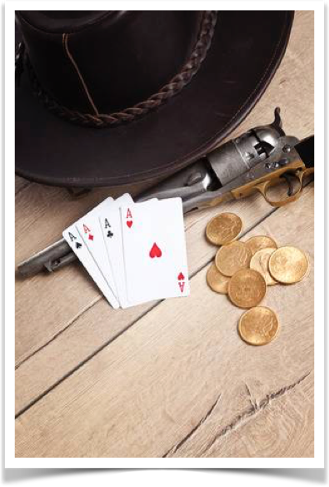
Don’t Gamble With Your Soul!
Association With Evil Companions
Gambling establishments are hosts to other corrupting vices,
Prostitution -
Drunkenness -
Credit card fraud -
Embezzlement -
Tax Evasion -
Drugs, Drunkenness -
Organized crime -
Christians are to avoid such environments - 1 Thes 5:21,22; 1 Cor 15:33,34

Slide 22
Don’t Gamble With Your Soul!
Association With Evil Companions
Supports an immoral, predatory and exploitative industry - Job 31:16-20
Associates with the works of the flesh - Gal. 5:19-21
Instead of partaking we are to expose – Eph. 5:7,11
“…by their fruits ye shall know them”
(Matt. 7:20).

Slide 23
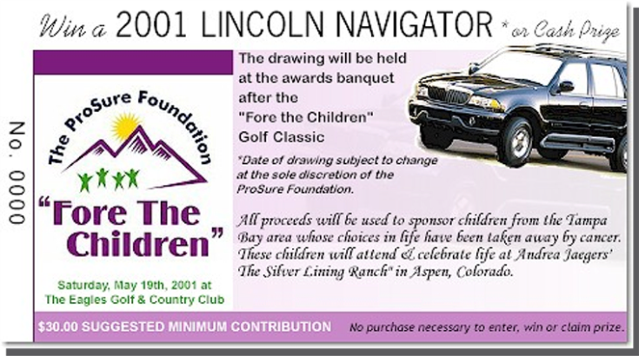
Don’t Gamble With Your Soul!
Not Determined By Amount Or Degree
Lottery
“Just a LITTLE ….”
The amount of money or the value of the thing risked does not alter the Biblical principles violated.
For one to consistently object to another’s gambling, he must totally abstain.
Raffles
It’s For GOOD
Should We Do Evil That Good May Come?
Rom. 3:8

Slide 24
Don’t Gamble With Your Soul!
It is a greed-driven, predatory vice, scientifically designed to squeeze the maximum amounts of money possible from every single patron.
It is by its very nature an enterprise wholly dependent on victims - James C. Dobson, Ph.D. 1999 Focus on the Family.

Slide 25
Don’t Gamble With Your Soul!
The spread of legalized gambling is exacting colossal social and economic costs.
Gambling expansion brings with it increased crime, divorce and family disruption, and it creates a multitude of new addicts.
Gambling also exploits the poor and youth.
Legalized gambling is harmful public policy that should be vigorously opposed at all levels.

Slide 26
Don’t Gamble With Your Soul!
Proverbs 1:10–19 (NKJV)
¹⁰ My son, if sinners entice you, Do not consent. ¹¹ If they say, “Come with us, Let us lie in wait to shed blood; Let us lurk secretly for the innocent without cause; ¹² Let us swallow them alive like Sheol, And whole, like those who go down to the Pit; ¹³ We shall find all kinds of precious possessions, We shall fill our houses with spoil; ¹⁴ Cast in your lot among us, Let us all have one purse”—

Slide 27
Don’t Gamble With Your Soul!
Proverbs 1:10–19 (NKJV)
¹⁵ My son, do not walk in the way with them, Keep your foot from their path; ¹⁶ For their feet run to evil, And they make haste to shed blood. ¹⁷ Surely, in vain the net is spread In the sight of any bird; ¹⁸ But they lie in wait for their own blood, They lurk secretly for their own lives. ¹⁹ So are the ways of everyone who is greedy for gain; It takes away the life of its owners.

Slide 28
1 Timothy 6:6–10 (NKJV)
⁶ Now godliness with contentment is great gain. ⁷ For we brought nothing into this world, and it is certain we can carry nothing out. ⁸ And having food and clothing, with these we shall be content. ⁹ But those who desire to be rich fall into temptation and a snare, and into many foolish and harmful lusts which drown men in destruction and perdition. ¹⁰ For the love of money is a root of all kinds of evil, for which some have strayed from the faith in their greediness, and pierced themselves through with many sorrows.

Slide 29
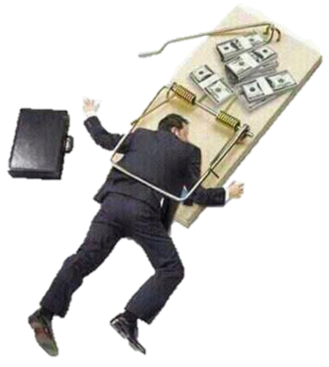
“… pierced themselves through with many sorrows.”
Tertullian said, "If you say that you are a Christian when you are a dice player, you say what you are not, because you are a partner with the world."

Slide 30
Don’t Gamble With Your Soul!
Titus 2:11-12 (NKJV)
¹¹ For the grace of God that brings salvation has appeared to all men, ¹² teaching us that, denying ungodliness and worldly lusts, we should live soberly, righteously, and godly in the present age,

Slide 32
Don’t Gamble
With Your Soul!

Slide 33
Proverbs 1:10–19 (NKJV)
¹⁰ My son, if sinners entice you, Do not consent. ¹¹ If they say, “Come with us, Let us lie in wait to shed blood; Let us lurk secretly for the innocent without cause; ¹² Let us swallow them alive like Sheol, And whole, like those who go down to the Pit; ¹³ We shall find all kinds of precious possessions, We shall fill our houses with spoil; ¹⁴ Cast in your lot among us, Let us all have one purse”—

Slide 34
Proverbs 1:10–19 (NKJV)
¹⁵ My son, do not walk in the way with them, Keep your foot from their path; ¹⁶ For their feet run to evil, And they make haste to shed blood. ¹⁷ Surely, in vain the net is spread In the sight of any bird; ¹⁸ But they lie in wait for their own blood, They lurk secretly for their own lives. ¹⁹ So are the ways of everyone who is greedy for gain; It takes away the life of its owners.

Slide 35
1 Timothy 6:10
Deuteronomy 8:18
Ecclesiastes 5:10
Exodus 20:17
Hebrews 13:5
Luke 12:15
Matthew 6:24
Philippians 4:19
Proverbs 13:11
Proverbs 16:33
Proverbs 23:5
Proverbs 28:19

