Slide 1
“But …
God Knows
My Heart”

Slide 2
God Knows
My Heart
Often said when the disparity between what the Scriptures teach and what a person actually believes or does becomes apparent …
Regarding the NT plan of salvation — Mark 16:16; Acts 2:38;
Regarding worship — John 8:24; Eph 5:19; Heb 12:28,29
Regarding one’s manner of life, (attendance; treatment of others; their words; their activities; etc.)

Slide 3
God Knows
My Heart
Intended to nullify obedience: “Because God knows my heart.”
“God knows I have good intentions” does NOT render the teaching of the scripture moot — 1 Sam 15:14-26
“I’m sincere” does NOT CHANGE DISOBEDIENCE INTO acceptable behavior! — Ac 26:9-11; Rm 10:2; Ga. 1:13, 14; Phi. 3:6; 1 Tim. 1:13

Slide 4
God Knows
My Heart
The Fact that “God Knows your Heart” DOES NOT Mean It Is Accepted!!!!
Sinful behavior CANNOT be disassociated from that which is IN THE HEART —- (Matthew 15:18-19).
This “defense” or “self-justification” for continued disobedience to the Scripture ONLY prevents the sinner from making the changes necessary to being acceptable to God — (Jere. 13:10; 23:17; 2 Thes 2:10-12)

Slide 5
God Knows
My Heart
Jeremiah 13:10 (NKJV)
¹⁰ This evil people, who refuse to hear My words, who follow the dictates of their hearts, and walk after other gods to serve them and worship them, shall be just like this sash which is profitable for nothing.

Slide 6
God Knows
My Heart
Psalm 78:8 (NKJV)
⁸ And may not be like their fathers, A stubborn and rebellious generation, A generation that did not set its heart aright, And whose spirit was not faithful to God.

Slide 7
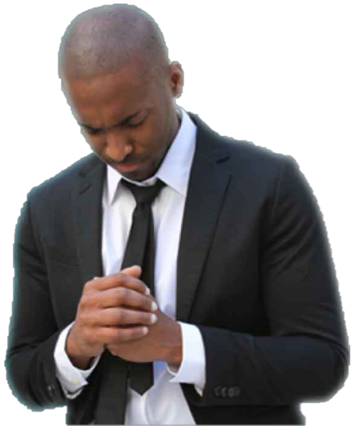
God Knows
My Heart
Psalm 44:20–21 (NKJV)
²⁰ If we had forgotten the name of our God, Or stretched out our hands to a foreign god, ²¹ Would not God search this out? For He knows the secrets of the heart.

Slide 8
God Knows
My Heart
1 Kings 8:39–40 (NKJV)
³⁹ then hear in heaven Your dwelling place, and forgive, and act, and give to everyone according to all his ways, whose heart You know (for You alone know the hearts of all the sons of men), ⁴⁰ that they may fear You all the days that they live in the land which You gave to our fathers.

Slide 9
God Knows
My Heart
1 Chronicles 28:9–10 (NKJV)
⁹ “As for you, my son Solomon, know the God of your father, and serve Him with a loyal heart and with a willing mind; for the Lord searches all hearts and understands all the intent of the thoughts. If you seek Him, He will be found by you; but if you forsake Him, He will cast you off forever. ¹⁰ Consider now, for the Lord has chosen you to build a house for the sanctuary; be strong, and do it.

Slide 10
God Knows
My Heart
God searches the heart — Psalm 44:21; 1 Kings 8:39; Jer. 17:9–10
God judges the heart — Jer 17:10; 1 Sam. 16:7
God CANNOT be deceived — BUT we CAN BE! —

Slide 11
God Knows
My Heart
Proverbs 21:2 (NKJV)
² Every way of a man is right in his own eyes, But the Lord weighs the hearts.

Slide 12
God Knows
My Heart
Jeremiah 17:9–10 (NKJV)
⁹ “The heart is deceitful above all things, And desperately wicked; Who can know it? ¹⁰ I, the Lord, search the heart, I test the mind, Even to give every man according to his ways, According to the fruit of his doings.

Slide 13
God Knows
My Heart
Luke 16:15 (NKJV)
¹⁵ And He said to them, “You are those who justify yourselves before men, but God knows your hearts. For what is highly esteemed among men is an abomination in the sight of God.

Slide 14
God Knows
My Heart
I am not A competent judge - even of my own heart.
1 Corinthians 4:3–4 (NKJV)
³ … In fact, I do not even judge myself. ⁴ For I know of nothing against myself, yet I am not justified by this; but He who judges me is the Lord.

Slide 15
God Knows
My Heart
By the scriptures — ALL of God’s truth is revealed in His word and it reveals the true nature of our heart — 2 Tim 3:16,17; Lk 8:11; Heb 4:12;
By our obedience — our heart is revealed in our response to God’s word — 1 John 4:1,2; Rom 8:1,2,12-14; Mat. 7:16–17; 12:33; 15:18

Slide 16
God Knows
My Heart
We may have confidence only in that which God has revealed
2 Timothy 4:2-4
I John 3:19–23;

Slide 17
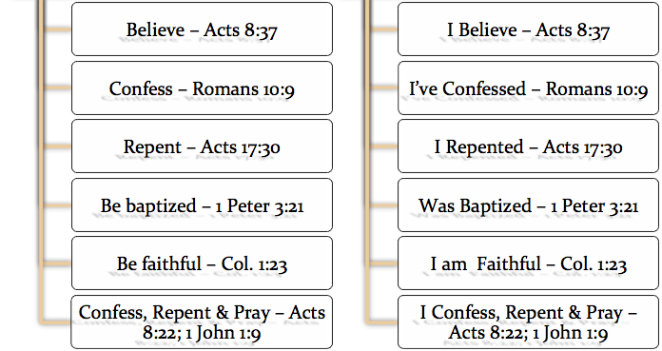
God Knows
My Heart

Slide 18
God Knows
My Heart

Slide 19
God Knows
My Heart
God’s knowing my heart is not proof of God ruling my heart — Job 11:11; Matthew 9:4; Acts 8:22
Doing God’s revealed will is proof of God ruling my heart — Deut 6:5–6; I Chron 28:8–9; 2 Chron 12:14; Rom 6:16-18; 1 Pet 1:22,23

Slide 20
God Knows
My Heart
1 Peter 3:13–17 (NKJV)
¹³ And who is he who will harm you if you become followers of what is good? ¹⁴ But even if you should suffer for righteousness’ sake, you are blessed. “And do not be afraid of their threats, nor be troubled.” ¹⁵ But sanctify the Lord God in your hearts, and always be ready to give a defense to everyone who asks you a reason for the hope that is in you, with meekness and fear; ¹⁶ having a good conscience, that when they defame you as evildoers, those who revile your good conduct in Christ may be ashamed. ¹⁷ For it is better, if it is the will of God, to suffer for doing good than for doing evil.

Slide 21
God Knows
My Heart
God Knows Every Heart Whether It Is Good or Evil
The fact that God knows the heart does not prove anything relative to whether or not we are accepted by Him.
It is what God knows about the heart that matters.

Slide 22
God Knows
My Heart
All We Can Know of Our Heart Is Revealed in God’s Word
We can only be assured of that which is in harmony with what God has revealed — (1 Jn 3:19-21; Heb 4:12).
Even then - God is the final judge (I Cor 4:3-5; Jn 12:48).
No man can contend that God will approve him when he will not obey God (Matt 7:21; Luke 6:46).

Slide 23
“Yes …
God Knows
My Heart”
Do I KNOW my heart is RIGHT in the sight of God?
Am I obeying God from my heart - or Not?
I HAVE My answer! - Rom 6:16-18

Slide 25
“But …
God Knows
My Heart”

Slide 26
1 Chronicles 29:16–20 (NKJV)
¹⁶ “O Lord our God, all this abundance that we have prepared to build You a house for Your holy name is from Your hand, and is all Your own. ¹⁷ I know also, my God, that You test the heart and have pleasure in uprightness. As for me, in the uprightness of my heart I have willingly offered all these things; and now with joy I have seen Your people, who are present here to offer willingly to You.

Slide 27
1 Chronicles 29:16–20 (NKJV)
¹⁸ O Lord God of Abraham, Isaac, and Israel, our fathers, keep this forever in the intent of the thoughts of the heart of Your people, and fix their heart toward You. ¹⁹ And give my son Solomon a loyal heart to keep Your commandments and Your testimonies and Your statutes, to do all these things, and to build the temple for which I have made provision.” ²⁰ Then David said to all the assembly, “Now bless the Lord your God.” So all the assembly blessed the Lord God of their fathers, and bowed their heads and prostrated themselves before the Lord and the king.

