Slide 1
Having Been
JUSTIFIED

Slide 3
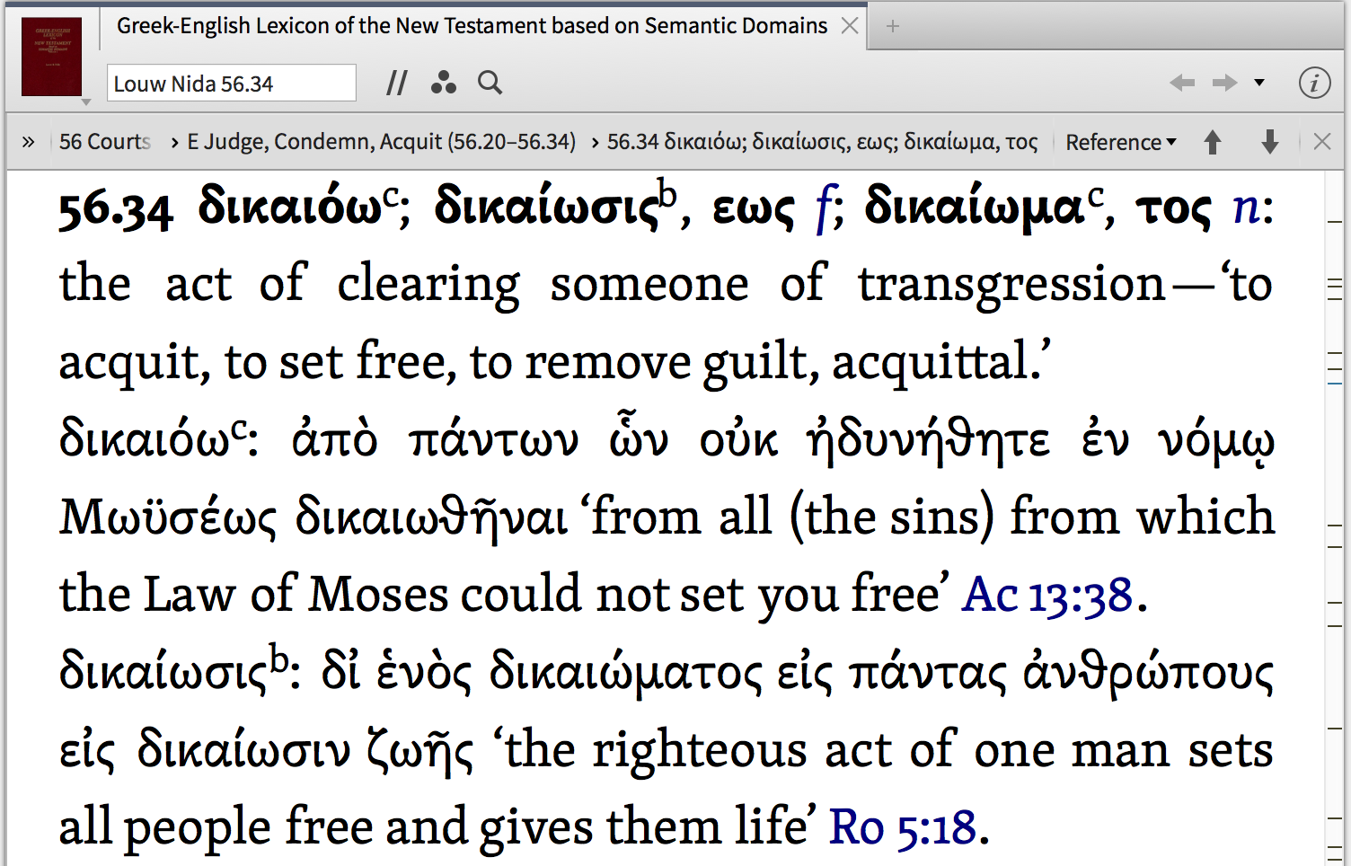

Slide 4
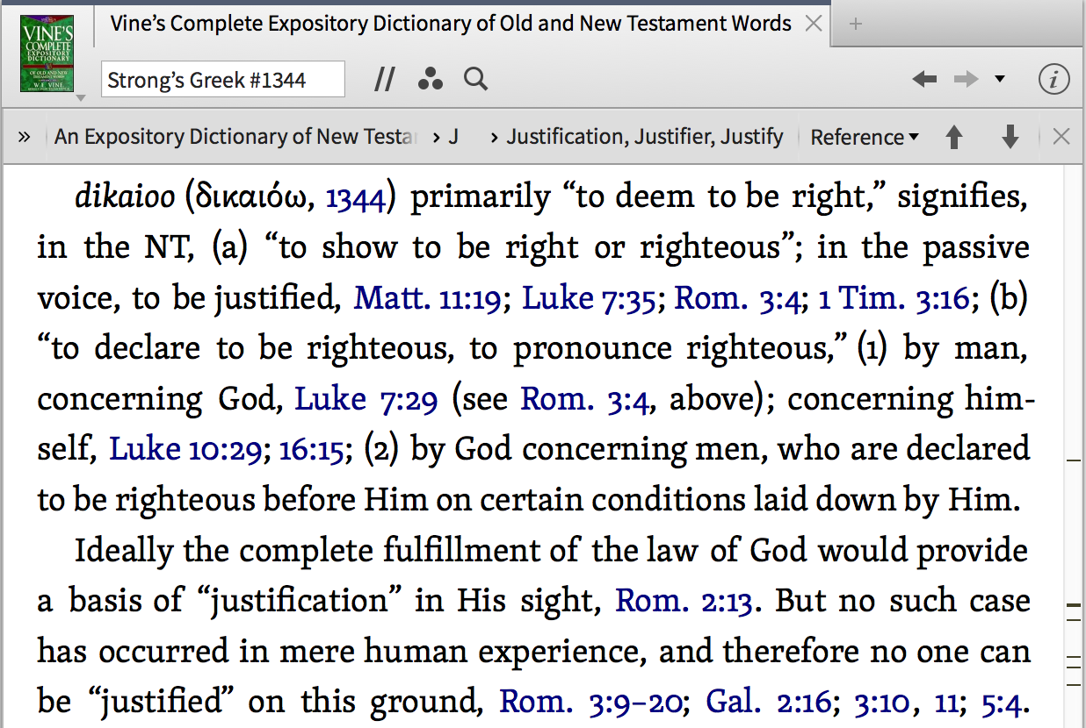

Slide 5
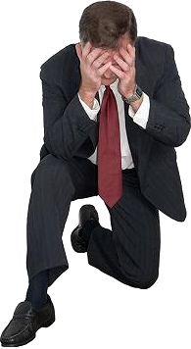
A sinful man CAN NEVER be right with God apart from:

Slide 6
Sin and death entered the world when Adam sinned - Gen 3; Rom 5:12,
Sin has passed to all men because all sinned - Ro 3:9,19,23; 5:12; Ez. 18:21-32
Sin separates men from God – Isa. 59:1,2
The wages of sin is death - Rom 6:23
God’s wrath is coming & we need to be saved from it! - Ro 1:18; Eph 5:6; Col 3:6;

Slide 7
Supposed partiality on the part of God / or wishful thinking — Rom. 2:5-11
Self-justification - Lk. 10:29; 16:15; 18:9-14
The Law of Moses - Acts 13:39; Rom. 3:19-20; 4:4; Gal. 5:4
Works of Merit – Eph 2:8,9; Lk. 18:11-12, 21-23; Jn. 1:29
Man’s ways or teaching - Rom. 10:1-3; Matt. 15:9; Gal. 1:8-9
Faith ALONE - James 2:14-24

Slide 8
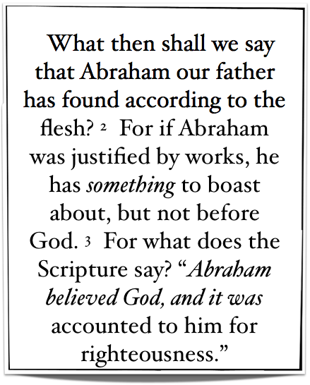

Slide 9
What is discovered by examining the justification of the physical forefather of the Jews - (4:1; Jn 8:39)
Abraham was not justified by boastful works / works of merit – (4:2,4; 11:6; Ep 2:8.9)
Abraham – “believed God” and it was COUNTED to him as righteousness – (4:3; Gen. 15:6; Gal. 3:6; James 2:23)

Slide 10
Paul clearly defines the type of works under consideration - (4:4; 3:27,28; 9:32; 11:6; Gal. 3:10-12)
“Works” is NOT discounting the necessity of humble submission to God’s stated will by faith – (4:5; 6:16-18; Mt. 7:21-23; Gal. 3:1)

Slide 11
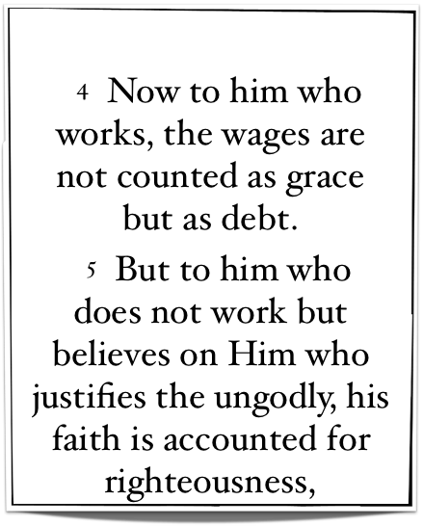
Paul clearly defines the type of works under consideration - (4:4; 3:27,28; 9:32; 11:6; Gal. 3:10-12)
“Works” is NOT discounting the necessity of humble submission to God’s stated will by faith – (4:5; 6:16-18; Mt. 7:21-23; Gal. 3:1)
The system by which men are justified rests on “forgiveness” not “merit”– (4:6-8; Ps. 32:1,2; Acts 2:38; Col 2:12-14; Ep. 2:8,9)

Slide 12
⁶ And if by grace, then it is no longer of works; otherwise grace is no longer grace.
But if it is of works, it is no longer grace; otherwise work is no longer work. —
Romans 11:6
Cf. Galatians 3:10-12

Slide 13
Romans 4:5–6 (NKJV)
⁵ But to him who does not work but believes on Him who justifies the ungodly, his faith is accounted for righteousness, ⁶ just as David also describes the blessedness of the man to whom God imputes righteousness apart from works:
Romans 6:16–18 (NKJV)
¹⁶ Do you not know that to whom you present yourselves slaves to obey, you are that one’s slaves whom you obey, whether of sin leading to death, or of obedience leading to righteousness? ¹⁷ But God be thanked that though you were slaves of sin, yet you obeyed from the heart that form of doctrine to which you were delivered. ¹⁸ And having been set free from sin, you became slaves of righteousness.
Equivalent to saying“does not earn” & “apart from merit”
WORK not same as OBEY!
[dikaiosune - δικαιοσύνη]

Slide 14
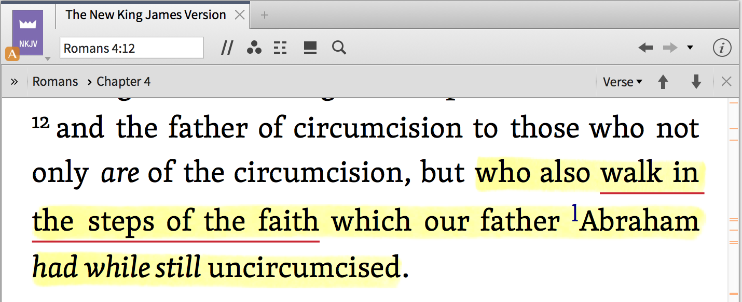
Genesis 12:1-4
Hebrews 11:8
Genesis 15:6
Romans 4:1-4,12
What Kind of Faith Did Abraham Have?
Genesis 13:4
Hebrews 11:9
Genesis 22:3,12,16,18
James 2:21-25

Slide 15
W
O
R
K
S
A system of merit
No need for forgiveness
A system where there is no need for God’s mercy or grace (Jesus)
Paul NEVER uses this term to negate the necessity of obedience to God by FAITH
A system of Grace
A system relying on forgiveness
A system where our need for God’s mercy & grace (Jesus) is recognized
Paul NEVER uses this term in a sense that EXCLUDES obedience
F
A
I
T
H

Slide 16
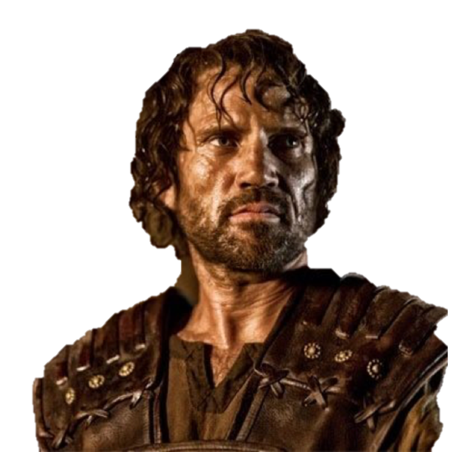
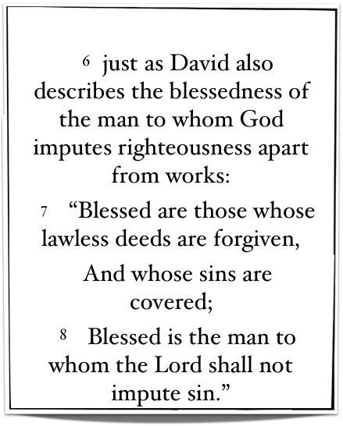
David proclaims & illustrates the same principle - Ps 32:1,2
David sinned - could never obtain justification by the Law — (2 Samuel 11,12; Gal. 3:10-12; Rom. 7:7-25)
He was counted as righteous by virtue of God’s mercy & grace through his faith. (David repented & confessed his sin - sought a steadfast spirit & pledged his future faithfulness) — Psalm 51

Slide 17
Gentiles receive this blessedness by FAITH — (4:9; 3:29,30; 9:24; 10:12,13; 15:8-19; Gal. 3:14,26-28)
Abraham was counted as justified before the giving of circumcision – (4:10-12,15; Gen. 15:6; 17:10)
Promise of justification not through the Law but through faith – (4:13-18; Gal. 3:16-29)
We must have the same kind of faith as Abraham – (4:12-25; Jn 8:39,40)

Slide 18
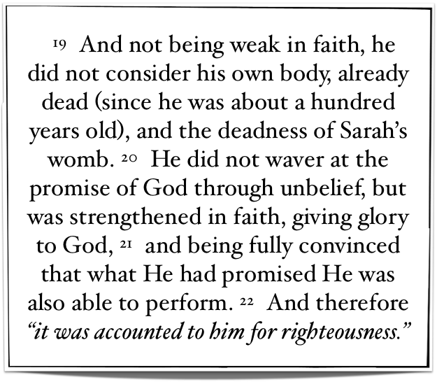
¹² buried with Him in baptism, in which you also were raised with Him through faith in the working of God, who raised Him from the dead.
Colossians 2:12
Gen 22; Jos 6; 2 Ki 5

Slide 19
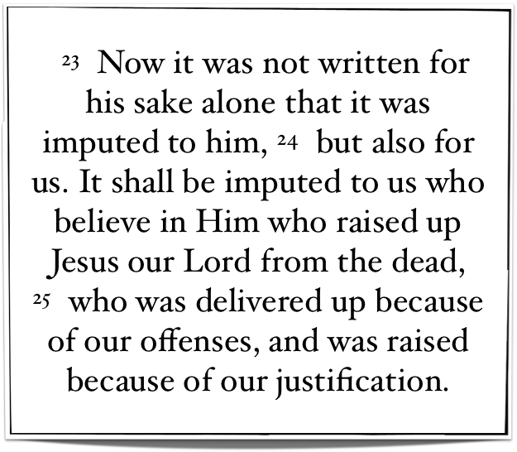
²¹ There is also an antitype which now saves us—baptism (not the removal of the filth of the flesh, but the answer of a good conscience toward God), through the resurrection of Jesus Christ,
1 Peter 3:21
cf. Rom 5:18; 1 Cor 15:17; 2 Cor 5:15

Slide 20
Romans 5:1–2 (NKJV)
¹ Therefore, having been justified by faith, we have peace with God through our Lord Jesus Christ, ² through whom also we have access by faith into this grace in which we stand, and rejoice in hope of the glory of God.

Slide 21
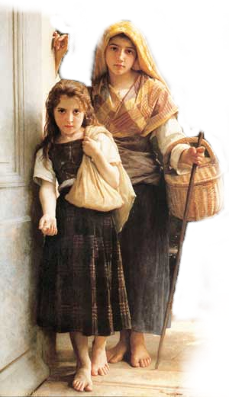
James 2:14–26 (NKJV)
¹⁴ What does it profit, my brethren, if someone says he has faith but does not have works? Can faith save him? ¹⁵ If a brother or sister is naked and destitute of daily food, ¹⁶ and one of you says to them, “Depart in peace, be warmed and filled,” but you do not give them the things which are needed for the body, what does it profit?
Faith ALONE CANNOT Save!!

Slide 22
James 2:14–26 (NKJV)
¹⁷ Thus also faith by itself, if it does not have works, is dead. ¹⁸ But someone will say, “You have faith, and I have works.” Show me your faith without your works, and I will show you my faith by my works. ¹⁹ You believe that there is one God. You do well. Even the demons believe—and tremble!
Faith that does not obey is worthless!
Demons Believe But Do Not Obey!

Slide 23
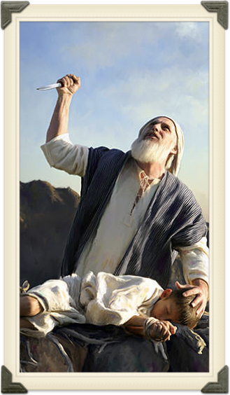
Genesis 22:16-19
Before God!!
James 2:14–26 (NKJV)
²⁰ But do you want to know, O foolish man, that faith without works is dead? ²¹ Was not Abraham our father justified by works when he offered Isaac his son on the altar? ²² Do you see that faith was working together with his works, and by works faith was made perfect?
What kind of faith did Abraham have? Rom 4:12

Slide 24
Genesis 15:6
Before God!!
James 2:14–26 (NKJV)
²³ And the Scripture was fulfilled which says, “Abraham believed God, and it was accounted to him for righteousness.” And he was called the friend of God. ²⁴ You see then that a man is justified by works, and not by faith only.
The Faith That Saves Is The Faith That Obeys!

Slide 25
Hebrews 11:31
Rahab justified by faith
James 2:14–26 (NKJV)
²⁵ Likewise, was not Rahab the harlot also justified by works when she received the messengers and sent them out another way? ²⁶ For as the body without the spirit is dead, so faith without works is dead also.

Slide 26
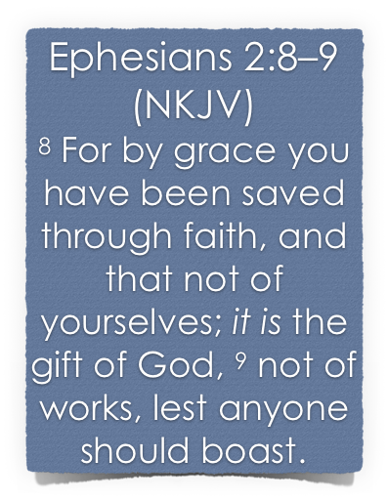
SAME principle In EVERY Age …
Salvation is a gift of God which no man deserves – Rom 3:23
Salvation is received through the means of our faith – John 3:16; 8:24; Heb 11:6; Rom 10:17
Salvation cannot be earned by our own efforts – Rom. 11:6
No man can boast before God – Rom. 4:2; 3:23

Slide 27
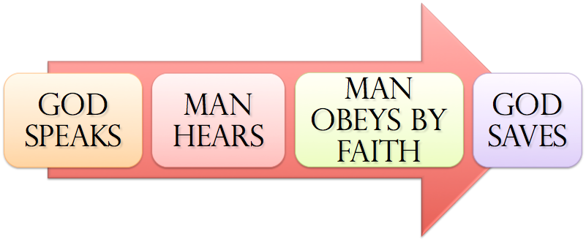
SAME principle In EVERY Age …
Noah - Gen. 6:8,13-17; 22; 7:5; Heb 11:7
Abraham – Gen 12:4; 15:6; 17:10,23; 22:3,16-18
Israel – Ex. 12:13; 14:30; Dt 30:15-19; Jos 6; 1 Cor 10:1-13
Us – Mark 16:16; Acts 2:38; 8:12,37; Rom 6:3-6; 10:9-13; Gal. 3:26,27; Col. 2:11-13; 1 Pet 3:21; 1 Jn 1:9

Slide 28
Other terms used to express ones saved state
All occur at the same point in time
Justification
Rom 6:16,17
SAVED IN
CHRIST
Sanctification
Acts 26:18
Regeneration
1 Pet 1:22,23

Slide 29
Other terms used to express ones saved state
All occur at the same point in time
Justification
Rom 6:16,17
FORGIVENESS
Acts 2:38
Sanctification
Acts 26:18
Regeneration
1 Pet 1:22,23
All tied inseparably to God’s grace

Slide 30
1 Corinthians 6:11 (NKJV) ¹¹ And such were some of you. But you were washed, but you were sanctified, but you were justified in the name of the Lord Jesus and by the Spirit of our God.
Justified
1 Cor 6:11
Rom 6:16,17
All occur at the same point in time
Baptism
Acts 18:8
1 Cor. 12:13
Washed
Acts 22:16
1 Pet 1:22,23
Sanctified
1 Cor. 1:2
All tied inseparably to God’s grace

Slide 31
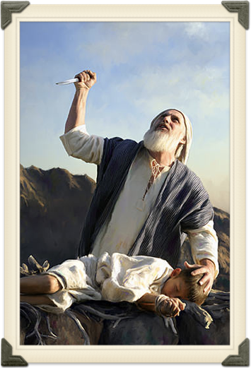
The only effectual faith is the faith that obeys God! — (James 2:14-26; Heb. 11)
What KIND of FAITH did Abraham manifest over & over again? — (Gen 12-22; Rom 4:12,23; James 2:24)
What kind of FAITH do you have? — (Mk 16:16; Acts 2:37,38,41; Gal. 3:26,27)

Slide 32
Don McClain
W. 65th St church of Christ / May 6, 2007

Slide 33
Having Been
JUSTIFIED
Charts by Don McClain
Preached March 18, 2018
West 65th Street church of Christ / P.O. Box 190062 Little Rock AR 72219 / 501-568-1062
Prepared using Keynote / Email – donmcclain@sbcglobal.net
More Keynote, PPT & Audio Sermons:
http://w65stchurchofchrist.org/coc/sermons/

Slide 34
Galatians 3:21–29 (NKJV)
²¹ Is the law then against the promises of God? Certainly not! For if there had been a law given which could have given life, truly righteousness would have been by the law. ²² But the Scripture has confined all under sin, that the promise by faith in Jesus Christ might be given to those who believe.

Slide 35
Galatians 3:21–29 (NKJV)
²³ But before faith came, we were kept under guard by the law, kept for the faith which would afterward be revealed. ²⁴ Therefore the law was our tutor to bring us to Christ, that we might be justified by faith. ²⁵ But after faith has come, we are no longer under a tutor.

Slide 36
Galatians 3:21–29 (NKJV)
²⁶ For you are all sons of God through faith in Christ Jesus. ²⁷ For as many of you as were baptized into Christ have put on Christ. ²⁸ There is neither Jew nor Greek, there is neither slave nor free, there is neither male nor female; for you are all one in Christ Jesus. ²⁹ And if you are Christ’s, then you are Abraham’s seed, and heirs according to the promise.

