Slide 1
Joshua 24:15; Psalm 37:5–6; 101:1-5; Acts 11:23

Slide 2
To be successful in ANY field - to meet and accomplish ANY great goal & task - REQUIRES
DECISION
PURPOSE
DETERMINATION
CONTINUED EFFORT
PERSEVERANCE
Joshua 24:15; Psalm 37:5–6; 101:1-5; Acts 11:23

Slide 3
RE SOLVED
adjective
firm in purpose or intent; determined.
verb (used with object), re·solved, re·solv·ing.
to come to a definite or earnest decision about; determine (to do something):
verb (used without object), re·solved, re·solv·ing.
to come to a determination; make up one's mind; determine (often followed by on or upon):
noun
a resolution or determination made, as to follow some course of action.

Slide 6
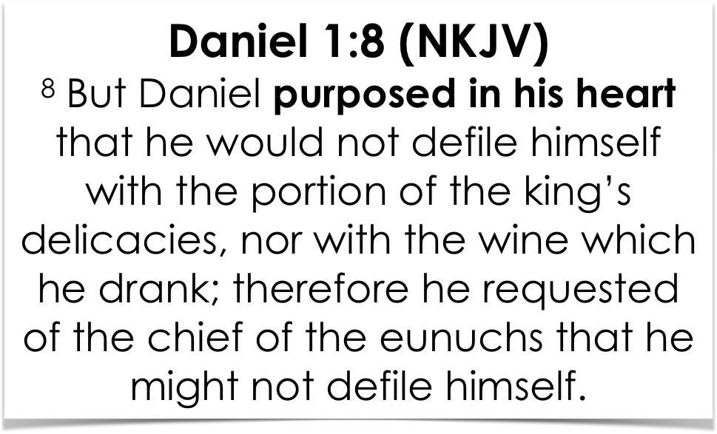

Slide 9
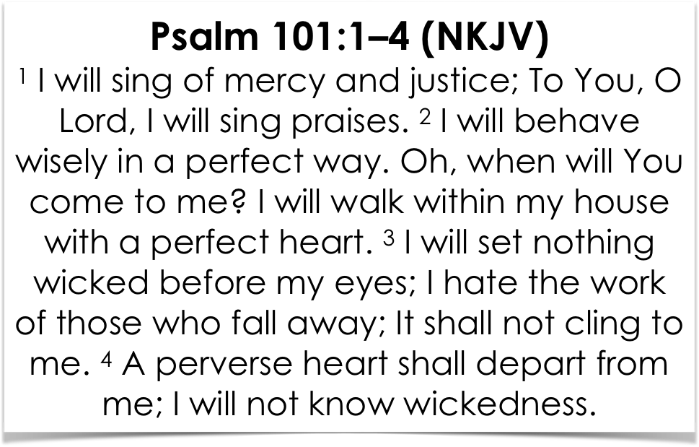
Psalm 101:1–4 (NKJV)
¹ I will sing of mercy and justice; To You, O Lord, I will sing praises. ² I will behave wisely in a perfect way. Oh, when will You come to me? I will walk within my house with a perfect heart. ³ I will set nothing wicked before my eyes; I hate the work of those who fall away; It shall not cling to me. ⁴ A perverse heart shall depart from me; I will not know wickedness.

Slide 10
Psalm 101:1 ¹ I will sing of mercy and justice;
I AM RESOLVED to be grateful to God for His love, mercy & grace!! — John 3:16; Eph 2:1-9; Rom. 5:8-10; 1 Jn 4:9,10
Gratitude will motivate us to loyal and faithful service — 2 Cor. 5:14,15; Gal 2:20; Rom 12:1,2
God will reward the FAITHFUL — 1 Cor. 15:58

Slide 11
Psalm 101:1 ¹ … I will sing praises.
I AM RESOLVED to praise and worship the LORD — Eph 5:19; Col. 3:16; Acts 16:25; Jam. 5:13
We should sing of God’s love, of Jesus’ sacrifice, of salvation, and heaven - and we should sing TOGETHER! — Ps. 122:1; 1 Cor. 11:18; 14:26; Eph. 5:19; Col. 3:16
We are to assemble together to encourage one another — Heb 10:24,25; 1 The 5:11

Slide 12
Psalm 101:2 ² I will behave wisely in a perfect way.
I AM RESOLVED to follow God’s word - to Keep His commandments, follow His precepts, live according to His judgments — Prov. 1:7; 9:10; Ps. 111:10; 15:33; 119:97-104,106,115; [Eccl. 12:13];
Living wisely requires I listen to God’s instructions & purpose to follow them — Prov. 4:1-27; Eph. 5:15-17

Slide 13
Psalm 101:2 ² … I will walk within my house with a perfect heart.
I AM RESOLVED to be the godly father; husband / mother; wife / son / daughter, God wants me to be! — Deut 6:7; Josh 24:15; Eph 5:22-6:4; Col 3:18-21; 1 Pet 3:1-7
I AM RESOLVED to be godly EVEN IN SECRET! — Gen. 20:6; (David’s plea) Ps 19:12; (Hezekiah) 2 Chro 31:20,21; Acts 24:16

Slide 14
Psalm 101:3 ³ I will set nothing wicked before my eyes;
I AM RESOLVED to NEVER flirt with temptation — Job 31:1; Psalm 119:37; Pr. 6:25; 23:31–35; Mat. 5:28-30; etc.
I AM RESOLVED to "hate the work of those who fall away;” to hate sin - all sin - Psalm 97:10
I AM RESOLVED to NEVER condone, or facilitate sin - "A perverse heart shall depart from me; I will not know wickedness.” vs. 4— Eph 5:3-14

Slide 15
Psalm 101:3 ³ I will set nothing wicked before my eyes;
I AM RESOLVED to NEVER listen to the slander and gossip of the wicked - “Whoever secretly slanders his neighbor, Him I will destroy;” vs. 5; Prov 26:20-22;
I AM RESOLVED to LOVE my brother - to seek justice for the upright — to defend the helpless, … — and NEVER be a stumbling block — Ex. 20:16; Prov 20:19; Rom 14:12, 15, 20; 1 Cor. 8:9-13;

Slide 16
To grow spiritually — 2 Pet 1:5-11
To study God’s word — Acts 17:11,12; 2 Tim 2:15
To attend every service & Bible study — Ps. 122:1; Heb 10:24,25
To encourage & help those who need it — Mat 25:36; Gal. 6:1
To give sacrificially — 1 Cor 16:1,2
To share the gospel — Act 8:4

Slide 17
TO Become a Christian
HEAR - Rom 10:17
BELIEVE - Jn 8:24
REPENT - Act 17:30
CONFESS - Rom 10:9
BAPTIZED - Acts 2:38
To save our own souls and as many others as possible. — Jn 1:9; 1 Cor. 15:58

Slide 18
Today is the day of salvation … 2 Cor 6:2
Joshua 24:15; Psalm 37:5–6; 101:1-4; Acts 11:23

Slide 21
