Slide 1
The Inward Man Is The Real Me!
The Real Me Will exist forever!
What Will Be My Eternal Condition?
“Even though our outward man is perishing, yet the inward man is being renewed day by day.” — 2 Corinthians 4:16 (NKJV)

Slide 2
INWARD or Outward
The Inward Man Is The Real Me
Encyclopedias - International Standard Bible Encyclopedia - Inward Man
INWARD MAN - in'-werd:
A Pauline term, nearly identical with the "hidden man of the heart" (1 Peter 3:4). The Greek original, 5 ho eso (also esothen) anthropos (Romans 7:22) is lexigraphically defined "the internal man," i.e. "soul," "conscience." It is the immaterial part of man--mind, spirit--in distinction from the "outward man" which "perishes" (2 Corinthians 4:16 the King James Version). As the seat of spiritual influences it is the sphere in which the Holy Spirit does His renewing and saving work (Ephesians 3:16). … Briefly stated, it is mind, soul, spirit--God's image in man--man's higher nature, intellectual, moral, and spiritual.
Dwight M. Pratt

Slide 3
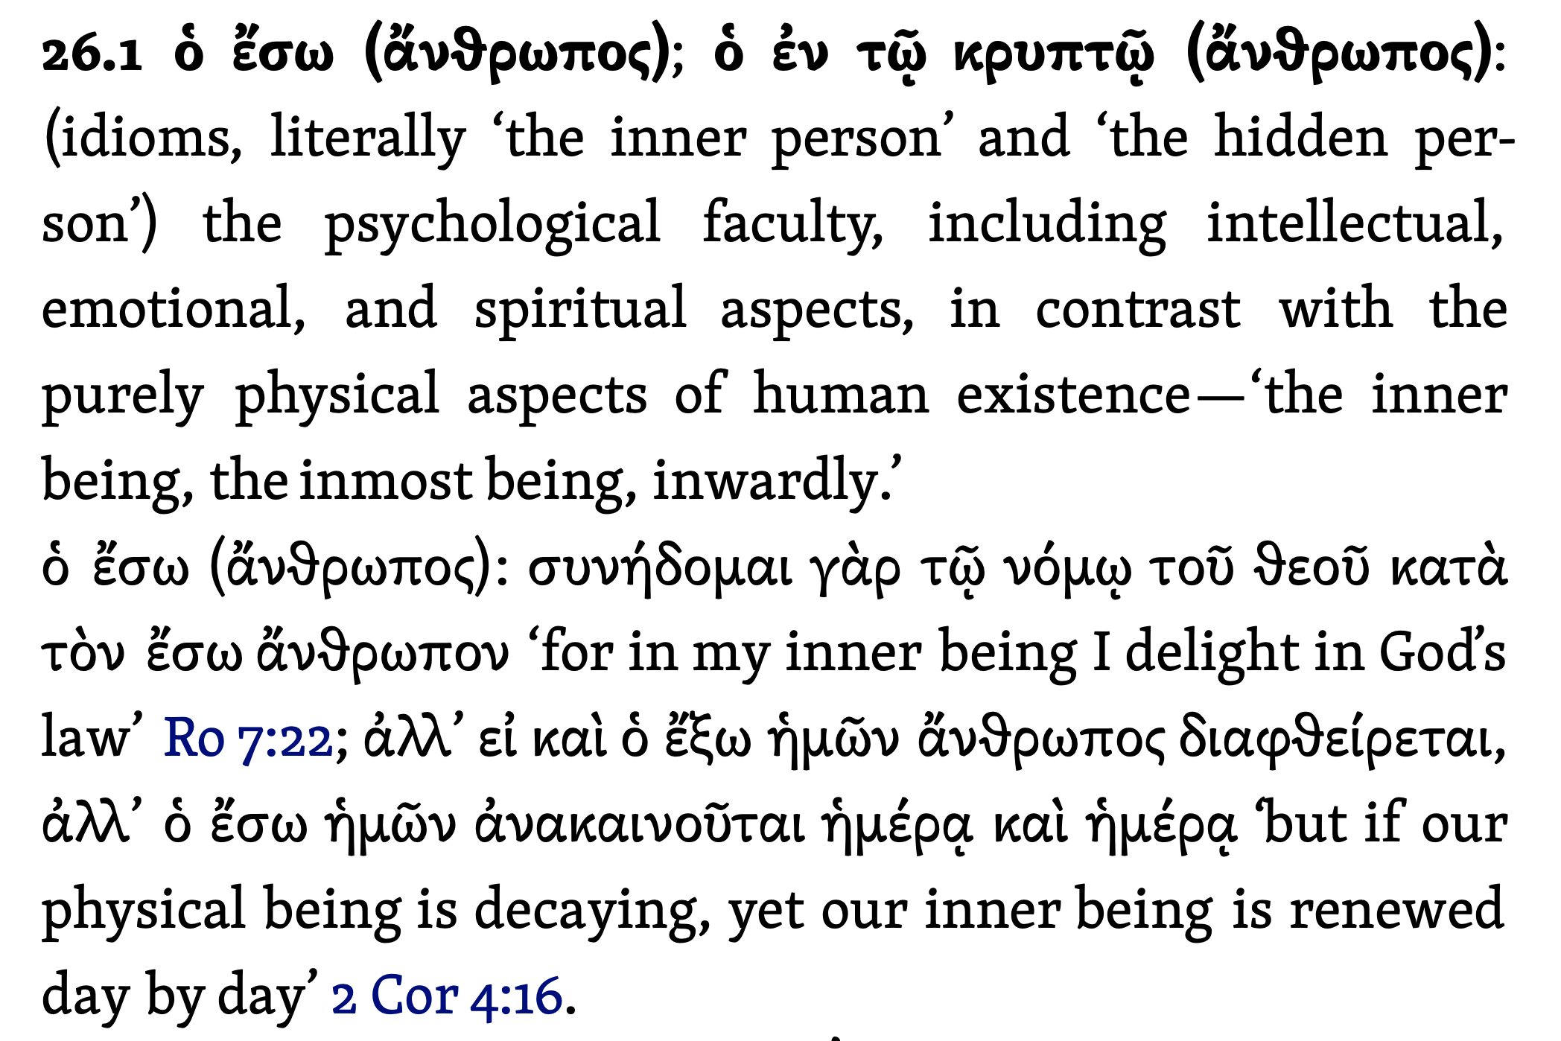
INWARD or Outward
The Inward Man Is The Real Me
Louw, J. P., & Nida, E. A. (1996). Greek-English lexicon of the New Testament: based on semantic domains (electronic ed. of the 2nd edition.). New York: United Bible Societies.

Slide 4
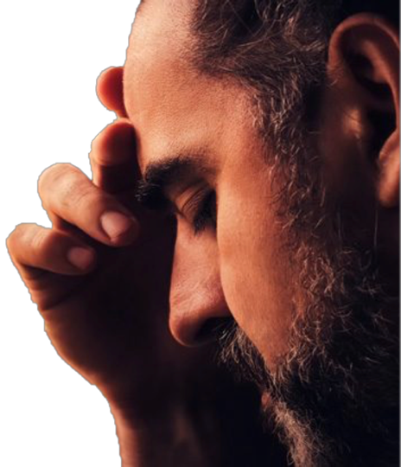
INWARD or Outward
The Inward Man Is The Real Me
One’s …
MIND
THOUGHTS
PURPOSES
ATTITUDE
WILL
SINCERITY
SPIRIT

Slide 5
INWARD or Outward
The Inward Man Is The Real Me
1 Samuel 16:7 (NKJV)
⁷ But the Lord said to Samuel, “Do not look at his appearance or at his physical stature, because I have refused him. For the Lord does not see as man sees; for man looks at the outward appearance, but the Lord looks at the heart.”
One’s …
MIND
THOUGHTS
PURPOSES
ATTITUDE
WILL
SINCERITY
SPIRIT

Slide 6
INWARD or Outward
The Inward Man Is The Real Me
Psalm 51:6 (NKJV)
⁶ Behold, You desire truth in the inward parts, And in the hidden part You will make me to know wisdom.
One’s …
MIND
THOUGHTS
PURPOSES
ATTITUDE
WILL
SINCERITY
SPIRIT

Slide 7
INWARD or Outward
The Inward Man Is The Real Me
Romans 2:29 (NKJV)
²⁹ but he is a Jew who is one inwardly; and circumcision is that of the heart, in the Spirit, not in the letter; whose praise is not from men but from God.
One’s …
MIND
THOUGHTS
PURPOSES
ATTITUDE
WILL
SINCERITY
SPIRIT

Slide 8
INWARD or Outward
The Inward Man Is The Real Me
Romans 7:22 (NKJV)
²² For I delight in the law of God according to the inward man.
One’s …
MIND
THOUGHTS
PURPOSES
ATTITUDE
WILL
SINCERITY
SPIRIT

Slide 9
INWARD or Outward
The Inward Man Is The Real Me
1 Peter 3:3–4 (NKJV)
³ Do not let your adornment be merely outward—arranging the hair, wearing gold, or putting on fine apparel—⁴ rather let it be the hidden person of the heart, with the incorruptible beauty of a gentle and quiet spirit, which is very precious in the sight of God.
One’s …
MIND
THOUGHTS
PURPOSES
ATTITUDE
WILL
SINCERITY
SPIRIT

Slide 10
INWARD or Outward
The Inward Man Is The Real Me
Psalm 62:4 (NKJV)
⁴ They only consult to cast him down from his high position; They delight in lies; They bless with their mouth, But they curse inwardly. Selah
One’s …
MIND
THOUGHTS
PURPOSES
ATTITUDE
WILL
SINCERITY
SPIRIT

Slide 11
INWARD or Outward
The Inward Man Is The Real Me
Matthew 7:15 (NKJV)
¹⁵ “Beware of false prophets, who come to you in sheep’s clothing, but inwardly they are ravenous wolves.
One’s …
MIND
THOUGHTS
PURPOSES
ATTITUDE
WILL
SINCERITY
SPIRIT

Slide 12
INWARD or Outward
The Inward Man Is The Real Me
Luke 11:39 (NKJV)
³⁹ Then the Lord said to him, “Now you Pharisees make the outside of the cup and dish clean, but your inward part is full of greed and wickedness.
One’s …
MIND
THOUGHTS
PURPOSES
ATTITUDE
WILL
SINCERITY
SPIRIT

Slide 13
INWARD or Outward
Spiritual = eternal / Material = temporal
2 Corinthians 4:16 (NKJV)
¹⁶ Therefore we do not lose heart. Even though our outward man is perishing, yet the inward man is being renewed day by day.
Our spirits are heading for eternity / Our flesh is heading towards the dust

Slide 14
INWARD or Outward
Spiritual = eternal / Material = temporal
Galatians 6:7–8 (NKJV)
⁷ Do not be deceived, God is not mocked; for whatever a man sows, that he will also reap. ⁸ For he who sows to his flesh will of the flesh reap corruption, but he who sows to the Spirit will of the Spirit reap everlasting life.
Our spirits are heading for eternity / Our flesh is heading towards the dust

Slide 15
INWARD or Outward
Spiritual = eternal / Material = temporal
1 John 2:15–17 (NKJV)
¹⁵ Do not love the world or the things in the world. If anyone loves the world, the love of the Father is not in him. ¹⁶ For all that is in the world—the lust of the flesh, the lust of the eyes, and the pride of life—is not of the Father but is of the world. ¹⁷ And the world is passing away, and the lust of it; but he who does the will of God abides forever.
1 John 2:15–17 (NKJV)
¹⁵ Do not love the world or the things in the world. If anyone loves the world, the love of the Father is not in him. ¹⁶ For all that is in the world—the lust of the flesh, the lust of the eyes, and the pride of life—is not of the Father but is of the world. ¹⁷ And the world is passing away, and the lust of it; but he who does the will of God abides forever.

Slide 16
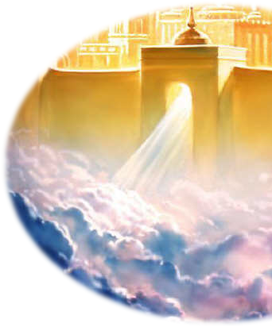
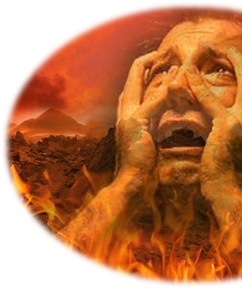
INWARD or Outward
Spiritual = eternal / Material = temporal
Hades: Temp. Abode of Departed Spirits
Mat 7:13,14
Paradise
Jesus & Thief
Lazarus -
Luke 16:19-31
J
u
d
g
m
e
n
t
Heaven
Mat 25:46
Soul of the righteous
Soul of the unrighteous
2 Cor 5:10
Rich man
Eccl. 12:7
Hell
Mat 25:41
Torment
Resurrection
John 5:28,29
Body to the grave

Slide 17
INWARD or Outward
WHERE ARE OUR PRIORITIES & VALUES?
Are the things you value most:
Material & Temporary?
OR
Spiritual & eternal?

Slide 18
Matthew 6:19–24 (NKJV)
¹⁹ “Do not lay up for yourselves treasures on earth, where moth and rust destroy and where thieves break in and steal; ²⁰ but lay up for yourselves treasures in heaven, where neither moth nor rust destroys and where thieves do not break in and steal. ²¹ For where your treasure is, there your heart will be also. ²² “The lamp of the body is the eye. If therefore your eye is good, your whole body will be full of light. ²³ But if your eye is bad, your whole body will be full of darkness. If therefore the light that is in you is darkness, how great is that darkness! ²⁴ “No one can serve two masters; for either he will hate the one and love the other, or else he will be loyal to the one and despise the other. You cannot serve God and mammon.

Slide 19
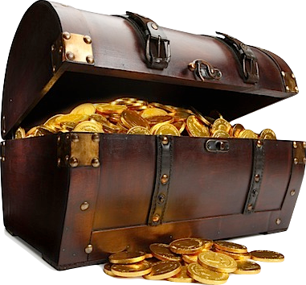
INWARD or Outward
WHERE ARE OUR PRIORITIES & VALUES?
Our treasure is that which we value most - seek the most - desire the most.
Lying before each of us is the choice between earth & heaven - physical & spiritual - flesh & spirit - temporal & eternal.
We will & must choose one or the other!

Slide 20
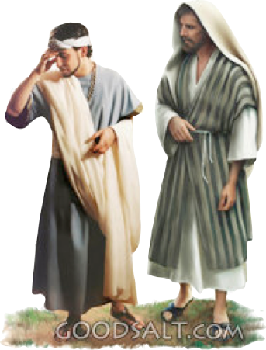
INWARD or Outward
WHERE ARE OUR PRIORITIES & VALUES?
The rich young ruler — Matthew 19:21-22
The certain rich man whom God called a fool — Luke 12:16-21
Demas, who forsook Paul, (and the Lord) for the world — 2 Timothy 4:10
Hypocritical Jewish leaders who loved the praises of men — Matthew 6:1-18; 23

Slide 21
INWARD or Outward
WHERE ARE OUR PRIORITIES & VALUES?
Ecclesiastes 5:15–16 (NKJV)
¹⁵ As he came from his mother’s womb, naked shall he return, To go as he came; And he shall take nothing from his labor Which he may carry away in his hand. ¹⁶ And this also is a severe evil— Just exactly as he came, so shall he go. And what profit has he who has labored for the wind?

Slide 22
INWARD or Outward
WHERE ARE OUR PRIORITIES & VALUES?
1 Timothy 6:6–8 (NKJV)
⁶ Now godliness with contentment is great gain. ⁷ For we brought nothing into this world, and it is certain we can carry nothing out. ⁸ And having food and clothing, with these we shall be content.

Slide 23
INWARD or Outward
WHERE ARE OUR PRIORITIES & VALUES?
Colossians 3:1–4 (NKJV)
¹ If then you were raised with Christ, seek those things which are above, where Christ is, sitting at the right hand of God. ² Set your mind on things above, not on things on the earth. ³ For you died, and your life is hidden with Christ in God. ⁴ When Christ who is our life appears, then you also will appear with Him in glory.

Slide 24
"There is a battle of two wolves inside us all.
One is evil. It is anger, jealousy, greed, resentment, lies, inferiority and ego.
The other is good. It is joy, peace, love, hope, humility, kindness, empathy and truth.
Which wolf wins? The one you feed."
Cherokee proverb

Slide 25
INWARD or Outward
Revealed In Our Actions & Efforts
Things which nourish us spiritually & produces spiritual growth
We must learn to cherish the things of heaven, things that have to do with our spiritual relationships & responsibilities. (Mark 12:29,30; Mat 6:33)
If we TRULY treasure spiritual things - our affections, concerns, efforts and time will be devoted to spiritual things!
WHERE IS YOUR HEART???

Slide 26
INWARD or Outward
Revealed In Our Actions & Efforts
Things which nourish us spiritually & produces spiritual growth
Proverbs 4:20–23 (NKJV)
²⁰ My son, give attention to my words; Incline your ear to my sayings. ²¹ Do not let them depart from your eyes; Keep them in the midst of your heart; ²² For they are life to those who find them, And health to all their flesh. ²³ Keep your heart with all diligence, For out of it spring the issues of life.

Slide 27
INWARD or Outward
Revealed In Our Actions & Efforts
Things which nourish us spiritually & produces spiritual growth
Bible reading & study,
Attending worship services and wholeheartedly participating,
Prayer - (praise & thanksgiving)
Serving - laboring in the kingdom
Associating with spiritually minded people.

Slide 28
INWARD or Outward
Revealed In Our Actions & Efforts
Things which nourish us spiritually & produces spiritual growth
Our primary intake must supplement our greatest need – i.e., a right relationship with God! — Deut 8:3; 2 Tim 2:15
Our time, energy, and effort should be Focused upon establishing, strengthening and solidifying this relationship! — 2 Pet 1:5-11

Slide 29
INWARD or Outward
Revealed In Our Actions & Efforts
Things which nourish us spiritually & produces spiritual growth
Romans 12:1–2 (NKJV)
¹ I beseech you therefore, brethren, by the mercies of God, that you present your bodies a living sacrifice, holy, acceptable to God, which is your reasonable service. ² And do not be conformed to this world, but be transformed by the renewing of your mind, that you may prove what is that good and acceptable and perfect will of God.

Slide 30
Ephesians 3:14–19 (NKJV)
¹⁴ For this reason I bow my knees to the Father of our Lord Jesus Christ, ¹⁵ from whom the whole family in heaven and earth is named, ¹⁶ that He would grant you, according to the riches of His glory, to be strengthened with might through His Spirit in the inner man, ¹⁷ that Christ may dwell in your hearts through faith; that you, being rooted and grounded in love, ¹⁸ may be able to comprehend with all the saints what is the width and length and depth and height—¹⁹ to know the love of Christ which passes knowledge; that you may be filled with all the fullness of God.
in the inner man

Slide 31
INWARD or Outward
Revealed In Our Actions & Efforts
2 Corinthians 4:16 (NKJV)
¹⁶ Therefore we do not lose heart. Even though our outward man is perishing, yet the inward man is being renewed day by day.

Slide 32
INWARD or Outward
Revealed In Our Actions & Efforts
The Inward Man Is The Real Me!
The Real Me Will exist forever!
What Will Be My Eternal Condition?
Matthew 16:24–26 (NKJV)
²⁴ Then Jesus said to His disciples, “If anyone desires to come after Me, let him deny himself, and take up his cross, and follow Me. ²⁵ For whoever desires to save his life will lose it, but whoever loses his life for My sake will find it. ²⁶ For what profit is it to a man if he gains the whole world, and loses his own soul? Or what will a man give in exchange for his soul?

Slide 33
INWARD or Outward
The Inward Man Is The Real Me!
The Real Me Will exist forever!
What Will Be My Eternal Condition?
Hear - The word of God - Luke 8:11; Rom 10:17
Believe in Christ — Jn 8:24
Repent — Luke 13:3,5
Confess Jesus — Rom 10:9,10
Be baptized in the name of Jesus Christ for the remission of sins — Mk 16:16; Acts 2:38
Continue following Jesus — becoming conformed to His image — 2 Col. 3:18

Slide 34
INWARD or Outward
The Inward Man Is The Real Me!
The Real Me Will exist forever!
What Will Be My Eternal Condition?
One day this life on earth will end
You will either regret for eternity your priorities in this life or you will be eternally happy that you put God first
If your life ended today - which would it be for you?

Slide 36
The Inward Man Is The Real Me!
The Real Me Will exist forever!
What Will Be My Eternal Condition?
“Even though our outward man is perishing, yet the inward man is being renewed day by day.” — 2 Corinthians 4:16 (NKJV)

Slide 37
Psalm 51:10–19 (NKJV)
¹⁰ Create in me a clean heart, O God, And renew a steadfast spirit within me. ¹¹ Do not cast me away from Your presence, And do not take Your Holy Spirit from me. ¹² Restore to me the joy of Your salvation, And uphold me by Your generous Spirit. ¹³ Then I will teach transgressors Your ways, And sinners shall be converted to You. ¹⁴ Deliver me from the guilt of bloodshed, O God, The God of my salvation, And my tongue shall sing aloud of Your righteousness.

Slide 38
Psalm 51:10–19 (NKJV)
¹⁵ O Lord, open my lips, And my mouth shall show forth Your praise. ¹⁶ For You do not desire sacrifice, or else I would give it; You do not delight in burnt offering. ¹⁷ The sacrifices of God are a broken spirit, A broken and a contrite heart— These, O God, You will not despise. ¹⁸ Do good in Your good pleasure to Zion; Build the walls of Jerusalem. ¹⁹ Then You shall be pleased with the sacrifices of righteousness, With burnt offering and whole burnt offering; Then they shall offer bulls on Your altar.

