Slide 1
Jesus Can Give You Rest
Matthew 11:28–30 (NKJV)
²⁸ Come to Me, all you who labor and are heavy laden, and I will give you rest. ²⁹ Take My yoke upon you and learn from Me, for I am gentle and lowly in heart, and you will find rest for your souls. ³⁰ For My yoke is easy and My burden is light.”

Slide 2
Psalm 107:1-32 (NKJV)
¹ Oh, give thanks to the Lord, for He is good! For His mercy endures forever. ² Let the redeemed of the Lord say so, Whom He has redeemed from the hand of the enemy, ³ And gathered out of the lands, From the east and from the west, From the north and from the south. ⁴ They wandered in the wilderness in a desolate way; They found no city to dwell in. ⁵ Hungry and thirsty, Their soul fainted in them. ⁶ Then they cried out to the Lord in their trouble, And He delivered them out of their distresses.

Slide 3
Psalm 107:1-32 (NKJV)
⁷ And He led them forth by the right way, That they might go to a city for a dwelling place. ⁸ Oh, that men would give thanks to the Lord for His goodness, And for His wonderful works to the children of men! ⁹ For He satisfies the longing soul, And fills the hungry soul with goodness. ¹⁰ Those who sat in darkness and in the shadow of death, Bound in affliction and irons—

Slide 4
Psalm 107:1-32 (NKJV)
¹¹ Because they rebelled against the words of God, And despised the counsel of the Most High, ¹² Therefore He brought down their heart with labor; They fell down, and there was none to help. ¹³ Then they cried out to the Lord in their trouble, And He saved them out of their distresses. ¹⁴ He brought them out of darkness and the shadow of death, And broke their chains in pieces.

Slide 5
Psalm 107:1-32 (NKJV)
¹⁵ Oh, that men would give thanks to the Lord for His goodness, And for His wonderful works to the children of men! ¹⁶ For He has broken the gates of bronze, And cut the bars of iron in two. ¹⁷ Fools, because of their transgression, And because of their iniquities, were afflicted. ¹⁸ Their soul abhorred all manner of food, And they drew near to the gates of death. ¹⁹ Then they cried out to the Lord in their trouble, And He saved them out of their distresses. ²⁰ He sent His word and healed them, And delivered them from their destructions.

Slide 6
Psalm 107:1-32 (NKJV)
²¹ Oh, that men would give thanks to the Lord for His goodness, And for His wonderful works to the children of men! ²² Let them sacrifice the sacrifices of thanksgiving, And declare His works with rejoicing. ²³ Those who go down to the sea in ships, Who do business on great waters, ²⁴ They see the works of the Lord, And His wonders in the deep. ²⁵ For He commands and raises the stormy wind, Which lifts up the waves of the sea. ²⁶ They mount up to the heavens, They go down again to the depths; Their soul melts because of trouble. ²⁷ They reel to and fro, and stagger like a drunken man, And are at their wits’ end. ²⁸ Then they cry out to the Lord in their trouble, And He brings them out of their distresses. ²⁹ He calms the storm, So that its waves are still. ³⁰ Then they are glad because they are quiet; So He guides them to their desired haven.

Slide 7
Psalm 107:1-32 (NKJV)
³¹ Oh, that men would give thanks to the Lord for His goodness, And for His wonderful works to the children of men! ³² Let them exalt Him also in the assembly of the people, And praise Him in the company of the elders.

Slide 8
Jesus Can Give You Rest
Proverbs 4:19 (NKJV)
¹⁹ The way of the wicked is like darkness; They do not know what makes them stumble.

Slide 9
Jesus Can Give You Rest
Proverbs 13:15 (NKJV)
¹⁵ Good understanding gains favor, But the way of the unfaithful is hard.

Slide 10
Jesus Can Give You Rest
Proverbs 13:18 (NKJV)
¹⁸ Poverty and shame will come to him who disdains correction, But he who regards a rebuke will be honored.

Slide 11
Jesus Can Give You Rest
Romans 6:21 (NKJV)
²¹ What fruit did you have then in the things of which you are now ashamed? For the end of those things is death.

Slide 12
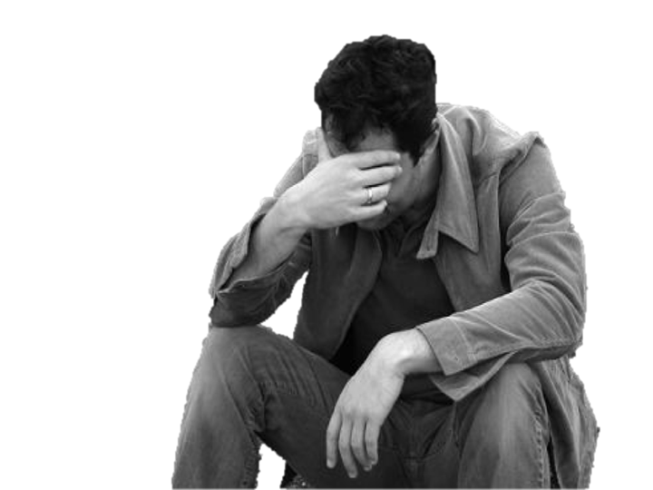
Jesus Can Give You Rest
Destroys One’s Life (Loss of health, income, well-being, etc.)
Destroys Relationships (Family, friendships, support, etc.)
Destroys Communities
Destroys Future / Posterity
Destroys One’s Own Soul
Destroys Other Souls (Family, friends, victims, etc.)

Slide 13
Jesus Can Give You Rest
Guilt
Fear
Loneliness
Depression
Enemies
Hardship
H
E
L
L

Slide 14
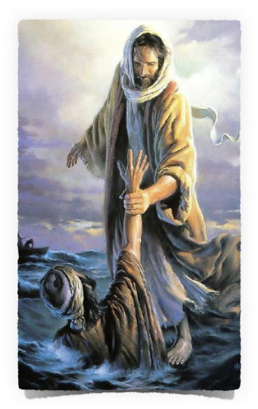
Jesus Can Give You Rest
Guilt
Fear
Loneliness
Depression
Enemies
Hardship
Peace
Faith
Love
Hope
Family
Joy
REST
²⁸ Come to Me, all you who labor and are heavy laden, and I will give you rest.

Slide 15
Jesus Can Give You Rest
Man’s ability to come – Josh. 24:15; Deut. 30:19; Jn 7:17; Acts 17:26,27; Rom. 6:16-18
Sin & Its Consequences - a heady burden – Prov. 13:15; Isa. 59:1,2; Rom. 3:23; 6:23; Luke 15:11-32; Rom. 3:23; 6:23; Eph. 2:1,2
Our greatest need – Jn 8:24, 32; Luke 13:3,5; Rom. 3:23-26; 6:23; 7:24,25; 2 Cor. 5:20; Rev. 21:7,8
²⁸ Come to Me, all you who labor and are heavy laden, and I will give you rest.

Slide 16
Jesus Can Give You Rest
Must learn the truth – Isa. 55:1-7; John 5:24-6:69; 7:37,38; 8:21-36; 14:1-6; Acts 17:11
Must submit to our loving Lord – John 5:22,23; Mt 28:18-20; Luke 6:46-49; Acts 2:36-42; Heb. 5:8,9; 2 Pet. 1:5-10
Will find rest for your SOUL – Mat. 6:19-34; Rom. 8:23-39; 1 Cor. 15:19; Eph. 1:3-13; 1 Pet. 1:3-9
²⁹ Take My yoke upon you and learn from Me, for I am gentle and lowly in heart, and you will find rest for your souls.

Slide 17
Jesus Can Give You Rest
Hebrews 4:1–13 (NKJV)
¹ Therefore, since a promise remains of entering His rest, let us fear lest any of you seem to have come short of it. ² For indeed the gospel was preached to us as well as to them; but the word which they heard did not profit them, not being mixed with faith in those who heard it. ³ For we who have believed do enter that rest, as He has said: “So I swore in My wrath, ‘They shall not enter My rest,’ ” although the works were finished from the foundation of the world.
²⁹ Take My yoke upon you and learn from Me, for I am gentle and lowly in heart, and you will find rest for your souls.

Slide 18
Jesus Can Give You Rest
Hebrews 4:1–13 (NKJV)
⁴ For He has spoken in a certain place of the seventh day in this way: “And God rested on the seventh day from all His works”; ⁵ and again in this place: “They shall not enter My rest.” ⁶ Since therefore it remains that some must enter it, and those to whom it was first preached did not enter because of disobedience, ⁷ again He designates a certain day, saying in David, “Today,” after such a long time, as it has been said: “Today, if you will hear His voice, Do not harden your hearts.”
²⁹ Take My yoke upon you and learn from Me, for I am gentle and lowly in heart, and you will find rest for your souls.

Slide 19
Jesus Can Give You Rest
Hebrews 4:1–13 (NKJV)
⁸ For if Joshua had given them rest, then He would not afterward have spoken of another day. ⁹ There remains therefore a rest for the people of God. ¹⁰ For he who has entered His rest has himself also ceased from his works as God did from His. ¹¹ Let us therefore be diligent to enter that rest, lest anyone fall according to the same example of disobedience.
²⁹ Take My yoke upon you and learn from Me, for I am gentle and lowly in heart, and you will find rest for your souls.

Slide 20
Jesus Can Give You Rest
Hebrews 4:1–13 (NKJV)
¹² For the word of God is living and powerful, and sharper than any two-edged sword, piercing even to the division of soul and spirit, and of joints and marrow, and is a discerner of the thoughts and intents of the heart. ¹³ And there is no creature hidden from His sight, but all things are naked and open to the eyes of Him to whom we must give account.
²⁹ Take My yoke upon you and learn from Me, for I am gentle and lowly in heart, and you will find rest for your souls.

Slide 21
Jesus Can Give You Rest
A Rest Remains – Hebrews 4:1; Titus 1:2; 1 Peter 1:1-4; Romans 2:4-11; 1 Corinthians 15:20-58; etc.
Entering is conditioned upon obedient Faith – Hebrews 4:11; 6:11; Mat. 7:13,14; Luke 13:24; John 8:24; Acts 2:38; John 6:27; Phili 2:12; 2 Pet 1:5-11; etc.
Do not harden your heart – Hebrews 4:7; 3:8,15; Psalms 95:7-8; Matthew 13:15; Romans 2:4-11
²⁹ Take My yoke upon you and learn from Me, for I am gentle and lowly in heart, and you will find rest for your souls.

Slide 22
Jesus Can Give You Rest
Romans 2:4–11 (NKJV)
⁴ Or do you despise the riches of His goodness, forbearance, and longsuffering, not knowing that the goodness of God leads you to repentance? ⁵ But in accordance with your hardness and your impenitent heart you are treasuring up for yourself wrath in the day of wrath and revelation of the righteous judgment of God,
²⁹ Take My yoke upon you and learn from Me, for I am gentle and lowly in heart, and you will find rest for your souls.

Slide 23
Jesus Can Give You Rest
Romans 2:4–11 (NKJV)
⁶ who “will render to each one according to his deeds”: ⁷ eternal life to those who by patient continuance in doing good seek for glory, honor, and immortality; ⁸ but to those who are self-seeking and do not obey the truth, but obey unrighteousness—indignation and wrath, ⁹ tribulation and anguish, on every soul of man who does evil, of the Jew first and also of the Greek;
²⁹ Take My yoke upon you and learn from Me, for I am gentle and lowly in heart, and you will find rest for your souls.

Slide 24
Jesus Can Give You Rest
Romans 2:4–11 (NKJV)
¹⁰ but glory, honor, and peace to everyone who works what is good, to the Jew first and also to the Greek. ¹¹ For there is no partiality with God.
²⁹ Take My yoke upon you and learn from Me, for I am gentle and lowly in heart, and you will find rest for your souls.

Slide 25
Jesus Can Give You Rest
Removal of sin leaves an easy yoke – John 13:17; 14:21-24; 15:10-14; 1 John 5:1-4
And a light burden – (The Lord’s way is TRULY the BEST way to live) - 2 Cor. 10:5; Rom. 5:1-4; Phili 4:6-13
³⁰ For My yoke is easy and My burden is light.”

Slide 26
Jesus Can Give You Rest
Peace in place of anxiety - John 14:27; Phili 4:7
Joy in place of sorrow - John 15:11; 1 Pet 1:8
Love in place of fear - 1 John 4:18; Eph 3:19
Hope in place of doubt - John 11:25; 14:1-6; Heb 11:13; Jam. 2:1-6; Rev 14:13
³⁰ For My yoke is easy and My burden is light.”

Slide 27
Jesus Can Give You Rest
Today, If You Will Hear His Voice – Hebrews 4:7; 2 Cor. 6:2
Jesus can heal your brokenness, your pain, your grief, your hopelessness and give you peace & life now and forever
We MUST learn of Him - What He has done for us, what He demands of us, and what He will do for us - John 14:6
We MUST follow Him - Luke 9:23-26; Hebrews 5:8,9; Romans 6:1-23
²⁸ Come to Me, all you who labor and are heavy laden, and I will give you rest.

Slide 28
Jesus Can Give You Rest
Today, If You Will Hear His Voice – Hebrews 4:7; 2 Cor. 6:2
Grace does not exclude conditions, healthy fear, or faithfulness - Ti. 2:11,12
It is possible to fall from grace - i.e. “fail to reach” His rest - Heb. 4:11; Gal. 5:1-4
We must give an account to Him Who sees all - Heb. 4:13; 2 Cor. 5:10
As the promise remains, so does God’s threat
²⁸ Come to Me, all you who labor and are heavy laden, and I will give you rest.

Slide 29
Jesus Can Give You Rest
Matthew 11:28–30 (NKJV)
²⁸ Come to Me, all you who labor and are heavy laden, and I will give you rest. ²⁹ Take My yoke upon you and learn from Me, for I am gentle and lowly in heart, and you will find rest for your souls. ³⁰ For My yoke is easy and My burden is light.”
The ONLY Question is
Will You Accept It?

Slide 31
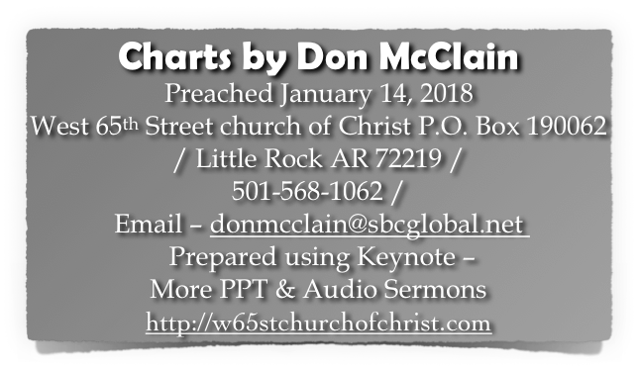
Jesus Can Give You Rest
Matthew 11:28–30 (NKJV)
²⁸ Come to Me, all you who labor and are heavy laden, and I will give you rest. ²⁹ Take My yoke upon you and learn from Me, for I am gentle and lowly in heart, and you will find rest for your souls. ³⁰ For My yoke is easy and My burden is light.”

Slide 32
Isaiah 61:1–3 (NKJV)
¹ “The Spirit of the Lord God is upon Me, Because the Lord has anointed Me To preach good tidings to the poor; He has sent Me to heal the brokenhearted, To proclaim liberty to the captives, And the opening of the prison to those who are bound; ² To proclaim the acceptable year of the Lord, And the day of vengeance of our God; To comfort all who mourn, ³ To console those who mourn in Zion, To give them beauty for ashes, The oil of joy for mourning, The garment of praise for the spirit of heaviness; That they may be called trees of righteousness, The planting of the Lord, that He may be glorified.”

