Slide 1
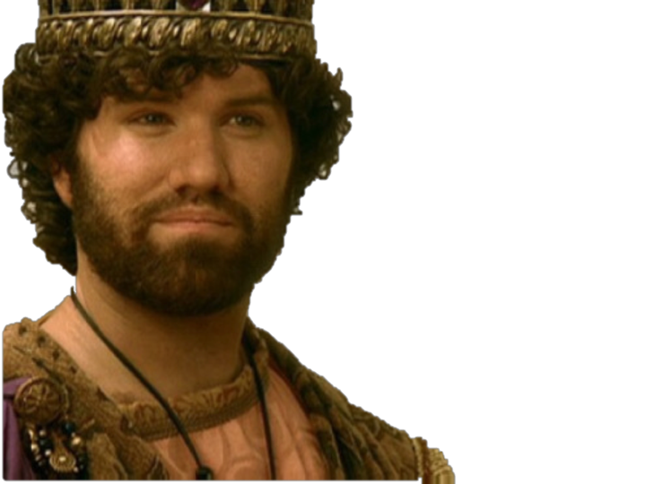
King Josiah
640-609 B.C.
What Walking In The Ways of God Looks Like
2 Chronicles 34:2 (NKJV)
² And he did what was right in the sight of the Lord, and walked in the ways of his father David; he did not turn aside to the right hand or to the left.
2 Chronicles 34:1-35:19
2 Kings 21:24-23:30

Slide 2
King Josiah What Walking In The Ways of God Looks Like

Slide 3
King Josiah What Walking In The Ways of God Looks Like
Hosea 4:6 (NKJV)
⁶ My people are destroyed for lack of knowledge.
Because you have rejected knowledge,
I also will reject you from being priest for Me;
Because you have forgotten the law of your God,
I also will forget your children.

Slide 4
King Josiah What Walking In The Ways of God Looks Like
Ezekiel 23:35 (NKJV)
³⁵ “Therefore thus says the Lord God: ‘Because you have forgotten Me and cast Me behind your back, Therefore you shall bear the penalty Of your lewdness and your harlotry.’ ”
640-609 B.C.

Slide 5
King Josiah What Walking In The Ways of God Looks Like
Ahaz (734 – 715 B.C. very wicked)
Hezekiah (715 – 686 B.C. A very good king, instituted many religious reforms)
Manasseh (696 – 642 B.C. very wicked, practiced human sacrifice)
Amon (642 – 640 B.C. Continued the evil ways of Manasseh)
Josiah (640 – 609 B.C. Served God with a loyal heart / restored the the Law in Judah)
640-609 B.C.

Slide 6
King Josiah What Walking In The Ways of God Looks Like
(630) Nahum’s prophecy against Nineveh
(627) Jeremiah begins his work and prophecies
(626) Nabopolassar becomes the first king of the Babylonian empire
(612) Fall of Nineveh by the union of Babylon & Media
(609) Death of Josiah by Pharaoh-Necho
(605) Battle of Carchemish [Control of Babylon over Egypt & Assyria]
Important world events that would impact Judah

Slide 7
King Josiah What Walking In The Ways of God Looks Like
Grandfather Manasseh, & his father Amon, BOTH wicked kings
Became king at 8 yrs. old.
At age 16, he began to seek the Lord (2Chron 34:3)
From age 20 - 26 destroyed idols (2Chron 34:3-8)
At age 26, ordered Temple repaired (2Kgs 22:3-7)
640-609 B.C.

Slide 8
King Josiah What Walking In The Ways of God Looks Like
Book of the Law found & read — (2 Kgs 22:8-11)
The LORD consulted — (2 Kgs 22:12-20)
Law read publicly & applied to people — (2 Kgs 23:1-23)
At age 39, killed in battle — (2 Kings 23:29-30; 2 Chron 35:20-27)
640-609 B.C.

Slide 9
King Josiah What Walking In The Ways of God Looks Like
2 Kings 22:1–2 (NKJV)
¹ Josiah was eight years old when he became king, and he reigned thirty-one years in Jerusalem. His mother’s name was Jedidah the daughter of Adaiah of Bozkath. ² And he did what was right in the sight of the Lord, and walked in all the ways of his father David; he did not turn aside to the right hand or to the left.
2 Chronicles 34,1.2
640-609 B.C.

Slide 10
King Josiah What Walking In The Ways of God Looks Like
2 Kings 23:25 (NKJV)
²⁵ Now before him there was no king like him, who turned to the Lord with all his heart, with all his soul, and with all his might, according to all the Law of Moses; nor after him did any arise like him.
640-609 B.C.

Slide 11
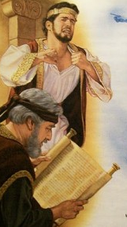
King Josiah What Walking In The Ways of God Looks Like
FIRST: At age 16, Josiah began to seek the Lord. —(2 Chronicles 34:3a)
For in the eighth year of his reign, while he was still young, he began to seek the God of his father David;

Slide 12
King Josiah What Walking In The Ways of God Looks Like
FIRST: At age 16, Josiah began to seek the Lord. —(2 Chronicles 34:3a)
He apparently was blessed with God-fearing advisors who resisted the idolatrous influence of his father (2 Chronicles 34:3a).
Apparently they taught him of David and how God blesses those who are faithful and earnest in their allegiance to God and His service.

Slide 13
King Josiah What Walking In The Ways of God Looks Like
SECOND: At age 20, Josiah began to cleanse Jerusalem. (2 Chron 34:3b)
in the twelfth year he began to purge Judah and Jerusalem of the high places, the wooden images, the carved images, and the molded images

Slide 14
King Josiah What Walking In The Ways of God Looks Like
SECOND: At age 20, Josiah began to cleanse Jerusalem. (2 Chron 34:3b)
Reforms even more extensive than Hezekiah’s (cf. 2 Ki 18:4; 2 Chron 29:3-36).
Destroyed the altars of the Baals, the wooden, carved and molded images as far north as the cities of Naphtali -- nominally controlled by Assyria (2 Chron 34:3b-7).

Slide 15
King Josiah What Walking In The Ways of God Looks Like
SECOND: At age 20, Josiah began to cleanse Jerusalem. (2 Chron 34:3b)
Purged the Mount of Olives which had been a “mt of corruption” since Solomon — (2 Ki 23:13-14).
Uncovered the altar of wicked Jeroboam as well as the tomb of the prophet who had warned him; fulfills prophecy of 1 Kings 13:1-5 (332 yrs later - 2 Kings 23:15-18).

Slide 16
King Josiah What Walking In The Ways of God Looks Like
THIRD: At age 26, Josiah orders the temple repairs: 2 Chron 34:8
2 Chronicles 34:8 (NKJV)
⁸ In the eighteenth year of his reign, when he had purged the land and the temple, he sent Shaphan the son of Azaliah, Maaseiah the governor of the city, and Joah the son of Joahaz the recorder, to repair the house of the Lord his God.

Slide 17
King Josiah What Walking In The Ways of God Looks Like
THIRD: At age 26, Josiah orders the temple repairs: 2 Chron 34:8
A copy of the book of the law was discovered (2 Chronicles 34:14-15).
When read to Josiah, he tore his clothes - horrified at how far Judah had departed from God. (2 Kings 22:12-20; 2 Chro. 34:20-28).
Provided basis for complete restoration of God’s will in Judah — (2 Kings 23:4-20).

Slide 18
King Josiah What Walking In The Ways of God Looks Like
THIRD: At age 26, Josiah orders the temple repairs: 2 Chron 34:8
Calls the people to pledge to follow God’s word (2 Kings 23:1-3).
Kept the Passover to its fullest extent since the days of the judges – (2 Kings 23:21-25; 2 Chron. 35:1-19)

Slide 19
King Josiah What Walking In The Ways of God Looks Like
All pagan vessels found in the temple were burned & ashes carried to Bethel (2 Ki 23:4)
Removed the pagan priests that had been appointed by Manasseh & Amon (2 Ki 23:5)
Removed the image (idol of Asherah) from the temple, burned it and spread the ashes on graves of the people (2 Ki 23:6)
Houses of the sodomites (homosexual priests) were torn down (2 Ki 23:7)
Defiled the “high places” where the Lord was worshiped illegitimately [w/out authority] (2 Ki 23:8-9)

Slide 20
King Josiah What Walking In The Ways of God Looks Like
Defiled Topheth, (valley of Hinnom) where children were sacrificed to Molech (2 Ki 23:10)
Destroyed a monument of horses & chariots that had been dedicated to the sun (god) (2 Ki 23:11)
Broke down & ground to dust certain unauthorized altars - cast the dust into the brook Kidron (2 Ki 23:12)
Destroyed the pagan shrines honoring the gods of the Zidonians, Moabites & Ammonites that had been built by Solomon (2 Ki 23:13-14)

Slide 21
King Josiah What Walking In The Ways of God Looks Like
He removed the altar that Jeroboam had built at Bethel, destroying the high place and the idol (2 Ki 23:15)
Burned the bones of those who had practiced idolatry [fulfilling the prophecy of 1 Ki 13:2] (2 Ki 23:16)
Destroyed the shrines and high places in Israel [Samaria] and killed the priests and burned their remains on the altars they had erected (2 Ki 23:19-20)
Removed those who practiced witchcraft (2 Ki 23:24)

Slide 22
King Josiah What Walking In The Ways of God Looks Like
In 609 B.C., Josiah attempted to block Pharaoh Necho II of Egypt as he marched north to assist Assyria in her fight with Babylon. — (2 Chron 35:20-24; 2 Kin 23:28-30)
Necho wanted Assyria as a buffer state between Egypt and Babylon.
Josiah engaged him at Megiddo.
The archers shot Josiah & seriously wounded him dying later in Jerusalem.
Great lamentation followed his death (2 Chron 35:20-27; Jer 22:10-12; Lam. 4:20).

Slide 23
King Josiah What Walking In The Ways of God Looks Like
Josiah was faithful in an evil environment.
His righteousness did not come from the influence of his family - His grandfather Manasseh (2 Kings 21:1-9, 16); nor his father Amon (2 Kings 21:19-22).
His righteousness did not come from the influence of society. - His people were worse than the nations God destroyed (2 Kings 21:9). - Jerusalem was filled “from one end to another” with blood (2 Kings 21:16). - His people were totally given over to idolatry (2 Kings 21:2-7, 21).

Slide 24
King Josiah What Walking In The Ways of God Looks Like
Josiah Used His position to Glorify God.
He instituted great changes in Israel - He removed idolatry and associated sins -
In the 18th year of his reign, 622 B.C., he began repairs on the house of the Lord in Jerusalem (2 Kings 22:3-7). — Nearly two and a half centuries had passed since the former restoration by Joash (2 Kings 12:4-16).
When the Law of God was found - he demanded the people obey it fully — 2 Chronicles 34:29-33

Slide 25
King Josiah What Walking In The Ways of God Looks Like
Josiah Changed as his knowledge of God’s will increased —
The king’s reaction at the reading of the law was one of immediate grief -- the tearing of his robes. The basis of his grief was twofold: Judah’s guilt and her coming judgment.
He tender-heartedly received the will of God and humbled himself (James 1:21; Colossians 1:4-6; 1 Thessalonians 2:13).
Judah was to be punished, but Josiah would be spared (2 Kin 22:18-20).

Slide 26
King Josiah What Walking In The Ways of God Looks Like
We can be faithful regardless of our parents / our environment / or our past — We all have a choice - Ezekiel 18:20ff
We should fully destroy sin in our lives and seek to destroy it in the lives of others — We cannot participate in, approve of, nor facilitate the sins of others — Eph 5:3-14; Rom. 1:32; 2 Cor. 6:14-7:1
We should always seek to grow in the grace and knowledge of the Lord - always bringing ourselves into greater harmony with God’s word as we learn better — Acts 17:11,12; 2 Pet 3:15-18; 2 Cor 13:5; etc.

Slide 27
King Josiah What Walking In The Ways of God Looks Like
Jeremiah & Josiah called Israel back to God’s written revelation, which was several hundred years old!
God’s word is understandable & doable — 2 Chron. 34:19; Eph 3:3-5; 2 Tim 3:16,17; Acts 20:32; Jam 1:21,22
God’s stated, written word is the ONLY standard by which we may determine truth today — Jude 3; 2 Tim. 3:16,17
We also need to seek Bible authority for all we do — Col. 3:17; 1 Cor. 4:6

Slide 28
King Josiah What Walking In The Ways of God Looks Like
How does your life compare to Josiah’s?
Do you desire to seek the Lord?
Are you willing to obey Him completely?
640-609 B.C.

Slide 30
King Josiah
640-609 B.C.
What Walking In The Ways of God Looks Like
2 Chronicles 34:1-35:19
2 Kings 21:24-23:30

