Slide 1
The
The IMPACT of What We
SEE & HEAR

Slide 2
The
Acts 14:1–7 (NKJV)
¹ Now it happened in Iconium that they went together to the synagogue of the Jews, and so spoke that a great multitude both of the Jews and of the Greeks believed. ² But the unbelieving Jews stirred up the Gentiles and poisoned their minds against the brethren. ³ Therefore they stayed there a long time, speaking boldly in the Lord, who was bearing witness to the word of His grace, granting signs and wonders to be done by their hands. ⁴ But the multitude of the city was divided: part sided with the Jews, and part with the apostles. ⁵ And when a violent attempt was made by both the Gentiles and Jews, with their rulers, to abuse and stone them, ⁶ they became aware of it and fled to Lystra and Derbe, cities of Lycaonia, and to the surrounding region. ⁷ And they were preaching the gospel there.

Slide 3
Mercury
Botulinum Toxin (Botox)
Ricin
Batrachotoxin
Tetradotoxin
Amatoxin
Cyanide
Nerve Gas / VX / Sarin
Brodifacoum
Cytotoxins, Neurotoxins, Hemotoxins
Strychnine
Polonium

Slide 4
The Poisoning of Our Minds
The IMPACT of What We SEE & HEAR
How many of us would KNOWINGLY eat something we KNEW was poisonous?

Slide 5
The Poisoning of Our Minds
The IMPACT of What We SEE & HEAR
How many of us would KNOWINGLY pick up a Black Mamba?

Slide 6
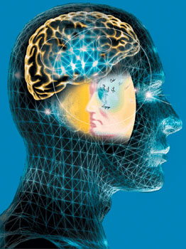
The Poisoning of Our Minds
The IMPACT of What We SEE & HEAR
How many of us would KNOWINGLY accept words, (thoughts, philosophies, doctrines, etc …) or images, (pictures, videos, imaginations, etc. …) if we knew they would destroy us spiritually?

Slide 7
The Poisoning of Our Minds
The IMPACT of What We SEE & HEAR
Temptation: Appealing Poisons
The Source … | Satan
The Means … | The flesh
The Result … | Spiritual death
The Antidote … | Jesus
James 1:13–15 (NKJV)
¹⁴ But each one is tempted when he is drawn away by his own desires and enticed. ¹⁵ Then, when desire has conceived, it gives birth to sin; and sin, when it is full-grown, brings forth death.

Slide 8
The Poisoning of Our Minds
The IMPACT of What We SEE & HEAR
We are what we think - Prov. 23:7
We are responsible for what we think — Prov. 4:1-27; Rom 12:1,2
Words & actions come from the heart / mind - but we determine what enters into our hearts / minds — Gen. 6:5; Mat 15:18,19; Rom 16:17; Eph 6:6 / Prov. 4:1, 4, 5, 6-8, 10, 13, 14-19, 20-23; Heb 2:1; 1 Thes 2:13; 2 Cor. 10:5
Both God & Satan desires the control of our thought life - Prov. 4; Col. 3:1,2; Mat 5:22,23; John 13:2; Acts 5:3; 2 Cor 11:3

Slide 9
The Poisoning of Our Minds
The IMPACT of What We SEE & HEAR
We determine Who & what we allow to occupy & control our mind -
Rom 8:5 “set their minds . . .”
Col. 3:2 - “set your mind on things above”
Phili 3:19 - the end of “those who set their mind on earthly things”
2 Cor. 10:5 - bringing every thought into captivity to the obedience of Christ

Slide 10
The Poisoning of Our Minds
The IMPACT of What We SEE & HEAR
Romans 1:21–28 (NKJV)
²¹ because, although they knew God, they did not glorify Him as God, nor were thankful, but became futile in their thoughts, and their foolish hearts were darkened. ²² Professing to be wise, they became fools, … ²⁴ Therefore God also gave them up to uncleanness, in the lusts of their hearts, to dishonor their bodies among themselves, ²⁵ who exchanged the truth of God for the lie, and worshiped and served the creature rather than the Creator, who is blessed forever. Amen. ²⁶ For this reason God gave them up to vile passions. … ²⁸ And even as they did not like to retain God in their knowledge, God gave them over to a debased mind, to do those things which are not fitting;

Slide 11
The Poisoning of Our Minds
The IMPACT of What We SEE & HEAR
Ephesians 2:1–3 (NKJV)
¹ And you He made alive, who were dead in trespasses and sins, ² in which you once walked according to the course of this world, according to the prince of the power of the air, the spirit who now works in the sons of disobedience, ³ among whom also we all once conducted ourselves in the lusts of our flesh, fulfilling the desires of the flesh and of the mind, and were by nature children of wrath, just as the others.

Slide 12
The Poisoning of Our Minds
The IMPACT of What We SEE & HEAR
Ephesians 4:17–24 (NKJV)
¹⁷ This I say, therefore, and testify in the Lord, that you should no longer walk as the rest of the Gentiles walk, in the futility of their mind, ¹⁸ having their understanding darkened, being alienated from the life of God, because of the ignorance that is in them, because of the blindness of their heart; ¹⁹ who, being past feeling, have given themselves over to lewdness, to work all uncleanness with greediness. ²⁰ But you have not so learned Christ, ²¹ if indeed you have heard Him and have been taught by Him, as the truth is in Jesus: ²² that you put off, concerning your former conduct, the old man which grows corrupt according to the deceitful lusts, ²³ and be renewed in the spirit of your mind, ²⁴ and that you put on the new man which was created according to God, in true righteousness and holiness.

Slide 13
The Poisoning of Our Minds
The IMPACT of What We SEE & HEAR
Romans 12:1–2 (NKJV)
¹ I beseech you therefore, brethren, by the mercies of God, that you present your bodies a living sacrifice, holy, acceptable to God, which is your reasonable service. ² And do not be conformed to this world, but be transformed by the renewing of your mind, that you may prove what is that good and acceptable and perfect will of God.

Slide 14
The Poisoning of Our Minds
The IMPACT of What We SEE & HEAR
The impact of the world:
Movie industry: from Pornography to Disney …
Television: from Sitcoms to Reality TV - even the news media …
Music industry: from Rap to Country …
Internet: from Porn to Facebook - every evil thing imaginable at your fingertips … (CAN ROB US OF OUR TIME)!
WE MUST BE ABLE TO DISCERN
HEALTHY FROM UNHEALTHY!
GOOD FROM BAD!
OUR OWN VULNERABILITY
1 John 2:15-17

Slide 15
The Poisoning of Our Minds
The IMPACT of What We SEE & HEAR
The impact of the world:
Pornography is POISON!
Filthy language is POISON!
Recreational alcohol and drug use are POISON!
Cultural views on marriage & sexuality are POISON!
Hatred is POISON!
Racism is POISON!
Injustice is POISON!
Gossip & slander are POISON!
Resentment is POISON!
WE MUST BE ABLE TO DISCERN
We can become desensitized to the world and to its dangers if we are not EXTREMELY carful and VIGILANT!
2 Peter 2:4-9

Slide 16
The Poisoning of Our Minds
The IMPACT of What We SEE & HEAR
The impact of the world:
Have we allowed worldly TOXINS to negatively affect our MARRIAGE?
Have we allowed worldly TOXINS to negatively affect us as PARENTS??
Have we allowed worldly TOXINS to negatively affect our CHILDREN?
Have we allowed worldly TOXINS to negatively affect our other RELATIONSHIPS?
Anger / Resentment
Bitterness / Unforgiveness
Hatred / Hurting
Division / Enemies
James 3:13-4:4

Slide 17
The Poisoning of Our Minds
The IMPACT of What We SEE & HEAR
Hebrews 12:14–15 (NKJV)
¹⁴ Pursue peace with all people, and holiness, without which no one will see the Lord: ¹⁵ looking carefully lest anyone fall short of the grace of God; lest any root of bitterness springing up cause trouble, and by this many become defiled;
Anger / Resentment
Bitterness / Unforgiveness
Hatred / Hurting
Division / Enemies

Slide 18
The Poisoning of Our Minds
The IMPACT of What We SEE & HEAR
The impact of the world:
These TOXINS ROB US OF:
our joy & peace …
our happiness …
our confidence …
our well being …
our hope …
our life …
Anger / Resentment
Bitterness / Unforgiveness
Hatred / Hurting
Division / Enemies

Slide 19
The Poisoning of Our Minds
The IMPACT of What We SEE & HEAR
The impact of FALSE DOCTRINE:
It doesn’t matter what you believe …
Matthew 7:15
BUT: Prov 14:12; John 8:24; 2 Thes 2:10-12;

Slide 20
The Poisoning of Our Minds
The IMPACT of What We SEE & HEAR
The impact of FALSE DOCTRINE:
It’s about the MAN, NOT the PLAN!!
Matthew 7:15
BUT: Mat. 28:19,20; Luke 6:46; 2 John 9; etc.

Slide 21
The Poisoning of Our Minds
The IMPACT of What We SEE & HEAR
The impact of FALSE DOCTRINE:
We are NOT saved by works - you don’t have to obey Jesus …
Matthew 7:15
BUT: Eph. 2:8-10; Rom 4:1-12; James 2:14-26; Heb 5:7-9; etc

Slide 22
The Poisoning of Our Minds
The IMPACT of What We SEE & HEAR
The impact of FALSE DOCTRINE:
Salvation is by faith ONLY - baptism is NOT necessary …
Matthew 7:15
BUT: Mk 16:16; Ac 2:38; 22:16; Rom. 6:3-6; Col. 2:12,13; 1 Pet 3:21; etc.

Slide 23
The Poisoning of Our Minds
The IMPACT of What We SEE & HEAR
The impact of FALSE DOCTRINE:
OSAS is true because of the finished work of Christ …
Matthew 7:15
BUT: John 15:1-10; Acts 14:22; 1 Cor. 10:1-13; Heb. 3:1-4:6; 2 Pet. 2; etc

Slide 24
The Poisoning of Our Minds
The IMPACT of What We SEE & HEAR
The impact of FALSE DOCTRINE:
One church is as GOOD as another …
Matthew 7:15
BUT: Mat. 16:18; Acts 2:47; Eph 1:22,23; 4:4-6; 5:23-25; etc.

Slide 25
The Poisoning of Our Minds
The IMPACT of What We SEE & HEAR
The impact of FALSE DOCTRINE:
The truth is not believed …
The truth is not obeyed …
The truth is ignored …
The truth is rejected …
The truth is suppressed …
The truth is misrepresented …
The truth is fought against …
The truth is maligned …
The truth is ridiculed / mocked …
The truth is hated …

Slide 26
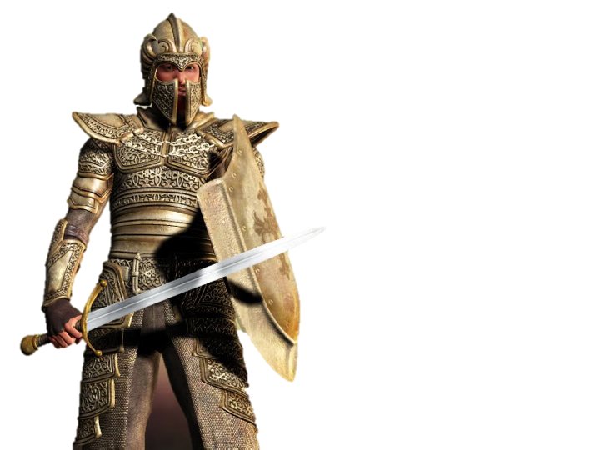
The Poisoning of Our Minds
The IMPACT of What We SEE & HEAR
The Battle For Your Mind
Satan’s goal is to pollute our minds? - 2 Cor. 4:4; Eph. 4:17-20
The world is evil - Jn 7:7; 1 Jn 5:19
We are to be holy – untainted by the world’s influence – 2 Cor. 6:14-7:1; James 1:27; 4:4
We MUST feed our minds with the things of God, IF we are to remain holy and serve God – Phili 4:7-9; 1 Pet. 1:13-16; 2:1-12

Slide 27
The Poisoning of Our Minds
The IMPACT of What We SEE & HEAR
The Battle For Your Mind
The lamp of the body is the eye – Mat. 6:22-23
“Can a man take fire to his bosom, And his clothes not be burned?" - Proverbs 6:27
If your right eye causes you to sin, . . . - Mat. 5:29-30
. . . Make no provision for the flesh, to fulfill its lusts. – Rom. 13:14
Keep your heart with all diligence, for out of it spring the issues of life. Proverbs 4:23

Slide 28
The Poisoning of Our Minds
The IMPACT of What We SEE & HEAR
The Battle For Your Mind
Receive the truth – (John 8:32; 14:6; James 1:21)
Obey the truth – (1 Pet 1:22,23)
Become spiritually minded – “Setting our minds on things above . . .“– (Col 3:1,2; Mat 6:33; Gal 5:22,23; 2 Pet 1:5-10)
Guarding our hearts and minds by thinking on the things of God – (Prov 4:23; Phili 4:6-9)

Slide 29
Don McClain
W. 65th St. church of Christ - 7/14/2005

Slide 30
The
The IMPACT of What We
SEE & HEAR
Charts by Don McClain
Preached May 6, 2018
West 65th Street church of Christ / P.O. Box 190062 / Little Rock AR 72219 / 501-568-1062
Email – donmcclain@sbcglobal.net
More Keynote, PPT & Audio Sermons:
http://w65stchurchofchrist.org/coc/sermons/

Slide 31
2 Corinthians 4:1–6 (NKJV)
¹ Therefore, since we have this ministry, as we have received mercy, we do not lose heart. ² But we have renounced the hidden things of shame, not walking in craftiness nor handling the word of God deceitfully, but by manifestation of the truth commending ourselves to every man’s conscience in the sight of God. ³ But even if our gospel is veiled, it is veiled to those who are perishing,

Slide 32
2 Corinthians 4:1–6 (NKJV)
⁴ whose minds the god of this age has blinded, who do not believe, lest the light of the gospel of the glory of Christ, who is the image of God, should shine on them. ⁵ For we do not preach ourselves, but Christ Jesus the Lord, and ourselves your bondservants for Jesus’ sake. ⁶ For it is the God who commanded light to shine out of darkness, who has shone in our hearts to give the light of the knowledge of the glory of God in the face of Jesus Christ.

Slide 33
The Poisoning of Our Minds
The IMPACT of What We SEE & HEAR
In Buddhist teachings, the three poisons (of ignorance, attachment, and aversion) are the primary causes that keep sentient beings trapped in samsara. These three poisons are said to be the root of all of the other mental states that cloud the mind and manifest in unwholesome actions. Kleshas include states of mind such as anxiety, fear, anger, jealousy, desire, depression, etc.
Poison | Sanskrit | Pali | Tibetan | Alternate English translations
Delusion | moha | moha | gti mug | confusion, ignorance
Attachment | rāga | lobha | 'dod chags | desire, sensuality, greed
Aversion | dveṣa | dosa | zhe sdang | hatred

