Slide 1
A Biblical Examination of
AKA: Calvinism
otal Inability
nconditional Election
imited Atonement
rresistible Grace
erseverance of The Saints

Slide 2
A Biblical Examination of
AKA: Calvinism
The namesake of the movement, French reformer John Calvin, converted to the Reformed tradition from Roman Catholicism only in the late 1520s or early 1530s as it was already being developed.

Slide 3
A Biblical Examination of
AKA: Calvinism
The movement was first called Calvinism, referring to John Calvin, by Lutherans who opposed it.
Many within the tradition would prefer the word Reformed be used instead.

Slide 4
A Biblical Examination of:
Calvinism’s influence permeates almost all mainstream protestant denominations.
Presbyterian Churches
Primitive Baptist or Reformed Baptist Churches
Reformed Churches
United Church of Christ
Protestant Reformed Churches in America

Slide 5
A Biblical Examination of:
Calvinism’s influence permeates almost all mainstream protestant denominations.
Many would deny being Calvinists, (all 5 points), but yet hold to two or more Calvinistic doctrines, (e.g., T.I.P. & reject U. & L.)
Other nuances of Calvinism influences mainstream, “orthodox” Evangelicalism - (Total Depravity; Inherited Sin; Faith Only; O.S.A.S.; Direct operation of the H.S., … etc.)

Slide 6
A Biblical Examination of:
“Calvinism has always been a danger & threat to the church of the Lord. Decades ago, preachers used to preach on it frequently but now it is rare to hear an entire sermon on it. Many members of the church think it is wrong because it “sounds” wrong or because Mom, Dad or the preacher said it was wrong. They cannot begin to tell anyone why it is wrong.”
— Gene Taylor:
Calvinism Analyzed & Answered - pg 4

Slide 7
A Biblical Examination of:
Born: July 10, 1509, Noyon, France /
Died: May 27, 1564, Geneva, Switzerland
Nationality: French
His father sent him to study law at the University of Orleans in 1528 (19) and later in Bourges.
He broke from the Roman Catholic Church around 1530.
He returned to Paris after his fathers death in 1931 to study the classics and Hebrew.
He became interested in the principles of the Reformation.

Slide 8
A Biblical Examination of:
After experiencing what he later termed a “sudden conversion” he began preaching Reformation doctrines in Paris.
To avoid government persecution, he moved from place to place making it to Basel, Switzerland where he completed the first version of “Institutes of the Christian Religion” in 1536.
He eventually settled in Geneva, Switzerland after 1536 at the request of religious reformer Guillaume Farel.
Born: July 10, 1509, Noyon, France /
Died: May 27, 1564, Geneva, Switzerland
Nationality: French

Slide 9
A Biblical Examination of:
He acquired a large following and was elected preacher by the city magistrates.
He compiled a systematic Protestant confession of faith of 21 articles which citizens were required to profess under oath.
He wrote the first Geneva Catechism (1536) for use in religious instruction and his reforms were so strict that they provoked strong political opposition.
Born: July 10, 1509, Noyon, France /
Died: May 27, 1564, Geneva, Switzerland
Nationality: French

Slide 10
A Biblical Examination of:
He was exiled from Geneva in 1538 but was persuaded to return in 1541.
He organized a theocratic form of government for the control of both the social and religious life of its citizens.
His second Geneva Catechism (1542) became the standard of doctrines for most of the Reformed churches in Europe.
Born: July 10, 1509, Noyon, France /
Died: May 27, 1564, Geneva, Switzerland
Nationality: French

Slide 11
A Biblical Examination of:
His rigid dogmatism & severe discipline led to controversies with Roman Catholicism, & also with other religious reformers, including Martin Luther.
His dispute with Spanish theologian Michael Servetus on the nature of the Godhead. resulted in Servetus being burned at the stake in 1553.
His strictness gave rise to discontent - even among his followers in Geneva.
Born: July 10, 1509, Noyon, France /
Died: May 27, 1564, Geneva, Switzerland
Nationality: French

Slide 12
A Biblical Examination of:
His political foes, (Libertines), were expelled from Geneva in 1555.
For the next 6 years he extended his influence and that of Protestantism throughout Europe.
He systemized the doctrines of Protestantism and organized its ecclesiastical discipline.
He constructed a new church organization that consolidated the scattered forces of the Reformation - becoming the Presbyterian church.
Born: July 10, 1509, Noyon, France /
Died: May 27, 1564, Geneva, Switzerland
Nationality: French

Slide 13
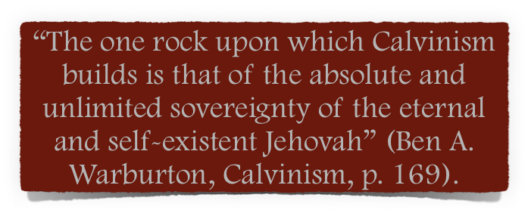
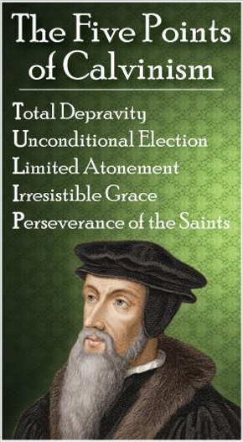
A Biblical Examination of:
Calvin isolated the doctrine of God’s sovereignty and exalted it to the exclusion of other truths taught in the Scriptures.
All of the five points of Calvinism flow from this basic premise.

Slide 14
A Biblical Examination of:

Slide 15
A Biblical Examination of:
The Westminster Confession of Faith - the doctrinal foundation of English and American Presbyterianism:
“God from all eternity did by the most wise and holy counsel of his own will, freely and unchangeably ordain whatsoever comes to pass”(Westminster Confession of Faith, Chapter III).
“By the decree of God, for the manifestation of his glory, some men and angels are predestined unto everlasting life, and others fore-ordained to everlasting death, are particularly and unchangeably designed; and their number is so certain and definite that it cannot be either increased or diminished” (Ibid.).

Slide 16
Does NOT Redemptively Love All Men - The large majority of men are born “foreordained” to eternal destruction – 2 Pet 3:9; 1 Tim 2:4
Is A Respecter Of Persons – chooses one sinner and condemns many others arbitrarily and capriciously - Acts 10:34
Is Unjust – Condemns men for what He predetermined that they do, without them having libertarian freewill to do otherwise - 2 Cor. 5:10
Everything Is Unchangeably Foreordained – EVEN EVERY SIN! “God is the first cause of ALL EVIL!”

Slide 17
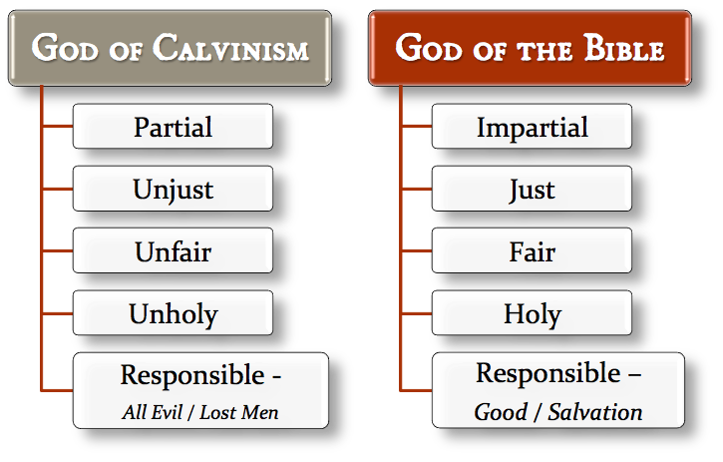

Slide 18
A Biblical Examination of:
False View of God’s Sovereignty
Perseverance of the Saints
Total Inability
The Circular Reasoning of A of False Theology
Irresistible Grace
Unconditional Election
Limited Atonement

Slide 19
A Biblical Examination of:
Calvinism: Domino Theology
T.U.L.I.P.
When One Falls They All Fall

Slide 21
A Biblical Examination of
AKA: Calvinism
otal Inability
nconditional Election
imited Atonement
rresistible Grace
erseverance of The Saints

Slide 22
2 Chronicles 20:5–12 (NKJV)
⁵ Then Jehoshaphat stood in the assembly of Judah and Jerusalem, in the house of the Lord, before the new court, ⁶ and said: “O Lord God of our fathers, are You not God in heaven, and do You not rule over all the kingdoms of the nations, and in Your hand is there not power and might, so that no one is able to withstand You? ⁷ Are You not our God, who drove out the inhabitants of this land before Your people Israel, and gave it to the descendants of Abraham Your friend forever?

Slide 23
2 Chronicles 20:5–12 (NKJV)
⁸ And they dwell in it, and have built You a sanctuary in it for Your name, saying, ⁹ ‘If disaster comes upon us—sword, judgment, pestilence, or famine—we will stand before this temple and in Your presence (for Your name is in this temple), and cry out to You in our affliction, and You will hear and save.’ ¹⁰ And now, here are the people of Ammon, Moab, and Mount Seir—whom You would not let Israel invade when they came out of the land of Egypt, but they turned from them and did not destroy them—

Slide 24
2 Chronicles 20:5–12 (NKJV)
¹¹ here they are, rewarding us by coming to throw us out of Your possession which You have given us to inherit. ¹² O our God, will You not judge them? For we have no power against this great multitude that is coming against us; nor do we know what to do, but our eyes are upon You.”

