Slide 1
A Biblical Examination of
AKA: Calvinism
otal Inability
nconditional Election
imited Atonement
rresistible Grace
erseverance of The Saints

Slide 2
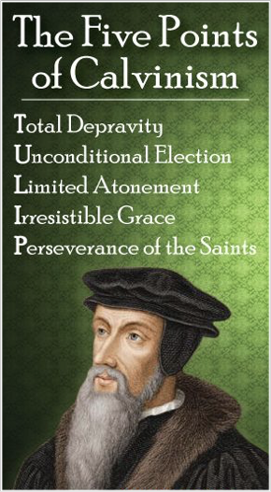
A Biblical Examination of:
False View of God’s Sovereignty
Perseverance of the Saints
Total Inability
The Circular Reasoning of A of False Theology
Irresistible Grace
Unconditional Election
Limited Atonement

Slide 3
A Biblical Examination of:
Calvinism: Domino Theology
T.U.L.I.P.
When One Falls They All Fall

Slide 4
A Biblical Examination of:
Total, Hereditary Depravity
Total – “Complete in degree; absolute, thorough.” (Webster)
Hereditary – “of or passed down by heredity; designating or of a characteristic transmitted from generation to generation.” (Webster)
Depravity – “corruption” (Webster) – “Inability” (Calvin attaches this idea to it)
“Total depravity; in theology, the doctrine that man’s nature is innately bad and perverse because of original sin.” (Webster)

Slide 5
A Biblical Examination of:
Total, Hereditary Depravity
The Effects of Adam's Sin upon his Posterity. "That the sin of Adam injured not himself only but also all descending from him by ordinary generation, is part of the faith of the whole Christian world.” (Hodge’s systematic theology)

Slide 6
A Biblical Examination of:
Total, Hereditary Depravity
"As to the ground of these evils, we are taught that 'the covenant being made with Adam not only for himself, but for his posterity, all mankind descending from him by ordinary generation, sinned in him, and fell with him in his first transgression.' Or, as is expressed in the Confession, 'Our first parents, being the root of all mankind, the guilt of their sin was imputed, and the same death in sin and corrupted nature were conveyed to all their posterity, descending from them by ordinary generation." —(Hodges’ Systematic Theology, Vol. II, Part II-Anthropology)

Slide 7
A Biblical Examination of:
Total, Hereditary Depravity
"It was the universal faith of the church that man was made in the image of God, pure and holy, and fell by his own guilt. But the extent of sin and the consequences of the fall were not fully discussed before the Pelagius-Augustine controversy in the fifth century." (Schaff, Vol. II, p. 246)

Slide 8
A Biblical Examination of:
Total, Hereditary Depravity
Augustine, (354-430AD) credited with formulating the concept of original sin, held that Adam's fall corrupted man, making the human race a mass of sin. Man inherited both the tendency to sin and the guilt for Adam's sin, for in him the entire race sinned. (ISBE)

Slide 9
A Biblical Examination of:
Total, Hereditary Depravity
Already the Roman Catholic hierarchy was developing and the doctrine of that church was forming. Original sin became a fundamental tenet of that faith.
Council of Trent 1545-1563: "Adam's first sin has been transmitted to all his descendants".

Slide 10
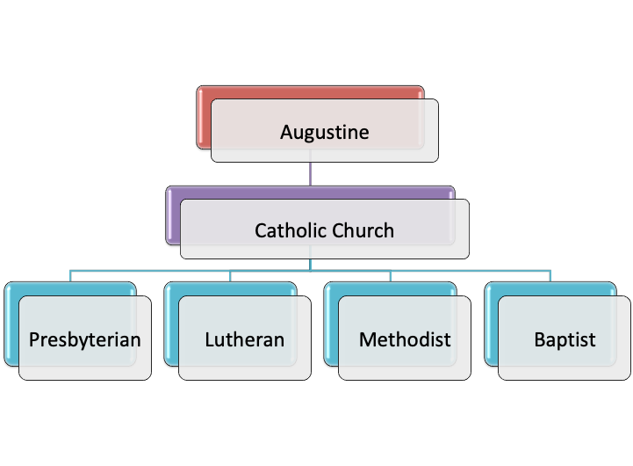
A Biblical Examination of:
Total, Hereditary Depravity

Slide 11
A Biblical Examination of:
Total, Hereditary Depravity
Confession of Faith: "Our first parents, being seduced by the subtlety and temptation of Satan, sinned in eating the forbidden fruit. This their sin, God was pleased, according to his wise and holy counsel, to permit, having purposed to order it to his own glory. By this sin they fell from their original righteousness and communion with God, and so became dead in sin, and wholly defiled in all the faculties and parts of the soul and body. …

Slide 12
A Biblical Examination of:
Total, Hereditary Depravity
“… They being the root of all mankind, the guilt of this sin was imputed and the same death in sin and corrupted nature conveyed to all their posterity descending from them by ordinary generation. From this original corruption, whereby we are utterly indisposed, disabled, and made opposite to all good, and wholly inclined to all evil, do proceed all actual transgressions."

Slide 13
A Biblical Examination of:
Total, Hereditary Depravity
Augsburg confession Article 2: “… all men who are born according to the course of nature are conceived and born in sin. That is, all men are full of evil lust and inclination from their mother's womb and are unable by nature to have true fear of God and true faith in God. Moreover, this inborn sickness and hereditary sin is truly sin and condemns to the eternal wrath of God

Slide 14
A Biblical Examination of:
Total, Hereditary Depravity
"Our first parents by this sin fell from their original righteousness and communion with God, and we in them, whereby death came upon all, all becoming dead in sin, and wholly defiled in all the faculties and parts of the souls and body.

Slide 15
A Biblical Examination of:
Total, Hereditary Depravity
The guilt of sin was imputed (and corrupt nature conveyed) to all their posterity descending from them by ordinary generation, being now conceived in sin, the subjects of death and all other spiritual miseries, temporal and eternal, unless the Lord Jesus set them free.

Slide 16
A Biblical Examination of:
Total, Hereditary Depravity
From the original corruption-whereby we are utterly indisposed disabled, and made opposite to all good and wholly inclined to all evil, do proceed all actual transgressions.” - (p. 24)

Slide 17
A Biblical Examination of:
Total, Hereditary Depravity
The ROOT of several false beliefs & practices of Catholic origin, and reformed teaching,
Immaculate Conception,
Infant baptism,
Direct & miraculous regeneration of the Holy Spirit making faith possible.

Slide 18
A Biblical Examination of:
Total, Hereditary Depravity
Gen. 6:5;
Psa. 51:5; 58:1-3;
Jer. 13:23; 17:9;
Rom. 3:10-18; 5:12-19; 8:6,7
1 Corinthians 2:14; 15:22
Ephesians 2:1-3

Slide 19
A Biblical Examination of:
Total, Hereditary Depravity
Gen. 6:5: The argument: Every intent of man’s heart was evil continually, therefore, all men were born totally depraved.
Gen. 6:5: The answer: - Noah was just, vs 9. - Vs 12 says they had corrupted themselves - How did men call upon the Lord in 4:26?

Slide 20
A Biblical Examination of:
Total, Hereditary Depravity
Psalm 51:1-5: The argument: Being conceived in sin and born in iniquity David was a sinner at birth.
Psalm 51:1-5: The answer: - The passage does not say David was born a sinner / David confesses HIS SIN & doesn’t excuse it / Hyperbole - emphasizing his guilt

Slide 21
A Biblical Examination of:
Total, Hereditary Depravity
Psalm 58:3: The argument:“The wicked are estranged (from God) from the womb.
Psalm 58:3: The answer: - They “go astray.” They are not born wicked / Not babies - “Speaking lies?” … “stop their ears?” (vv. 4-5). / “Break their teeth in their mouth?” (v. 6)

Slide 22
A Biblical Examination of:
Total, Hereditary Depravity
Romans 3:9-20: The argument: All the world is guilty of sin before God because they are born in sin.
Romans 3:9-20: The answer: - both Jews and Gentiles are guilty of sinning against God. - Note “they have turned aside” - “have become unprofitable …”

Slide 23
A Biblical Examination of:
Total, Hereditary Depravity
Romans 3:10–18 (NKJV)
¹⁰ As it is written: “There is none righteous, no, not one; ¹¹ There is none who understands; There is none who seeks after God. ¹² They have all turned aside; They have together become unprofitable; There is none who does good, no, not one.” …

Slide 24
A Biblical Examination of:
Total, Hereditary Depravity
Romans 5:12-19: The argument: “The guilt of the sin of Adam, and thus depravity, has been passed unto all people.”
Romans 5:12-19: The answer: - People are subject to death because of their own sin. vs. 12 / Vs 17 - life & death conditional. If Adam’s sin brings automatic spiritual death, - Christ’s life brings automatic spiritual life.

Slide 25
A Biblical Examination of:
Total, Hereditary Depravity
Romans 8:6-7: The argument: “The “carnal mind” (v. 7), refers to the unconverted ”
Romans 8:6-7: The answer: - the ones with carnal minds “walk according to the flesh.” It does not state that they are born in sin. … The carnal mind in the broader context is the mind seeking justification through the Law of Moses … chapter 7.

Slide 26
A Biblical Examination of:
Total, Hereditary Depravity
1 Cor. 2:14: The argument: “The natural man cannot understand & does not accept the things of God because he is inherently sinful.”
1 Cor. 2:14: The answer: - The natural man is concerned only with material, things & neglects spiritual things / Seeks earthly wisdom & signs, not God’s wisdom and teaching. (1 Cor. 1:18-25)

Slide 27
A Biblical Examination of:
Total, Hereditary Depravity
1 Cor. 15:22: The argument: “Adam brought physical death upon all people and every person who dies bears the guilt and penalty of Adam’s sin”
1 Cor. 15:22: The answer: - Physical death is the penalty imposed upon all humanity - not spiritual death. As many as die because of Adam will be made alive because of Christ …

Slide 28
A Biblical Examination of:
Total, Hereditary Depravity
Ephesians 2:1-3: The argument: “we sin because it is our nature”
Ephesians 2:1-3: The answer: -“Nature” in this passage speaks to the result of their practice, not the cause of the practice … The result of choosing sin and pursuing its follies becomes their habit & “WRATH” is the result

Slide 29
A Biblical Examination of:
Total, Hereditary Depravity
No unregenerate person can do good or even want to do good..
An individual’s salvation lies entirely at the discretion of God. Nothing a person does can affect his salvation.

Slide 30
A Biblical Examination of:
Total, Hereditary Depravity
Exodus 32:31-33 - “Whoever has sinned against Me, I will blot him out of My book”
Ecclesiastes 7:29 God made man upright. He is not depraved when born.
Isaiah 59:1-8 “Your sins …”
Ezekiel 18:1-32 “The son shall not bear the guilt of the father …”

Slide 31
A Biblical Examination of:
Total, Hereditary Depravity
Matthew 18:1-5 — we are to be as little children and if Total Hereditary Depravity is true, we need to be more like sinners.
Romans 7:9-11 - Rather than being born spiritually dead, the apostle Paul was born spiritually alive.
1 John 3:4 — "sin is the transgression of the Law …”

Slide 32
A Biblical Examination of:
Total, Hereditary Depravity
The basis of Calvinism originated, not in the mind of God, but in the mind of a mistaken theologian.
A person becomes a sinner when he violates God’s law not when he is born.
We do not inherit the sin of our parents, Adam or anyone else.
We can choose FAITH!!!!

Slide 33
A Biblical Examination of:
Total, Hereditary Depravity
We can choose FAITH!!!!
Deuteronomy 30:15,18
Joshua 24:15
Romans 6:16,17
Revelation 22:17

Slide 35
A Biblical Examination of:
Calvinism: Domino Theology
T.U.L.I.P.
When One Falls They All Fall

