Slide 1
A Biblical Examination of
AKA: Calvinism
otal Inability
nconditional Election
imited Atonement
rresistible Grace
erseverance of The Saints

Slide 2
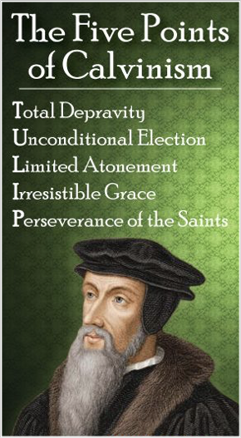
A Biblical Examination of:
False View of God’s Sovereignty
Perseverance of the Saints
Total Inability
The Circular Reasoning of A of False Theology
Irresistible Grace
Unconditional Election
Limited Atonement

Slide 3
A Biblical Examination of:
Calvinism: Domino Theology
T.U.L.I.P.
When One Falls They All Fall

Slide 4
A Biblical Examination of:
Unconditional Election
Unconditional Election, proceeds from the first point of Reformed theology, “Total Depravity.”
Remember, they say, mankind is so totally depraved men cannot respond in faith to God’s word—people cannot choose to obey — God has to choose for them.
“Unconditional Election” states that God chooses some to be regenerated, giving them the ability to believe and thereby be justified.

Slide 5
A Biblical Examination of:
Unconditional Election
Unconditional Election states that God, with no regard to the will of man, made an eternal choice of certain persons unto eternal life and some to eternal damnation and that number is so fixed that it cannot be changed.
Rooted in a misunderstanding and false view of the sovereignty of God, Unconditional Election is logically connected with what the reformed position is concerning the doctrine of predestination.

Slide 6
A Biblical Examination of:
Unconditional Election
“God has predestined and foreordained some men and angels to everlasting life out of His free grace and love without any foresight of faith or works in man or perseverance in either of them, and others are foreordained to everlasting death and the number of either is so certain and definite that it cannot be increased or diminished.”
— (Chap. III, art. 3,4 &5; Chap. X, art. 2)

Slide 7
A Biblical Examination of:
Unconditional Election
“God from all eternity did by the most wise and holy counsel of his own will, freely and unchangeably ordain whatsoever comes to pass ... By the decree of God, for the manifestation of his glory, some men and angels are predestined unto life, and others foreordained to everlasting death. These angels and men, thus predestinated and foreordained, are particularly and unchangeably designed; and their number is so certain and definite it cannot be either increased or diminished.” (Chap. III)

Slide 8
A Biblical Examination of:
Unconditional Election
“Those of mankind who are predestinated unto Life, God, before the foundation of the world was laid, according to His eternal and immutable Purpose, and the secret counsel and good pleasure of His will, hath chosen in Christ to everlasting glory, out of His mere free grace and love, without any other thing in the creature as a condition or cause moving Him thereunto.”

Slide 9
A Biblical Examination of:
Unconditional Election
“All are not created on equal terms, but some are preordained to eternal life, others to eternal damnation; and, accordingly, as each has been created for one or other of these ends, we say that he has been predestinated to life or to death.”

Slide 10
A Biblical Examination of:
Unconditional Election
"God's choice of certain individuals unto salvation before the foundation of the world rested solely in His own sovereign will. His choice of particular sinners was not based on any foreseen response of obedience on their part, such as faith, repentance, etc. On the contrary, God gives faith and repentance to each individual whom He selected. These acts are the result, not the cause of God's choice. Election therefore was not determined by or conditioned upon any virtuous quality or act foreseen in man. Those whom God sovereignly elected He brings through the power of the Spirit to a willing acceptance of Christ. Thus God's choice of the sinner, not the sinner's choice of Christ, is the ultimate cause of salvation."

Slide 11
A Biblical Examination of:
Unconditional Election
Chose - ἐκλέγομαι - eklegomai
Middle voice from G1537 and G3004 (in its primary sense); to select: - make choice, choose (out), chosen.
Peoples New Testament – B. W. Johnson
. . . This does not affirm that God chose some individuals and rejected others, but that before the world was, before there was Jew or Gentile, God chose to have a people for himself, the whole church of Christ, a covenant people confined to no one earthly race.
Ephes. 1:4 (NKJV)
just as He chose us in Him before the foundation of the world, that we should be holy and without blame before Him in love,

Slide 12
A Biblical Examination of:
Unconditional Election
Predestined - προορίζω - proorizō
Strong’s - to limit in advance, that is, (figuratively) predetermine: - determine before, ordain, predestinate.
Thayer Definition: G4309 –
1) to predetermine, decide beforehand
2) in the NT of God decreeing from eternity
3) to foreordain, appoint beforehand
Ephes. 1:5 (NKJV)
having predestined us to adoption as sons by Jesus Christ to Himself, according to the good pleasure of His will,

Slide 13
A Biblical Examination of:
Unconditional Election
Predestined - πρωρίζω prōrizō
Means properly “to set bounds before;” and then to “pre-determine.” It is originally a geographical term, but applied also to any thing concluded, or determined, or demonstrated.
Here the word is used to point out God’s fixed purpose or predetermination to bestow upon those who believe the gospel the blessing of the adoption of sons by Jesus Christ, (Eph. 1:5,13)
Ephes. 1:5 (NKJV)
having predestined us to adoption as sons by Jesus Christ to Himself, according to the good pleasure of His will,

Slide 14
A Biblical Examination of:
Unconditional Election
Predestined - πρωρίζω prōrizō
Peoples New Testament – Having predestinated us. Foreordained that we, the church of Jesus Christ, should be adopted as his children. The whole line of argument is general instead of particular. God foreordained a church which should be composed of those adopted as his children.
Ephes. 1:5 (NKJV)
having predestined us to adoption as sons by Jesus Christ to Himself, according to the good pleasure of His will,

Slide 15
A Biblical Examination of:
Unconditional Election
Predestination refers to God’s creation of man and His determination beforehand of the conditions through which man might live with Him eternally. It concerns the Father’s predetermination that all people who meet His conditions would live eternally in heaven and all who refuse submission to those conditions would suffer eternal damnation.
Ephes. 1:5 (NKJV)
having predestined us to adoption as sons by Jesus Christ to Himself, according to the good pleasure of His will,

Slide 16
A Biblical Examination of:
Unconditional Election
Acts 13:48 (ESV)
⁴⁸ And when the Gentiles heard this, they began rejoicing and glorifying the word of the Lord, and as many as were appointed to eternal life believed.

Slide 17
A Biblical Examination of:
Unconditional Election
The argument: God, before the foundation of the world, appointed only certain individuals to life.
Those who believed became part of those who had been appointed to eternal life.

Slide 18
A Biblical Examination of:
Unconditional Election
Romans 8:28–30 (NKJV)
²⁸ And we know that all things work together for good to those who love God, to those who are the called according to His purpose. ²⁹ For whom He foreknew, He also predestined to be conformed to the image of His Son, that He might be the firstborn among many brethren. ³⁰ Moreover whom He predestined, these He also called; whom He called, these He also justified; and whom He justified, these He also glorified.

Slide 19
A Biblical Examination of:
Unconditional Election
The argument: God, before the foundation of the world, predestinated certain individuals to salvation.
Under consideration in this passage are: “Those who love God” (v. 28), not just a few who God loves. “Those who are called according to His purpose.” (v. 28; cf 2 Thes. 2:14)
Those who hear, believe, and respond in obedience are referred to as being “called.” (Gal. 1:6; Heb. 9:15; 1 Pet. 2:9)

Slide 20
A Biblical Examination of:
Unconditional Election
Ephesians 1:4–5,11 (NKJV)
⁴ just as He chose us in Him before the foundation of the world, that we should be holy and without blame before Him in love, ⁵ having predestined us to adoption as sons by Jesus Christ to Himself, according to the good pleasure of His will, … ¹¹ In Him also we have obtained an inheritance, being predestined according to the purpose of Him who works all things according to the counsel of His will,

Slide 21
A Biblical Examination of:
Unconditional Election
Wisdom
God planned it before the world began – Ep 1:4; 3:11
The "chosen" would be holy and without blame in Christ - Ep 1:4; 5:27
Believers would be adopted as sons – Ep 1:5; Gal 3:26,27 – (i.e. the means & conditions)
This plan is according to God's good pleasure – Ep 1:5,10-13
What?
Class
Motive?

Slide 22
A Biblical Examination of:
Unconditional Election
Who?
The faithful in Christ – (1,4,5,13)
Those In Christ’s body, i.e. church, (1-13; 2:16; cf. Rom 16:13)
By grace through faith – (2,7,13; 2:8-10)
Baptized Into The Family of God – (5,7,13; cf. Acts 2:38,41; Gal 3:26,27)
Forgiveness - Grace, peace – Inheritance, Adoption, eternal life (3)
Where?
How?
When?
What?

Slide 23
A Biblical Examination of:
Unconditional Election
God Chose Before The World:
The type of person - Mat 5:3-12
The obedient - becoming members of the chosen family – Galatians 3:26,27; Hebrews 5:8,9,
Those who make their “Calling and Election sure” – 2 Pet 1:5-10
The Head — Is 42:1
The Class, -“The body of Christ, i.e. the church”
Eph 1:22,23

Slide 24
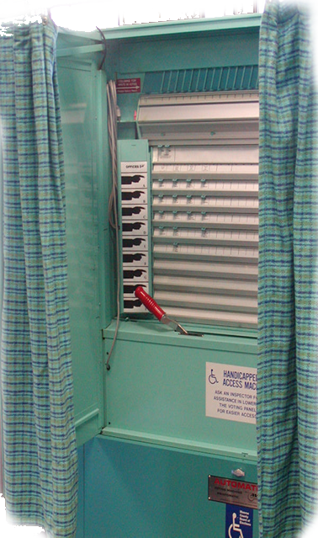
A Biblical Examination of:
Unconditional Election
God Chose Before The World:
“ELECT – or “CHOSEN” – Yes!! –
Unconditionally? – NO!!!
Individually? – NO!!!
Violate Free Will? – NO!!!
“Predestined” – Yes
Unconditionally? – NO!!!
Individually? – NO!!!
Violate Free Will? – NO!!!

Slide 25
A Biblical Examination of:
Conditional Election
Baptized Into
Rom. 6:3-6
Gal. 3:26,27
Acts 2:38,47
Inside Christ
Saved / Hope
ALL spiritual blessings
Chosen –
A child of God –
Accepted –
Redeemed –
Forgiven –
A Heavenly Inheritance
Outside Christ
Lost Without Hope
NO spiritual blessings –
NOT chosen –
NOT children of God –
NOT accepted -
NO redemption –
NO forgiveness –
NO heavenly Inheritance
Predestined Sphere

Slide 26
A Biblical Examination of:
Unconditional Election
Romans 9:10–13 (NKJV)
¹⁰ And not only this, but when Rebecca also had conceived by one man, even by our father Isaac ¹¹ (for the children not yet being born, nor having done any good or evil, that the purpose of God according to election might stand, not of works but of Him who calls), ¹² it was said to her, “The older shall serve the younger.” ¹³ As it is written, “Jacob I have loved, but Esau I have hated.”

Slide 27
A Biblical Examination of:
Unconditional Election
Romans 9:11 (for the children not yet being born, nor having done any good or evil, that the purpose of God according to election might stand, not of works but of Him who calls),
“The Purpose Of God According To His Choice WILL STAND” – Rom. 9:11
“The Word of Promise” – Rom. 9:9
Not based upon their goodness
Not based upon their works
Not based upon their EVIL

Slide 28
A Biblical Examination of:
Unconditional Election
Romans 9:11 (for the children not yet being born, nor having done any good or evil, that the purpose of God according to election might stand, not of works but of Him who calls),
“The Purpose Of God According To His Choice WILL STAND” – Rom. 9:11
“The Word of Promise” – Rom. 9:9
Dependent Upon The Faithfulness Of God
Not based upon their goodness
Not based upon their works
Not based upon their EVIL

Slide 29
A Biblical Examination of:
Unconditional Election
Romans 9:11-13 (NKJV) ¹² it was said to her, "The older shall serve the younger." ¹³ As it is written, "Jacob I have loved, but Esau I have hated."
Not Emphasizing Individual Election
Genesis 25:23 (NKJV) ²³ And the LORD said to her: "Two nations are in your womb, Two peoples shall be separated from your body; One people shall be stronger than the other, And the older shall serve the younger."

Slide 30
A Biblical Examination of:
Unconditional Election
Romans 9:11-13 (NKJV) ¹² it was said to her, "The older shall serve the younger." ¹³ As it is written, "Jacob I have loved, but Esau I have hated."
Not Emphasizing Individual Election
Malachi 1:2-3 (NKJV) ² "I have loved you," says the LORD. "Yet you say, 'In what way have You loved us?' Was not Esau Jacob's brother?" Says the LORD. "Yet Jacob I have loved; ³ But Esau I have hated, And laid waste his mountains and his heritage For the jackals of the wilderness." (cf. 4)

Slide 31
A Biblical Examination of:
Unconditional Election
God preserved the Messianic lineage through which Christ came.
The ones NOT chosen “Ishmael & Esau” are NOT thereby condemned to hell; they are simply excluded from having a part in the working out of God’s redemptive plan.

Slide 32
A Biblical Examination of:
Unconditional Election
God chose Jacob over Esau?
God raised up Pharaoh –
The potter clay metaphor -
To demonstrate that God did not choose Israel as a nation for salvation, but that He chose Israel as a nation to provide the Savior.

Slide 33
A Biblical Examination of:
Unconditional Election
God chose Jacob over Esau?
God raised up Pharaoh –
The potter clay metaphor -
To demonstrate that God sets the terms of mercy and not Israel.

Slide 34
A Biblical Examination of:
Unconditional Election
God chose Jacob over Esau?
God raised up Pharaoh –
The potter clay metaphor -
To demonstrate from Old Testament scripture man’s need and ability to repent and God’s sovereign right to demand that he do so.

Slide 35
A Biblical Examination of:
Unconditional Election
God has created EVERY man with the ability to choose faith! — Jos. 24:15; Acts 17:26-27
God’s invitation to all men genuine! — Rev. 22:17
All who accept God’s call to have faith in Christ become a part of the elect body - all those in Christ — Eph 1:3-11

Slide 36
A Biblical Examination of:
Unconditional Election
God desires that ALL MEN come to a knowledge of the truth and be saved! –- (1 Tim 2:4)
The grace of God that brings salvation has appeared to ALL MEN! –- (Titus 2:11,12)
God is NOT willing that ANY should perish but that ALL should come to repentance! –- (2 Peter 3:9)
Jesus died for the sins of the WHOLE WORLD! — (1 John 2:1,2)

Slide 37
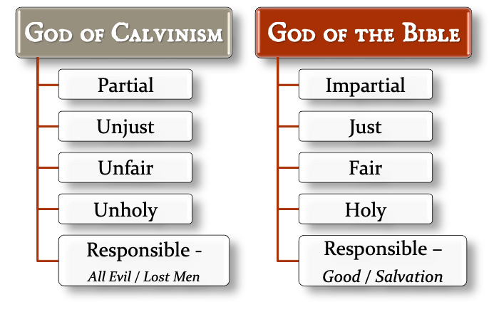
A Biblical Examination of:
Unconditional Election

Slide 39
A Biblical Examination of:
Calvinism: Domino Theology
T.U.L.I.P.
When One Falls They All Fall

