Slide 1
A Biblical Examination of
AKA: Calvinism
otal Inability
nconditional Election
imited Atonement
rresistible Grace
erseverance of The Saints

Slide 2
A Biblical Examination of:
False View of God’s Sovereignty
Perseverance of the Saints
Total Inability
The Circular Reasoning of A of False Theology
Irresistible Grace
Unconditional Election
Limited Atonement

Slide 3
A Biblical Examination of:
Calvinism: Domino Theology
T.U.L.I.P.
When One Falls They All Fall

Slide 4
A Biblical Examination of:
Unconditional Election
Unconditional Election, proceeds from the first point of Reformed theology, “Total Depravity.”
Remember, they say, mankind is so totally depraved men cannot respond in faith to God’s word—people cannot choose to obey — God has to choose for them.
“Unconditional Election” states that God chooses some to be regenerated, giving them the ability to believe and thereby be justified.

Slide 5
A Biblical Examination of:
Unconditional Election
Unconditional Election states that God, with no regard to the will of man, made an eternal choice of certain persons unto eternal life and some to eternal damnation and that number is so fixed that it cannot be changed.
Rooted in a misunderstanding and false view of the sovereignty of God, Unconditional Election is logically connected with what the reformed position is concerning the doctrine of predestination.

Slide 6
A Biblical Examination of:
Limited Atonement
The third basic tenet of Calvinism is that Christ died only for the ones God had unconditionally chosen to save.
Calvinists rationalize that God would not waste the sacrifice of Christ on those whom He had determined not to save.
Their conclusion: Christ only died for the elect.

Slide 7
A Biblical Examination of:
Limited Atonement
“Limited atonement is the teaching within Calvinism which states that Jesus only bore the sins of the elect (those chosen for salvation by God) and that He did not bear the sins of every individual who has ever lived. This teaching is also called "particular redemption" and "definite atonement.”” —
Matt Slick / https://carm.org/what-is-limited-atonement

Slide 8
A Biblical Examination of:
Limited Atonement
“Limited atonement (or definite atonement or particular redemption) … states that though the death of Jesus Christ is sufficient to atone for the sins of the whole world,[1] it was the intention of God the Father that the atonement of Christ's death would work itself out in the elect only, thereby leading them without fail to salvation. According to Limited Atonement, Christ died for the sins of the elect alone, and no atonement was provided for the reprobate. …”

Slide 9
A Biblical Examination of:
Limited Atonement
“… This is in contrast to a belief that God's prevenient grace (or "enabling grace") enables all to respond to the salvation offered by God in Jesus Christ Acts 2:21 so that it is each person's decision and response to God's grace that determines whether Christ's atonement will be effective to that individual.”

Slide 10
A Biblical Examination of:
Limited Atonement
The Synod of Dort was convened in 1618 in order to decide a controversy between the followers of Jacobus Arminius (Arminians), and other Calvinists. …Both sides of the controversy agreed that this efficacy was limited to the elect. The disagreement had to do with the grounds for this limitation. For Arminius, the ground was the free choice of people to believe, .… For the opponents of Arminius, … this efficacy was limited based on God's predestination, without any foreknowledge of human choice.[4] Calvin clearly taught this second view, and it is also the view of Reformed theologians following the Synod of Dort.”

Slide 11
A Biblical Examination of:
Limited Atonement
“Christ’s redeeming work was intended to save the elect only and actually secured salvation for them. His death was a substitutionary sacrifice of the penalty of sin in the place of certain specified sinners. In addition to putting away the sins of His people, Christ’s redemption secured everything necessary for their salvation, including faith, which united them to Him. The gift of faith is infallibly applied by the Spirit to all for whom Christ died, thereby guaranteeing their salvation.”

Slide 12
A Biblical Examination of:
Limited Atonement
John 10:15 (NKJV)
¹⁵ As the Father knows Me, even so I know the Father; and I lay down My life for the sheep.

Slide 13
A Biblical Examination of:
Limited Atonement
John 10:15 (NKJV)
Yes Jesus died for His sheep, (those who hear & follow Him vs. 27) — vs. 11, 15, 17, 18
There were sheep not of that fold - He also died for them — vs. 16
Before the sheep heard Him and followed Him, were they His sheep? No - but His atoning blood was available.

Slide 14
A Biblical Examination of:
Limited Atonement
Acts 20:28 (NKJV)
²⁸ Therefore take heed to yourselves and to all the flock, among which the Holy Spirit has made you overseers, to shepherd the church of God which He purchased with His own blood.

Slide 15
A Biblical Examination of:
Limited Atonement
Ephesians 5:25 (NKJV)
²⁵ Husbands, love your wives, just as Christ also loved the church and gave Himself for her,

Slide 16
A Biblical Examination of:
Limited Atonement
Acts 20:28 & Ephesians 5:25
YES, Jesus died to purchase the church, but the Scriptural truth Calvinists overlook is any person can become a part of His church. (Rev. 22:17)
Those who “gladly receive” the word are added by the Lord to His church. (Acts 2:41,47)

Slide 18
A Biblical Examination of:
Limited Atonement
Baptized Into
Rom. 6:3-6
Gal. 3:26,27
Acts 2:38,47
Inside Christ
Saved / Hope
ALL spiritual blessings
Chosen –
A child of God –
Accepted –
Redeemed –
Forgiven –
A Heavenly Inheritance
Outside Christ
Lost Without Hope
NO spiritual blessings –
NOT chosen –
NOT children of God –
NOT accepted -
NO redemption –
NO forgiveness –
NO heavenly Inheritance
Predestined Sphere

Slide 19
A Biblical Examination of:
Limited Atonement
The gospel is for all.
Matt. 28:18-20 teach all nations …
Mark 16:15-16 preach the gospel to every creature, he who believes and is baptized …
Acts 10:34,35 … God shows no partiality. ³⁵ But in every nation whoever fears Him and works righteousness is accepted by Him.
Acts 17:27,28 … desires all to seek Him …Not far from each one of us

Slide 20
A Biblical Examination of:
Limited Atonement
Jesus died for all men
Luke 19:10. “For the Son of Man has come to seek and to save that which was lost.”
John 12:32. “And I, if I am lifted up from the earth, will draw all peoples to Myself.”
Romans 5:18. “through one Man’s righteous act the free gift came to all men, …”

Slide 21
A Biblical Examination of:
Limited Atonement
Jesus died for all men
2 Corinthians 5:14, 15. “… One died for all, then all died; and He died for all, that those who live should live no longer for themselves, …”
1 Timothy 2:5, 6. “… the Man Christ Jesus, who gave Himself a ransom for all…”
Hebrews 2:9. “… that He, by the grace of God, might taste death for everyone.”

Slide 22
A Biblical Examination of:
Limited Atonement
John 1:29 (NKJV)
²⁹ The next day John saw Jesus coming toward him, and said, “Behold! The Lamb of God who takes away the sin of the world!

Slide 23
A Biblical Examination of:
Limited Atonement
1 John 2:2 (NKJV)
² And He Himself is the propitiation for our sins, and not for ours only but also for the whole world.

Slide 24
A Biblical Examination of:
Limited Atonement
Titus 2:11 (NKJV)
¹¹ For the grace of God that brings salvation has appeared to all men,

Slide 25
A Biblical Examination of:
Limited Atonement
Some for whom Jesus died could perish …
2 Peter 2:1–2 - “… there will be false teachers among you, who will secretly bring in destructive heresies, even denying the Lord who bought them, and bring on themselves swift destruction.
Romans 14:15 - “…Do not destroy with your food the one for whom Christ died.”

Slide 26
A Biblical Examination of:
Limited Atonement
God desires that ALL MEN come to a knowledge of the truth and be saved! –- (1 Tim 2:4)
God is NOT willing that ANY should perish but that ALL should come to repentance! –- (2 Peter 3:9)

Slide 27
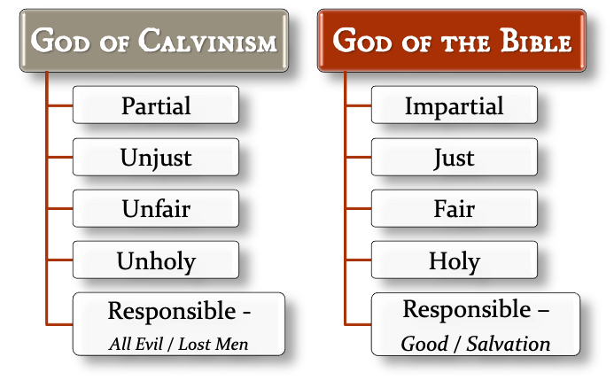
A Biblical Examination of:
Limited Atonement

Slide 29
A Biblical Examination of:
Calvinism: Domino Theology
T.U.L.I.P.
When One Falls They All Fall

Slide 30
John 3:13–17 (NKJV)
¹³ No one has ascended to heaven but He who came down from heaven, that is, the Son of Man who is in heaven. ¹⁴ And as Moses lifted up the serpent in the wilderness, even so must the Son of Man be lifted up, ¹⁵ that whoever believes in Him should not perish but have eternal life. ¹⁶ For God so loved the world that He gave His only begotten Son, that whoever believes in Him should not perish but have everlasting life. ¹⁷ For God did not send His Son into the world to condemn the world, but that the world through Him might be saved.

