Slide 1
A Biblical Examination of
AKA: Calvinism
otal Inability
nconditional Election
imited Atonement
rresistible Grace
erseverance of The Saints

Slide 2
A Biblical Examination of:
False View of God’s Sovereignty
Perseverance of the Saints
Total Inability
The Circular Reasoning of A of False Theology
Irresistible Grace
Unconditional Election
Limited Atonement

Slide 3
A Biblical Examination of:
Calvinism: Domino Theology
T.U.L.I.P.
When One Falls They All Fall

Slide 4
A Biblical Examination of:
Irresistible Grace
The fourth basic doctrine of Calvinism is Irresistible Grace. (also called Efficacious or Invincible Grace).
Efficacious Grace, we are told, is an immediate, miraculous transformation of a man's nature
The totally depraved sinner - who has been unable and unwilling to make the slightest move toward God - is given a new nature. He is born again unto a life he never sought and never desired.

Slide 5
A Biblical Examination of:
Irresistible Grace
The doctrine is predicated on the preceding tenets of Calvinism -
A persons depraved inability is made capable by the Holy Spirit - the dead is made alive - born again - regenerated …
This ONLY happens to those whom God has unconditionally chosen & predestined.
Those for whom Jesus died are awakened and given faith in order for them to be justified.

Slide 6
A Biblical Examination of:
Irresistible Grace
The Westminster Confession of Faith.
“All those whom God hath predestinated unto life, and those only, he is pleased, in his appointed and accepted time, effectually to call, by his word and Spirit, out of that state of sin and death in which they are by nature, to grace and salvation by Jesus Christ; enlightening their minds spiritually and savingly to understand the things of God; taking away their heart of stone, and giving unto them an heart of flesh; renewing their wills, and by his almighty power determining them to that which is good, and effectually drawing them to Jesus Christ; yet so as they come most freely, being made willing by his grace” (Chap. X, Sect. 1).

Slide 7
A Biblical Examination of:
Irresistible Grace
David N. Steele and Curtis C. Thomas.
“The gospel invitation extends a call to salvation to every one who hears its message. It invites all men without distinction to drink freely of the water of life and live. It promises salvation to all who repent and believe. But this outward general call, extended to the elect and non-elect alike, will not bring sinners to Christ. Why? Because men are by nature dead in sin and are under its power. They are of themselves unable and unwilling to forsake their evil ways and to turn to Christ for mercy. Consequently, the unregenerate will not respond to the gospel call to repentance and faith.”

Slide 8
A Biblical Examination of:
Irresistible Grace
David N. Steele and Curtis C. Thomas.
“… No amount of external threatenings or promises will cause blind, deaf, dead, rebellious sinners to bow before Christ as Lord and to look to Him alone for salvation. Such an act of faith and submission is contrary to the lost man’s nature. … Therefore, the Holy Spirit, in order to bring God’s elect to salvation, extends to them a special inward call in addition to the outward call contained in the gospel message. Through this special call the Holy Spirit performs a work of grace within the sinner which inevitably brings him to faith in Christ. Although the general outward call of the gospel can be, and often is, rejected, ... “

Slide 9
A Biblical Examination of:
Irresistible Grace
David N. Steele and Curtis C. Thomas.
“… the special inward call of the Spirit never fails to result in the conversion of those to whom it is made. This special call is not made to all sinners but is issued to the elect only! The Spirit is in no way dependent upon their help or cooperation for success in His work of bringing them to Christ. It is for this reason that Calvinists speak of the Spirit’s call and of God’s grace in saving sinners as being ‘efficacious,’ ‘invincible,’ or ‘irresistible.’ For the grace which the Holy Spirit extends to the elect cannot be thwarted or refused, it never fails to bring them to true faith in Christ!” (David N. Steele, Curtis C. Thomas, op. cit., pp. 48-49).

Slide 10
A Biblical Examination of:
Irresistible Grace
Acts 16:14 (NKJV)
¹⁴ Now a certain woman named Lydia heard us. She was a seller of purple from the city of Thyatira, who worshiped God. The Lord opened her heart to heed the things spoken by Paul.

Slide 11
A Biblical Examination of:
Irresistible Grace
Acts 16:14 (NKJV)
Lydia began as a worshiper of God. (vv. 13,14)
After she heard Paul, Silas and Timothy preaching, her heart was then opened. (v. 14)
She responded and obeyed the Lord. (v. 15)

Slide 12
A Biblical Examination of:
Irresistible Grace
Romans 8:6–7 (NKJV)
⁶ For to be carnally minded is death, but to be spiritually minded is life and peace. ⁷ Because the carnal mind is enmity against God; for it is not subject to the law of God, nor indeed can be.

Slide 13
A Biblical Examination of:
Irresistible Grace
Romans 8:6–7 (NKJV)
The context makes it clear that being carnally minded or spiritual minded is a choice, - vs 1,2, 5, 13
The broader context also indicates that the carnal mind pertains to the one under the Law in contrast to the one who has accepted the gospel - Romans 1:16,17; 3:19-7:25

Slide 14
A Biblical Examination of:
Irresistible Grace
1 Corinthians 2:13–14 (NKJV)
¹³ These things we also speak, not in words which man’s wisdom teaches but which the Holy Spirit teaches, comparing spiritual things with spiritual. ¹⁴ But the natural man does not receive the things of the Spirit of God, for they are foolishness to him; nor can he know them, because they are spiritually discerned.

Slide 15
A Biblical Examination of:
Irresistible Grace
1 Corinthians 2:13–14 (NKJV)
This text is dealing with inspiration & the source of what the apostles revealed - “words” which were given by the Holy Spirit - 10-12
The natural man is the same as the Jews who seek a sign and the Greek who seeks human wisdom (20-25) - such will not believe.

Slide 16
A Biblical Examination of:
Irresistible Grace
John 6:44 (NKJV)
⁴⁴ No one can come to Me unless the Father who sent Me draws him; and I will raise him up at the last day.

Slide 17
A Biblical Examination of:
Irresistible Grace
John 6:44 (NKJV)
Context - look at the next verse - it tells us how the Father draws - (45)
Those who rejected Moses, John the baptist, and the works of Christ could NOT COME to the Father - (chp 5,6)
God draws, (i.e. attracts) men with His love, which is declared in His words and Actions. — Jn 12:32

Slide 18
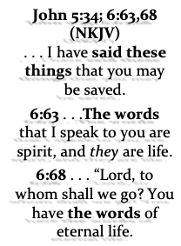
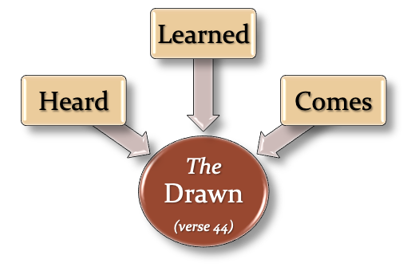
A Biblical Examination of:
Irresistible Grace

Slide 19
A Biblical Examination of:
Irresistible Grace
Ephesians 2:8–9 (NKJV)
⁸ For by grace you have been saved through faith, and that not of yourselves; it is the gift of God, ⁹ not of works, lest anyone should boast.

Slide 20
A Biblical Examination of:
Irresistible Grace
Ephesians 2:8–9 (NKJV)
“However plausible this interpretation, (i.e. faith being a miraculous gift, DM), may seem in English, it is very clear from the Greek that Ephesians 2:8,9 is not referring to faith as a gift from God.”
(Chosen But Free, page 189)

Slide 21
A Biblical Examination of:
Irresistible Grace
Titus 2:11 (NKJV)
¹¹ For the grace of God that brings salvation has appeared to all men,

Slide 22
A Biblical Examination of:
Irresistible Grace
People are called by God to salvation by the gospel.
Called by the gospel. (2 Thes. 2:14)
God’s power to save - (Rom. 1:16; 1 Cor. 1:18ff; 1 Thes 2:13; Heb 4:12)
Faith comes by the hearing of God’s word …
Romans 10:17
John 20:30,31

Slide 23
A Biblical Examination of:
Irresistible Grace
God’s grace can be resisted …
The grace of God has appeared to all men - but most reject it - (Titus 2:11,12; cf. Mat 23:37)
The Holy Spirit’s message can be rejected - (Acts 7:51)
God’s desire & will is that all be saved … Acts 17:26,27; 1 Tim 2:3,4; 2 Pet 3:9; - But Men reject - Isa. 65:2-5; Acts 13:46,47; Rom 10:21;

Slide 24
A Biblical Examination of:
Irresistible Grace
God desires that ALL MEN come to a knowledge of the truth and be saved! –- (1 Tim 2:4)
God is NOT willing that ANY should perish but that ALL should come to repentance! –- (2 Peter 3:9)

Slide 25
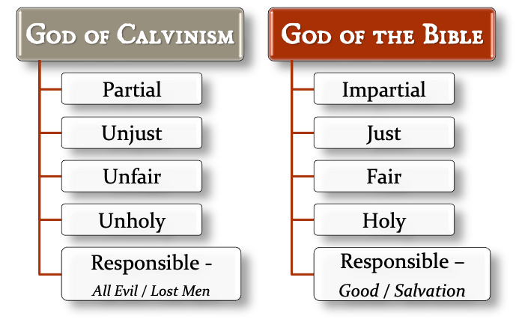
A Biblical Examination of:
Irresistible Grace

Slide 27
A Biblical Examination of:
Calvinism: Domino Theology
T.U.L.I.P.
When One Falls They All Fall

Slide 28
John 6:41–46 (NKJV)
⁴¹ The Jews then complained about Him, because He said, “I am the bread which came down from heaven.” ⁴² And they said, “Is not this Jesus, the son of Joseph, whose father and mother we know? How is it then that He says, ‘I have come down from heaven’?” ⁴³ Jesus therefore answered and said to them, “Do not murmur among yourselves. ⁴⁴ No one can come to Me unless the Father who sent Me draws him; and I will raise him up at the last day. ⁴⁵ It is written in the prophets, ‘And they shall all be taught by God.’ Therefore everyone who has heard and learned from the Father comes to Me. ⁴⁶ Not that anyone has seen the Father, except He who is from God; He has seen the Father.

