Slide 1
Some Fools In The Bible
⁷ The fear of the Lord is the beginning of knowledge,
But fools despise wisdom and instruction.
— Proverbs 1:7 (NKJV) —

Slide 2
Some Fools In The Bible
FOOL. Represented by a large number of Heb. and Gk. words.
The word is used in Scripture with respect to moral more than to intellectual deficiencies. The “fool” is not so much one lacking in mental powers, as one who misuses them; not one who does not reason, but reasons wrongly.

Slide 3
Some Fools In The Bible
FOOL. Represented by a large number of Heb. and Gk. words.
In Scripture the “fool” primarily is the person who casts off the fear of God and thinks and acts as if he could safely disregard the eternal principles of God’s righteousness (Psalm 14:1; Proverbs 14:9; Jeremiah 17:11; etc.). Yet in many passages, especially in Proverbs, the term has its ordinary use and denotes one who is rash, senseless, or unreasonable.

Slide 4
Some Fools In The Bible
Proverbs 10:23 (NKJV)
²³ To do evil is like sport to a fool, But a man of understanding has wisdom.
Proverbs 17:12 (NKJV)
¹² Let a man meet a bear robbed of her cubs, Rather than a fool in his folly.
Proverbs 27:22 (NKJV)
²² Though you grind a fool in a mortar with a pestle along with crushed grain, Yet his foolishness will not depart from him.
A Hardened Fool

Slide 5
Some Fools In The Bible
Proverbs 21:24 (NKJV)
²⁴ A proud and haughty man—“Scoffer” is his name; He acts with arrogant pride.
Proverbs 22:10 (NKJV)
¹⁰ Cast out the scoffer, and contention will leave; Yes, strife and reproach will cease.
Proverbs 29:8 (NKJV)
⁸ Scoffers set a city aflame, But wise men turn away wrath.
A Hardened Fool
An Arrogant Fool

Slide 6
Some Fools In The Bible
Proverbs 9:6 (NKJV)
⁶ Forsake foolishness and live, And go in the way of understanding.
Titus 3:3 (NKJV)
³ For we ourselves were also once foolish, disobedient, deceived, serving various lusts and pleasures, living in malice and envy, hateful and hating one another.
A Hardened Fool
An Arrogant Fool
A Teachable Fool

Slide 7
Some Fools In The Bible
The Professed Unbeliever
Psalm 14:1 (NKJV)
¹ The fool has said in his heart, “There is no God.” They are corrupt, They have done abominable works, There is none who does good.
The fool has said
Bill Nye the 'science guy'

Slide 8
Some Fools In The Bible
The Professed Unbeliever
In the last five years alone, the unaffiliated have increased from just over 15% to just under 20% of all U.S. adults.
Their ranks now include more than 13 million self-described atheists and agnostics (nearly 6% of the U.S. public), as well as nearly 33 million people who say they have no particular religious affiliation (14%).

Slide 9
Some Fools In The Bible
The Professed Unbeliever
The Atheist – (Psalm 14:1)
The Skeptic – (2 Pet. 3:1-15)
The Moral Unbeliever – (Acts 10; John 8:24; Rom 3:23; 6:23)

Slide 10
Some Fools In The Bible
The Religious / Idolatrous Fool
Romans 1:21–23 (NKJV)
²¹ because, although they knew God, they did not glorify Him as God, nor were thankful, but became futile in their thoughts, and their foolish hearts were darkened. ²² Professing to be wise, they became fools, ²³ and changed the glory of the incorruptible God into an image made like corruptible man—and birds and four-footed animals and creeping things.
they became fools

Slide 11
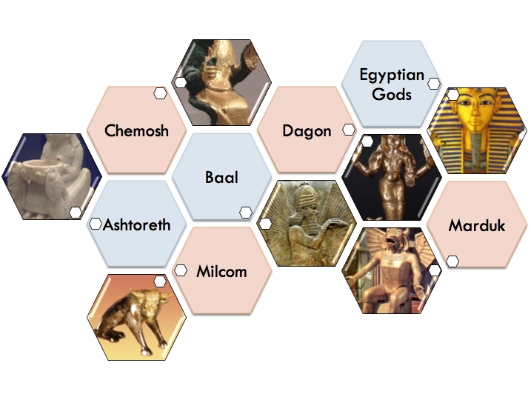
Some Fools In The Bible
The Religious / Idolatrous Fool
Idolatry is a major theme of the Bible.
Over 30 Pagan/false gods mentioned in the Bible.
Idolatry is the dethroning of the One True God in our heart & replacing Him with ANYTHING or ANYONE else!

Slide 12
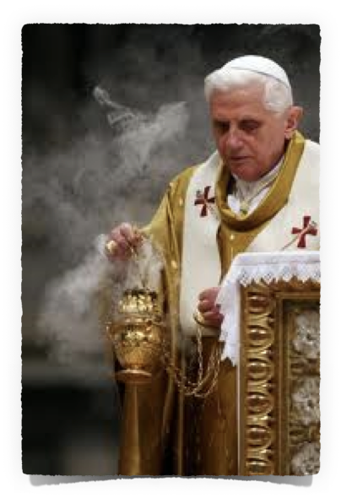
Some Fools In The Bible
The Religious / Idolatrous Fool
Eastern Religions –
Humanism -
Catholicism –
Money, Sports, Entertainment, Politics, Possessions
Doctrines & commandments of men - Mat 15:7-9

Slide 13
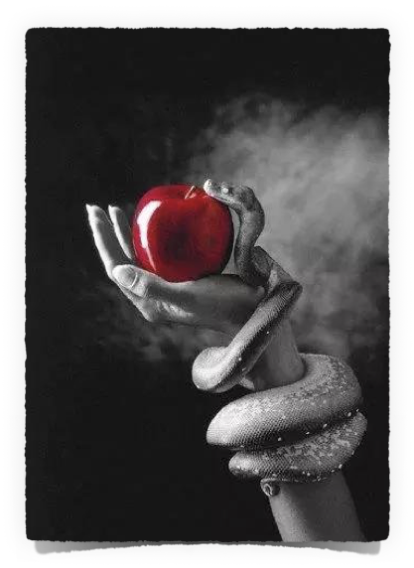
Some Fools In The Bible
The Immoral Fool
Proverbs 7:21–22 (NKJV)
²¹ With her enticing speech she caused him to yield, With her flattering lips she seduced him. ²² Immediately he went after her, as an ox goes to the slaughter, Or as a fool to the correction of the stocks,

Slide 14
Some Fools In The Bible
The Immoral Fool
Proverbs 6:32–33 (NKJV)
³² Whoever commits adultery with a woman lacks understanding; He who does so destroys his own soul. ³³ Wounds and dishonor he will get, And his reproach will not be wiped away.

Slide 15
Some Fools In The Bible
The Immoral Fool
1 Corinthians 6:9–11 (NKJV)
⁹ Do you not know that the unrighteous will not inherit the kingdom of God? Do not be deceived. Neither fornicators, nor idolaters, nor adulterers, nor homosexuals, nor sodomites, ¹⁰ nor thieves, nor covetous, nor drunkards, nor revilers, nor extortioners will inherit the kingdom of God. ¹¹ And such were some of you. But you were washed, but you were sanctified, but you were justified in the name of the Lord Jesus and by the Spirit of our God.

Slide 16
Some Fools In The Bible
The Immoral Fool
Revelation 21:7–8 (NKJV)
⁷ He who overcomes shall inherit all things, and I will be his God and he shall be My son. ⁸ But the cowardly, unbelieving, abominable, murderers, sexually immoral, sorcerers, idolaters, and all liars shall have their part in the lake which burns with fire and brimstone, which is the second death.”

Slide 17
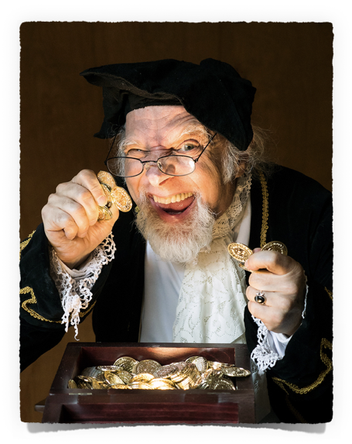
Some Fools In The Bible
The Materialistic Fool
Luke 12:13–21 (NKJV)
¹³ Then one from the crowd said to Him, “Teacher, tell my brother to divide the inheritance with me.” ¹⁴ But He said to him, “Man, who made Me a judge or an arbitrator over you?” ¹⁵ And He said to them, “Take heed and beware of covetousness, for one’s life does not consist in the abundance of the things he possesses.”

Slide 18
Some Fools In The Bible
The Materialistic Fool
Luke 12:13–21 (NKJV)
¹⁶ Then He spoke a parable to them, saying: “The ground of a certain rich man yielded plentifully. ¹⁷ And he thought within himself, saying, ‘What shall I do, since I have no room to store my crops?’ ¹⁸ So he said, ‘I will do this: I will pull down my barns and build greater, and there I will store all my crops and my goods. ¹⁹ And I will say to my soul, “Soul, you have many goods laid up for many years; take your ease; eat, drink, and be merry.” ’

Slide 19
Some Fools In The Bible
The Materialistic Fool
Luke 12:13–21 (NKJV)
²⁰ But God said to him, ‘Fool! This night your soul will be required of you; then whose will those things be which you have provided?’ ²¹ “So is he who lays up treasure for himself, and is not rich toward God.”

Slide 20
Some Fools In The Bible
The Materialistic Fool
We must lay our treasures up in heaven – Mat. 6:19-21
We must build our lives upon a lasting foundation – Mat 7:24-27
What is the eternal value of the things that you are pursuing?

Slide 21
Some Fools In The Bible
The Unprepared Fool
Matthew 25:1–13 (NKJV)
¹ “Then the kingdom of heaven shall be likened to ten virgins who took their lamps and went out to meet the bridegroom. ² Now five of them were wise, and five were foolish. ³ Those who were foolish took their lamps and took no oil with them, ⁴ but the wise took oil in their vessels with their lamps. ⁵ But while the bridegroom was delayed, they all slumbered and slept. ⁶ “And at midnight a cry was heard: ‘Behold, the bridegroom is coming; go out to meet him!’ ⁷ Then all those virgins arose and trimmed their lamps.

Slide 22
Some Fools In The Bible
The Unprepared Fool
Matthew 25:1–13 (NKJV)
⁸ And the foolish said to the wise, ‘Give us some of your oil, for our lamps are going out.’ ⁹ But the wise answered, saying, ‘No, lest there should not be enough for us and you; but go rather to those who sell, and buy for yourselves.’ ¹⁰ And while they went to buy, the bridegroom came, and those who were ready went in with him to the wedding; and the door was shut.

Slide 23
Some Fools In The Bible
The Unprepared Fool
Matthew 25:1–13 (NKJV)
¹¹ “Afterward the other virgins came also, saying, ‘Lord, Lord, open to us!’ ¹² But he answered and said, ‘Assuredly, I say to you, I do not know you.’ ¹³ “Watch therefore, for you know neither the day nor the hour in which the Son of Man is coming.

Slide 24
Some Fools In The Bible
The Unprepared Fool
Heaven is a prepared place for a prepared people – (John 14:1-6; 2 Tim 4:6-8; Rev 16:15)
We do not know when the Lord is coming - (2 Pet 3:10; Rev 3:3)
Are You Prepared To Meet The Lord?– (Mk 16:16; 2 Thes. 1:7-9)

Slide 25
Some Fools In The Bible
ARE YOU LIKE:
Are You Hardened?
The Unbelieving Fool
The Idolatrous Fool
The Immoral Fool
The Materialistic Fool
The Unprepared Fool
Are You Arrogant?
Are You Teachable?

Slide 26
Some Fools In The Bible
⁷ The fear of the Lord is the beginning of knowledge,
But fools despise wisdom and instruction.
— Proverbs 1:7 (NKJV) —
Ephesians 5:15–17 (NKJV)
¹⁵ See then that you walk circumspectly, not as fools but as wise, ¹⁶ redeeming the time, because the days are evil. ¹⁷ Therefore do not be unwise, but understand what the will of the Lord is.

Slide 27
Don McClain
W. 65th St church of Christ / April 13, 2008

Slide 28
Some Fools In The Bible
⁷ The fear of the Lord is the beginning of knowledge,
But fools despise wisdom and instruction.
Charts by Don McClain
Preached February 18, 2018
West 65th Street church of Christ / P.O. Box 190062 / Little Rock AR 72219 / 501-568-1062
Email – donmcclain@sbcglobal.net
More Keynote, PPT & Audio Sermons:
http://w65stchurchofchrist.org/coc/sermons/
— Proverbs 1:7 (NKJV) —

