Slide 1
“The Just Shall Live By Faith”
Habakkuk 2:4

Slide 2
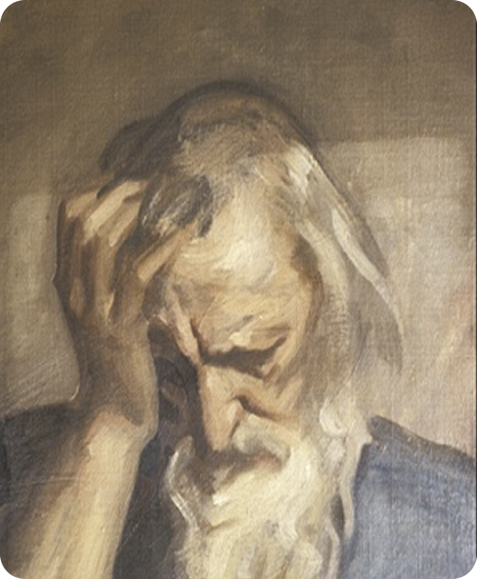
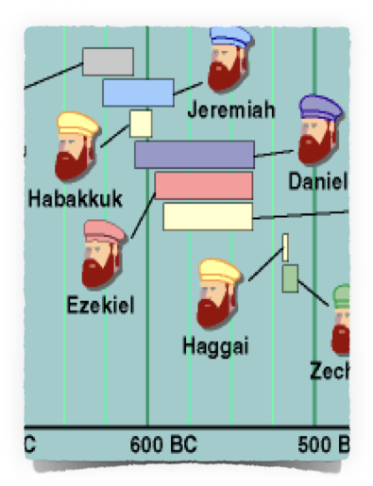
“The Just Shall Live By Faith”
Habakkuk 2:4
Author - Habakkuk: [Love's Embrace]
Habakkuk is specifically called a prophet - 1:1
Nothing is known of Habakkuk's birthplace or heritage.
When - 612-606 B.C. (1:5; 3:16)

Slide 3
Babylonia had just emerged as a world power - The Assyrians were forced to devote their energies to stop the Babylonian rebellion. - 612 BC
The Babylonians finally crushed the Assyrian Empire and proceeded to defeat the once-powerful Egyptians with the victory in the battle of Carchemish 605 BC
It was a time of international crisis and national corruption.

Slide 4
Josiah
640-609 BC
31 years /
Killed by Neco
Jehoahaz 609 BC
3 Months – taken prisoner by Neco
Jehoiakim 609-598 BC
11 Years / Died in Jerusalem
Jeoiachin 597 BC
3 MonthsTaken to Babylon by Neb.
Zedekiah – 597-586 BC
11 Years
Taken blind to Babylon
Captivity
586
After Josiah - Jehoahaz rose to the throne & did evil . . .
In only three months, the king of Egypt invaded Judah, deposed Jehoahaz, and placed his brother Jehoiakim on the throne.
Jehoiakim was evil, ungodly, & rebellious (2 Ki 23:36–24:7; 2 Chr 36:5–8).

Slide 5
Josiah
640-609 BC
31 years /
Killed by Neco
Jehoahaz 609 BC
3 Months – taken prisoner by Neco
Jehoiakim 609-598 BC
11 Years / Died in Jerusalem
Jeoiachin 597 BC
3 MonthsTaken to Babylon by Neb.
Zedekiah – 597-586 BC
11 Years
Taken blind to Babylon
Captivity
586
Shortly after Jehoiakim ascended to power, Habakkuk wrote his lament over the decay, violence, greed, fighting, and perverted justice that surrounded him.
No wonder Habakkuk looked at all the corruption and asked, “Why doesn’t God do something?” - 1:2-4

Slide 6
Habakkuk 1:2–4 (NKJV)
² O Lord, how long shall I cry, And You will not hear? Even cry out to You, “Violence!” And You will not save. ³ Why do You show me iniquity, And cause me to see trouble? For plundering and violence are before me; There is strife, and contention arises. ⁴ Therefore the law is powerless, And justice never goes forth. For the wicked surround the righteous; Therefore perverse judgment proceeds.

Slide 7
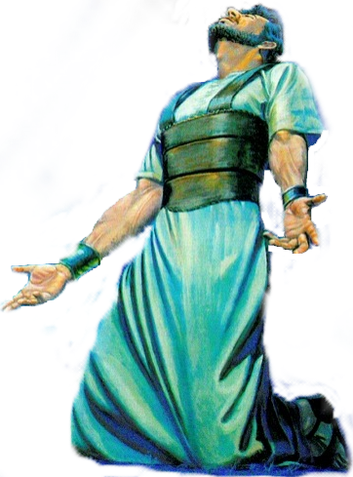
The burden which the prophet Habakkuk saw.
Habakkuk 1:1 (NKJV)
Unlike the other prophets, Habakkuk presented his message in the form of questions addressed to God - (Hab. 1:2,3).
Divided into two parts by the two superscriptions in 1:1 (“the oracle that Habakkuk the prophet received”) and 3:1 (“a prayer of Habakkuk the prophet”).
Book resembles the literary style of the Psalms and the Wisdom books. (esp chat 3)

Slide 8
The burden which the prophet Habakkuk saw.
Habakkuk 1:1 (NKJV)
Faith Struggling With A Sinful Nation & The Lord’s Reply – 1:1-11
Faith Struggling With God’s Judgment & The Lord’s Answer – 1:12-2:20
The Prophets Prayer: Fear & Humility With Hope before God - 3:1-16
The Prophets “Song“: Faith Glorying In Assurance - 3:17-19

Slide 9
“The Just Shall Live By Faith” — Habakkuk 2:4
The prophet’s perplexity – How can God remain indifferent to the wickedness of His people? – 1:2
The prophet’s lamentation -wickedness & violence rules in the land – 1:3,4
God’s reply – “I am raising up the Chaldeans” to judge this people – 1:5,6
God’s description of their character – Bitter, hasty, terrible, dreadful, violent, mockers, idolatrous – 1:6-11

Slide 10
“The Just Shall Live By Faith” — Habakkuk 2:4
The prophet’s perplexity – How can a holy God employ an impure and godless agent? – (1:12,13)
The prophet’s rationalization – The Chaldeans were more wicked than Israel – (1:14-2:1)
Write it down and make it plain – (2)
The time will come – (3)
A proud soul is not upright – but the just shall live by faith – (4)
Five woes proclaimed against wicked – (5-20)

Slide 11
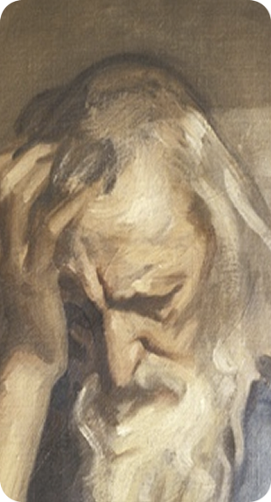
“The Just Shall Live By Faith” — Habakkuk 2:4
Woe to him who – (2:5-20)
Has an appetite for conquest — 2:5-8
Profits from evil gain because of greed and Pride — 2:9-11
Becomes rich through bloodshed & iniquity — 2:12-14
Corrupts his neighbors through alcohol and temptation — 2:15-17
Is given over to idolatry - 2:18-20
(Does Not Live By Faith)

Slide 12
“The Just Shall Live By Faith” — Habakkuk 2:4
The Prophets “Prayer":
Fear & Humility With Hope before God - 3:1-16
Praise for the Person of God (3:1-3)–(Asking that in His wrath He remember mercy - Praised God as Holy; Glorious; Praiseworthy)
Praise for the Power of God (3:4-7) – (God’s exposing light; His judgment upon the nations; power over the earth)

Slide 13
“The Just Shall Live By Faith” — Habakkuk 2:4
The Prophets “Prayer":
Fear & Humility With Hope before God - 3:1-16
Praise for the Purpose of God (3:8-16) – (Bringing both judgment to the wicked and salvation to His people )
Humility & Hope Before God (3:16) – (He trembled at what he has heard, that he will have rest in the day of trouble )

Slide 14
“The Just Shall Live By Faith” — Habakkuk 2:4
The Prophets “Song”:
Faith Glorying In Assurance - 3:17-19
Habakkuk 3:17–19 (NKJV)
¹⁷ Though the fig tree may not blossom, Nor fruit be on the vines; Though the labor of the olive may fail, And the fields yield no food; Though the flock may be cut off from the fold, And there be no herd in the stalls—

Slide 15
“The Just Shall Live By Faith” — Habakkuk 2:4
The Prophets “Song”:
Faith Glorying In Assurance - 3:17-19
Habakkuk 3:17–19 (NKJV)
¹⁸ Yet I will rejoice in the Lord, I will joy in the God of my salvation. ¹⁹ The Lord God is my strength; He will make my feet like deer’s feet, And He will make me walk on my high hills. To the Chief Musician. With my stringed instruments.

Slide 16
“The Just Shall Live By Faith” — Habakkuk 2:4
Faith Struggling With A Problem & The Lord’s Reply – 1:1-11
Faith Struggling With The Solution & The Lord’s Reply – 1:12-2:20
Faith & the Prophets Prayer: Fear & Humility With Hope before God - 3:1-16
Faith & the Prophets “Song“: Faith Glorying In Assurance - 3:17-19

Slide 17
“The Just Shall Live By Faith” — Habakkuk 2:4
God will judge the wicked
The faithful often suffer because of wickedness of others
Evil is self destructive
The fact of divine discipline
“The just shall live by his faith”

Slide 18
“The Just Shall Live By Faith” — Habakkuk 2:4
always has been & always will be the case!
“For in it the righteousness of God is revealed from faith to faith; as it is written, "The just shall live by faith." — Romans 1:17 (NKJV)
“But that no one is justified by the law in the sight of God is evident, for "the just shall live by faith." — Gal. 3:11 (NKJV)
“Now the just shall live by faith; But if anyone draws back, My soul has no pleasure in him.“ — Heb. 10:38 (NKJV)

Slide 19
“The Just Shall Live By Faith” — Habakkuk 2:4
always has been & always will be the case!
God is NOT indifferent towards sin today – God still judges nations and people!! – Prov 14:34; Acts 13:40,41; 17:26-31
We will reap what we sow – God’s judgment is coming - Gal 6:7-9; Rom 2:6-10
ARE YOU LIVING BY FAITH?

Slide 21
“The Just Shall Live By Faith”
Habakkuk 2:4
Charts by Don McClain
Preached - February 11, 2018
West 65th Street church of Christ
P.O. Box 190062, Little Rock AR 72219 / 501-568-1062
Prepared using Keynote / Email – donmcclain@sbcglobal.net
http://w65stchurchofchrist.com

Slide 22
Hebrews 10:32–39 (NKJV)
³² But recall the former days in which, after you were illuminated, you endured a great struggle with sufferings: ³³ partly while you were made a spectacle both by reproaches and tribulations, and partly while you became companions of those who were so treated; ³⁴ for you had compassion on me in my chains, and joyfully accepted the plundering of your goods, knowing that you have a better and an enduring possession for yourselves in heaven.

Slide 23
Hebrews 10:32–39 (NKJV)
³⁵ Therefore do not cast away your confidence, which has great reward. ³⁶ For you have need of endurance, so that after you have done the will of God, you may receive the promise: ³⁷ “For yet a little while, And He who is coming will come and will not tarry. ³⁸ Now the just shall live by faith; But if anyone draws back, My soul has no pleasure in him.” ³⁹ But we are not of those who draw back to perdition, but of those who believe to the saving of the soul.

