Slide 1
Hebrews 8:1-13

Slide 2
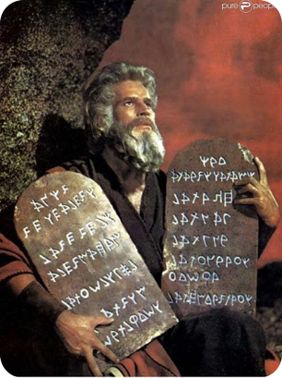
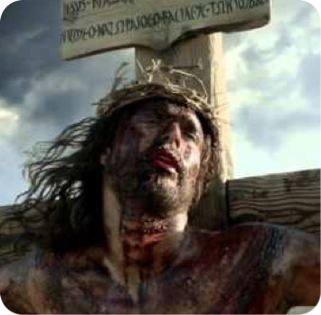
The failure to understand the difference, & make the distinction between the Old Covenant & New Covenant is the cause of much confusion & errors in todays religious world!
This is not just a modern problem but has plagued the church from the beginning - (cf. Romans; Galatians & Hebrews)

Slide 3
Hebrews 8:1–13 (NKJV)
¹ Now this is the main point of the things we are saying: We have such a High Priest, who is seated at the right hand of the throne of the Majesty in the heavens, ² a Minister of the sanctuary and of the true tabernacle which the Lord erected, and not man. ³ For every high priest is appointed to offer both gifts and sacrifices. Therefore it is necessary that this One also have something to offer.

Slide 4
Hebrews 8:1–13 (NKJV)
⁴ For if He were on earth, He would not be a priest, since there are priests who offer the gifts according to the law; ⁵ who serve the copy and shadow of the heavenly things, as Moses was divinely instructed when he was about to make the tabernacle. For He said, “See that you make all things according to the pattern shown you on the mountain.” ⁶ But now He has obtained a more excellent ministry, inasmuch as He is also Mediator of a better covenant, which was established on better promises. ⁷ For if that first covenant had been faultless, then no place would have been sought for a second.

Slide 5
Hebrews 8:1–13 (NKJV)
⁸ Because finding fault with them, He says: “Behold, the days are coming, says the Lord, when I will make a new covenant with the house of Israel and with the house of Judah—⁹ not according to the covenant that I made with their fathers in the day when I took them by the hand to lead them out of the land of Egypt; because they did not continue in My covenant, and I disregarded them, says the Lord. ¹⁰ For this is the covenant that I will make with the house of Israel after those days, says the Lord: I will put My laws in their mind and write them on their hearts; and I will be their God, and they shall be My people.

Slide 6
Hebrews 8:1–13 (NKJV)
¹¹ None of them shall teach his neighbor, and none his brother, saying, ‘Know the Lord,’ for all shall know Me, from the least of them to the greatest of them. ¹² For I will be merciful to their unrighteousness, and their sins and their lawless deeds I will remember no more.” ¹³ In that He says, “A new covenant,” He has made the first obsolete. Now what is becoming obsolete and growing old is ready to vanish away.

Slide 7
1347 διαθήκη (diathēkē), ης (ēs), ἡ (hē): n.fem.; ≡ DBLHebr 1382; Str 1242; TDNT 2.106—
LN 34.43 making of a covenant, promise in a solemn agreement (Mk 14:24; Lk 1:72; 22:20; Ac 3:25; 7:8; Ro 11:27; 1Co 11:25; 2Co 3:6; Gal 4:24; Eph 2:12; Heb 7:22; 12:24; 13:20);
LN 34.44 covenant, the content of an agreement between two parties (Gal 3:15);
LN 57.124 testament, making of a will (Heb 9:16, 17+) -
Swanson, J. (1997). Dictionary of Biblical Languages with Semantic Domains: Greek (New Testament) (electronic ed.). Oak Harbor: Logos Research Systems, Inc.

Slide 8
34.44 διαθήκη^{b}, ης f:
the verbal content of an agreement between two persons specifying reciprocal benefits and responsibilities—‘covenant, pact.’ …
Louw, J. P., & Nida, E. A. (1996). Greek-English lexicon of the New Testament: based on semantic domains (electronic ed. of the 2nd edition.). New York: United Bible Societies.

Slide 9
34.44 διαθήκη^{b}, ης f:
… Septuagint translators employed διαθήκη, literally ‘a final will or testament,’ in place of συνθήκη ‘contract, agreement,’ since they evidently wished to emphasize the fact that the initiative for such a covenantal relationship existed with one person rather than being the result of negotiation and compromise.
Louw, J. P., & Nida, E. A. (1996). Greek-English lexicon of the New Testament: based on semantic domains (electronic ed. of the 2nd edition.). New York: United Bible Societies.

Slide 10
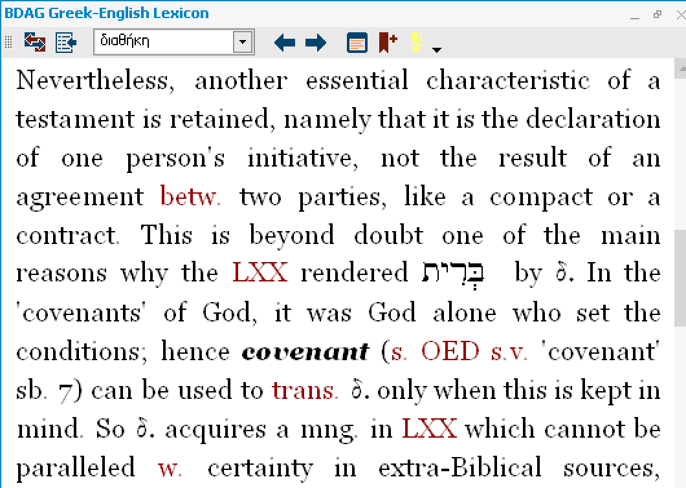
A Greek-English Lexicon of the New Testament and Other Early Christian Literature.

Slide 11
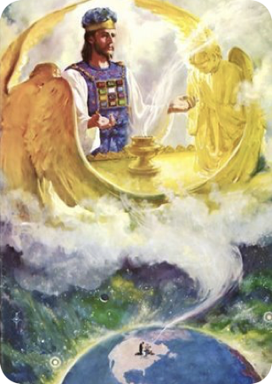
“Now this is the main point of the things we are saying:” — (8:1)
“The principal point” is now ready to be addressed -
Based on the fact that Christ is our great high priest, after the order of Melchizedek, - Jesus is worthy to be the minister of a better covenant.

Slide 12
Our "High Priest" is at the “right hand of the majesty on high” - (8:1)
Hebrews 8:1 (NKJV)
¹ Now this is the main point of the things we are saying: We have such a High Priest, who is seated at the right hand of the throne of the Majesty in the heavens,
Jesus is NOW BOTH King & Priest after the order of Melchizedek - 8:1; see 7:1; cf. Ge 14:18; Ps 110:4; Zec. 6:13; Col. 3:1; Re. 3:21; 1 Chr 29:23; 1 Ki 2:12; Ac 2:30-36
Christ's place of supreme authority mentioned 5 times in Hebrews - 1:3, 13; 10:12; 12:2;

Slide 13
Jesus is a priest of the “heavenly tabernacle” - (8:2-4)
Hebrews 8:2 (NKJV)
² a Minister of the sanctuary and of the true tabernacle which the Lord erected, and not man.
The work of the priest is to minister in the tabernacle - Ex 28:1,35
The OT tabernacle was a transitory structure - The “true tabernacle” on the other hand is of divine origin and is perfect for its purpose. It is eternal and unshakeable in the heavens. (9:8, 11,12, 23-25)

Slide 14
Jesus is a priest of the “heavenly tabernacle” - (8:2-4)
Hebrews 8:3 (NKJV)
³ For every high priest is appointed to offer both gifts and sacrifices. Therefore it is necessary that this One also have something to offer.
The primary role of a priest is to offer sacrifices at an altar. Jesus has a sacrifice & an altar upon which to offer gifts (9:11-15).
“but with His own blood He entered the Most Holy Place once for all, having obtained eternal redemption” - 9:12

Slide 15
Jesus is a priest of the “heavenly tabernacle” - (8:2-4)
Hebrews 8:4 (NKJV)
⁴ For if He were on earth, He would not be a priest, since there are priests who offer the gifts according to the law;
Jesus could not have been a priest on earth according to the Law - (Heb 7:13, 14)
Priest were still serving according to the Law, which was merely a shadow of the heavenly things - (5)

Slide 16
The Old Covenant A MERE Shadow of Better Things To Come
Hebrews 8:5 (NKJV)
⁵ who serve the copy and shadow of the heavenly things, as Moses was divinely instructed when he was about to make the tabernacle. For He said, “See that you make all things according to the pattern shown you on the mountain.”
Jesus could not have been a priest on earth according to the Law - (Heb 7:13, 14)
Priest were still serving according to the Law, which was merely a shadow of the heavenly things - (5)
It was important for the things which constituted the “SHADOW” be made according to the pattern God gave - (5)

Slide 17
The Ministry of Jesus & What He Provides Is FAR SUPERIOR
Hebrews 8:6 (NKJV)
⁶ But now He has obtained a more excellent ministry, inasmuch as He is also Mediator of a better covenant, which was established on better promises.
Christ Has A More Excellent Ministry - Heb 9:11, 24-28
Christ is “Mediator of a better Covenant” — (because of Him) — 1:1,2; 12:24; 1 Tim 2:5
The N.C. is Established on Better Promises — (The 1st covenant emphasized the land, national & earthly promises - - (types & shadows) - (Deut 28:1-14)

Slide 18
The Ministry of Jesus & What He Provides Is FAR SUPERIOR
Hebrews 8:6 (NKJV)
⁶ But now He has obtained a more excellent ministry, inasmuch as He is also Mediator of a better covenant, which was established on better promises.
The better promises of the better covenant denotes the whole system of salvation by faith in Christ -
All spiritual blessings - Eph 1:3;
Adoption / acceptance - Eph 1:5,6
forgiveness; redemption - Eph 1:7
New body - Phili 3:21; 1 Cor. 15:20ff
New home - Jn 14:1-6; Col. 1:5
Eternal life - John 3:16

Slide 19
The OLD COVENANT Had “Fault”
The Law of Moses Could Not Take Away Sin - (8:7)
It could not accomplish, (by design), what man needed most - the forgiveness of sin & peace with God - (10:1-4; Gal 3:10-14; Rom 7)
The Law emphasized the sinfulness of sin, (Rom 7:7,13), & pointed to the need for a new & better covenant - Rom 8:3; Gal 21-25; Jer 31:31-34)
Hebrews 8:7 (NKJV)
⁷ For if that first covenant had been faultless, then no place would have been sought for a second.

Slide 20
The New Covenant Was Promised By God - (8:8)
Hebrews 8:8 (NKJV)
⁸ Because finding fault with them, He says: “Behold, the days are coming, says the Lord, when I will make a new covenant with the house of Israel and with the house of Judah—
Heb 8:8-12 quotes Jer 31:31-34, (Heb 10:16,17)
The New Covenant was not contrary to the Law of Moses, or God’s promise to Abraham - (Gal 3:15-18)
The Law was given because of transgressions until the Seed should come to prepare the way for the NC - (Gal 3:19-25)

Slide 21
The New Covenant Was Promised By God - (8:8)
Hebrews 8:8 (NKJV)
⁸ Because finding fault with them, He says: “Behold, the days are coming, says the Lord, when I will make a new covenant with the house of Israel and with the house of Judah—
The second, (N.C.) fulfilled the spiritual element of God’s promise to Abraham - (Gal 3:26-29)
“House” God’s people are united under this NC - (vs. 10), Seeing this NC as a spiritual covenant, we should recognize the people (Israel & Judah), as God’s spiritual people - (Gal 6:16; 3:7-9, 28; Rom 2:28; 9:6-8; Phil 3:3; 1 Pet 2:5-9)

Slide 22
The New Covenant is different - (8:9)
Hebrews 8:9 (NKJV)
⁹ not according to the covenant that I made with their fathers in the day when I took them by the hand to lead them out of the land of Egypt; because they did not continue in My covenant, and I disregarded them, says the Lord.
The Hebrew writer is contrasting two covenants, or arrangements, through which His requirements & blessings have been made known to mankind.
The NC is NOT according to the OC given at Sinai - (Ex. 19:5,6; 24:3,7; 32:8; Jer 2:5-13)

Slide 23
The New Covenant is different - (8:9)
Hebrews 8:9 (NKJV)
⁹ not according to the covenant that I made with their fathers in the day when I took them by the hand to lead them out of the land of Egypt; because they did not continue in My covenant, and I disregarded them, says the Lord.
The first Covenant was largely carnal in that it was entered via physical birth, with accompanying physical promises, …
Whereas the NC is entered by a spiritual birth, (Jn 3:3-5; 1 Pet 1:22,23), emphasizing spiritual service, (Jn 4:24,25; Ro 2:28,29; 2 Cor 3:3,7,8; Jam 1:18-21) & spiritual promises (Heb 4:9; 9:6-15; Eph 1:3)

Slide 24
The New Covenant is different - (8:9)

Slide 25
The New Covenant is different - (8:9)
Main Differences:
 | Subjects | Where the Law is written | The Resulting Relationship
OC | Fleshly Israel — Deut 7:6 | Stone / (FLESH) - Ex. 24:12; 34:1; 2 Cor. 3:7; | National / Separate from other nations — Ex 19:5-6; etc
NC | Spiritual Israel — Rom 2:28 | Hearts / (MINDS) — Heb 8:10; 10:16; Rom 6:17; 12:1,2 | Spiritual / Separate from the world / from sin — 2 Cor. 6:14

Slide 26
The N.C. Prompts Inner / Spiritual Response- 8:10
Hebrews 8:10 (NKJV)
¹⁰ For this is the covenant that I will make with the house of Israel after those days, says the Lord: I will put My laws in their mind and write them on their hearts; and I will be their God, and they shall be My people.
“After those days” = the last days - the time which began at Pentecost & continues till Jesus returns in judgment - (Heb 1:1,2; Deut 18:15; Is 2:1; Acts 2:16-21)
The first covenant was written on stones, Ex. 24:4,7; 34:1,27; 2 Cor 3:7 - Under the NC, one’s obedience will be from the heart, (Rom 6:16-18; 1 Pet 1:22,23; 1 John 4:8-11)

Slide 27
The N.C. Prompts Inner / Spiritual Response- 8:10
Hebrews 8:10 (NKJV)
¹⁰ For this is the covenant that I will make with the house of Israel after those days, says the Lord: I will put My laws in their mind and write them on their hearts; and I will be their God, and they shall be My people.
This does NOT mean hypocritical obedience under the OC system accepted. - (Deut 30:6; 10:16; Lev 26:41; Jer 4:4)
In the NC sonship is chosen & attained through believing from the heart - emphasizes FAITH, HOPE & LOVE - (Jn 1:13; 3:3-5; 8:31,32; 14:23; Rom 6:3-6, 16-18; Gal 3:26-29; 2 Cor. 5:14,15; 1 Cor. 13).

Slide 28
Faith is necessary unto sonship - 8:11
Hebrews 8:11 (NKJV)
¹¹ None of them shall teach his neighbor, and none his brother, saying, ‘Know the Lord,’ for all shall know Me, from the least of them to the greatest of them.
One does not automatically enter into this new covenant relationship with God by virtue of his natural birth - (Like OC Rom. 4:1)
All who are in God’s kingdom will know Him because knowledge is a prerequisite of faith, & faith is a prerequisite of sonship - (Heb 11:6; Gal 3:26,27; Rom 10:14-17).

Slide 29
Faith is necessary unto sonship - 8:11
Hebrews 8:11 (NKJV)
¹¹ None of them shall teach his neighbor, and none his brother, saying, ‘Know the Lord,’ for all shall know Me, from the least of them to the greatest of them.
Spiritual birth is by choice, not inheritance — (Luke 8:11-15)
Whether Jew or Gentile, one can become a child of God through being born again of water & the Spirit - Jn 3:3-5; 1 Pet 1:22,23
God is NOT a respecter of persons - Acts 10:34,35; 15:14–18; Rom 2:5-11
The distinction is faith - not flesh! - Rom 4; Gal 3:10-29

Slide 30
The N.C. Reveals God’s System of Grace - 8:12,13
The Law (first covenant) demanded justice - payment for sin - (WORKS) Lev 20; & was against us - Col. 2:14; 2 Cor 3:7; Rom. 7; Gal 3:10
Under the New Covenant - absolute forgiveness is made available to sinners - (GRACE) - (Heb 10:16,17; Acts 13:37,38; Ro. 11:27; Ep. 1:7; 2:1-10; Col. 1:14; 1 Jno. 1:7–9; 2:1, 2; Re. 1:5.).
Hebrews 8:12 (NKJV)
¹² For I will be merciful to their unrighteousness, and their sins and their lawless deeds I will remember no more.”

Slide 31
The N.C. Reveals God’s System of Grace - 8:12,13
Hebrews 8:13 (NKJV)
¹³ In that He says, “A new covenant,” He has made the first obsolete. Now what is becoming obsolete and growing old is ready to vanish away.
The first covenant was both spiritual & civil - the spiritual element had already been nailed to the cross, (Col. 2:14). The civil aspect would be divinely removed in 70 AD; Mat 24
There is absolutely no aspect of the first covenant in force today - (Gal 2:21; 3:10,11; 5:1-4).

Slide 32
God’s Gift of SALVATION In Christ His SON!
The first covenant pointed to, foreshadowed, & led us to Christ in many ways! - (Jn 5:46; Dt 18:18,19; Gal 3:23-25; Heb 10:1; Col. 2:17)
Prophets looked forward to this time & longed to see it - (1 Pet 1:10-12).
God’s gift of salvation ONLY possible in Christ - GRACE - (Eph 2:8-10; Rom 5:8)

Slide 33
God’s Gift of SALVATION In Christ His SON!
Being under the New Covenant (grace) does NOT mean you do not HAVE to obey God - (Heb 10:26-31; 12:22-25; Rom. 6:1; Gal. 3:1; 2 Thes. 1:7-9; John 12:48)
The N.C. provides real, actual, present salvation in Christ — Acts 2:38; Rom 6:3-6; 10:4-17; Col. 2:11-13; Gal 3:26-29
AND the promise of eternal LIFE WITH our Lord — Titus 1:2; 1 Pet. 1:4; Col. 1:5

Slide 34
Hebrews 8:1-13
Are you a child of God by FAITH? —
Gal 3:26-29; Acts 22:16

Slide 35
Don McClain
W. 65th St church of Christ / May 6, 2007

Slide 36
Hebrews 8:1-13
Charts by Don McClain
Preached March 18, 2018
West 65th Street church of Christ / P.O. Box 190062 Little Rock AR 72219 / 501-568-1062
Prepared using Keynote / Email – donmcclain@sbcglobal.net
More Keynote, PPT & Audio Sermons:
http://w65stchurchofchrist.org/coc/sermons/

Slide 37
2 Corinthians 3:4–11 (NKJV)
⁴ And we have such trust through Christ toward God. ⁵ Not that we are sufficient of ourselves to think of anything as being from ourselves, but our sufficiency is from God, ⁶ who also made us sufficient as ministers of the new covenant, not of the letter but of the Spirit; for the letter kills, but the Spirit gives life. ⁷ But if the ministry of death, written and engraved on stones, was glorious, so that the children of Israel could not look steadily at the face of Moses because of the glory of his countenance, which glory was passing away,

Slide 38
2 Corinthians 3:4–11 (NKJV)
⁸ how will the ministry of the Spirit not be more glorious? ⁹ For if the ministry of condemnation had glory, the ministry of righteousness exceeds much more in glory. ¹⁰ For even what was made glorious had no glory in this respect, because of the glory that excels. ¹¹ For if what is passing away was glorious, what remains is much more glorious.

