Slide 1
The Subjects, Purpose & Duration of The
Old Covenant

Slide 2
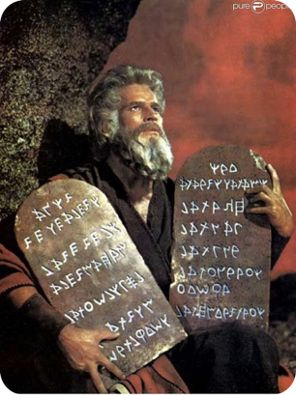
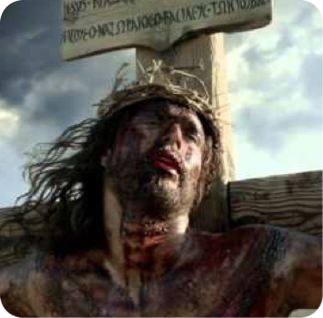
The failure to understand the difference, & make the distinction between the Old Covenant & New Covenant is the cause of much confusion & errors in todays religious world!
This is not just a modern problem but has plagued the church from the beginning - (cf. Romans; Galatians & Hebrews)

Slide 3
Hebrews 7:11–13 (NKJV)
¹¹ Therefore, if perfection were through the Levitical priesthood (for under it the people received the law), what further need was there that another priest should rise according to the order of Melchizedek, and not be called according to the order of Aaron? ¹² For the priesthood being changed, of necessity there is also a change of the law. ¹³ For He of whom these things are spoken belongs to another tribe, from which no man has officiated at the altar.

Slide 4
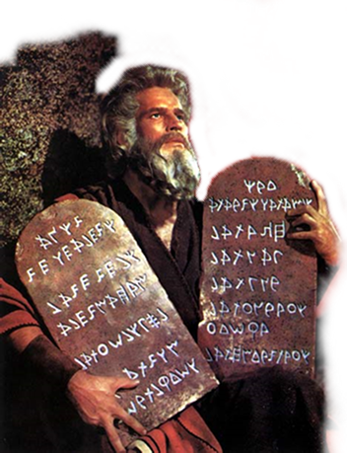
The Subjects, Purpose & Duration of The Old Covenant
The Ten Commandments, the heart of the O.C., is found in Exodus 20:1-17 and Deuteronomy 5:1-22
The Jewish scribes divided the Law of Moses into 613 commandments, 248 positive and 365 negative (Hendriksen. 809).
Four books, Exodus, Leviticus, Numbers and Deuteronomy.

Slide 5
The Subjects, Purpose & Duration of The Old Covenant
Theologians divide the Law into two parts: moral and ceremonial.
Most denominations teach that the moral law (10 commandments) is still binding but the ceremonial law is not. (Some teach that all of the Law is still binding)
The Bible itself makes no such distinction. (The Law is the Law)

Slide 6
The Subjects, Purpose & Duration of The Old Covenant
The Law was a covenant between God and Israel
(Exodus 19:5-6; 24:3-8; Deuteronomy 5:1-3).

Slide 7
The Subjects, Purpose & Duration of The Old Covenant
Exodus 19:5-8 (NKJV)
5 Now therefore, if you will indeed obey My voice and keep My covenant, then you shall be a special treasure to Me above all people; for all the earth is Mine. 6 And you shall be to Me a kingdom of priests and a holy nation.' These are the words which you shall speak to the children of Israel."

Slide 8
The Subjects, Purpose & Duration of The Old Covenant
Exodus 19:5-8 (NKJV)
7 So Moses came and called for the elders of the people, and laid before them all these words which the LORD commanded him. 8 Then all the people answered together and said, "All that the LORD has spoken we will do." So Moses brought back the words of the people to the LORD.

Slide 9
The Subjects, Purpose & Duration of The Old Covenant
Exodus 24:3-8 (NKJV)
3 So Moses came and told the people all the words of the LORD and all the judgments. And all the people answered with one voice and said, "All the words which the LORD has said we will do." 4 And Moses wrote all the words of the LORD. And he rose early in the morning, and built an altar at the foot of the mountain, and twelve pillars according to the twelve tribes of Israel.

Slide 10
The Subjects, Purpose & Duration of The Old Covenant
Exodus 24:3-8 (NKJV)
5 Then he sent young men of the children of Israel, who offered burnt offerings and sacrificed peace offerings of oxen to the LORD. 6 And Moses took half the blood and put it in basins, and half the blood he sprinkled on the altar. 7 Then he took the Book of the Covenant and read in the hearing of the people. And they said, "All that the LORD has said we will do, and be obedient."

Slide 11
The Subjects, Purpose & Duration of The Old Covenant
Exodus 24:3-8 (NKJV)
8 And Moses took the blood, sprinkled it on the people, and said, "This is the blood of the covenant which the LORD has made with you according to all these words."

Slide 12
The Subjects, Purpose & Duration of The Old Covenant
Deuteronomy 5:1-3 (NKJV)
1 And Moses called all Israel, and said to them: "Hear, O Israel, the statutes and judgments which I speak in your hearing today, that you may learn them and be careful to observe them. 2 The LORD our God made a covenant with us in Horeb. 3 The LORD did not make this covenant with our fathers, but with us, those who are here today, all of us who are alive.

Slide 13
The Subjects, Purpose & Duration of The Old Covenant
Psalm 147:19-20 (NKJV)
19 He declares His word to Jacob, His statutes and His judgments to Israel. 20 He has not dealt thus with any nation; And as for His judgments, they have not known them. Praise the LORD!

Slide 14
The Subjects, Purpose & Duration of The Old Covenant
"A covenant is a binding contract between two parties, both of whom have obligations specified in the covenant." (Fee and Stuart. 150)
The Law
God
Israel
We will keep
You shall keep

Slide 15
The Subjects, Purpose & Duration of The Old Covenant
"A covenant is a binding contract between two parties, both of whom have obligations specified in the covenant." (Fee and Stuart. 150)
Israel
God’s chosen people
Separated from the world as a nation -
The Law
613 Commands
Toward God
Toward Others
National / Civil
God
You shall keep

Slide 16
The Subjects, Purpose & Duration of The Old Covenant
To govern the nation of Israel that they may be separate from other nations – Deut. 4:8,9; Psalm 147:19,20
Added because of transgression – To provide a standard by which sin may be known – Gal. 3:19; Romans 3:20; 4:15; 7:7-13
A tutor to bring us to Christ – Gal. 3:23,24

Slide 17
The Subjects, Purpose & Duration of The Old Covenant
A Shadow of Good Things To Come
Colossians 2:17 (NKJV)
17 which are a shadow of things to come, but the substance is of Christ.

Slide 18
The Subjects, Purpose & Duration of The Old Covenant
A Shadow of Good Things To Come
Hebrews 8:5-6 (NKJV)
5 who serve the copy and shadow of the heavenly things, . . . 6 But now He has obtained a more excellent ministry, inasmuch as He is also Mediator of a better covenant, which was established on better promises.

Slide 19
The Subjects, Purpose & Duration of The Old Covenant
A Shadow of Good Things To Come
Hebrews 9:23-24 (NKJV)
23 Therefore it was necessary that the copies of the things in the heavens should be purified with these, but the heavenly things themselves with better sacrifices than these. 24 For Christ has not entered the holy places made with hands, which are copies of the true . . .

Slide 20
The Subjects, Purpose & Duration of The Old Covenant
Aspects Of The Law Said To Last Forever –
Aaron and his sons to tend the Tabernacle and altar “forever” – Exodus 27:21; Leviticus 24:8
Aaron and his sons offering the heave offering – Exodus 29:28
Aaron and his sons to offer the grain offering – Leviticus 6:22
The land promise - Exodus 32:13

Slide 21
The Subjects, Purpose & Duration of The Old Covenant
Aspects Of The Law Said To Last Forever –
The Levitical priesthood – Exodus 40:15; Deut. 18:5; Numbers 25:13; Heb 11:7-16
The Passover and feast of unleavened bread – Exodus 12:14-24
The Sabbath – Exodus 31:12-17

Slide 22
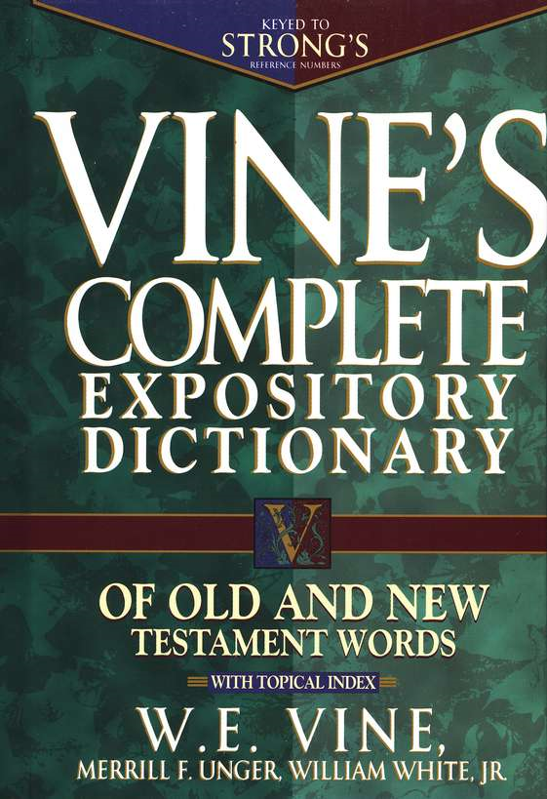
The Subjects, Purpose & Duration of The Old Covenant
Aspects Of The Law Said To Last Forever –
Everlasting; Forever <H5769> עוֹלָם‎, ʿôlām
“Eternity" in the sense of not being limited to the present
With the preposition 'ad, the word can mean "into the indefinite future"
In the largest number of its occurrences. . . with the preposition le. . . - "simple duration."

Slide 23
The Subjects, Purpose & Duration of The Old Covenant
Jesus Came?
Not to destroy –
(Thayer) - kataluw kataluo - Metaph. to overthrow i.e. render vain, deprive of success, bring to naught, to subvert, overthrow
(Matthew 24:2)
Matthew 5:17-20 (NKJV)
¹⁷ "Do not think that I came to destroy the Law or the Prophets. I did not come to destroy but to fulfill. ¹⁸ For assuredly, I say to you, till heaven and earth pass away, one jot or one tittle will by no means pass from the law till all is fulfilled.

Slide 24
The Subjects, Purpose & Duration of The Old Covenant
Jesus Came?
But To Fulfill –
Fulfill – Thayer –
1) to make full, to fill up, i.e. to fill to the full
2) to render full, i.e. to complete
2a) to fill to the top: so that nothing shall be wanting . . .
Matthew 5:17-20 (NKJV)
¹⁷ "Do not think that I came to destroy the Law or the Prophets. I did not come to destroy but to fulfill. ¹⁸ For assuredly, I say to you, till heaven and earth pass away, one jot or one tittle will by no means pass from the law till all is fulfilled.

Slide 25
The Subjects, Purpose & Duration of The Old Covenant
Fulfilled every prophecy – Deut. 18:15,18-19; Is 53:1-12; Dan 2:44; Mark 9:1; Col. 1:13; John 18:37
Fulfilled it by perfectly keeping it – Heb 4:15; 1 Pet 2:22
Fulfilled it by satisfying its demand for justice, offering Himself as the all sufficient sacrifice – Heb 9:23-28
Jesus Came?
But To Fulfill –
Fulfill – Thayer –
1) to make full, to fill up, i.e. to fill to the full
2) to render full, i.e. to complete
2a) to fill to the top: so that nothing shall be wanting . . .

Slide 26
The Subjects, Purpose & Duration of The Old Covenant
Jesus Came?
But To Fulfill –
Fulfill – Thayer –
1) to make full, to fill up, i.e. to fill to the full
2) to render full, i.e. to complete
2a) to fill to the top: so that nothing shall be wanting . . .
John 17:4 (NKJV)
⁴ I have glorified You on the earth. I have finished the work which You have given Me to do.
(John 4:34; 19:30)

Slide 27
The Subjects, Purpose & Duration of The Old Covenant
Matthew 5:17-20 (NKJV)
18 For assuredly, I say to you, till heaven and earth pass away, one jot or one tittle will by no means pass from the law till all is fulfilled.
Jesus Taught The Stability of The Law?
It would ALL be in force until it was fulfilled!
(Luke 16:17)

Slide 28
The Subjects, Purpose & Duration of The Old Covenant
Galatians 3:23-25 (NKJV)
23 But before faith came, we were kept under guard by the law, kept for the faith which would afterward be revealed. 24 Therefore the law was our tutor to bring us to Christ, that we might be justified by faith. 25 But after faith has come, we are no longer under a tutor.
Jesus Taught The Stability of The Law?
It would ALL be in force until it was fulfilled!
(Luke 16:17)

Slide 29
The Subjects, Purpose & Duration of The Old Covenant
Hebrews 10:9
then He said, “Behold, I have come to do Your will, O God.” He takes away the first that He may establish the second.
7:12, Change –
7:18, Annulling –
8:13, Obsolete
Jesus Taught The Stability of The Law?
It would ALL be in force until it was fulfilled!
(Luke 16:17)

Slide 30
The Subjects, Purpose & Duration of The Old Covenant
If it can be shown that ANY part of the Law has ceased to remain in force – then it has all ceased to be in force
Jesus Taught The Stability of The Law?
It would ALL be in force until it was fulfilled!
(Luke 16:17)

Slide 31
The Subjects, Purpose & Duration of The Old Covenant
The OLD COVENANT Had “Fault”
The Law of Moses Could Not Take Away Sin - (8:7)
It could not accomplish, (by design), what man needed most - the forgiveness of sin & peace with God - (10:1-4; Gal 3:10-14; Rom 7)
The Law emphasized the sinfulness of sin, (Rom 7:7,13), & pointed to the need for a new & better covenant - Rom 8:3; Gal 21-25; Jer 31:31-34)
Hebrews 8:7 (NKJV)
⁷ For if that first covenant had been faultless, then no place would have been sought for a second.

Slide 32
The Subjects, Purpose & Duration of The Old Covenant
A New Covenant Was Promised By God - (8:8)
Hebrews 8:8 (NKJV)
⁸ Because finding fault with them, He says: “Behold, the days are coming, says the Lord, when I will make a new covenant with the house of Israel and with the house of Judah—
Heb 8:8-12 quotes Jer 31:31-34, (Heb 10:16,17)
The New Covenant was not contrary to the Law of Moses, or God’s promise to Abraham - (Gal 3:15-18)
The Law was given because of transgressions until the Seed should come to prepare the way for the NC - (Gal 3:19-25)

Slide 33
The Subjects, Purpose & Duration of The Old Covenant
The New Covenant is different - (8:9)
Hebrews 8:9 (NKJV)
⁹ not according to the covenant that I made with their fathers in the day when I took them by the hand to lead them out of the land of Egypt; because they did not continue in My covenant, and I disregarded them, says the Lord.
The first Covenant was largely carnal in that it was entered via physical birth, with accompanying physical promises, …
Whereas the NC is entered by a spiritual birth, (Jn 3:3-5; 1 Pet 1:22,23), emphasizing spiritual service, (Jn 4:24,25; Ro 2:28,29; 2 Cor 3:3,7,8; Jam 1:18-21) & spiritual promises (Heb 4:9; 9:6-15; Eph 1:3)

Slide 34
The Subjects, Purpose & Duration of The Old Covenant

Slide 35
The Subjects, Purpose & Duration of The Old Covenant
Main Differences:
 | Subjects | Where the Law is written | The Resulting Relationship
OC | Fleshly Israel — Deut 7:6 | Stone / (FLESH) - Ex. 24:12; 34:1; 2 Cor. 3:7; | National / Separate from other nations — Ex 19:5-6; etc
NC | Spiritual Israel — Rom 2:28 | Hearts / (MINDS) — Heb 8:10; 10:16; Rom 6:17; 12:1,2 | Spiritual / Separate from the world / from sin — 2 Cor. 6:14

Slide 36
The Subjects, Purpose & Duration of The Old Covenant
Hebrews 8:13 (NKJV)
¹³ In that He says, “A new covenant,” He has made the first obsolete. Now what is becoming obsolete and growing old is ready to vanish away.
The first covenant was both spiritual & civil - the spiritual element had already been nailed to the cross, (Col. 2:14). The civil aspect would be divinely removed in 70 AD; Mat 24
There is absolutely no aspect of the first covenant in force today - (Gal 2:21; 3:10,11; 5:1-4).

Slide 37
The Subjects, Purpose & Duration of The Old Covenant
Romans 15:4 (NKJV)
4 For whatever things were written before were written for our learning, that we through the patience and comfort of the Scriptures might have hope.

Slide 38
The Subjects, Purpose & Duration of The Old Covenant
It Is The Word of God – 2 Pet 1:20-21
It Was Written For Our Admonition – 1 Cor. 10:11
It was written for our learning – Romans 15:4
Makes one wise regarding salvation – 2 Tim 3:15

Slide 39
The Subjects, Purpose & Duration of The Old Covenant
Life’s basic questions are answered . . .
God holds man accountable to a divine standard . . .
The nature and attributes of God are revealed . . .
The OT has immeasurable evidential value . . .
The OT furnishes the background for much of the NT.

Slide 40
The Subjects, Purpose & Duration of The Old Covenant
To Whom Was It Given?
What Was Its purpose?
What Was To Be Its Duration?
Its Relevance To Us?

Slide 41
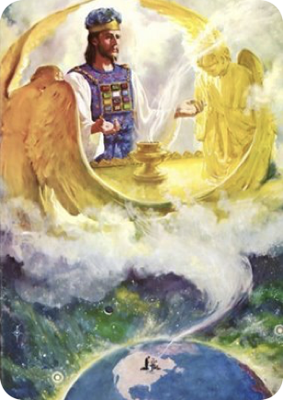
God’s Gift of SALVATION In Christ His SON!
The first covenant pointed to, foreshadowed, & led us to Christ in many ways! - (Jn 5:46; Dt 18:18,19; Gal 3:23-25; Heb 10:1; Col. 2:17)
Prophets looked forward to this time & longed to see it - (1 Pet 1:10-12).
God’s gift of salvation ONLY possible in Christ - GRACE - (Eph 2:8-10; Rom 5:8)

Slide 42
God’s Gift of SALVATION In Christ His SON!
Being under the New Covenant (grace) does NOT mean you do not HAVE to obey God - (Heb 10:26-31; 12:22-25; Rom. 6:1; Gal. 3:1; 2 Thes. 1:7-9; John 12:48)
The N.C. provides real, actual, present salvation in Christ — Acts 2:38; Rom 6:3-6; 10:4-17; Col. 2:11-13; Gal 3:26-29
AND the promise of eternal LIFE WITH our Lord — Titus 1:2; 1 Pet. 1:4; Col. 1:5

Slide 43
Hebrews 8:1-13
Are you a child of God by FAITH? —
Gal 3:26-29; Acts 22:16

Slide 44
The Subjects, Purpose & Duration of The
Old Covenant
Charts by Don McClain
Preached March 18, 2018
West 65th Street church of Christ / P.O. Box 190062 Little Rock AR 72219 / 501-568-1062
Prepared using Keynote / Email – donmcclain@sbcglobal.net
More Keynote, PPT & Audio Sermons:
http://w65stchurchofchrist.org/coc/sermons/

