Slide 1
How To
BECOME A
WISE
INVESTOR

Slide 2
BECOME A
WISE
INVESTOR
TAKING INVENTORY
We are to examine ourselves — (2 Cor. 13:5)
Do we have what we ought to have? - (Heb 5:12-14; Col. 3:1-16)
What of our values, focus & commitment? — (Mat 6:19-33)

Slide 3
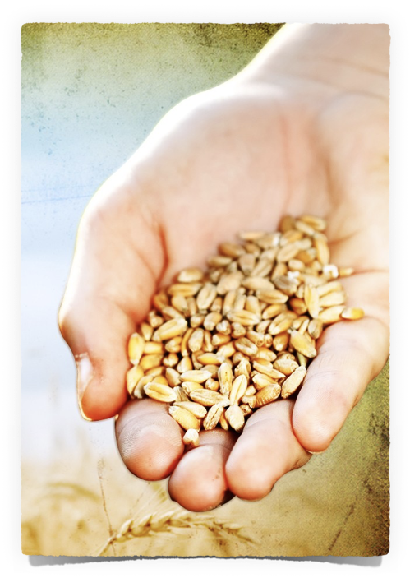
BECOME A
WISE
INVESTOR
TAKING INVENTORY
Have our expenditures in time, resources and effort resulted in:
Our spiritual growth? — (Matthew 13:18-23; 2 Peter 1:5-11)
The growth of the kingdom? — (Matthew 6:33; 29:19,20; Acts 8:4; Ephesians 4:12-16; etc.

Slide 4
BECOME A
WISE
INVESTOR
Philippians 3:12-16 (NKJV)
¹² Not that I have already attained, or am already perfected; but I press on, that I may lay hold of that for which Christ Jesus has also laid hold of me. ¹³ Brethren, I do not count myself to have apprehended; but one thing I do, forgetting those things which are behind and reaching forward to those things which are ahead, ¹⁴ I press toward the goal for the prize of the upward call of God in Christ Jesus. ¹⁵ Therefore let us, as many as are mature, have this mind; and if in anything you think otherwise, God will reveal even this to you. ¹⁶ Nevertheless, to the degree that we have already attained, let us walk by the same rule, let us be of the same mind.

Slide 5
BECOME A
WISE
INVESTOR
“Life under the sun”
The message of Ecclesiastes - “Vanity of vanities! All is vanity.”
Life is frequently disappointing, unfair, oppressive, tragic, and seemingly without point or meaning.

Slide 6
BECOME A
WISE
INVESTOR
“Life under the sun”
BUT, we should NOT take the message of Ecclesiastes to be predominately negative!
The wise man points us away from worthless things to the things in life that REALLY MATTER!

Slide 7
BECOME A
WISE
INVESTOR
“Life under the sun”
The last 2 chapters emphasize the need to INVEST our resources, time, efforts, & abilities toward that which will LAST instead of towards things that will PERISH — 12:7
God will hold us all accountable to our PURPOSE in the end. — 12:13,14

Slide 8
Ecclesiastes 11:1–8 (NKJV)
¹ Cast your bread upon the waters, For you will find it after many days. ² Give a serving to seven, and also to eight, For you do not know what evil will be on the earth. ³ If the clouds are full of rain, They empty themselves upon the earth; And if a tree falls to the south or the north, In the place where the tree falls, there it shall lie.

Slide 9
Ecclesiastes 11:1–8 (NKJV)
⁴ He who observes the wind will not sow, And he who regards the clouds will not reap. ⁵ As you do not know what is the way of the wind, Or how the bones grow in the womb of her who is with child, So you do not know the works of God who makes everything. ⁶ In the morning sow your seed, And in the evening do not withhold your hand;

Slide 10
Ecclesiastes 11:1–8 (NKJV)
For you do not know which will prosper, Either this or that, Or whether both alike will be good. ⁷ Truly the light is sweet, And it is pleasant for the eyes to behold the sun; ⁸ But if a man lives many years And rejoices in them all, Yet let him remember the days of darkness, For they will be many. All that is coming is vanity.

Slide 11
BECOME A
WISE
INVESTOR
Invest In Sacrificial Living (11:1,2)
Ecclesiastes 11:1–2 (NKJV)
¹ Cast your bread upon the waters, For you will find it after many days. ² Give a serving to seven, and also to eight, For you do not know what evil will be on the earth.
"Cast your bread upon the waters,” — A metaphor for engaging in thankless toil — i.e., do good without hope of return — (Luke 14:12-14)
"For you will find it after many days” — However, what we do now will be returned later — (Pr. 11:24,25; 19:17. Mat. 6:4; 7:2; 10:41,42; 25:34–40; 2 Cor. 9:8; Gal. 6:9, 10; Heb. 6:10; Luke 6:38).

Slide 12
BECOME A
WISE
INVESTOR
Invest In Sacrificial Living (11:1,2)
Ecclesiastes 11:1–2 (NKJV)
¹ Cast your bread upon the waters, For you will find it after many days. ² Give a serving to seven, and also to eight, For you do not know what evil will be on the earth.
“Give a serving to seven, & also to eight” — Diversify your investments - i.e., do good for as many as you can, while you can, as often as you can — (Luke 6:30-35; 16:9; 1 Tim 6:18).
This is practical wisdom, (Luke 16:9), for we do not know when we may need help — (Ga. 6:1. Ep. 5:16)

Slide 13
BECOME A
WISE
INVESTOR
Invest In Sacrificial Living (11:1,2)
Ecclesiastes 11:1–2 (NKJV)
¹ Cast your bread upon the waters, For you will find it after many days. ² Give a serving to seven, and also to eight, For you do not know what evil will be on the earth.
Most apply the principle to benevolence - but can also be applied to:
Being actively involved in good works - Mt 5:13-16; Rom 12:1,2; 1 Pet 3:1-6
Mercy / Forgiveness - Luke 6:38
Evangelism — Mat 13:18-23; 1 Cor 3:5-8; 9:19-23

Slide 14
BECOME A
WISE
INVESTOR
Invest In Self Discipline (11:3,4)
Ecclesiastes 11:3–4 (NKJV)
³ If the clouds are full of rain, They empty themselves upon the earth; And if a tree falls to the south or the north, In the place where the tree falls, there it shall lie. ⁴ He who observes the wind will not sow, And he who regards the clouds will not reap.

Slide 15
BECOME A
WISE
INVESTOR
Invest In Self Discipline (11:3,4)
“They empty themselves … there it shall lie” — Though the future is uncertain and we may find ourselves HELPLESS against the forces of nature, and various realities of life, we cannot ALLOW uncertainty to rob us of our diligence and our engagement in necessary activities! — Eccl. 9:10
Ecclesiastes 11:3–4 (NKJV)
³ If the clouds are full of rain, They empty themselves upon the earth; And if a tree falls to the south or the north, In the place where the tree falls, there it shall lie. ⁴ He who observes the wind will not sow, And he who regards the clouds will not reap.

Slide 16
BECOME A
WISE
INVESTOR
Invest In Self Discipline (11:3,4)
We cannot allow our focus to be on the negatives of life - doing good in the face of adverse circumstances requires SELF-DISCIPLINE - Pr. 3:27; Mat 14:28-31
We CANNOT allow any APPARENT lack of success to dissuade us from continued faithfulness - 1 Cor 3:5-8; James 4:17
Ecclesiastes 11:3–4 (NKJV)
³ If the clouds are full of rain, They empty themselves upon the earth; And if a tree falls to the south or the north, In the place where the tree falls, there it shall lie. ⁴ He who observes the wind will not sow, And he who regards the clouds will not reap.

Slide 17
BECOME A
WISE
INVESTOR
Invest In Self Discipline (11:3,4)
God will not accept our excuses!!
Proverbs 20:4 (NKJV) ⁴ The lazy man will not plow because of winter; He will beg during harvest and have nothing.
Proverbs 22:13 (NKJV) ¹³ The lazy man says, “There is a lion outside! I shall be slain in the streets!”
Matthew 25:41 (NKJV) ⁴¹ “…‘Depart from Me, you cursed, into the everlasting fire prepared for the devil and his angels:
Ecclesiastes 11:3–4 (NKJV)
³ If the clouds are full of rain, They empty themselves upon the earth; And if a tree falls to the south or the north, In the place where the tree falls, there it shall lie. ⁴ He who observes the wind will not sow, And he who regards the clouds will not reap.

Slide 18
BECOME A
WISE
INVESTOR
Invest In Faithfulness (11:5,6)
Ecclesiastes 11:5–6 (NKJV)
⁵ As you do not know what is the way of the wind, Or how the bones grow in the womb of her who is with child, So you do not know the works of God who makes everything. ⁶ In the morning sow your seed, And in the evening do not withhold your hand; For you do not know which will prosper, Either this or that, Or whether both alike will be good.

Slide 19
BECOME A
WISE
INVESTOR
Invest In Faithfulness (11:5,6)
Ecclesiastes 11:5–6 (NKJV)
⁵ As you do not know what is the way of the wind, Or how the bones grow in the womb of her who is with child, So you do not know the works of God who makes everything. ⁶ In the morning sow your seed, And in the evening do not withhold your hand; For you do not know which will prosper, Either this or that, Or whether both alike will be good.
There are MANY things we CANNOT know - we CANNOT comprehend - Deut 29:29; Rom 11:33-36; etc.
If we REALLY TRUST God we will continue to obey His commands, even if and when we do NOT fully understand the why of it, or the how it will accomplish God’s will - Josh. 6; 2 Ki 5; Gen 16-18; 22; Mark 16:16; Acts 2:38; Eph 5:19; etc.

Slide 20
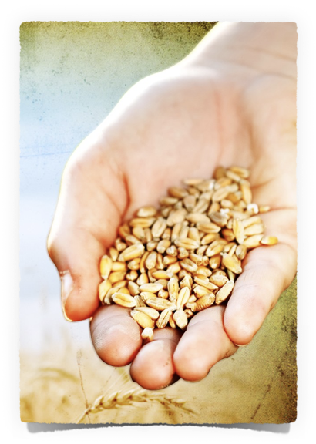
BECOME A
WISE
INVESTOR
Invest In TODAY (11:7,8)
Ecclesiastes 11:7–8 (NKJV)
⁷ Truly the light is sweet, And it is pleasant for the eyes to behold the sun; ⁸ But if a man lives many years And rejoices in them all, Yet let him remember the days of darkness, For they will be many. All that is coming is vanity.

Slide 21
BECOME A
WISE
INVESTOR
Invest In TODAY (11:7,8)
“When one acts benevolently and works diligently as Koheleth has previously advised, life is worth living, and affords continuous enjoyment for the faithful worker. …
“The thought that the night comes when no man can work (John 9:4) should stir mankind to make the best of every day of life, to be content and cheerful, to perform daily duties with the consciousness that this is the day of labor and joy.”
Ecclesiastes 11:7–8 (NKJV)
⁷ Truly the light is sweet, And it is pleasant for the eyes to behold the sun; ⁸ But if a man lives many years And rejoices in them all, Yet let him remember the days of darkness, For they will be many. All that is coming is vanity.
Smith, J. E. (1996). The wisdom literature and Psalms

Slide 22
BECOME A
WISE
INVESTOR
Invest In TODAY (11:7,8)
Today is the day of salvation — (2 Cor. 6:2; Heb. 3:7,13)
Faithfulness brings true fulfillment and joy to life — (Acts 16:34; Phili 4:6-13).
We have today, we do not know what will be tomorrow — (Eccl. 9:10; Mat 6:33,34; Eph 5:16; James 4:13-17)
One day, tomorrow will not come! — (Luke 12:13-21)
Ecclesiastes 11:7–8 (NKJV)
⁷ Truly the light is sweet, And it is pleasant for the eyes to behold the sun; ⁸ But if a man lives many years And rejoices in them all, Yet let him remember the days of darkness, For they will be many. All that is coming is vanity.

Slide 23
BECOME A
WISE
INVESTOR
Invest In TODAY (11:7,8)
The Earlier The Better
Ecclesiastes 11:9–10 (NKJV)
⁹ Rejoice, O young man, in your youth, And let your heart cheer you in the days of your youth; Walk in the ways of your heart, And in the sight of your eyes; But know that for all these God will bring you into judgment. ¹⁰ Therefore remove sorrow from your heart, And put away evil from your flesh, For childhood and youth are vanity.

Slide 24
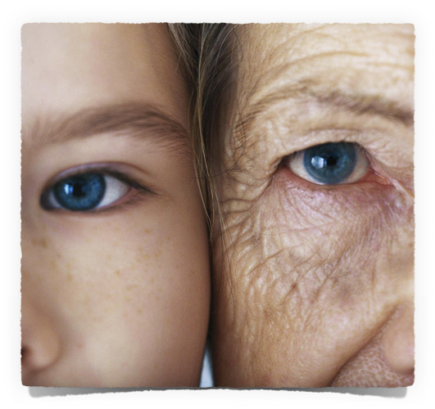
BECOME A
WISE
INVESTOR
Invest In TODAY (11:7,8)
The Earlier The Better
Before difficult days come (12:1,2)
Before loss of strength & teeth – (12:3)
Everything becomes more difficult, hearing loss – (12:4)
Weak & feeble, gray, everything hard, no pleasure in things once enjoyed – (12:5)
Death, mourning – (12:6)

Slide 25
BECOME A
WISE
INVESTOR
Invest In The Future (12:7-14)
Ecclesiastes 12:7–14 (NKJV)
⁷ Then the dust will return to the earth as it was, And the spirit will return to God who gave it. ⁸ “Vanity of vanities,” says the Preacher, “All is vanity.” ⁹ And moreover, because the Preacher was wise, he still taught the people knowledge; yes, he pondered and sought out and set in order many proverbs. ¹⁰ The Preacher sought to find acceptable words; and what was written was upright—words of truth. ¹¹ The words of the wise are like goads, and the words of scholars are like well-driven nails, given by one Shepherd.

Slide 26
BECOME A
WISE
INVESTOR
Invest In The Future (12:7-14)
Ecclesiastes 12:7–14 (NKJV)
¹² And further, my son, be admonished by these. Of making many books there is no end, and much study is wearisome to the flesh. ¹³ Let us hear the conclusion of the whole matter: Fear God and keep His commandments, For this is man’s all. ¹⁴ For God will bring every work into judgment, Including every secret thing, Whether good or evil.

Slide 27
BECOME A
WISE
INVESTOR
Invest In The Future (12:7-14)
Place a greater value on spiritual things — Mat. 6:19-21,33
Increase my spiritual focus — (Mat 6:22,23; Col. 3:1,2)
Increase my loyalty to Jesus and serve Him and Him alone — (Mat. 6:24; Luke 9:23)
Bear more fruit by growing in my knowledge of Christ and in His likeness — (Gal. 5:22,23; Phili 2)
Press even more diligently towards the goal — (Phili 3:14

Slide 28
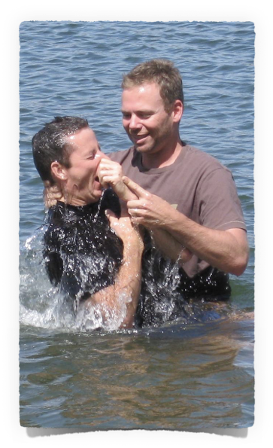
BECOME A
WISE
INVESTOR
Invest In The Future (12:7-14)
Hear the word of God - Rom 10:17
Believe that Jesus is the Christ, the Son of God - John 8:24; Heb 11:6
By faith - repent - Acts 17:30
By faith confess Jesus - Rom 10:10
Become a child of God by faith by being baptized into Christ for the remission of sins - Acts 2:38; Rom 6:3-6; Gal 3:26,27; Col 2:12,13
Live faithfully / Abide in Christ — Jn 10:1-15; 1 Cor 15:58; 2 Pet 1:5-10

Slide 29
BECOME A
WISE
INVESTOR
Invest In The Future (12:7-14)
Matthew 16:24–26 (NKJV)
²⁴ Then Jesus said to His disciples, “If anyone desires to come after Me, let him deny himself, and take up his cross, and follow Me. ²⁵ For whoever desires to save his life will lose it, but whoever loses his life for My sake will find it. ²⁶ For what profit is it to a man if he gains the whole world, and loses his own soul? Or what will a man give in exchange for his soul?

Slide 30
BECOME A
WISE
INVESTOR
Invest In The Future (12:7-14)

Slide 32
How To
BECOME A
WISE
INVESTOR

Slide 33
Matthew 6:19–25 (NKJV)
¹⁹ “Do not lay up for yourselves treasures on earth, where moth and rust destroy and where thieves break in and steal; ²⁰ but lay up for yourselves treasures in heaven, where neither moth nor rust destroys and where thieves do not break in and steal. ²¹ For where your treasure is, there your heart will be also.

Slide 34
Matthew 6:19–25 (NKJV)
²² “The lamp of the body is the eye. If therefore your eye is good, your whole body will be full of light. ²³ But if your eye is bad, your whole body will be full of darkness. If therefore the light that is in you is darkness, how great is that darkness!

Slide 35
Matthew 6:19–25 (NKJV)
²⁴ “No one can serve two masters; for either he will hate the one and love the other, or else he will be loyal to the one and despise the other. You cannot serve God and mammon. ²⁵ “Therefore I say to you, do not worry about your life, what you will eat or what you will drink; nor about your body, what you will put on. Is not life more than food and the body more than clothing?

