Slide 1
(Matthew 28:1-8)

Slide 4
The resurrection of Jesus witnessed by many – (5-8; Mat 28; Mk 14; Lk 24; 1 Cor. 15:3-8; etc.)
A supreme example of God’s power and testifies to Jesus’ authority — (Acts 2:36; Eph 1:19–20)
The Resurrection of Christ is a guarantee of our own resurrection. —(1 Cor 15:22–23; cf. Rom 6:5).
God’s proof that the Lord Jesus was Who He claimed to be:
the Son of God (Romans 1:4)

Slide 5
The Resurrection of Christ is at the CORE of the Christian’s FAITH:

Slide 6
There are some monuments revealed in the NT that center around and point clearly to the resurrection of Jesus

Slide 7
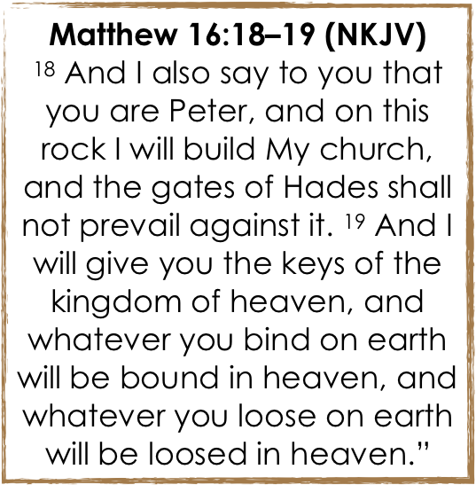
“Things That Speak To The Resurrection of Christ”

Slide 8
“Things That Speak To The Resurrection of Christ”
Raised to be seated at the right hand of God and HEAD of the church —Acts 2:36; Eph 1:19-23
The church, (body), is the saved for whom Jesus died, and we are saved because Jesus lives — Jn 14:19; Rom 5:6-11; 1 Cor 15:12-19

Slide 9
“Things That Speak To The Resurrection of Christ”
The New Covenant is predicated on the death & resurrection of Christ —Acts 2:29-36; 1 Cor. 15:12-20
“Jesus has become a surety of a better covenant. … He continues forever, has an unchangeable priesthood" - Heb 7:22,23; 9:23,24
“He is also Mediator of a better covenant, which was established on better promises.” — Heb. 8:6
At the right hand of God — having perfected - Heb 10:11-25

Slide 10
“Things That Speak To The Resurrection of Christ”

Slide 11
“Things That Speak To The Resurrection of Christ”
Romans 6:3–5 (NKJV)
³ Or do you not know that as many of us as were baptized into Christ Jesus were baptized into His death? ⁴ Therefore we were buried with Him through baptism into death, that just as Christ was raised from the dead by the glory of the Father, even so we also should walk in newness of life. ⁵ For if we have been united together in the likeness of His death, certainly we also shall be in the likeness of His resurrection,

Slide 12
“Things That Speak To The Resurrection of Christ”
Romans 6:16–17 (NKJV)
¹⁶ Do you not know that to whom you present yourselves slaves to obey, you are that one’s slaves whom you obey, whether of sin leading to death, or of obedience leading to righteousness? ¹⁷ But God be thanked that though you were slaves of sin, yet you obeyed from the heart that form of doctrine to which you were delivered.

Slide 13
“Things That Speak To The Resurrection of Christ”
Colossians 2:12–13 (NKJV)
¹² buried with Him in baptism, in which you also were raised with Him through faith in the working of God, who raised Him from the dead. ¹³ And you, being dead in your trespasses and the uncircumcision of your flesh, He has made alive together with Him, having forgiven you all trespasses,

Slide 14
“Things That Speak To The Resurrection of Christ”
1 Corinthians 15:3–4 (NKJV)
³ For I delivered to you first of all that which I also received: that Christ died for our sins according to the Scriptures, ⁴ and that He was buried, and that He rose again the third day according to the Scriptures, …
²⁹ Otherwise, what will they do who are baptized for the dead, if the dead do not rise at all? Why then are they baptized for the dead?

Slide 15
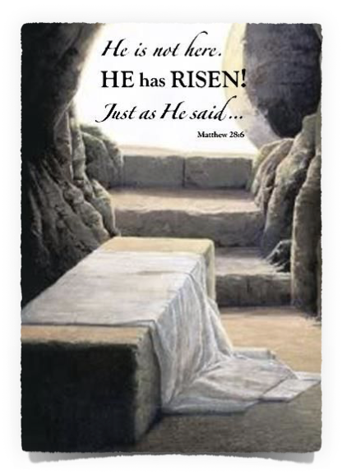
“Things That Speak To The Resurrection of Christ”
Christians met together on the first day of the week—Acts 20:7; 1 Cor. 16:1,2
The church began on a Sunday - Acts 2
By the end of the first century, the first day of the week was called the Lord's Day to commemorate that Jesus rose from the grave (Rev. 1:10; the first-century document Didache 14.1).

Slide 16
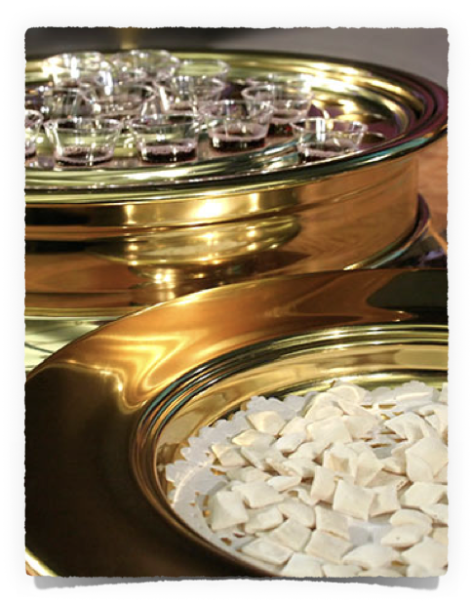
“Things That Speak To The Resurrection of Christ”
Christians assembled on the first day of the week to partake of the Lord’s Supper — Ac 20:7; 1 Cor. 11:23-26;
"You proclaim the Lord’s death till He comes.” — 1 Cor. 11:26
"I will not drink of this fruit of the vine from now on until that day when I drink it new with you in My Father’s kingdom.” — Mat 26:29

Slide 17
“Things That Speak To The Resurrection of Christ”
What enabled first century Christians to persevere through intense suffering? — Acts 7:57-60; 12:1,2; Rev. 2:10 …
“Knowing that He who raised up the Lord Jesus will also raise us up with Jesus, …” — 2 Cor. 4:14
Paul often spoke of the certainty of the resurrection of Jesus in connection with our faithfulness & hope — Rom 8:10-13; 1 Cor 6:14

Slide 18
“Things That Speak To The Resurrection of Christ”
1 Peter 3:18; … 4:1–2 … (NKJV)
¹⁸ For Christ also suffered once for sins, the just for the unjust, that He might bring us to God, being put to death in the flesh but made alive by the Spirit, … ¹ Therefore, since Christ suffered for us in the flesh, arm yourselves also with the same mind, for he who has suffered in the flesh has ceased from sin, ² that he no longer should live the rest of his time in the flesh for the lusts of men, but for the will of God.

Slide 19
“Things That Speak To The Resurrection of Christ”
Philippians 3:7–11 (NKJV)
⁷ But what things were gain to me, these I have counted loss for Christ. ⁸ Yet indeed I also count all things loss for the excellence of the knowledge of Christ Jesus my Lord, for whom I have suffered the loss of all things, and count them as rubbish, that I may gain Christ ⁹ and be found in Him, not having my own righteousness, which is from the law, but that which is through faith in Christ, the righteousness which is from God by faith; ¹⁰ that I may know Him and the power of His resurrection, and the fellowship of His sufferings, being conformed to His death, ¹¹ if, by any means, I may attain to the resurrection from the dead.

Slide 20
“Things That Speak To The Resurrection of Christ”
The Church of Christ
The New Covenant
Baptism Into Christ
The Day of NT Worship
The Lord’s Supper
Our Faithfulness
What Does My Life Say about what Jesus’ Resurrection means to me?

Slide 22
(Matthew 28:1-8)

