Slide 1
Traditions

Slide 2
Traditions
“Good or Bad?”
“TRADITIONAL” Can Be GOOD OR BAD!
traditional adjective
Definition of traditional
1 : of or relating to tradition : consisting of or derived from tradition
a traditional celebration
2 : handed down from age to age
traditional history
traditional songs/stories
3 : following or conforming to tradition : adhering to past practices or established conventions
traditional morality
traditional values/beliefs
employing traditional methods of cooking

Slide 3
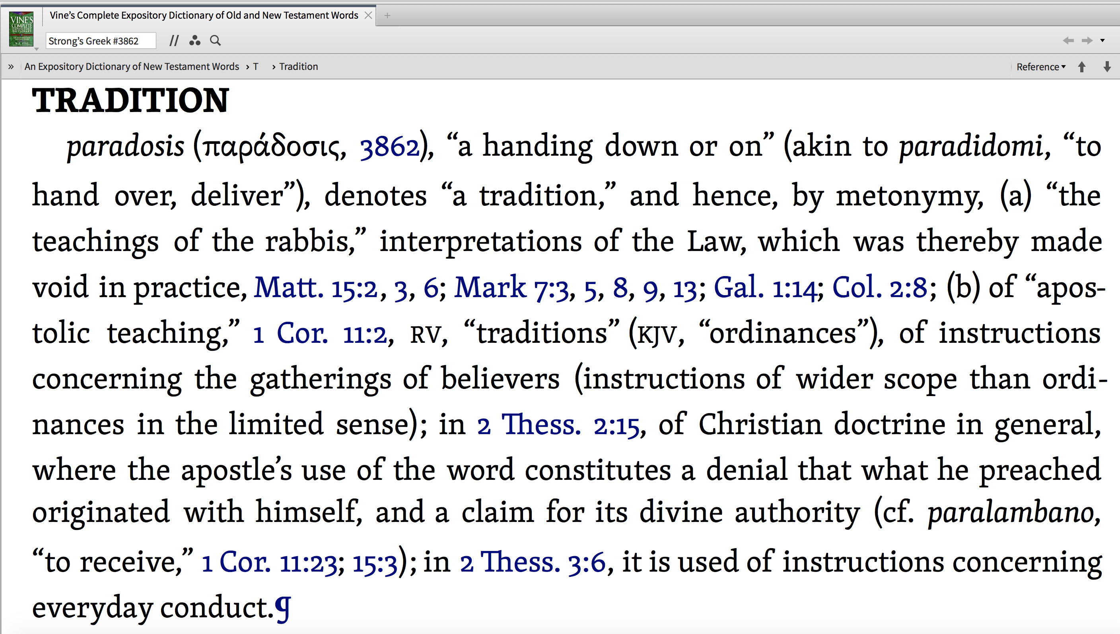
Traditions
“Good or Bad?”
“TRADITIONAL” Can Be GOOD OR BAD!

Slide 4
Traditions
“Good or Bad?”
“TRADITIONAL” Can Be GOOD OR BAD!
RIGHT
WRONG
NEUTRAL
Synonymous With
the Word Of God,
God’s Commands, Apostolic Teachings, Doctrine, of Christ,
God’s Precepts, Etc.; Thus, Must Be Faithfully Obeyed!
(1 Cor. 11:2; 2 Thes. 2:15; 3:6)
Traditions that Originate With Men And Are Elevated Above God’s Word
Denotes hurtful, human traditions that are condemned — (Mat 15:3; Col 2:8).
Things done to fulfill a commandment of God when the “HOW” is NOT specified. (i.e. Expediency);
SUCH, Cannot Be Bound

Slide 5
Traditions
“Good or Bad?”
“TRADITIONAL” Can Be GOOD OR BAD!
HEAVEN
MEN
What is the source of the TRADITION (teaching or practice)?
Matthew 21:24–25 (NKJV)
²⁴ … I likewise will tell you by what authority I do these things: ²⁵ The baptism of John—where was it from? From heaven or from men?” …

Slide 6
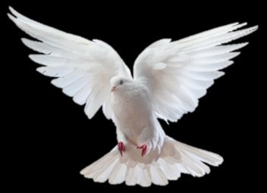
Traditions
“Good or Bad?”
AUTHorized “TRADITIONs” Are GOOD!
Hebrews 1:1,2
IS IT FROM HEAVEN?
Matthew 28:19
John 16:13
Acts 2
If it is from heaven, it is found in the scriptures!
If it is approved of by heaven, it will be authorized by scripture (C.E.N.I.)
1 Corinthians 2:13
Ephesians 3:3-5
2 Timothy 3:16,17

Slide 7
Traditions
“Good or Bad?”
God Given “TRADITIONs” Must Be Kept!
1 Corinthians 11:2 (NKJV)
² Now I praise you, brethren, that you remember me in all things and keep the traditions just as I delivered them to you. (cf. 11:23)
IS IT FROM HEAVEN?
APOSTOLIC TEACHING

Slide 8
Traditions
“Good or Bad?”
God Given “TRADITIONs” Must Be Kept!
IS IT FROM HEAVEN?
2 Thessalonians 2:15 (NKJV)
¹⁵ Therefore, brethren, stand fast and hold the traditions which you were taught, whether by word or our epistle.
APOSTOLIC TEACHING

Slide 9
Traditions
“Good or Bad?”
God Given “TRADITIONs” Must Be Kept!
2 Thessalonians 3:6 (NKJV)
⁶ But we command you, brethren, in the name of our Lord Jesus Christ, that you withdraw from every brother who walks disorderly and not according to the tradition which he received from us.
IS IT FROM HEAVEN?
APOSTOLIC TEACHING

Slide 10
Traditions
“Good or Bad?”
God Given “TRADITIONs” Must Be Kept!
Marriage between one man and one woman for life — Gen. 1:27; 2:24; Mat. 19:3-9; Eph. 5:31; Heb 13:4
Family Roles — Eph 5:22-6:4; Col. 3:18-21; 1 Pet 3:1-7
Submitting to governing authority — Mat. 22:21; Rom. 13:1-7; 1 Pet 3:13-17
Love your neighbor — Matt. 22:39; Gal. 5:14; James 2:8
IS IT FROM HEAVEN?
APOSTOLIC TEACHING

Slide 11
Traditions
“Good or Bad?”
God Given “TRADITIONs” Must Be Kept!
Plan of SALVATION — Hear - Romans 10:17; believe - John 8:24; repent - Acts 17:30; confess - Rom. 10:9; baptism - Acts 2:38; endurance - Heb 10:35,36
The oneness of the Lord’s church — Mat. 16:18; Eph 1:22,23; 4:4; 5:23-27
The organization of local churches — Phili 1:1; 1 Tim. 3:1-13; Titus 1:5-9; 1 Pet 5:1-3
IS IT FROM HEAVEN?
APOSTOLIC TEACHING

Slide 12
Traditions
“Good or Bad?”
God Given “TRADITIONs” Must Be Kept!
Assemble together — Acts 2:42; 1 Cor. 14:26; Heb 10:25
Worship in spirit & truth — John 4:24; Heb 12:28,29
Pray together — Acts 4:24ff
Edify by teaching — 1 Cor 14
Giving — 1 Cor. 16:1,2
Lord’s supper — 1 Cor. 11:23-26; Acts 20:7
Singing together — Eph. 5:19; Col. 3:16
IS IT FROM HEAVEN?
APOSTOLIC TEACHING

Slide 13
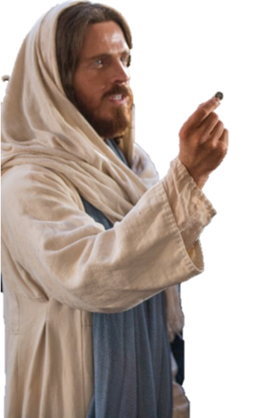
Traditions
“Good or Bad?”
UNAUTHorized “TRADITIONs” Are BAD!
Matthew 15:1-14
Mark 7:1-13
MEN
Galatians 1:13,14
Colossians 2:8
Commandments of men make WORSHIP VAIN
1 Peter 1:18
Galatians 1:6-9
2 John 9,10

Slide 14
Traditions
“Good or Bad?”
MAN Given “TRADITIONs” Must Be Rejected!
Matthew 15:3–9 (NKJV)
³ “Why do you also transgress the commandment of God because of your tradition? …. ⁶ …Thus you have made the commandment of God of no effect by your tradition. ⁷ Hypocrites! Well did Isaiah prophesy about you, saying: ⁸ ‘These people draw near to Me with their mouth, And honor Me with their lips, But their heart is far from Me. ⁹ And in vain they worship Me, Teaching as doctrines the commandments of men.’ ”
MEN
Commandments of men make WORSHIP VAIN

Slide 15
Traditions
“Good or Bad?”
MAN Given “TRADITIONs” Must Be Rejected!
Colossians 2:8 (NKJV)
⁸ Beware lest anyone cheat you through philosophy and empty deceit, according to the tradition of men, according to the basic principles of the world, and not according to Christ.
MEN
Commandments of men make WORSHIP VAIN

Slide 16
Traditions
“Good or Bad?”
MAN Given “TRADITIONs” Must Be Rejected!
Catholicism — 2 The. 2:1-12
Denominationalism — John 17:20,21; 1 Cor. 1:10-13; etc
Unbiblical organization — 3 Jn 9; Acts 20:29,30
Salvation by FAITH ALONE — Eph. 2:8,9; James 2:14-26; Mark 16:16; Acts 2:38; etc.
Rejection of the need for Biblical authority — Col. 3:17; 2 Jn 9; Rom 10:17; etc.
MEN
Commandments of men make WORSHIP VAIN

Slide 17
Traditions
“Good or Bad?”
MAN Given “TRADITIONs” Must Be Rejected!
Unbiblical worship — Eph 5:19; Mat. 15:7-9; etc.
Vain repetitions — Mat 6:7
Corruption of the Lord’s supper — 1 Cor. 11:20-26
Tithing — 1 Cor 16:1,2
Adding instruments to singing — Ep 5:19; Col 3:16
Not teaching the word of God — Women preaching — 2 Tim 4:2-4 — 1 Cor 14:34
Holidays — Gal. 4:10,11
MEN
Commandments of men make WORSHIP VAIN

Slide 18
Traditions
“Good or Bad?”
MAN Given “TRADITIONs” Must Be Rejected!
Unauthorized work — Col. 3:17; 1 Pet. 5:1-4; Acts 20:28
General, unlimited benevolence — Acts 2:44; 1 Tim. 5:3-11; etc.
Recreation & entertainment — 2 Tim 3:4; 2 John 2:15-17
Individual & congregational responsibilities shifted to unscriptural organizations & institutions — Gal. 6:1-10; Eph. 3:10; 1 Tim 3:15; 1 Pt 5:2
MEN
Commandments of men make WORSHIP VAIN

Slide 19
Traditions
“Good or Bad?”
“TRADITIONAL” is neither GOOD OR BAD!
What is the source of the TRADITION (teaching or practice)?
Is it REQUIRED or merely ALLOWED? (Rom 14; 1 Cor 8:13)
1 Corinthians 8:13 (NKJV)
¹³ Therefore, if food makes my brother stumble, I will never again eat meat, lest I make my brother stumble.

Slide 20
Traditions
“Good or Bad?”
NEUTRAL “TRADITIONs” Must Not Be Bound as divine Law
Assemble together — time on Lord’s day / number of times / midweek? - Acts 2:42; 1 Cor. 14:26; Heb 10:25
Worship in spirit & truth — order of services / # of songs / # of prayers / preaching or teaching - John 4:24; Heb 12:28,29
Work of the church — Evangelism / Edification / Benevolence — who, how, when, how much …
EXPEDIENTS ARE GOOD If NOT ABUSED
MUST BE AUTHORIZED

Slide 21
Traditions
“Good or Bad?”
“TRADITIONAL” Can Be GOOD OR BAD!
RIGHT
WRONG
NEUTRAL
Synonymous With
the Word Of God,
God’s Commands, Apostolic Teachings, Doctrine, of Christ,
God’s Precepts, Etc.; Thus, Must Be Faithfully Obeyed!
(1 Cor. 11:2; 2 Thes. 2:15; 3:6)
Traditions that Originate With Men And Are Elevated Above God’s Word
Denotes hurtful, human traditions that are condemned — (Mat 15:3; Col 2:8).
Things done to fulfill a commandment of God when the “HOW” is NOT specified. (i.e. Expediency);
SUCH, Cannot Be Bound
Philippians 2:1-5

Slide 24
Traditions

Slide 25
Mark 7:5–13 (NKJV)
⁵ Then the Pharisees and scribes asked Him, “Why do Your disciples not walk according to the tradition of the elders, but eat bread with unwashed hands?” ⁶ He answered and said to them, “Well did Isaiah prophesy of you hypocrites, as it is written: ‘This people honors Me with their lips, But their heart is far from Me. ⁷ And in vain they worship Me, Teaching as doctrines the commandments of men.’

Slide 26
Mark 7:5–13 (NKJV)
⁸ For laying aside the commandment of God, you hold the tradition of men—the washing of pitchers and cups, and many other such things you do.” ⁹ He said to them, “All too well you reject the commandment of God, that you may keep your tradition. ¹⁰ For Moses said, ‘Honor your father and your mother’; and, ‘He who curses father or mother, let him be put to death.’

Slide 27
Mark 7:5–13 (NKJV)
¹¹ But you say, ‘If a man says to his father or mother, “Whatever profit you might have received from me is Corban”—’ (that is, a gift to God), ¹² then you no longer let him do anything for his father or his mother, ¹³ making the word of God of no effect through your tradition which you have handed down. And many such things you do.”

