Slide 1
“What Happens When We Die?”

Slide 2
Ecclesiastes 12:6–14 (NKJV)
⁶ Remember your Creator before the silver cord is loosed, Or the golden bowl is broken, Or the pitcher shattered at the fountain, Or the wheel broken at the well. ⁷ Then the dust will return to the earth as it was, And the spirit will return to God who gave it. ⁸ “Vanity of vanities,” says the Preacher, “All is vanity.”

Slide 3
To DEFINE
What Is Man?
A human is a composite being. He is a dual being, composed of both a body and a spirit.
The physical body is derived from the dust of the ground and back to the dust it shall ultimately return (Gen. 2:7; 3:19).
Further, man has a spirit or soul. This is that imperishable aspect of the human being from God which departs the body in death (Job 32:8; Eccl. 12:7; Zech. 12:1; Dan. 7:15).'

Slide 4
To DEFINE
What Is Life & Death?
Life may be viewed under two categories - physical life and spiritual life.
The essential characteristic of death is "separation."
Physical life & death - Life is the union of body and spirit. When these elements are separated, they constitute physical death - Eccle. 12:7; James 2:26
Spiritual life & death - Life is that state of being united with God in a Father/child relationship / sin breaks that union causing spiritual death, i.e., separation from God — Isa. 59:1,2; Eph 2:11-18

Slide 5
SOME FALSE VIEWS …
What would an atheists say?
There is nothing beyond the grave.
What would a materialists say?
Sadducees taught their souls perished (Mat 22:23-33).
What would a Buddhist say?
One goes round in cycles of birth, death, and rebirth
What would a Catholic say?
the spirit at death, goes into a place called "purgatory."
What would a J.W. (& a few others) say?
At death the soul goes to sleep & only righteous raised.

Slide 6
SOME FALSE VIEWS …
https://www.amazingfacts.org/media-library/study-guide/e/4987/t/are-the-dead-really-dead-
2. What happens when a person dies?
“Then the dust will return to the earth as it was, and the spirit will return to God who gave it” (Ecclesiastes 12:7).
Answer: The body turns to dust again, and the spirit goes back to God, who gave it. The spirit of every person who dies—whether saved or unsaved—returns to God at death.
3. What is the “spirit” that returns to God at death?
“The body without the spirit is dead” (James 2:26).
“The spirit of God is in my nostrils” (Job 27:3 KJV).
Answer: The spirit that returns to God at death is the breath of life. Nowhere in all of God’s book does the “spirit” have any life, wisdom, or feeling after a person dies. It is the “breath of life” and nothing more.

Slide 7
To DEFINE
What is the “spirit”?
A human is a composite being. He is a dual being, composed of both a body and a spirit.
Luke 23:46 (NKJV)
⁴⁶ And when Jesus had cried out with a loud voice, He said, “Father, ‘into Your hands I commit My spirit.’ ” Having said this, He breathed His last.

Slide 8
To DEFINE
What is the “spirit”?
A human is a composite being. He is a dual being, composed of both a body and a spirit.
Acts 7:59 (NKJV)
⁵⁹ And they stoned Stephen as he was calling on God and saying, “Lord Jesus, receive my spirit.”

Slide 9
To DEFINE
What is the “spirit”?
A human is a composite being. He is a dual being, composed of both a body and a spirit.
1 Thessalonians 5:23 (NKJV)
²³ Now may the God of peace Himself sanctify you completely; and may your whole spirit, soul, and body be preserved blameless at the coming of our Lord Jesus Christ.

Slide 10
To DEFINE
What is the “spirit”?
A human is a composite being. He is a dual being, composed of both a body and a spirit.
Hebrews 4:12 (NKJV)
¹² For the word of God is living and powerful, and sharper than any two-edged sword, piercing even to the division of soul and spirit, and of joints and marrow, and is a discerner of the thoughts and intents of the heart.

Slide 11
To DEFINE
What is the “spirit”?
A human is a composite being. He is a dual being, composed of both a body and a spirit.
Hebrews 12:23 (NKJV)
²³ to the general assembly and church of the firstborn who are registered in heaven, to God the Judge of all, to the spirits of just men made perfect,

Slide 12
SOME FALSE VIEWS …
https://www.amazingfacts.org/media-library/study-guide/e/4987/t/are-the-dead-really-dead-
4. What is a "soul"?
“The Lord God formed man of the dust of the ground, and breathed into his nostrils the breath of life; and man became a living soul” (Genesis 2:7 KJV).
Answer: A soul is a living being. A soul is always a combination of two things: body plus breath. A soul cannot exist unless body and breath are combined. God’s Word teaches that we are souls—not that we have souls.
Matthew 10:28; Acts 2:27; 1 Thessalonians 5:23; Hebrews 4:12; 10:38; 3 John 2; Revelation 6:9; 20:4

Slide 13
To DEFINE
What is a "soul"?
A human is a composite being. He is a dual being, composed of both a body and a spirit.
Hebrews 10:38–39 (NKJV)
³⁸ Now the just shall live by faith; But if anyone draws back, My soul has no pleasure in him.” ³⁹ But we are not of those who draw back to perdition, but of those who believe to the saving of the soul.

Slide 14
To DEFINE
What is a "soul"?
A human is a composite being. He is a dual being, composed of both a body and a spirit.
Matthew 10:28 (NKJV)
²⁸ And do not fear those who kill the body but cannot kill the soul. But rather fear Him who is able to destroy both soul and body in hell.

Slide 15
To DEFINE
What is a "soul"?
A human is a composite being. He is a dual being, composed of both a body and a spirit.
3 John 2 (NKJV)
² Beloved, I pray that you may prosper in all things and be in health, just as your soul prospers.

Slide 16
To DEFINE
What is a "soul"?
A human is a composite being. He is a dual being, composed of both a body and a spirit.
Revelation 6:9–10 (NKJV)
⁹ When He opened the fifth seal, I saw under the altar the souls of those who had been slain for the word of God and for the testimony which they held. ¹⁰ And they cried with a loud voice, saying, “How long, O Lord, holy and true, until You judge and avenge our blood on those who dwell on the earth?”

Slide 17
To DEFINE
What is a "soul"?
A human is a composite being. He is a dual being, composed of both a body and a spirit.
Revelation 20:4 (NKJV)
⁴ And I saw thrones, and they sat on them, and judgment was committed to them. Then I saw the souls of those who had been beheaded for their witness to Jesus and for the word of God, who had not worshiped the beast or his image, and had not received his mark on their foreheads or on their hands. And they lived and reigned with Christ for a thousand years.

Slide 18
To DEFINE
What is a "soul"?
A human is a composite being. He is a dual being, composed of both a body and a spirit.
Acts 2:27 (NKJV)
²⁷ For You will not leave my soul in Hades, Nor will You allow Your Holy One to see corruption. … ³¹ he, foreseeing this, spoke concerning the resurrection of the Christ, that His soul was not left in Hades, nor did His flesh see corruption.

Slide 19
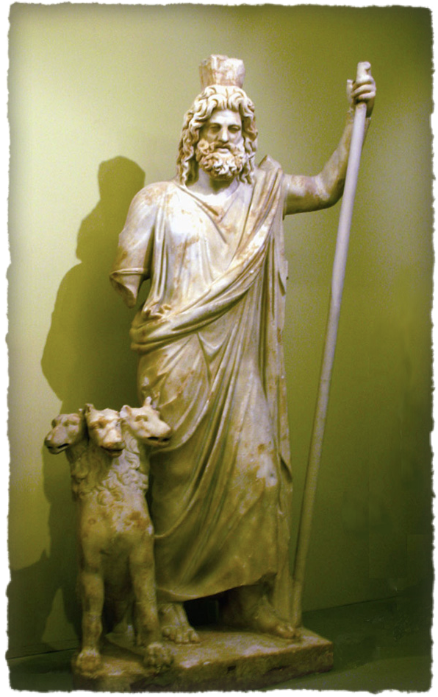
To DEFINE
The Word “Hades”
In Classical Greek:
Homer - "god of the underworld“
In other literature, it stood for "the underworld" as the abode of all the dead which was divided into two parts (similar to Luke 16)
These two parts were 1) The "Elysian fields", & 2) “Tartarus", the place of punishment

Slide 20
To DEFINE
The Word “Hades”
Eleven times in the NT:
It is translated "hades" in the NKJV & “hell" 10 times in the KJV (Mat 11:23; 16:18; Luke 10:15; 16:23; Ac 2:27, 31; Rev 1:18; 6:8; 20:13,14), and once it is the "grave" (1 Co 15:55)
The realm of ALL the dead and made up of two separate parts... Paradise and Tartarus - cf. Acts 2:27,31; Rev. 20:11–15; 2 Pe 2:4,9

Slide 21
To DEFINE
The Word “Hades”
Hades: Temporary Abode of Departed Spirits
Luke 23:42–43 (NKJV)
⁴² Then he said to Jesus, “Lord, remember me when You come into Your kingdom.” ⁴³ And Jesus said to him, “Assuredly, I say to you, today you will be with Me in Paradise.”

Slide 22
What ABOUT SOUL SLEEPING??
Will We Be AWARE Of Our Condition After We Die?
Ecclesiastes 9:5–6, 10 (NKJV)
⁵ For the living know that they will die; But the dead know nothing, And they have no more reward, For the memory of them is forgotten. ⁶ Also their love, their hatred, and their envy have now perished; Nevermore will they have a share In anything done under the sun. … ¹⁰ Whatever your hand finds to do, do it with your might; for there is no work or device or knowledge or wisdom in the grave where you are going.
anything done under the sun

Slide 23
What ABOUT SOUL SLEEPING??
Will We Be AWARE Of Our Condition After We Die?
Job 14:12,21 (NKJV)
¹² So man lies down and does not rise. Till the heavens are no more, They will not awake Nor be roused from their sleep. … ²¹ His sons come to honor, and he does not know it; They are brought low, and he does not perceive it.

Slide 24
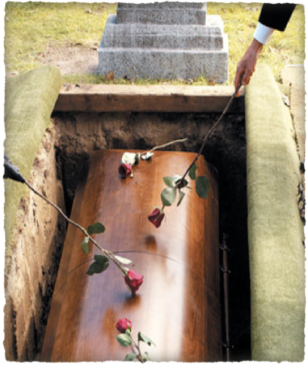
What ABOUT SOUL SLEEPING??
Will We Be AWARE Of Our Condition After We Die?
We will NOT be aware of anything that occurs on the earth.
The resurrection will not occur until the last day - John 5:28,29; 12:48
All that others may say and do after we leave this earth will be unknown to us.

Slide 25
Luke 16:19–31 (NKJV)
¹⁹ “There was a certain rich man who was clothed in purple and fine linen and fared sumptuously every day. ²⁰ But there was a certain beggar named Lazarus, full of sores, who was laid at his gate, ²¹ desiring to be fed with the crumbs which fell from the rich man’s table. Moreover the dogs came and licked his sores.

Slide 26
Luke 16:19–31 (NKJV)
²² So it was that the beggar died, and was carried by the angels to Abraham’s bosom. The rich man also died and was buried. ²³ And being in torments in Hades, he lifted up his eyes and saw Abraham afar off, and Lazarus in his bosom.

Slide 27
Luke 16:19–31 (NKJV)
²⁴ “Then he cried and said, ‘Father Abraham, have mercy on me, and send Lazarus that he may dip the tip of his finger in water and cool my tongue; for I am tormented in this flame.’ ²⁵ But Abraham said, ‘Son, remember that in your lifetime you received your good things,

Slide 28
Luke 16:19–31 (NKJV)
and likewise Lazarus evil things; but now he is comforted and you are tormented. ²⁶ And besides all this, between us and you there is a great gulf fixed, so that those who want to pass from here to you cannot, nor can those from there pass to us.’

Slide 29
Luke 16:19–31 (NKJV)
²⁷ “Then he said, ‘I beg you therefore, father, that you would send him to my father’s house, ²⁸ for I have five brothers, that he may testify to them, lest they also come to this place of torment.’ ²⁹ Abraham said to him, ‘They have Moses and the prophets; let them hear them.’

Slide 30
Luke 16:19–31 (NKJV)
³⁰ And he said, ‘No, father Abraham; but if one goes to them from the dead, they will repent.’ ³¹ But he said to him, ‘If they do not hear Moses and the prophets, neither will they be persuaded though one rise from the dead.’ ”

Slide 31
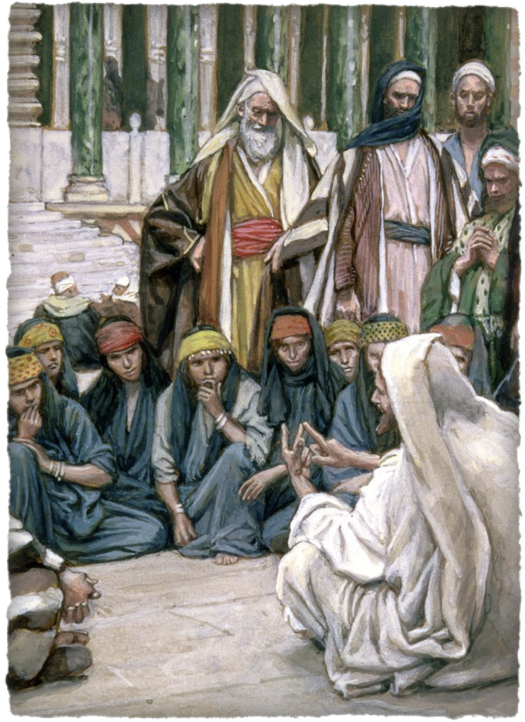
Rich Man Lazarus
Validity of The Narrative . .
Not called a parable -
Does not have the marks of a parable -
Contains proper names
Parable or not – it teaches the truth!
Luke 16:19-31

Slide 32
Rich Man Lazarus
Negates Many False Doctrines
Universalism
Annihilation-ism
Purgatory
Soul-Sleeping
Second Chance
Luke 16:19-31

Slide 33
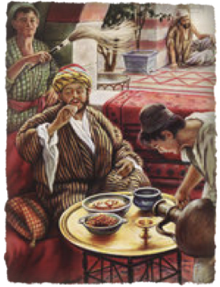
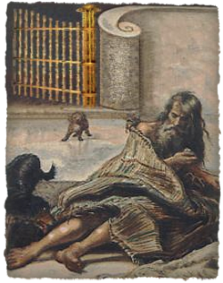
Rich Man Lazarus
The Two Men While Living
A certain rich man
16:19,25
A beggar Lazarus -
16:20,21,25
Fine clothes - Clothed in purple and fine linen
Plenty to eat & enjoy - “Fared sumptuously every day”
Received Good Things - 25
Full of sores licked by dogs
Laid at the rich man's gate,
Hoping to be fed crumbs from the rich man's table
Received evil things - 25

Slide 34
Rich Man Lazarus
The Two Men While Living
A certain rich man
16:19,25
A beggar Lazarus -
16:20,21,25
From all appearances, the Pharisees would have supposed, was a righteous man. Surely he would go to heaven when he died.
He was the kind of person that the Pharisees would brand a “sinner,” a man whom, in their minds, was cursed by God - lost.

Slide 35
Rich Man Lazarus
The Two Men In Death
A certain rich man
16:19,25
A beggar Lazarus -
16:20,21,25
Died - had a funeral
Conscious - knew where he was & where he wasn’t
Tormented in flames
Couldn’t change his state
Died - no funeral mentioned
Carried away by angels to Abraham's bosom
Comforted -
Couldn’t change his state

Slide 36
Rich Man Lazarus
The Two Men In Death
A certain rich man
16:19,25
A beggar Lazarus -
16:20,21,25
Beyond opportunity for receiving mercy
Could remember his life and those he cared about
Couldn’t help those on earth
Died - no funeral mentioned
Carried away by angels to Abraham's bosom
Comforted -
Couldn’t change his state

Slide 37
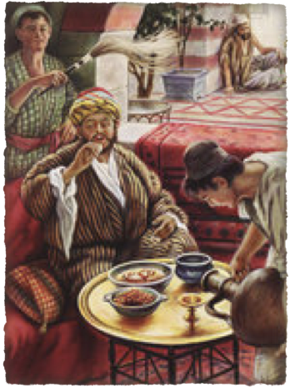
Rich Man Lazarus
The Rich Man’s Request
The plea for mercy for himself - that Lazarus be sent to dip his finger in water and touch his tongue - 16:24-26
He failed to value spiritual things in life - spent his time pursuing material things - 12:21; 16:13
He chose his own end and must now suffer the consequences - Mat 7:13,14; Gal. 6:7-9

Slide 38
Rich Man Lazarus
The Rich Man’s Request
The plea for mercy for himself - that Lazarus be sent to dip his finger in water and touch his tongue - 16:24-26
One cannot go from one section of hades to the other - after death, one’s eternal state is sealed - Heb 9:27; 2 Thes 1:7-9
The rich man lived in pleasure for a little while - Lazarus will live in pleasure forever.

Slide 39
Rich Man Lazarus
The Rich Man’s Request
The plea for mercy for his five brothers - 16:27-31
That Abraham might send Lazarus to warn them of this place - Abraham says they have Moses and the prophets (i.e., the word of God)
The rich man fears that will be inadequate to convince them to repent -

Slide 40
Rich Man Lazarus
The Rich Man’s Request
Abraham says that if they won't listen to Moses and the prophets, neither would they be persuaded though one rise from the dead.
Jesus later raises a man named Lazarus from the dead - John 11:38-44 - (The Jewish leaders hated Jesus even more and sought to kill Him & Lazarus - John 11:45-57; 12:9-11)

Slide 41
Rich Man Lazarus
The Rich Man’s Request
Jesus was raised from the dead - but that didn’t convince most of the Jews either! - (Mat 28:11-15; John 5:42-47; Acts 17:5)
If men today will not accept the word of God and the testimony of His resurrection by the apostles, we reject the ONLY means of salvation - (Acts 2:30-38; Rom 1:16; 10:17)

Slide 42
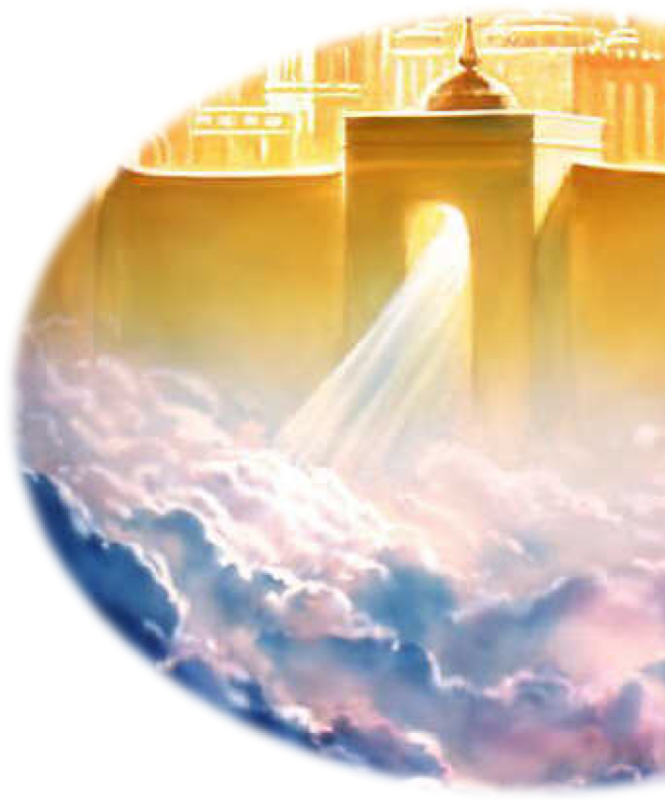
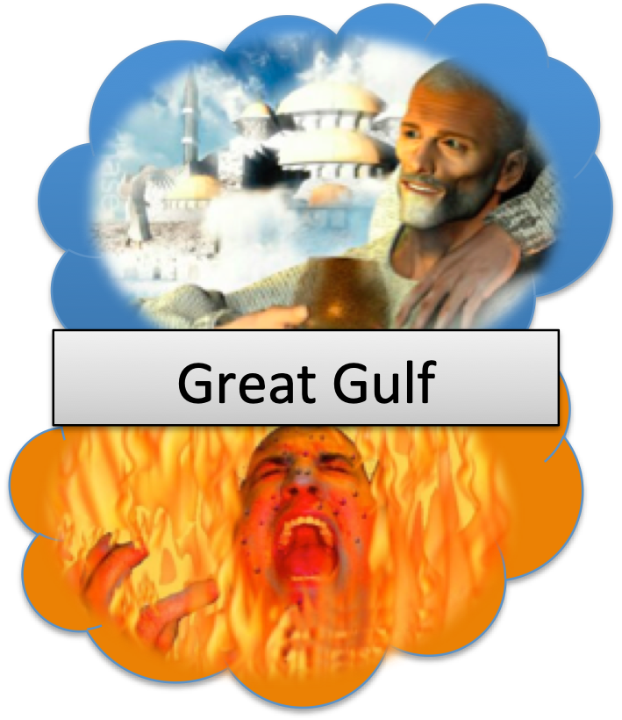
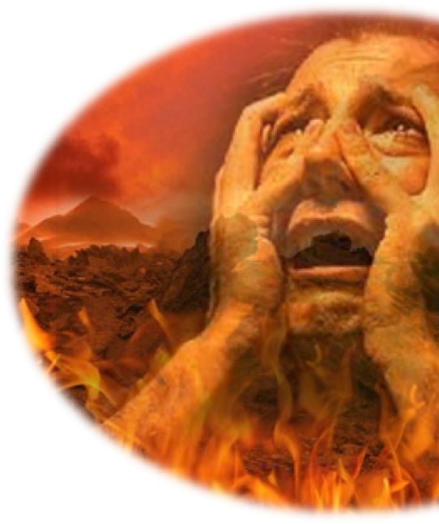
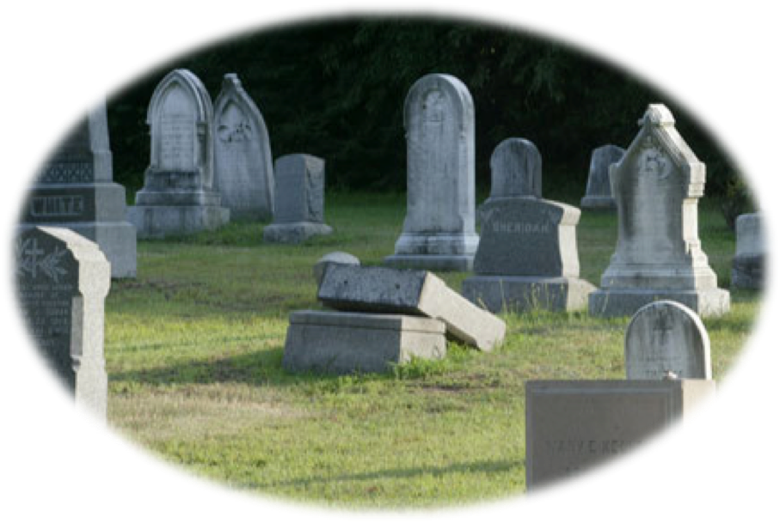
Hades: Temp. Abode of Departed Spirits
Mat 7:13,14
Jesus
Thief
Lazarus
Paradise
Heaven
Soul of the righteous
J
u
d
g
m
e
n
t
Mat 25:46
2 Cor 5:10
Soul of the unrighteous
Torment
Rich man
Eccl. 12:7
Hell
Mat 25:41
John 5:28,29
Body to the grave
Resurrection

Slide 43
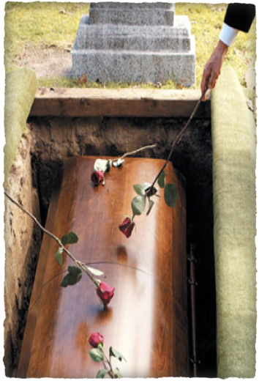
Lessons From These Texts
Death is the common end for all classes of mankind - ("the same event happens to them all" - cf. Ecc 2:14)
Will not take ANY material thing with us from this world - It is foolish to seek riches of this world and not lay up treasure in heaven - (Luke 12:20)
Unconverted men find out the value of their soul after death, when it is too late - (Mt 16:26)

Slide 44
Lessons From These Texts
The reality of hell - (Mt 25:41,46
The wicked do not cease to exist ("lifted up his eyes and saw") - 23
The wicked are aware of where they are, and what is going on ("I am tormented in this flame") - 24b
Recognize others ("Father Abraham … send Lazarus") - 24a
Remember those who have yet to follow them in death - ("for I have five brothers") - 28a

Slide 45
Lessons From These Texts
The importance of heeding the Word of God! - Lk 16:29
Only by heeding the Word of God can one escape the torment of Hades - John 6:63; 2 Thes 1:7-9; Jn 12:48; Jam 1:18,21;1 Pet 1:22-25
If God's Word doesn't move you to repent, a miracle won’t either! - 31; cf. Ac 13:46; 17:1-3; Rom 10:17; Jn 20:30,31

Slide 46
Lessons From These Texts
We will be Conscious after death!! – Phili 1:23
There Will Be NO Second Chance After Death!! - Heb 9:27
We Must Hear & Obey Jesus Christ or Be Lost For All Eternity!! – John 12:48; 2 Cor. 5:10
We must love & care for our fellow man – seeking spiritual things rather than material things!! - Gal 6:10; Rom 8:5-8

Slide 47
Lessons From These Texts
If I am lost it will be MY fault!! –
Titus 2:11,12;
2 Pet 3:9;
Rev 22:17

Slide 48
Are you ready for YOUR existence after death???
Today is the day of salvation!! — 2 Cor 6:2

Slide 49
Is there ANYTHING you have, or are seeking, or are doing that you are willing to forfeit heaven for?

Slide 50
How will you feel about that thing the second after you die????

Slide 52
“What Happens When We Die?”
Charts by Don McClain
Preached August 26, 2018 PM
West 65th Street church of Christ / P.O. Box 190062 / Little Rock AR 72219 / 501-568-1062
Email – donmcclain@sbcglobal.net
More Keynote, PPT & Audio Sermons: http://w65stchurchofchrist.com

Slide 53
Ecclesiastes 12:6–14 (NKJV)
⁶ Remember your Creator before the silver cord is loosed, Or the golden bowl is broken, Or the pitcher shattered at the fountain, Or the wheel broken at the well. ⁷ Then the dust will return to the earth as it was, And the spirit will return to God who gave it. ⁸ “Vanity of vanities,” says the Preacher, “All is vanity.” ⁹ And moreover, because the Preacher was wise, he still taught the people knowledge; yes, he pondered and sought out and set in order many proverbs. ¹⁰ The Preacher sought to find acceptable words; and what was written was upright—words of truth.

Slide 54
Ecclesiastes 12:6–14 (NKJV)
¹¹ The words of the wise are like goads, and the words of scholars are like well-driven nails, given by one Shepherd. ¹² And further, my son, be admonished by these. Of making many books there is no end, and much study is wearisome to the flesh. ¹³ Let us hear the conclusion of the whole matter: Fear God and keep His commandments, For this is man’s all. ¹⁴ For God will bring every work into judgment, Including every secret thing, Whether good or evil.

