Slide 1
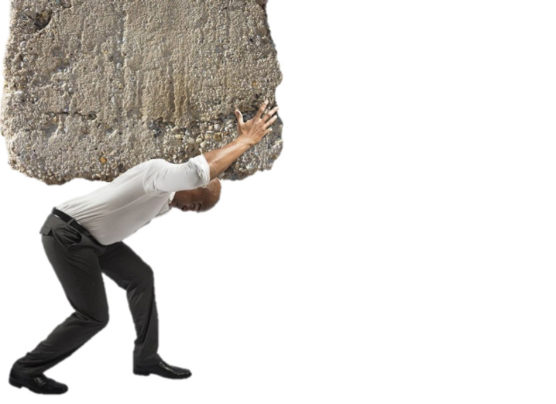
1 Peter 5:7 (NKJV)
⁷ casting all your care upon Him, for He cares for you.
What Are We To Do With
Burdens?

Slide 2
What Are We To Do With
Burdens?
“BURDENS”
Come In Many Forms
Proverbs 13:15 Good understanding gains favor, But the way of the unfaithful is hard.

Slide 3
What Are We To Do With
Burdens?
“BURDENS”
Come In Many Forms
Guilt / Sins Consequences
From our own sin …
From other’s sins …
Disappointments / Frustrations
Temptation / Anxiety / Doubt /

Slide 4
What Are We To Do With
Burdens?
“BURDENS”
Come In Many Forms
From living in a fallen world
Work / sickness / death / Grief
Sorrow / Discouragement / Worry
Burdens from living right …
Duty / Fatigue / hardship

Slide 5
What Are We To Do With
Burdens?
Bear One Another’s
“BURDENS”
Galatians 6:1–2 (NKJV)
¹ Brethren, if a man is overtaken in any trespass, you who are spiritual restore such a one in a spirit of gentleness, considering yourself lest you also be tempted. ² Bear one another’s burdens, and so fulfill the law of Christ.

Slide 6
What Are We To Do With
Burdens?
Bear One Another’s
“BURDENS”
Bear – to support, sustain, help hold up - (Gal 5:13,14; Rom. 15:1; 1 Thes 5:14)
Burdens – temptations, trials, hardships, weaknesses, etc. - “hardship which is regarded as particularly burdensome and exhausting - Louw Nida n 22.4” (Rom 8:35-39; Heb. 12:1-15)

Slide 7
What Are We To Do With
Burdens?
Bear One Another’s
“BURDENS”
Law of Christ – the Gospel, a law of love, serving others instead of ourselves - (5:13; John 13:34; Phili 2:1-8; 1 John 3:16-19; 4:7-11)

Slide 8
What Are We To Do With
Burdens?
Bear Our Own
“BURDENS”
Galatians 6:3–5 (NKJV)
³ For if anyone thinks himself to be something, when he is nothing, he deceives himself. ⁴ But let each one examine his own work, and then he will have rejoicing in himself alone, and not in another. ⁵ For each one shall bear his own load.

Slide 9
What Are We To Do With
Burdens?
Bear Our Own
“BURDENS”
Examine own work – [4] Faith, obedience, work, worship, (2 Cor. 13:5; Mat. 7:1-5; Rom 2; 14:10-13)
Each one shall bear his own burden – [5] We are responsible for our own duties & actions - (Rom 14:7,8,10-12)

Slide 10
What Are We To Do With
Burdens?
Give GOD Our
“BURDENS”
1 Peter 5:6–7 (NKJV)
⁶ Therefore humble yourselves under the mighty hand of God, that He may exalt you in due time, ⁷ casting all your care upon Him, for He cares for you.

Slide 11
⁷ casting all your care upon Him, for He cares for you.
What Are We To Do With
Burdens?
Give GOD Our
“BURDENS”
Not a promise that God will FIX all our troubles and problems like we want Him to – [1 Pet 5:7] (Rom 8:28)
God will provide what is needed to sustain us IF WE SUBMIT TO HIM & TRUST HIM – [1 Pet 5:5,6, 8-11]

Slide 12
Burdens?
What Are We To Do With
casting all your care upon Him …
“God resists the proud, But gives grace to the humble.” ⁶ Therefore humble yourselves under the mighty hand of God … (1 Peter 5:5,6)
H
U
M
B
L
E
Yield Our Will to His — Mat 26:39-44; Ja. 4:13-17
God is sovereign, not us — Ps. 103:19; Gal 2:20,21
Wholly submit to God’s rule — Mt 7:21-23; Co. 3:17
Accept God’s Discipline — Heb. 12:3-12
Full Pursuit of God’s Purpose — 2 Pet. 1:5-11
Full Utilization of God’s Provisions — Eph. 6:10-18

Slide 13
⁷ casting all your care upon Him, for He cares for you.
What Are We To Do With
Burdens?
Give GOD Our
“BURDENS”
“Casting” – [the action of humbling ourselves, vs. 6 — 1 Pet 5:7]
We are to move from the sphere of trusting in our own resources & strategies for life to resting in God and His resources. - James 4:13-17

Slide 14
⁷ casting all your care upon Him, for He cares for you.
What Are We To Do With
Burdens?
Give GOD Our
“BURDENS”
“All your care” – [Gk - μέριμνα, ης merimna, “care, anxiety, worry.”]
It is used in both a good sense of “godly concerns,” [2 Cor. 11:28], and in a bad sense of “worry, anxiety.” [Mat. 13:22]

Slide 15
⁷ casting all your care upon Him, for He cares for you.
What Are We To Do With
Burdens?
Give GOD Our
“BURDENS”
“All your care” – [Gk - μέριμνα, ης merimna, “care, anxiety, worry.”]
The emphasis is not on casting each individual care, but on casting the whole of one’s life on the Lord—lock, stock, and barrel.

Slide 16
⁷ casting all your care upon Him, for He cares for you.
What Are We To Do With
Burdens?
Give GOD Our
“BURDENS”
“Upon HIM” – Our life is wholly dependent upon God.
Don’t worry about life, food or clothing - Mat 6:25-27
Trust God - Mat 6:28-32
Put God FIRST - Mat 6:33,34

Slide 17
⁷ casting all your care upon Him, for He cares for you.
What Are We To Do With
Burdens?
Give GOD Our
“BURDENS”
“For He cares for you” – [John 3:16; Rom. 5:8-10; 1 Jn 4:9-11]
God is infinitely more capable of caring for us than we are for ourselves. — [Heb 12:4-11; Rom. 8:12-39]

Slide 18
⁷ casting all your care upon Him, for He cares for you.
What Are We To Do With
Burdens?
Give GOD Our
“BURDENS”
God is seeking to move us from the place of self-trust & self-reliance into greater and greater levels of faith.

Slide 19
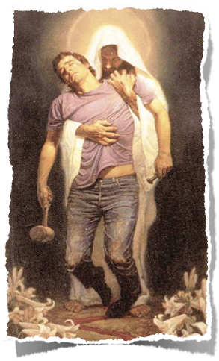
Burdens?
What Are We To Do With
⁶ Therefore humble yourselves under the mighty hand of God, that He may exalt you in due time, ⁷ casting all your care upon Him, for He cares for you. — 1 Peter 5:6–7 (NKJV)
1 Peter 5:8–11 (NKJV)
⁸ Be sober, be vigilant; because your adversary the devil walks about like a roaring lion, seeking whom he may devour. ⁹ Resist him, steadfast in the faith, knowing that the same sufferings are experienced by your brotherhood in the world.

Slide 20
Burdens?
What Are We To Do With
⁶ Therefore humble yourselves under the mighty hand of God, that He may exalt you in due time, ⁷ casting all your care upon Him, for He cares for you. — 1 Peter 5:6–7 (NKJV)
1 Peter 5:8–11 (NKJV)
¹⁰ But may the God of all grace, who called us to His eternal glory by Christ Jesus, after you have suffered a while, perfect, establish, strengthen, and settle you. ¹¹ To Him be the glory and the dominion forever and ever. Amen.

Slide 21
What Are We To Do With
Burdens?
Matthew 11:28–30 (NKJV)
²⁸ Come to Me, all you who labor and are heavy laden, and I will give you rest. ²⁹ Take My yoke upon you and learn from Me, for I am gentle and lowly in heart, and you will find rest for your souls. ³⁰ For My yoke is easy and My burden is light.”

Slide 23
1 Peter 5:7 (NKJV)
⁷ casting all your care upon Him, for He cares for you.
Charts by Don McClain
Preached - January 28, 2018
West 65th Street church of Christ
P.O. Box 190062, Little Rock AR 72219 / 501-568-1062
Prepared using Keynote / Email – donmcclain@sbcglobal.net
http://w65stchurchofchrist.com
What Are We To Do With
Burdens?

Slide 24
Luke 12:22–31 (NKJV)
²² Then He said to His disciples, “Therefore I say to you, do not worry about your life, what you will eat; nor about the body, what you will put on. ²³ Life is more than food, and the body is more than clothing. ²⁴ Consider the ravens, for they neither sow nor reap, which have neither storehouse nor barn; and God feeds them. Of how much more value are you than the birds? ²⁵ And which of you by worrying can add one cubit to his stature? ²⁶ If you then are not able to do the least, why are you anxious for the rest?

Slide 25
Luke 12:22–31 (NKJV)
²⁷ Consider the lilies, how they grow: they neither toil nor spin; and yet I say to you, even Solomon in all his glory was not arrayed like one of these. ²⁸ If then God so clothes the grass, which today is in the field and tomorrow is thrown into the oven, how much more will He clothe you, O you of little faith? ²⁹ “And do not seek what you should eat or what you should drink, nor have an anxious mind. ³⁰ For all these things the nations of the world seek after, and your Father knows that you need these things. ³¹ But seek the kingdom of God, and all these things shall be added to you.

