Slide 1
Introduction & Greeting

Slide 2
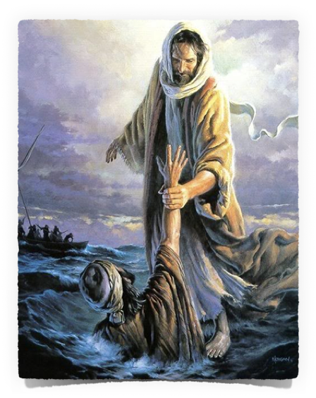
Background of Peter
One of the most well known characters of the NT
Most of us can relate to him in some way

Slide 3
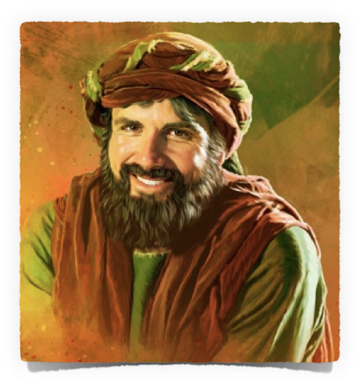
Background of Peter
Father: Jona (John)- Mat. 16:17
Brother: Andrew - Mat 10:2
Wife: - 1 Cor. 9:5; Mt. 8:14
Children: - 1 Pet. 5:1-4
Fisherman - Matt. 4:18
Education: little - Ac 4:13
From: Bethsaida - Jno.1:44
Lived in Capernaum - Mt. 8:5, 14; 17:24; Mk 1:21, 28-30

Slide 4
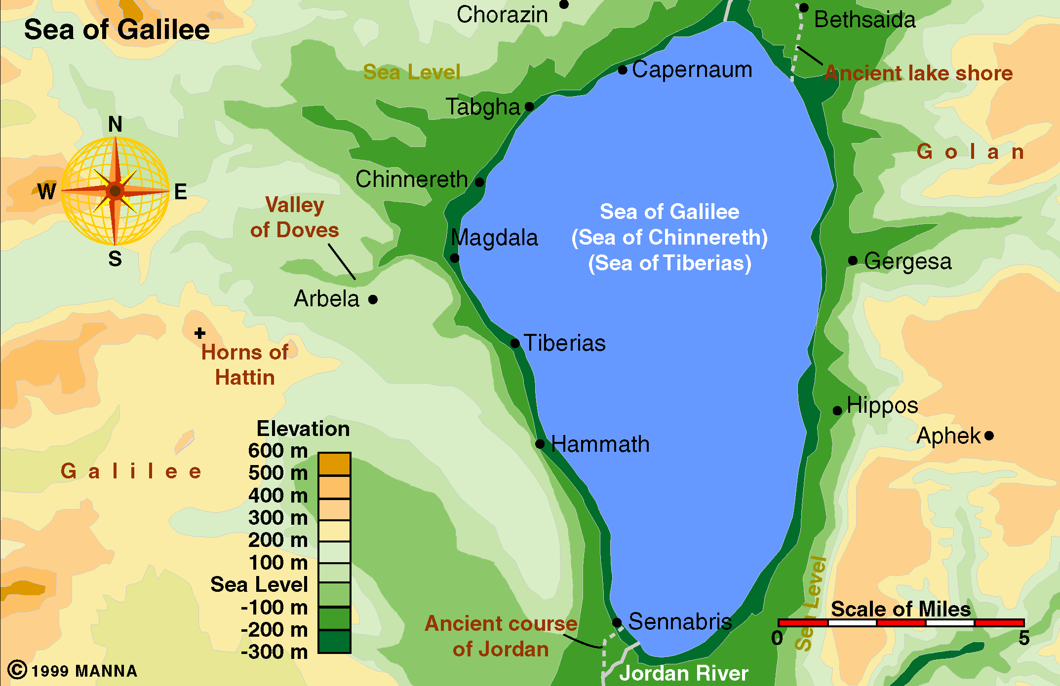
Don McClain
W. 65th St church of Christ / September 20,2009

Slide 5
Background of Peter
Introduced to Jesus by Andrew his brother – John 1:35-42
Jesus called Peter to follow Him while Peter and his brother were fishing – Mat. 4:18-22

Slide 6
Close To Jesus
At transfiguration - (Mat. 17:1)
In Garden - (Mat. 26:37-40; Mk. 5:37)
Raising daughter of Jarius - (Lk 8:51)
Asked about destruction of Jerusalem - (Mk. 13:3)

Slide 7
Prior to Passion
Healing of mother-in-law (Mt 8:14)
Great draught of fishes (Lk 5:1-11)
Call to be an apostle (Mt. 10:2)
Walking on water (Mt. 14:28)
Asking “To whom shall we go” (Jn 6:68)
Confession about Christ (Mt. 16:13ff)
Raising of Jairus’ daughter (Mk 5:37)
Transfiguration (Mt. 17:1-5)
Tribute money (Mt. 17:24)

Slide 8
Beginning at Passion
Jesus washed his feet (Jn 13:1-10)
Boasted of his loyalty (Lk 22:31-33)
Told he would deny (Mt. 26:31-35)
In Garden / Asleep (Mt. 26:36-46)
Attack on Malchus (Jn 18:10-12)
Distance & deny (Mt. 26:56-58)
Runs to tomb (Jn 20:1-10)
Sees Jesus alive (Lk 24:34)
Breakfast by sea (Jn 21)

Slide 9
Ascension To Death
Choosing Matthias (Acts 1:15-26)
Preach 1st sermon to Jews (Acts 2)
Heals man, preaches in Temple (Acts 3-4)
Arrested & beaten (Acts 5)
Goes to Samaria to impart gifts (Acts 8)
Heals Aeneas at Lydda (Acts 9:32-41)
Raises Dorcas (Acts 9:32-41)

Slide 10
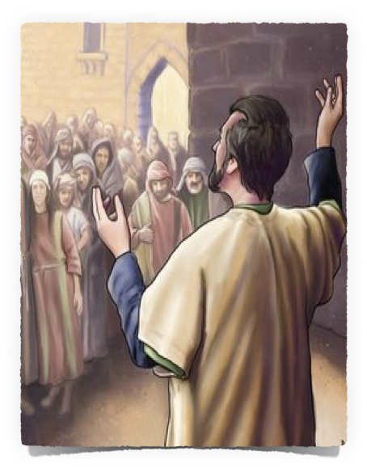
Restoration & Usefulness
Luke 22:31-32 (NKJV) ³¹ And the Lord said, "Simon, Simon! Indeed, Satan has asked for you, that he may sift you as wheat. ³² But I have prayed for you, that your faith should not fail; and when you have returned to Me, strengthen your brethren."

Slide 11
Restoration & Usefulness
Preach 1st to Gentiles (Acts 10)
Defends work w/ Gentiles (Acts 11)
Imprisoned & released (Acts 12)
Discussion at Jerusalem (Acts 15)
Hypocrisy @ Antioch (Ga 2:11-14)
Traveled with wife (1 Cor. 9:5)
Wrote two epistles (1 & 2 Peter)
Served as an Elder (1 Pet. 5:1-4)
Jesus foretold death (Jn 21:18-19)

Slide 12
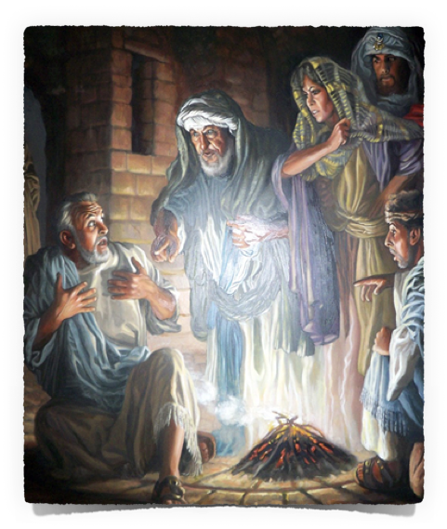
Can We Relate?
Impulsive - Quick to Speak Out - Matt. 15:15; 16:13-18, 22-23; 17:4; John 13:8-9; 18:10-11
Rebuked the Lord - Mk. 8
Denied the Lord - Mt 26:58ff
Worrying After Other’s Affairs - John 21:20-21
Hypocrite - Gal. 2:11-14
Over Confident - Mt 26:33-35

Slide 13
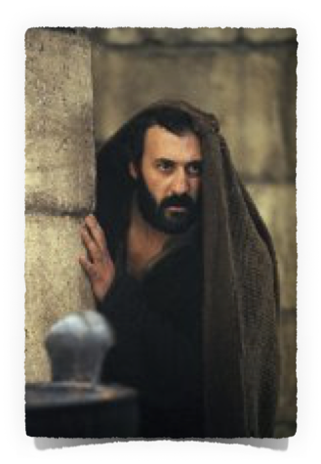
1 Peter 5:13 (NKJV) — ¹³ She who is in Babylon, elect together with you, greets you; and so does Mark my son.
Rome - Kelly, Davids, Lenski, Kistemaker, Valesills, Grotius, Cave, Whitby, and Lardner.
A place called Babylon in Egypt, not far from Cairo - Pearson and Le Clerc, and by most of the Coptic interpreters,
Babylon is Jerusalem - Capellus, Spanheim, Hardouin, and some others.
Babylon is Babylon – Hamilton, Barnes, Erasmus, Drusius, Lightfoot, Bengel, Wetstein, Bashage, Beausobre, Alford, Huther, Calvin, Neander, Weiss, and Reuss

Slide 14
1 Peter 1:1 (NKJV) - ¹ Peter, an apostle of Jesus Christ, To the pilgrims of the Dispersion in Pontus, Galatia, Cappadocia, Asia, and Bithynia,
Time: Nothing certainly can be determined. There are no marks of time in the epistle itself.
Hamilton — 64 or 65, (xxxvii)
Thiessen — 65
Lardner — 63, 64, or at the latest 65;
Michaelis, — about the year 60.
Barnes — probably between 58 and 61 AD
“Cave …, in his “Life of St. Peter,” written in English 1676, places his death in 64 or 65” by Nero in Rome.

Slide 16
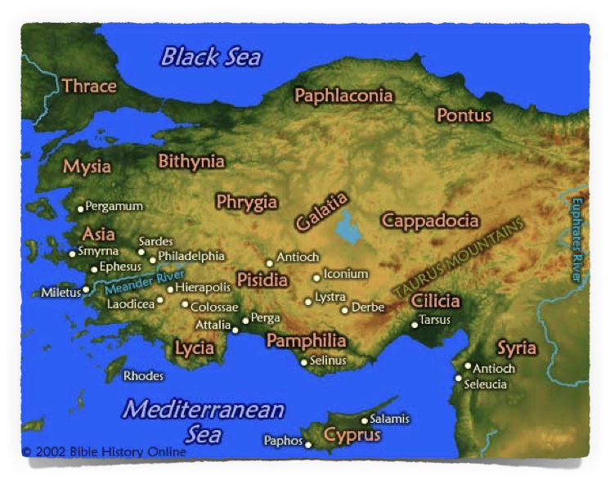
1 Peter 1:1 (NKJV)
¹ Peter, an apostle of Jesus Christ, To the pilgrims of the Dispersion in Pontus, Galatia, Cappadocia, Asia, and Bithynia,

Slide 17
1 Peter 1:1 (NKJV) - ¹ Peter, an apostle of Jesus Christ, To the pilgrims of the Dispersion in Pontus, Galatia, Cappadocia, Asia, and Bithynia,
Jews & Gentiles - Christians
Makes comments that Jews would more clearly understand - (1:1-12; 3:5,6; 2:5,6)
Peter speaks as though many of them were Gentiles - (1:18;2:9,10; 4:3,4)

Slide 18
Introduction – (1:1-25)
Author - (1:1a).
Ones addressed – (1:1b-2a)
Salutation (1:2b)
Theme & Purpose – (1:3-25)
Body – (2:1-5:11)
General admonitions in consequence of the new birth - (2:1-12; 4:7-11)
Various relationships & consequent obligations – (2:13-18; 3:1-12; 5:1-9)
Behavior in suffering – (2:19-25; 3:13-4:6, 12-19; 5:10,11)
Conclusion – (5:12-14)

Slide 19
To Encourage Christians To Live For Christ While Suffering For Him
Trials of faith - (1:6).
Good spoken of as evil – (2:12)
Suffering as Jesus suffered - (2:18-24).
We may even suffer for doing what is right! (3:14)
We should arm ourselves with Jesus’ attitude (4:1)
Should not be surprised at painful trials (4:12-16).
Perfection comes after suffering – (5:10)

Slide 20
The Word “Elect”
1. eklego (ἐκλέγομαι, 1586), “to pick out, select,” means, in the middle voice, “to choose for oneself,” … eklektos (ἐκλεκτός, 1588)signifies “chosen out, select,”(Vines)
30.93 ἐκλεκτός, ή, όν; ἐκλογή^{b}, ῆς f: (derivatives of ἐκλέγομαι^{b} and ἐκλογήª ‘to choose, choice,’ 30.92) that which has been chosen—‘chosen.” … (Lou Nida)
1 Peter 1:2 (NKJV) -
² elect according to the foreknowledge of God

Slide 21
The word "foreknowledge"
Comes from "prognosis" {prog'-no-sis}
a. Formed from two terms – pro – before & ginosko – to know
1. It means "forethought, pre-arrangement"
2. I.e., being the "elect" (chosen) of God is in keeping with God's plan which He designed beforehand
1 Peter 1:2 (NKJV) -
² elect according to the foreknowledge of God

Slide 22
"Their election and salvation was in accordance with God's predetermined purpose to save men through the gospel, and hence, according to foreknowledge."
[B. W. Johnson says in his "People's New Testament" commentary:]
1 Peter 1:2 (NKJV) -
² elect according to the foreknowledge of God

Slide 23
Comparing W/ Ephesians 1
ALL BLESSINGS IN CHRIST - Ep 1:3
God’s plan before the world began – Ep 1:4
The "chosen" in Christ would be holy and without blame - Ep 1:4
The "elect" would be adopted as sons – Ep 1:5
This plan is according to God's good pleasure – Ep 1:5,10-13
1 Peter 1:2 (NKJV) -
² elect according to the foreknowledge of God

Slide 24
Corporate Election
General, not particular;
God’s election is – “the body of Christ, the church”
Type of person - Mat 5:3-12
The obedient - becoming members of the chosen family – Galatians 3:26,27; Hebrews 5:8,9,
Those who make their “Calling and Election sure” – 2 Peter 1:5-10
1 Peter 1:2 (NKJV) -
² elect according to the foreknowledge of God

Slide 25
1 Peter 1:2 Ephesians 1:3-13 | God Chose Before The World:
Who? | Those Who Obey The Gospel –
Where? | Those In Christ’s Church, (body)
When? | Baptized Into The Family of God –
How? | God’s Predetermined plan –sanctification–obedience & purification
What? | Forgiveness - Grace and peace – eternal life

Slide 26
Corporate Election
The character, nature, conduct, and destiny of Christians are foreknown and predetermined
To be in this group is our decision.
Just as Israel (as a nation) had been chosen by God during the Old Testament period
Individually, they had to make "their calling and election sure"
1 Peter 1:2 (NKJV) -
² elect according to the foreknowledge of God

Slide 27
2 Thessalonians 2:13-15 (NKJV)
13 But we are bound to give thanks to God always for you, brethren beloved by the Lord, because God from the beginning chose you for salvation through sanctification by the Spirit and belief in the truth, 14 to which He called you by our gospel, for the obtaining of the glory of our Lord Jesus Christ. 15 Therefore, brethren, stand fast and hold the traditions which you were taught, whether by word or our epistle.
1 Peter 1:2 (NKJV)
² … in sanctification of the Spirit, for obedience and sprinkling of the blood of Jesus Christ:…

Slide 28
Chosen & Sanctified Through
2 Thessalonians 2:13-14 (NKJV)
1 Peter 1:2 (NKJV)
² … in sanctification of the Spirit, for obedience and sprinkling of the blood of Jesus Christ:…
“God from the beginning chose you for <eis – unto> salvation “through <en – in/through> sanctification by the Spirit and belief in the truth, ¹⁴ to which He called you by our gospel,”
through <en – in, through, by means of> sanctification by the Spirit
and belief in the truth,
to which He called you by <dia – through> our gospel,

Slide 29
John 17:14–19 (NKJV)
¹⁴ I have given them Your word; and the world has hated them because they are not of the world, just as I am not of the world. ¹⁵ I do not pray that You should take them out of the world, but that You should keep them from the evil one. ¹⁶ They are not of the world, just as I am not of the world. ¹⁷ Sanctify them by Your truth. Your word is truth. ¹⁸ As You sent Me into the world, I also have sent them into the world. ¹⁹ And for their sakes I sanctify Myself, that they also may be sanctified by the truth.
1 Peter 1:2 (NKJV)
² … in sanctification of the Spirit, for obedience and sprinkling of the blood of Jesus Christ:…

Slide 30
1 Peter 1:22–23 (NKJV)
22 Since you have purified your souls in obeying the truth through the Spirit in sincere love of the brethren, love one another fervently with a pure heart, 23 having been born again, not of corruptible seed but incorruptible, through the word of God which lives and abides forever,
1 Peter 1:2 (NKJV)
² … in sanctification of the Spirit, for obedience and sprinkling of the blood of Jesus Christ:…

Slide 31
1 Corinthians 12:13 (NKJV)
¹³ For by one Spirit we were all baptized into one body—whether Jews or Greeks, whether slaves or free—and have all been made to drink into one Spirit.
cf. 6:11
1 Peter 1:2 (NKJV)
² … in sanctification of the Spirit, for obedience and sprinkling of the blood of Jesus Christ:…

Slide 32
CALVINISM: God chose them to believe - God is responsible for the unbelief of every person that is condemned.
THE BIBLE: God chose them that believe - God is NOT responsible for the unbelief of any person that is condemned.
1 Peter 1:2 (NKJV)
² … in sanctification of the Spirit, for obedience and sprinkling of the blood of Jesus Christ:…

Slide 33
Led By The Instruction of The Gospel Given By The Holy Spirit We Must Come “Unto Obedience” — 1 Cor. 12:2,3,13
Our obedience, and the application of the blood of Christ which purifies us is simultaneous – Titus 3:5
Obedience enacts the purifying agent - We do not provide it – We access it through obedience — Acts 22:16
1 Peter 1:2 (NKJV)
² … in sanctification of the Spirit, for obedience and sprinkling of the blood of Jesus Christ:…

Slide 34
1 Peter 1:22–23 (NKJV)
²² Since you have purified your souls in obeying the truth through the Spirit in sincere love of the brethren, love one another fervently with a pure heart, ²³ having been born again, not of corruptible seed but incorruptible, through the word of God which lives and abides forever,
1 Peter 1:2 (NKJV)
² … in sanctification of the Spirit, for obedience and sprinkling of the blood of Jesus Christ:…

Slide 35
Colossians 2:12–13 (NKJV)
¹² buried with Him in baptism, in which you also were raised with Him through faith in the working of God, who raised Him from the dead. ¹³ And you, being dead in your trespasses and the uncircumcision of your flesh, He has made alive together with Him, having forgiven you all trespasses,
1 Peter 1:2 (NKJV)
² … in sanctification of the Spirit, for obedience and sprinkling of the blood of Jesus Christ:…

Slide 36
By the grace of God and Our obedience to the gospel of Jesus Christ, we become:
Part of God's predetermined plan –
Chosen through the sanctifying work of the Holy Spirit –
Recipients of the Sprinkling of Jesus’ blood –
Thereby we are recipients of the richest blessings God has to offer (Grace, peace & forgiveness of sins)
1 Peter 1:2 (NKJV)
² … in sanctification of the Spirit, for obedience and sprinkling of the blood of Jesus Christ:…

Slide 37
Are you part of God’s chosen people?
Set apart through the Holy Spirit?
Obedient and thereby a recipient of the cleansing the blood of Jesus provides?
1 Peter 1:2 (NKJV)
² … in sanctification of the Spirit, for obedience and sprinkling of the blood of Jesus Christ:…

Slide 38
347 - Who Will Follow Jesus - 1.1

Slide 39
347 - Who Will Follow Jesus - 1.2

Slide 40
347 - Who Will Follow Jesus - 1.3

Slide 41
347 - Who Will Follow Jesus - C.1

Slide 42
347 - Who Will Follow Jesus - C.2

Slide 43
347 - Who Will Follow Jesus - C.3
End of Verse 1

Slide 44
347 - Who Will Follow Jesus - 2.1

Slide 45
347 - Who Will Follow Jesus - 2.2

Slide 46
347 - Who Will Follow Jesus - 2.3

Slide 47
347 - Who Will Follow Jesus - C.1

Slide 48
347 - Who Will Follow Jesus - C.2

Slide 49
347 - Who Will Follow Jesus - C.3
End of Verse 2

Slide 50
347 - Who Will Follow Jesus - 3.1

Slide 51
347 - Who Will Follow Jesus - 3.2

Slide 52
347 - Who Will Follow Jesus - 3.3

Slide 53
347 - Who Will Follow Jesus - C.1

Slide 54
347 - Who Will Follow Jesus - C.2

Slide 55
347 - Who Will Follow Jesus - C.3
End of Song

Slide 56
013.15 - Alleluia - Title

Slide 57
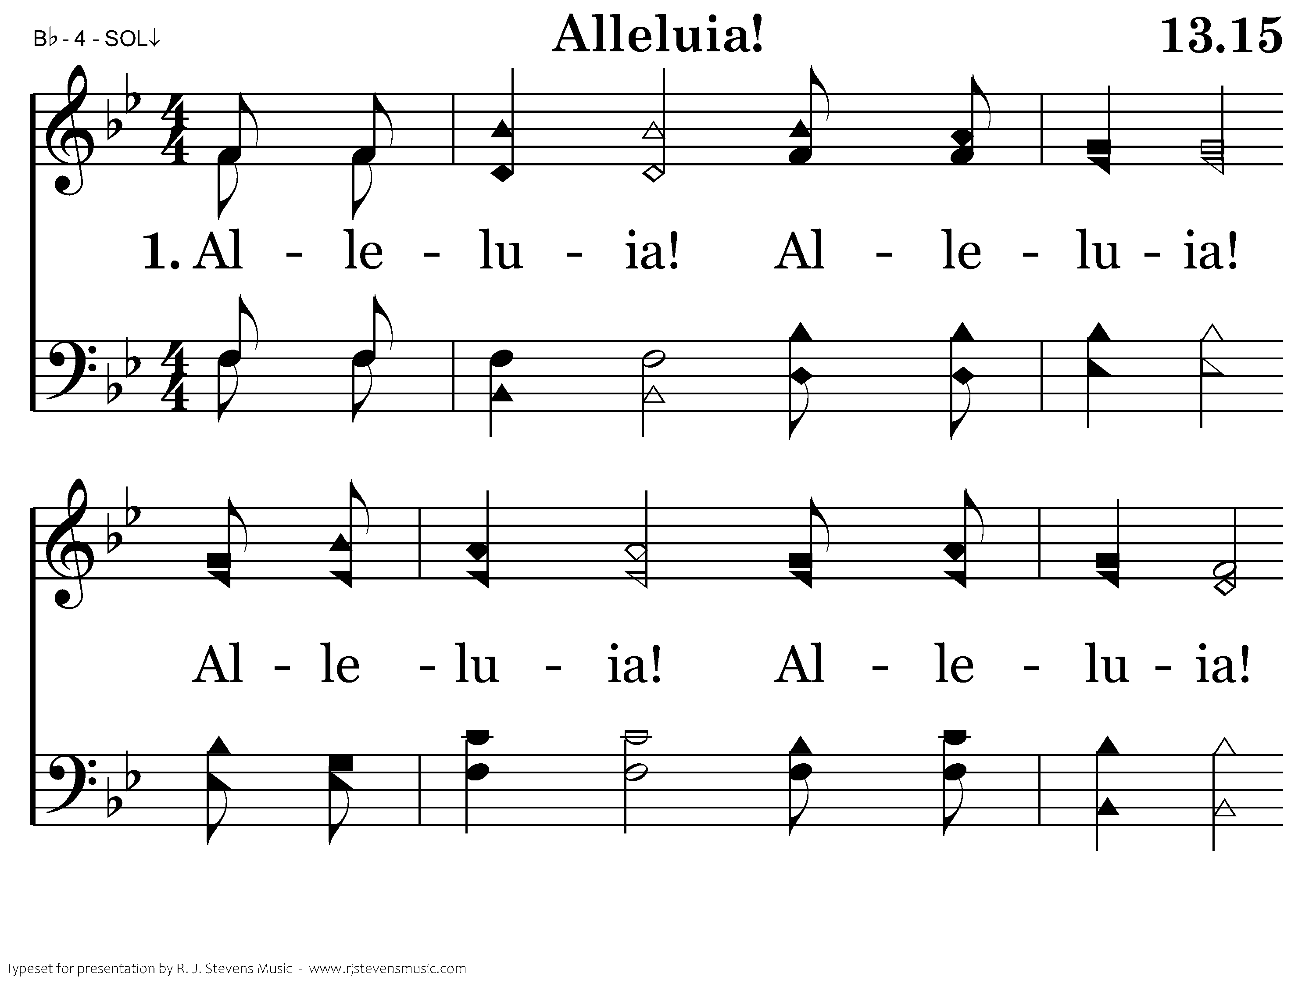
013.15 - Alleluia - 1.1

Slide 58
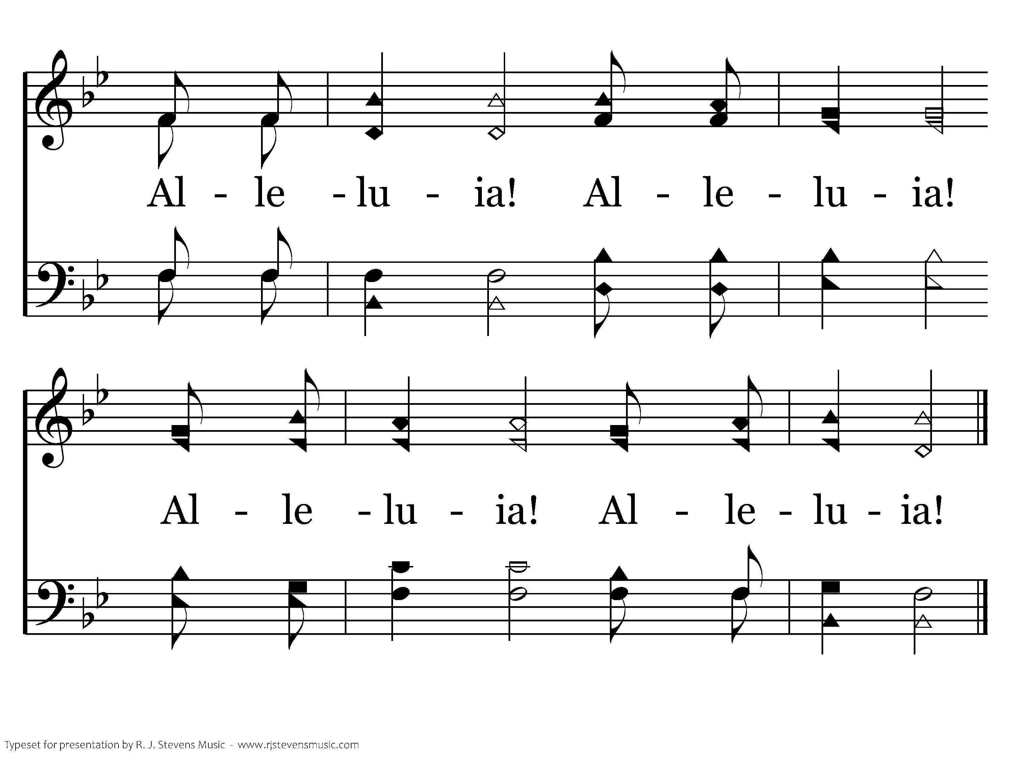
013.15 - Alleluia - 1.2
End of Verse 1

Slide 59
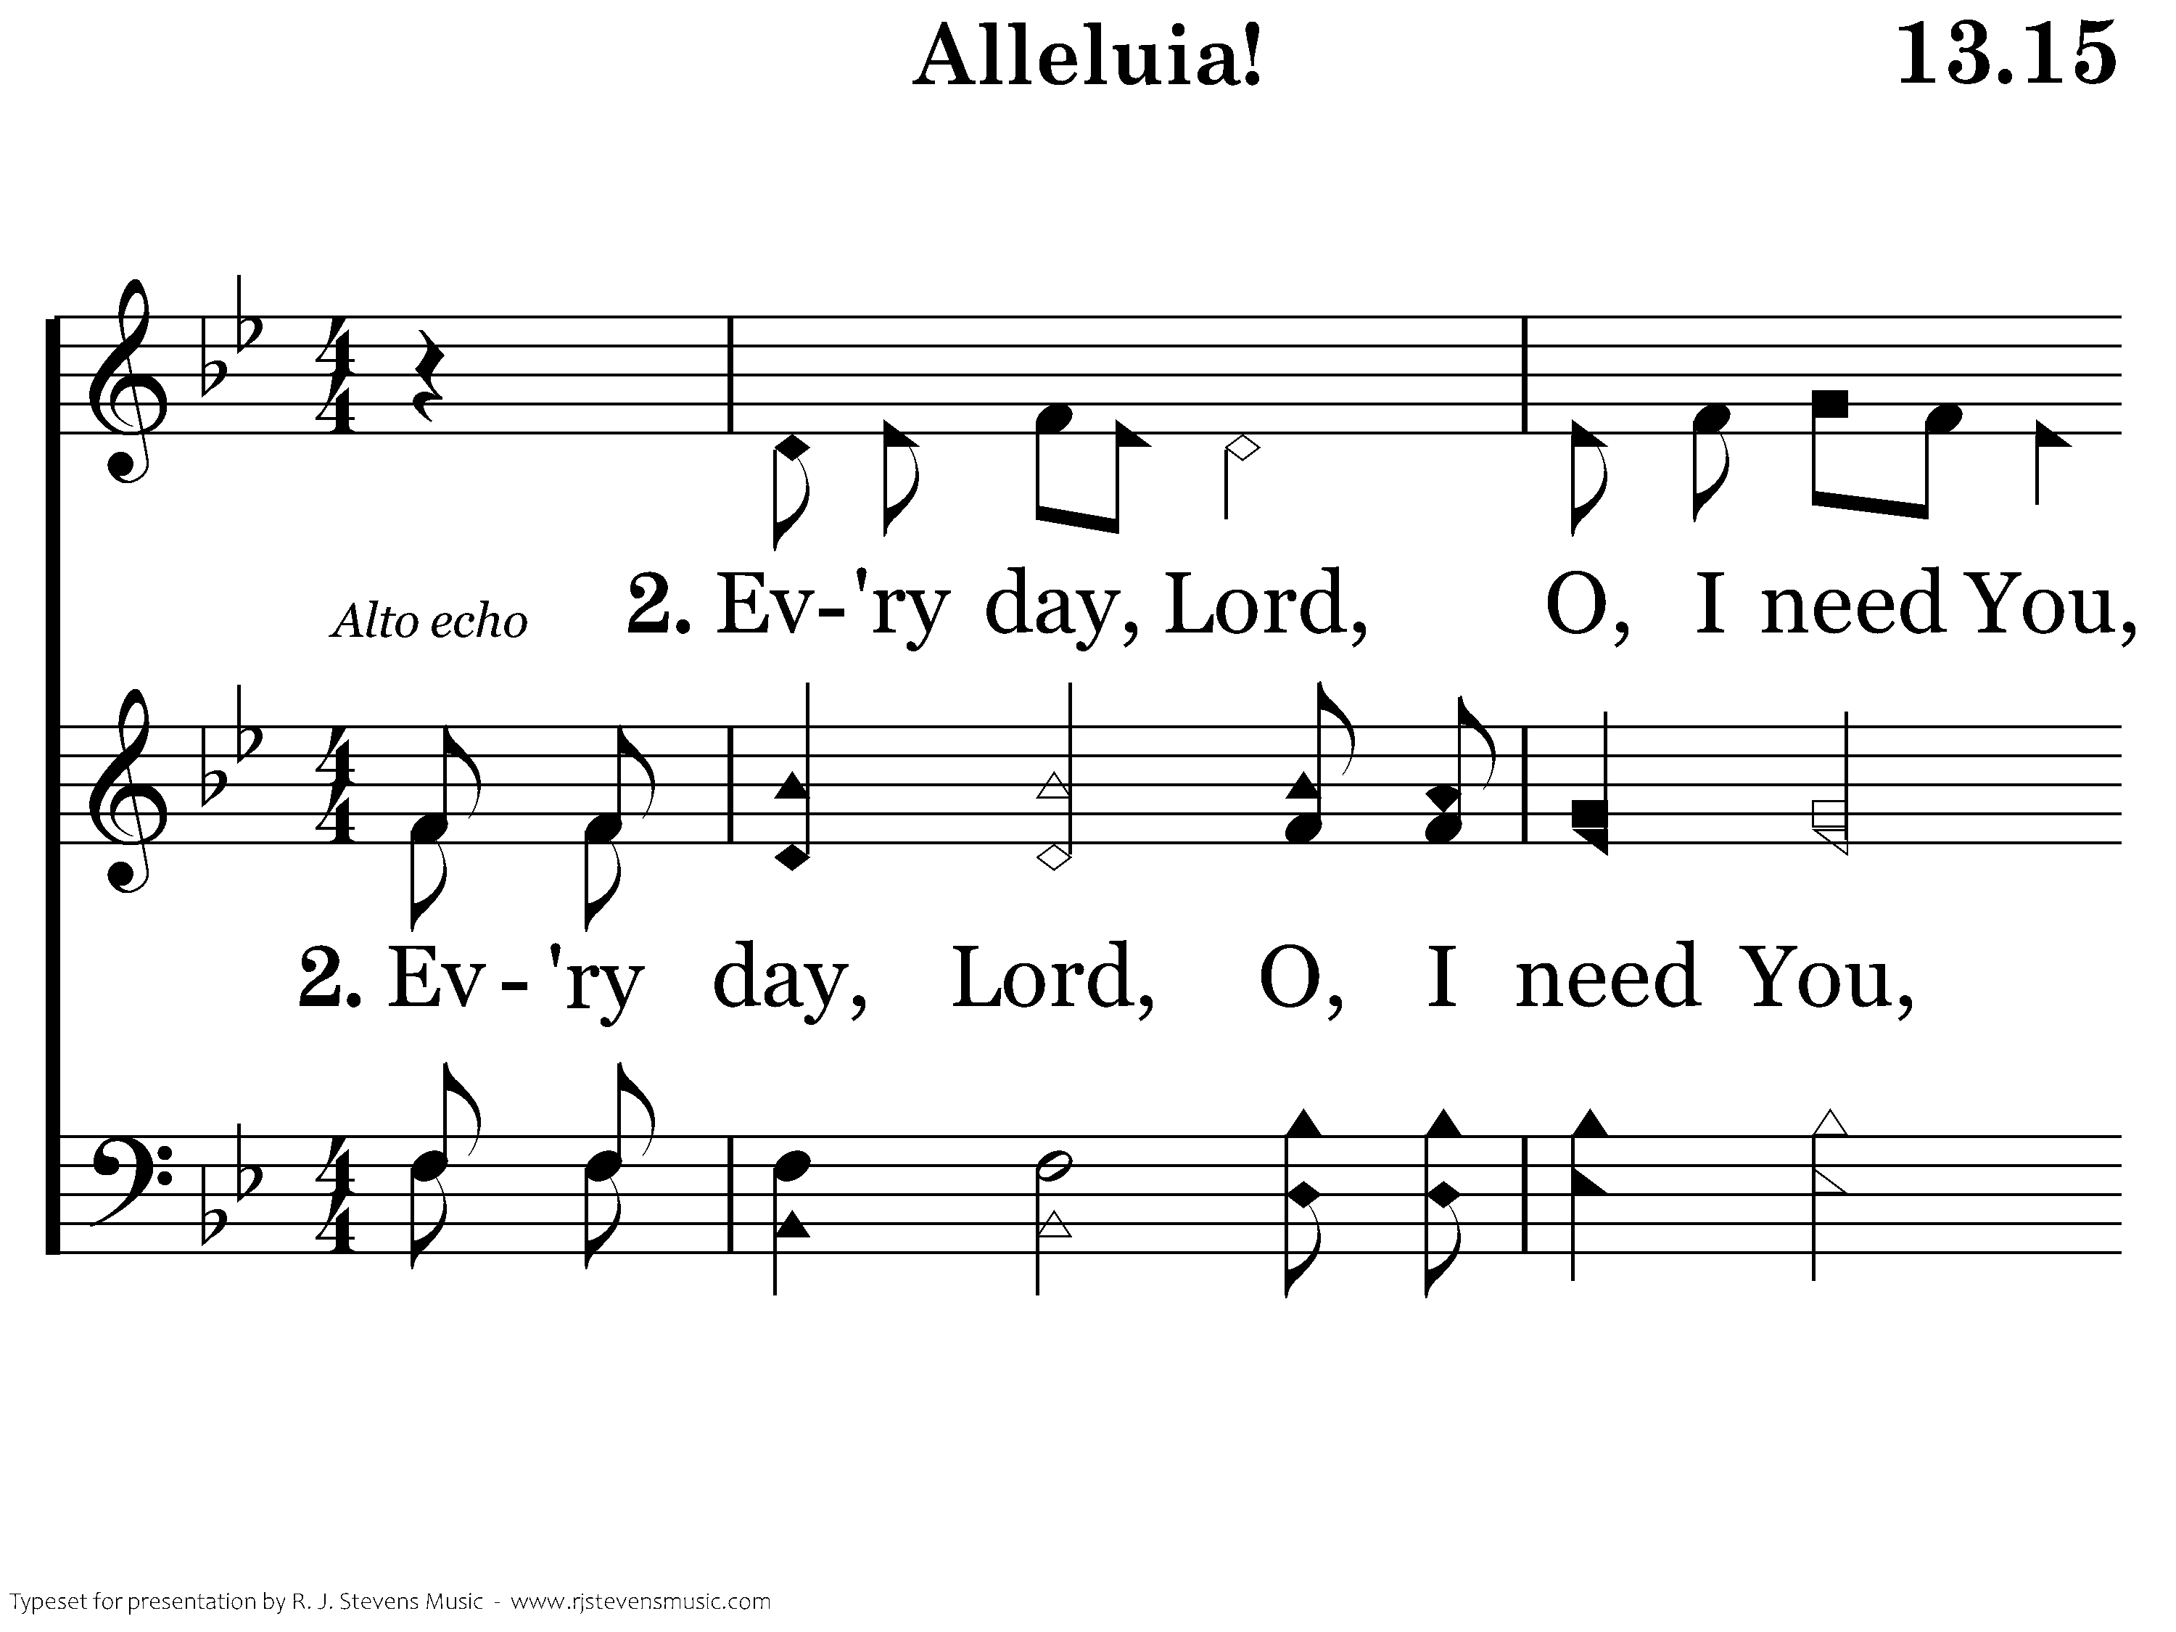
013.15 - Alleluia - 2.1

Slide 60
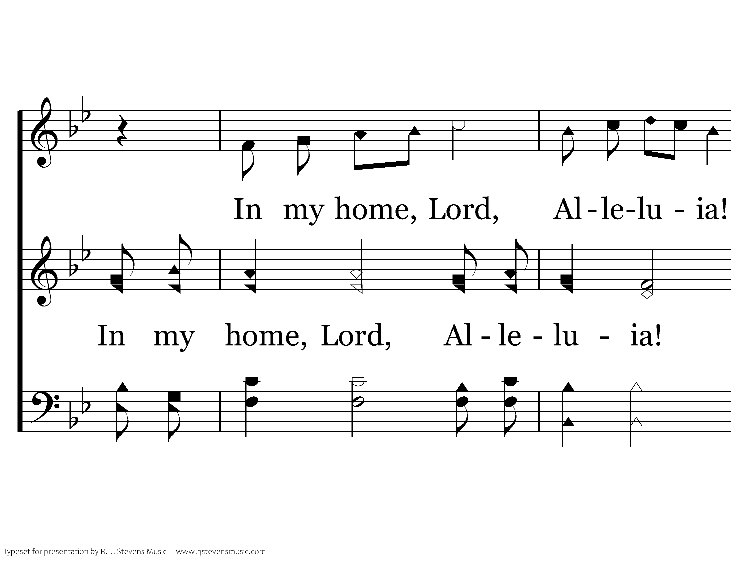
013.15 - Alleluia - 2.2

Slide 61
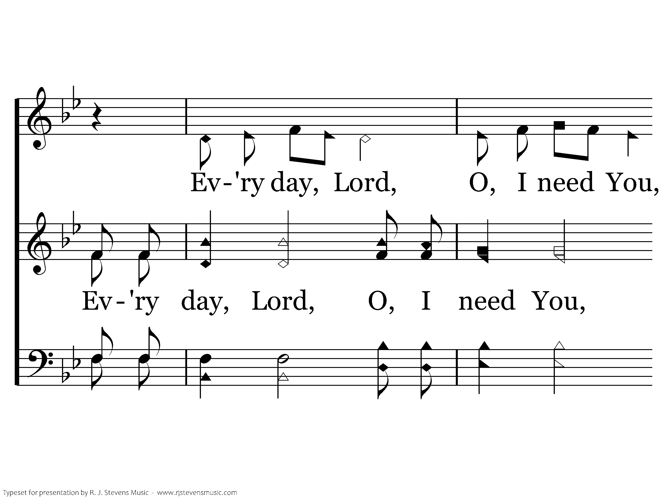
013.15 - Alleluia - 2.3

Slide 62
013.15 - Alleluia - 2.4
End of Verse 2

Slide 63
013.15 - Alleluia - 3.1

Slide 64
013.15 - Alleluia - 3.2

Slide 65
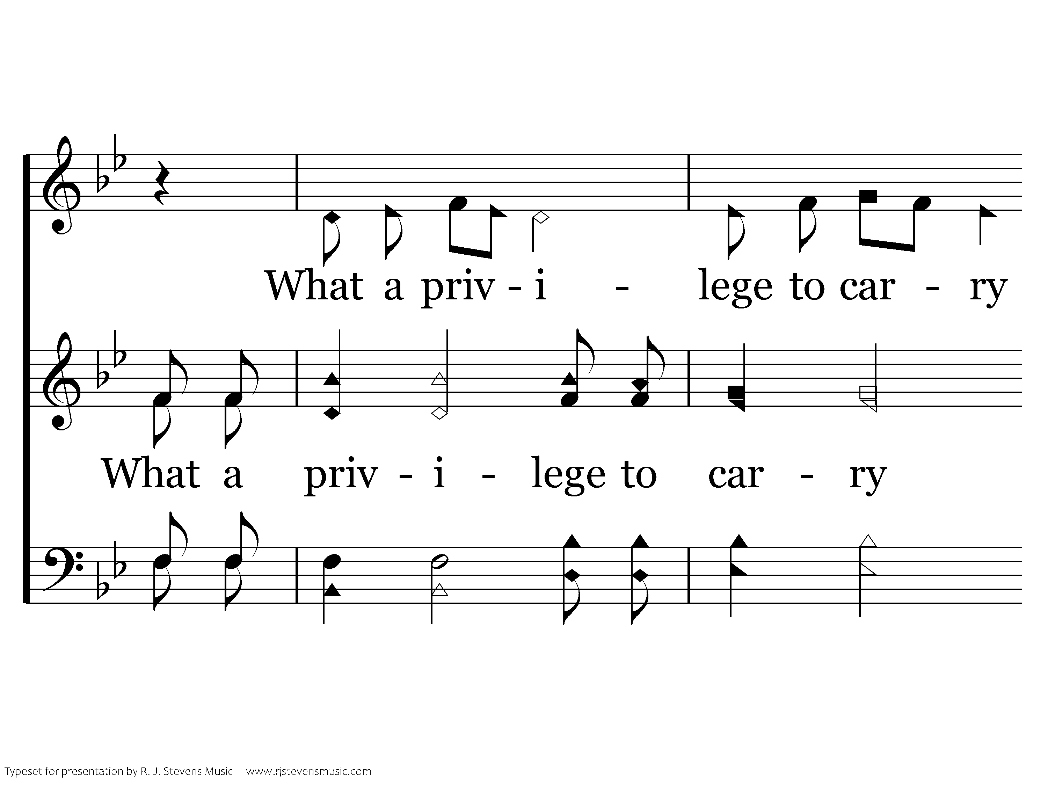
013.15 - Alleluia - 3.3

Slide 66
013.15 - Alleluia - 3.4
End of Verse 3

Slide 67
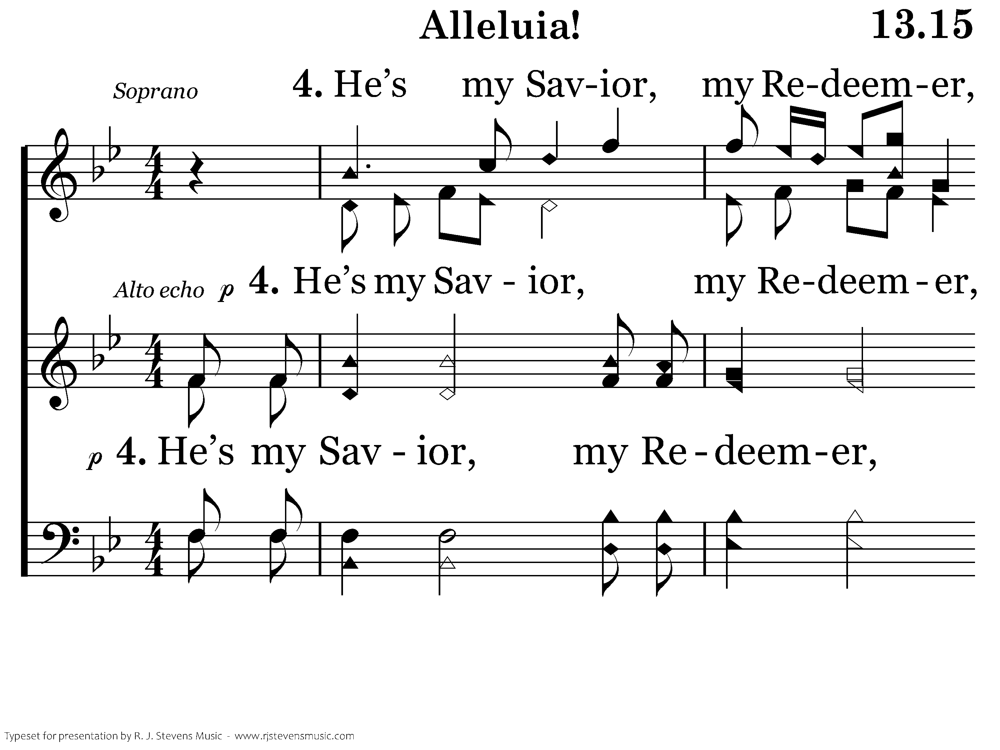
013.15 - Alleluia - 4.1

Slide 68
013.15 - Alleluia - 4.2

Slide 69
013.15 - Alleluia - 4.3

Slide 70
013.15 - Alleluia - 4.4
End of Verse 4

Slide 71
013.15 - Alleluia - 5.1

Slide 72
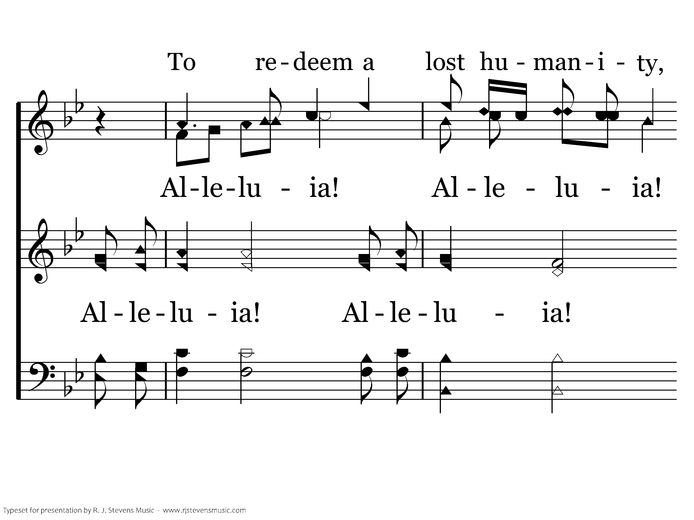
013.15 - Alleluia - 5.2

Slide 73
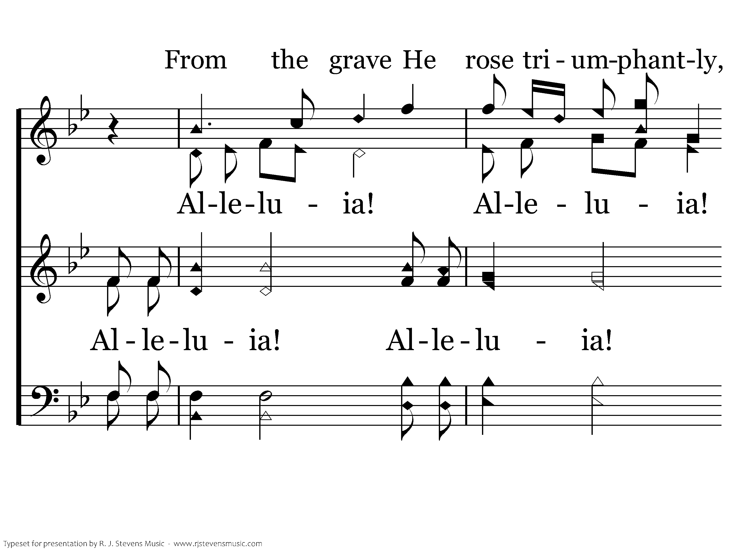
013.15 - Alleluia - 5.3

Slide 74
013.15 - Alleluia - 5.4
End of Song

Slide 76
Introduction & Greeting
Charts by Don McClain
Preached December 8, 2019
West 65th Street church of Christ - P.O. Box 190062 - Little Rock AR 72219 - Phone — 501-568-1062 — Email – donmcclain@sbcglobal.net
Prepared using Keynote / More Keynote, PPT & Audio Sermons:
www.w65stchurchofchrist.com

