Slide 1
The “Bible Speaks” Series
A Study Book for Teachers & Students
Robert Harkrider

Slide 2
The “Bible Speaks” Series - A Study Book for Teachers & Students
I. The Superiority of Christ As God’s Spokesman - Hebrews 1:1-4:11
Lesson 1 - 1:1-3 - God Has Spoken o Us Through His Son - 1
Lesson 2 - 1:4-2:4 - The Position of Christ Superior To Angels - 7
Lesson 3 - 2:5-18 - A Savior Made Perfect Through Suffering - 12
Lesson 4 - 3:1-19 - Christ Is Greater Than Moses - 18
Lesson 5 - 4:1-11 - The Christian Sabbath - 23

Slide 3
The “Bible Speaks” Series - A Study Book for Teachers & Students
II. The Superiority of Christ As High Priest - Hebrews 4:12-7:28
Lesson 6 - 4:12-16 - Let Us Come Boldly To The Throne of Grace - 28
Lesson 7 - 5:1-10 - Christ Our Great High Priest - 33
Lesson 8 - 5:11-6:8 - Dangers of Immaturity & Apostasy - 38
Lesson 9 - 6:9-20 - Hope, The Anchor of Our Souls - 44
Lesson 10 - 7:1-17 - How Could Christ Be A High Priest? - 49
Lesson 11 - 7:18-28 - What Christ’s Priesthood Means to Christians - 54

Slide 4
The “Bible Speaks” Series - A Study Book for Teachers & Students
III. The Superiority of The New Covenant of Christ - Hebrews 8:1-10:18
Lesson 12 - 8:1-6 - Christ Is Mediator of a Better Covenant - 59
Lesson 13 - 8:7-13 - What Makes The New Covenant So Great? - 66
Lesson 14 - 9:1-10 - Why Follow Only The “Figure of the True”? - 72
Lesson 15 - 9:11-17 - Three Great Provisions By His Blood of the New Covenant - 79
Lesson 16 - 9:18-28 - Why Was A Blood Sacrifice Necessary? - 86
Lesson 17 - 10:1-18 - Christ The Fulfillment of the Law - 92

Slide 5
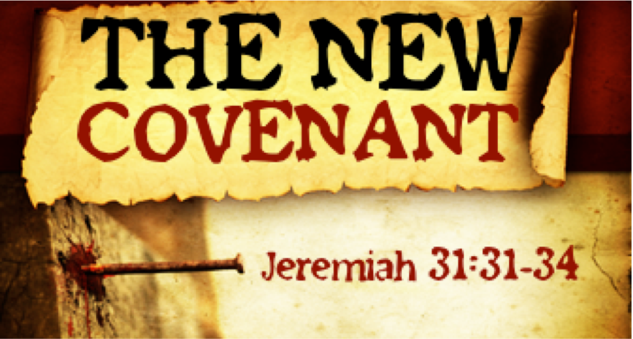
The “Bible Speaks” Series - A Study Book for Teachers & Students Lesson 12 - 8:1-6 - pg - 59
Christ Is Mediator of a Better Covenant - 8:1-6
Introduction
“Now this is the main point of the things we are saying:” - The sum—rather, “the principal point” is now ready to be addressed . . .
Based on the fact that Christ is our great high priest, after the order of Melchizedek, the writer now enters into the next topic - Jesus is worthy to be the minister of a better covenant.

Slide 6
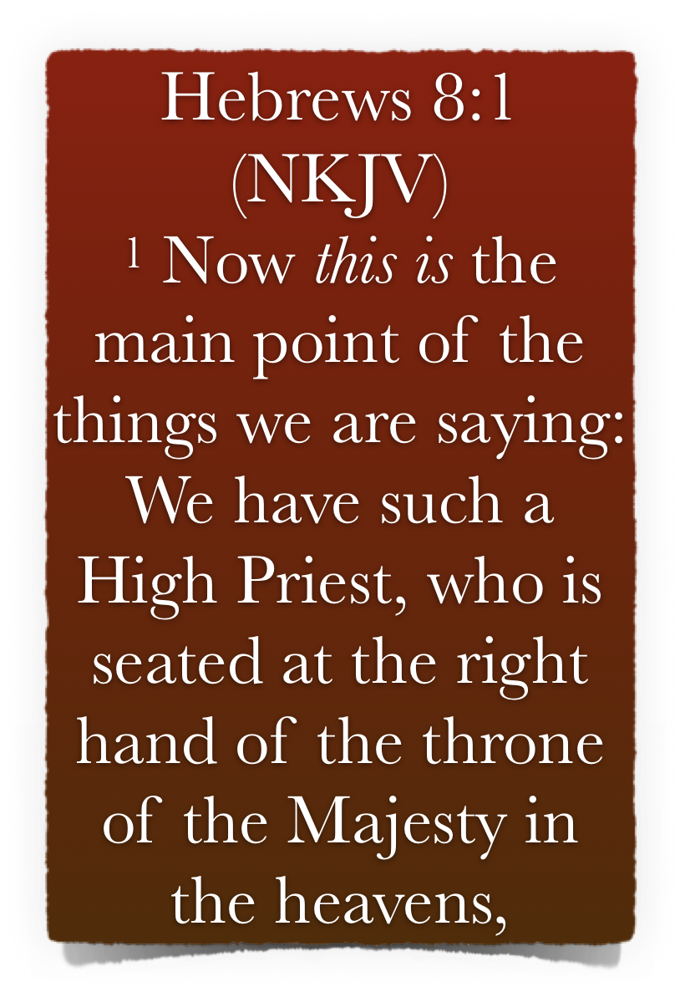
The “Bible Speaks” Series - A Study Book for Teachers & Students Lesson 12 - 8:1-6 - pg - 59
Christ Is Mediator of a Better Covenant - 8:1-6
The Main Point “Christ is both King & Priest” - 8:1-4
Jesus is set at the “right hand of the majesty on high” - (8:1)
Jesus is BOTH King & Priest after the order of Melchizedek - 8:1; see 7:1; cf. Ge 14:18; Ps 110:4; Zec. 6:13; Col. 3:1; Re. 3:21.
Christ now occupies the place of supreme power at God’s right hand - mentioned 5 times in Hebrews - 1:3, 13; 10:12; 12:2

Slide 7
The “Bible Speaks” Series - A Study Book for Teachers & Students Lesson 12 - 8:1-6 - pg - 59
Christ Is Mediator of a Better Covenant - 8:1-6
The Main Point “Christ is both King & Priest” - 8:1-4
Jesus is set at the “right hand of the majesty on high” - (8:1)
Ascended to the right hand of God - Mark 16:19
Raised to sit on David’s throne - Acts 2:30-36
Far above all principality & power & might & dominion & every name named - Eph. 1:20-23
Stephen saw Jesus there - Acts 7:55
Jesus will remain where He is till final resurrection - Heb 10:11-14; 1 Cor. 15:23-28

Slide 8
The “Bible Speaks” Series - A Study Book for Teachers & Students Lesson 12 - 8:1-6 - pg - 59
Christ Is Mediator of a Better Covenant - 8:1-6
The Main Point “Christ is both King & Priest” - 8:1-4
Jesus is set at the “right hand of the majesty on high” - (8:1)
Premillennialist deny Jesus is now on the throne of David, believing He will assume that position in the future, here on the earth, for 1,000 years
Jesus was prophesied to be priest & king on His throne - if priest now, then He is king NOW - Zec 6:12,13
Jesus is NOW of David’s throne, i.e., the throne of the Lord - 1 Chr 29:23; 1 Ki 2:12; Ac 2:30-36

Slide 9
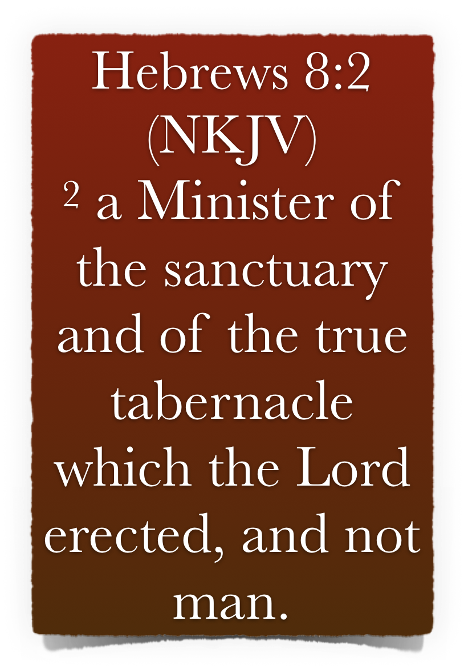
The “Bible Speaks” Series - A Study Book for Teachers & Students Lesson 12 - 8:1-6 - pg - 59
Christ Is Mediator of a Better Covenant - 8:1-6
The Main Point “Christ is both King & Priest” - 8:1-4
Jesus is a priest of the “heavenly tabernacle” - (8:2-4)
Minister -leitourgos - denoted among the Greeks, firstly, “one who discharged a public office at his own expense,” then, in general, “a public servant, minister.” (Vine’s)
The work of the priest is to minister in the tabernacle - Ex 28:1,35

Slide 10
The “Bible Speaks” Series - A Study Book for Teachers & Students Lesson 12 - 8:1-6 - pg - 59
Christ Is Mediator of a Better Covenant - 8:1-6
The Main Point “Christ is both King & Priest” - 8:1-4
Jesus is a priest of the “heavenly tabernacle” - (8:2-4)
“The true tabernacle which the Lord erected” – this passage introduces a contrast between the tabernacle of Moses (the type) & the “true tabernacle” (the antitype)
The OT tabernacle a transitory structure - The “true tabernacle” on the other hand is of divine origin and is perfect for its purpose. It is eternal and unshakeable

Slide 11
The “Bible Speaks” Series - A Study Book for Teachers & Students Lesson 12 - 8:1-6 - pg - 59
Christ Is Mediator of a Better Covenant - 8:1-6
The Main Point “Christ is both King & Priest” - 8:1-4
Jesus is a priest of the “heavenly tabernacle” - (8:2-4)
It is true that the church is spoken of as the Lord’s temple in the NT, (Eph 2:19-22; 1 Cor. 3:16,17; 1 Pet 2:4-10)
However, the consistent application of the idea in this context has reference to heaven itself - (9:8, 11,12, 23-25)

Slide 12
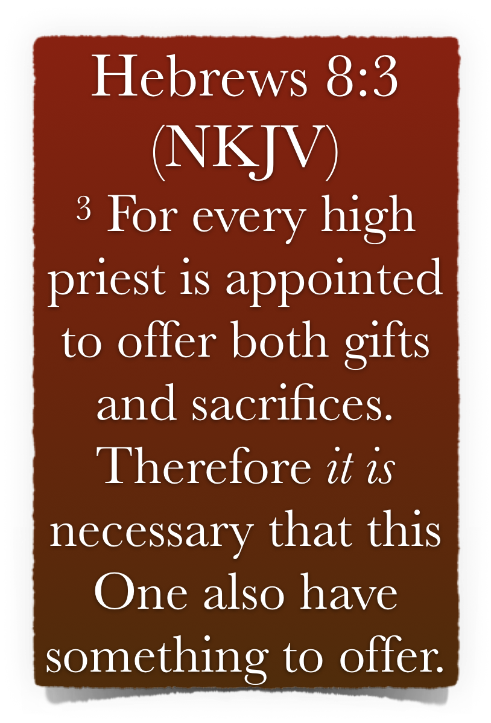
The “Bible Speaks” Series - A Study Book for Teachers & Students Lesson 12 - 8:1-6 - pg - 59
Christ Is Mediator of a Better Covenant - 8:1-6
The Main Point “Christ is both King & Priest” - 8:1-4
Jesus is a priest of the “heavenly tabernacle” - (8:2-4)
Since the role of a priest involved gifts (dōra) and sacrifices (thysias; cf. 5:1; 9:9), it follows that this new High Priest should have something to offer.
The primary role of a priest is to offer sacrifices at an altar. Jesus has a sacrifice & an altar upon which to offer gifts (9:11-15).

Slide 13
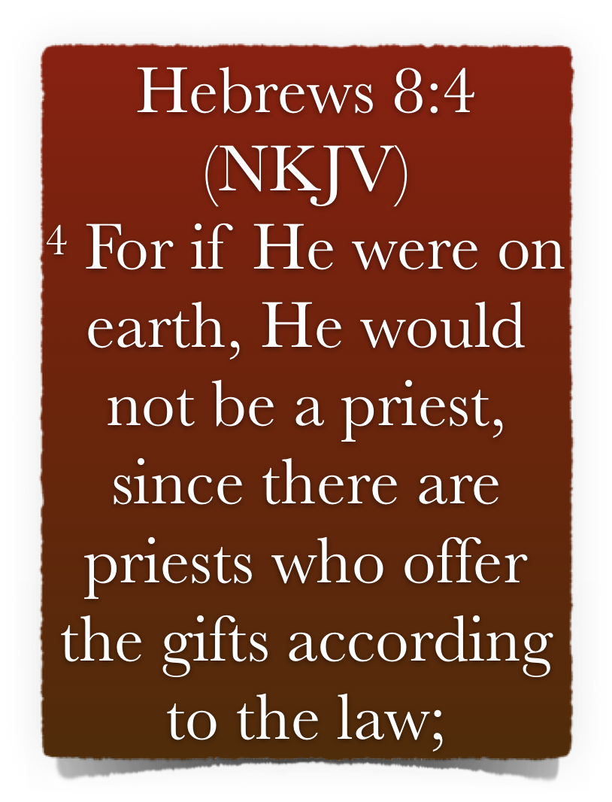
The “Bible Speaks” Series - A Study Book for Teachers & Students Lesson 12 - 8:1-6 - pg - 59
Christ Is Mediator of a Better Covenant - 8:1-6
The Main Point “Christ is both King & Priest” - 8:1-4
Jesus is a priest of the “heavenly tabernacle” - (8:2-4)
The law would not have allowed for Jesus to carry out his work as a priest here on earth, it had already made provision for an earthly priest and Jesus did not meet those prerequisites - (compare Heb 7:13, 14)
Jesus never assumed such for Himself, however He now serves at the true altar in the tabernacle erected by the Lord

Slide 14
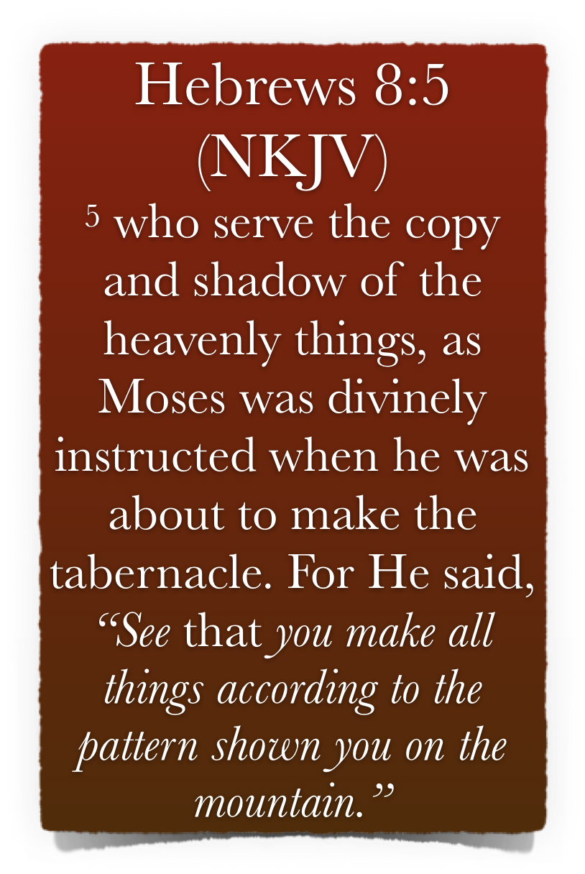
The “Bible Speaks” Series - A Study Book for Teachers & Students Lesson 12 - 8:1-6 - pg - 59
Christ Is Mediator of a Better Covenant - 8:1-6
God Gave A Pattern - 8:5
Moses was told to follow “the pattern” given him on the mount - (8:5)
First - the tabernacle was the “copy” or “shadow” of the heavenly things - ch. 9:9, 23, 24; 10:1. Col. 2:17.
It was necessary & important that the “copy” & “shadow” be made according to the pattern God gave - Ex. 25:40; 26:30; 27:8. Nu. 8:4. 1 Ch. 28:12, 19. Ac. 7:44.

Slide 15
The “Bible Speaks” Series - A Study Book for Teachers & Students Lesson 12 - 8:1-6 - pg - 59
Christ Is Mediator of a Better Covenant - 8:1-6
God Gave A Pattern - 8:5
Moses was told to follow “the pattern” given him on the mount - (8:5)
The “type” or “shadow” consisted of the tabernacle & all of its furnishings - the ark, candlesticks, altars, tables, etc.
These things were only “likenesses of the things they represented - (God’s holiness, access to God, divine provision for moral cleansing, the necessity of mediation, for sacrifice, for intercession).

Slide 16
The “Bible Speaks” Series - A Study Book for Teachers & Students Lesson 12 - 8:1-6 - pg - 59
Christ Is Mediator of a Better Covenant - 8:1-6
“A shadow has no substance in itself, no independent meaning or existence apart from what it is a shadow of. It exists only as evidence of the real thing. Likewise, a ‘copy’ or ‘pattern’ falls far short of the reality of the genuine article. The point of the author is that no one should ever be satisfied with a copy or shadow when the reality is within his easy grasp” (Dan King pg. 245)

Slide 17
The “Bible Speaks” Series - A Study Book for Teachers & Students Lesson 12 - 8:1-6 - pg - 59
Christ Is Mediator of a Better Covenant - 8:1-6
God Gave A Pattern - 8:5
We Too Must Follow God’s Pattern - (8:5)
We cannot know what God wants except from what He has revealed - (1 Cor 2:9-13; 2 Tim 3:16,17; Rom 10:17; 2 Cor 5:7)
Our role is not to question God’s pattern, or to establish our own patterns - (worship, organization of the church, work of the church, etc.) - Rom 10:1-3

Slide 18
The “Bible Speaks” Series - A Study Book for Teachers & Students Lesson 12 - 8:1-6 - pg - 59
Christ Is Mediator of a Better Covenant - 8:1-6
God Gave A Pattern - 8:5
We Too Must Follow God’s Pattern - (8:5)
We must not change God’s pattern - 2 Jn 1:9; Gal 1:7-9; 2 Tim 3:16,17
We do not have the liberty to add to God’s word that which He has not authorized - (where God is silent, we are to be silent) - 7:14; Prov 30:6; Rev 22:18
Nor are we at liberty to take away from God’s word - Deut 4:2; 12:32; Rev 22:19

Slide 19
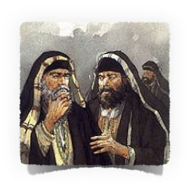
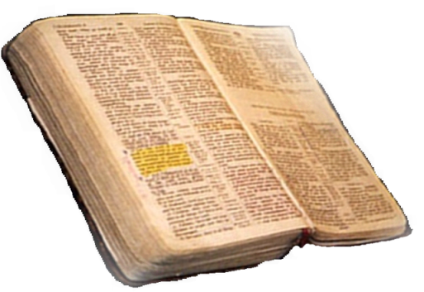
The “Bible Speaks” Series - A Study Book for Teachers & Students Lesson 12 - 8:1-6 - pg - 59
Christ Is Mediator of a Better Covenant - 8:1-6
Matthew 21:25-26
Only Two Possible Sources
From Heaven
Mt. 21:23-27
1 John 4:4-6
Gal. 1:6-9
Col. 2:6-10
2 Thess. 2:15
From Men
Mt. 15:1-9
1 Cor. 4:6
Gal. 1:10-17
Col. 2:8
2 Thess. 2:2-4

Slide 20
The “Bible Speaks” Series - A Study Book for Teachers & Students Lesson 12 - 8:1-6 - pg - 59
Christ Is Mediator of a Better Covenant - 8:1-6
We cannot know the mind of God except through revelation
1 Cor 2:10, 11,14
Eph 3:3-5
Isaiah 55:8,9
God has revealed everything that He wants from us –
2 Pet 1:3;
2 Tim 3:16,17
Jude 3
Faith comes by hearing
ROMANS 10:17
Walking by faith means walking by what God has said
2 Cor. 5:7; 1 Cor. 4:6; Gal. 1:6-9

Slide 21
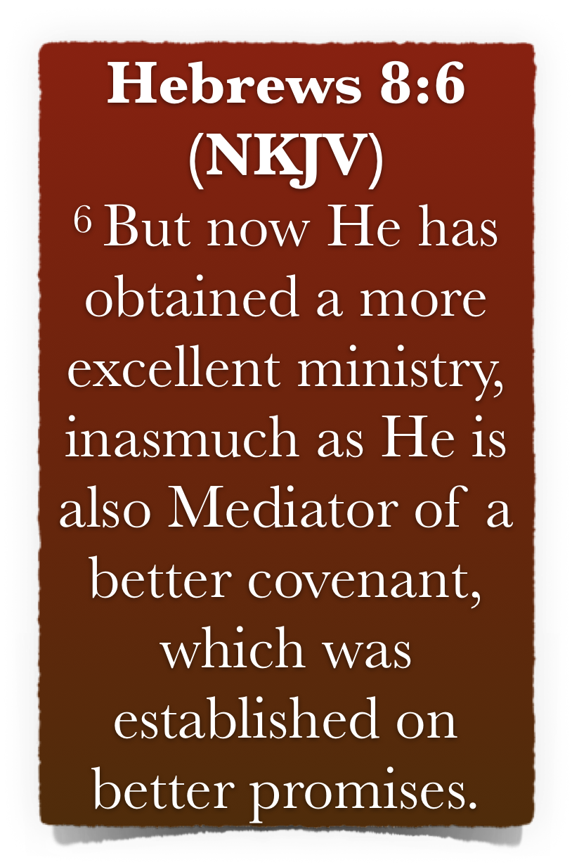
The “Bible Speaks” Series - A Study Book for Teachers & Students Lesson 12 - 8:1-6 - pg - 59
Christ Is Mediator of a Better Covenant - 8:1-6
A Better Covenant Established on Better Promises - 8:6
Christ Has A More Excellent Ministry - Heb 9:11, 24-28
Christ is “Mediator of a better Covenant” -
Christ, as God’s spokesman, acts as the “go between” before God for us - (intercessor, reconciler, advocate) - 1:1,2; 12:24; 1 Tim 2:5

Slide 22
The “Bible Speaks” Series - A Study Book for Teachers & Students Lesson 12 - 8:1-6 - pg - 59
Christ Is Mediator of a Better Covenant - 8:1-6
A Better Covenant Established on Better Promises - 8:6
The New Covenant is Established on Better Promises -
The first covenant emphasized the land & national promises - earthly benefits - (types & shadows) - (Deut 28:1-14)
The better covenant denotes the whole system of salvation by faith in Christ - (all spiritual blessings, Eph 1:3; forgiveness; Eph 1:7; New home - John 14:1-6; New body - Phili 3:21; Eternal life - John 3:16)

Slide 23
The “Bible Speaks” Series - A Study Book for Teachers & Students Lesson 12 - 8:1-6 - pg - 59
Christ Is Mediator of a Better Covenant - 8:1-6
A Better Covenant Established on Better Promises - 8:6
The New Covenant is Established on Better Promises -
Why would anyone want to cling to the Old, or worse still - desire to return to the Old?
The Old Covenant could not take away sins - Heb 8:6-13

Slide 24
The “Bible Speaks” Series - A Study Book for Teachers & Students Lesson 12 - 8:1-6 - pg - 59
Christ Is Mediator of a Better Covenant - 8:1-6
Answer Giving Scriptural References
Study Questions For Hebrews 8:1-6
What is the “sum” of the things spoken by the Hebrew writer?
Who pitched the true tabernacle?
Why was it necessary Christ have something to offer?
Why would Jesus not be a priest if He were on earth?
Where is our high priest seated?

Slide 25
The “Bible Speaks” Series - A Study Book for Teachers & Students Lesson 12 - 8:1-6 - pg - 59
Christ Is Mediator of a Better Covenant - 8:1-6
Answer Giving Scriptural References
Study Questions For Hebrews 8:1-6
The priests who offer gifts according to the Law serve unto what?
What was Moses admonished of God?
What comparison is made of the “ministry” & the “covenant” of Christ with that of Moses?
Upon what is the New covenant established?
What was shown to Moses on the mount?

Slide 26
The “Bible Speaks” Series - A Study Book for Teachers & Students Lesson 12 - 8:1-6 - pg - 59
Christ Is Mediator of a Better Covenant - 8:1-6
Study Questions For Hebrews 8:1-6
_______ If Christ were on the earth He would be a priest.
_______ The first covenant is equal to the covenant of Christ.
_______ God has never given a “pattern,” only messages of love.
_______ Christ is serving as priest while seated on the right hand of the Majesty.
_______ Christ is a minister of the “true tabernacle.”
True
or
False

Slide 27
The “Bible Speaks” Series - A Study Book for Teachers & Students Lesson 12 - 8:1-6 - pg - 59
Christ Is Mediator of a Better Covenant - 8:1-6
Research
What Old Testament prophecy foretold Christ would serve as king while at the same time He was serving as priest?
Thought Question
If Moses was required to follow “the pattern” (Heb 8:5), what lesson from this can one apply in our service to God?

