Slide 1
The “Bible Speaks” Series
A Study Book for Teachers & Students
Robert Harkrider

Slide 2
The “Bible Speaks” Series - A Study Book for Teachers & Students
I. The Superiority of Christ As God’s Spokesman - Hebrews 1:1-4:11
Lesson 1 - 1:1-3 - God Has Spoken o Us Through His Son - 1
Lesson 2 - 1:4-2:4 - The Position of Christ Superior To Angels - 7
Lesson 3 - 2:5-18 - A Savior Made Perfect Through Suffering - 12
Lesson 4 - 3:1-19 - Christ Is Greater Than Moses - 18
Lesson 5 - 4:1-11 - The Christian Sabbath - 23

Slide 3
The “Bible Speaks” Series - A Study Book for Teachers & Students
II. The Superiority of Christ As High Priest - Hebrews 4:12-7:28
Lesson 6 - 4:12-16 - Let Us Come Boldly To The Throne of Grace - 28
Lesson 7 - 5:1-10 - Christ Our Great High Priest - 33
Lesson 8 - 5:11-6:8 - Dangers of Immaturity & Apostasy - 38
Lesson 9 - 6:9-20 - Hope, The Anchor of Our Souls - 44
Lesson 10 - 7:1-17 - How Could Christ Be A High Priest? - 49
Lesson 11 - 7:18-28 - What Christ’s Priesthood Means to Christians - 54

Slide 4
The “Bible Speaks” Series - A Study Book for Teachers & Students
III. The Superiority of The New Covenant of Christ - Hebrews 8:1-10:18
Lesson 12 - 8:1-6 - Christ Is Mediator of a Better Covenant - 59
Lesson 13 - 8:7-13 - What Makes The New Covenant So Great? - 66
Lesson 14 - 9:1-10 - Why Follow Only The “Figure of the True”? - 72
Lesson 15 - 9:11-17 - Three Great Provisions By His Blood of the New Covenant - 79
Lesson 16 - 9:18-28 - Why Was A Blood Sacrifice Necessary? - 86
Lesson 17 - 10:1-18 - Christ The Fulfillment of the Law - 92

Slide 5
The “Bible Speaks” Series - A Study Book for Teachers & Students
IV. Exhortations To Steadfastness In Christ - Hebrews 10:19-13:25
Lesson 18 - 10:19-25 - Faith, Hope & Love - 98
Lesson 19 - 10:25-39 - What If One Turns Away From Christ? - 105
Lesson 20 - 11:1-7 - Faith Essential To Please God - 112
Lesson 21 - 11:8-22 - He Looked For A City - 119
Lesson 22 - 11:23-40 - The World Was Not Worthy of Them - 125

Slide 6
The “Bible Speaks” Series - A Study Book for Teachers & Students
IV. Exhortations To Steadfastness In Christ - Hebrews 10:19-13:25
Lesson 23 - 12:1-13 - Running The Race By Faith - 130
Lesson 24 - 12:14-29 - Refuse Not Him That Speaketh - 137
Lesson 25 - 13:1-14 - Let Us Go Out Side The Camp - 144
Lesson 26 - 13:15-25 - Continually Offer Praise To God - 151

Slide 7
The “Bible Speaks” Series - A Study Book for Teachers & Students Lesson 18 - 10:19-25 pg 98–104
Faith, Hope And Love - 10:19-25
Introduction
The Hebrew writer has presented forceful doctrinal arguments supporting the necessity for, & the all sufficient sacrifice of Christ.
At this point, exhortations & warnings are given as the focus shifts to encouraging them to remain faithful through the various trials they will facing.
Three terms that best summarize the foundational stands enabling us to remain strong - faith, hope & love - 1 Cor 13:13

Slide 8
The “Bible Speaks” Series - A Study Book for Teachers & Students Lesson 18 - 10:19-25 pg 98–104
Faith, Hope And Love - 10:19-25
Let Us Draw Near With A Sincere Heart of Faith - (10:19-22)
Christ has inaugurated a new & living way - 10:19,20
Therefore—i.e., seeing the afore mentioned things are true - (Heb 9:11-12, 23; 10:13-18).
Boldness—“free confidence,” grounded on the consciousness that our sins have been forgiven “by the blood of Jesus” - (Heb 3:6; 4:14–16; cf. Heb 10:22, 23)

Slide 9
The “Bible Speaks” Series - A Study Book for Teachers & Students Lesson 18 - 10:19-25 pg 98–104
Faith, Hope And Love - 10:19-25
Let Us Draw Near With A Sincere Heart of Faith - (10:19-22)
Christ has inaugurated a new & living way - 10:19,20
To enter into the holiest — i.e., God’s very presence. - Eph 2:18; 3:12.
“Through the veil …” – The high priest passed through the veil to enter into the presence of God, (Mt. 27:51). Jesus entered through the veil of His flesh - making a “new” & “living” way - (Heb 5:8.9; 1 Pet 3:18)

Slide 10
The “Bible Speaks” Series - A Study Book for Teachers & Students Lesson 18 - 10:19-25 pg 98–104
Faith, Hope And Love - 10:19-25
Let Us Draw Near With A Sincere Heart of Faith - (10:19-22)
Christ has inaugurated a new & living way - 10:19,20
New (prosphatos) – lately slaughtered, freshly killed (Strong’s) - b. of fresh events or newly arrived people: “not there before,” “new,” “fresh” - (TDNT)
Living way – living is zao “to enjoy real life” (Strong’s) used in 1Pet 2:4,5 describing Christians as living stones - Jesus is the WAY & the LIFE - Jn 14:6

Slide 11
The “Bible Speaks” Series - A Study Book for Teachers & Students Lesson 18 - 10:19-25 pg 98–104
Faith, Hope And Love - 10:19-25
Let Us Draw Near With A Sincere Heart of Faith - (10:19-22)
Christ has inaugurated a new & living way - 10:19,20
Not a contrast between two ways - but the way & no way - & between life & death. - (Jn 14:6; Acts 4:12)
“It is by the offering of the body of Jesus; … in his body he made an atonement for sin, and that with his body raised up from the dead he has ascended to heaven, that we have access now to the throne of mercy.” - Barnes

Slide 12
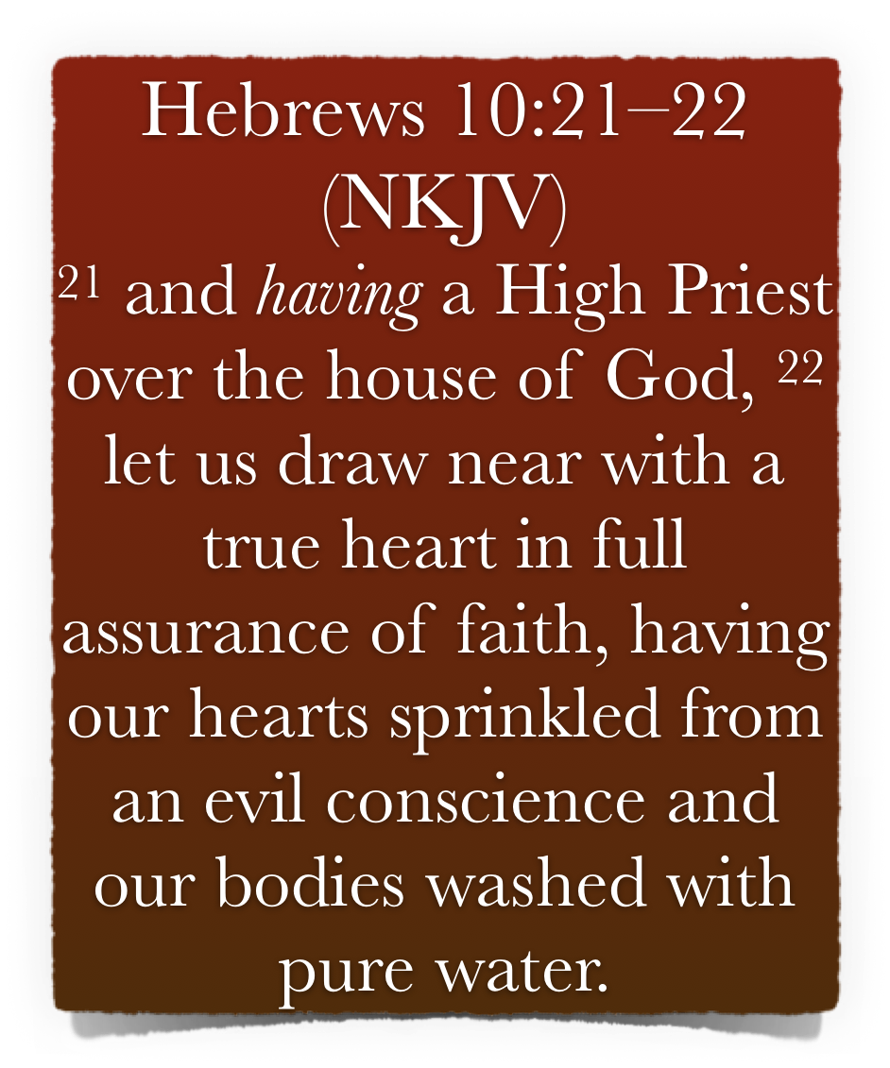
The “Bible Speaks” Series - A Study Book for Teachers & Students Lesson 18 - 10:19-25 pg 98–104
Faith, Hope And Love - 10:19-25
Let Us Draw Near With A Sincere Heart of Faith - (10:19-22)
Let us draw near in full assurance of faith - 10:21.22
Jesus is the “High Priest over the house of God” (ch. 2:17; 3:1; 4:14–16; 6:20; 7:25,26; 8:1) - Faithful Christians are the house of God, i.e., the church - (Heb 3:3-6; 12:22,23; Eph 2:19-22; 1 Tim 3:15; 1 Pet 4:17)
Let us draw near - knowing access is possible, do it! - (Heb 4:16; 7:19)

Slide 13
The “Bible Speaks” Series - A Study Book for Teachers & Students Lesson 18 - 10:19-25 pg 98–104
Faith, Hope And Love - 10:19-25
Let Us Draw Near With A Sincere Heart of Faith - (10:19-22)
Let us draw near in full assurance of faith - 10:21.22
With a true heart.—“True,” the word used in Heb 8:2; 9:24, a real—i.e., a sincere heart.
“In full assurance of faith” —As in Heb 6 we read of “full assurance,” or rather, “fulness of hope,” so here fulness of faith - We know God will do what He promises - (Heb 4:16; Rom 4:19-21)

Slide 14
The “Bible Speaks” Series - A Study Book for Teachers & Students Lesson 18 - 10:19-25 pg 98–104
Faith, Hope And Love - 10:19-25
Let Us Draw Near With A Sincere Heart of Faith - (10:19-22)
Our hearts sprinkled & our bodies washed - 10:22
Having our hearts sprinkled from an evil conscience.—As the priests were sprinkled with the sacrificial blood and washed with water before ministering, more-so have we who have been sprinkled with the blood of Jesus. - (Heb 12:9)

Slide 15
The “Bible Speaks” Series - A Study Book for Teachers & Students Lesson 18 - 10:19-25 pg 98–104
Faith, Hope And Love - 10:19-25
Let Us Draw Near With A Sincere Heart of Faith - (10:19-22)
Our hearts sprinkled & our bodies washed - 10:22
Obedience is the action of sincere, (real) faith, (James 2:14-26; Heb 11:6) - We draw near to God in Jesus when we humbly submit to His will - (James 4:7-10; 1 Pet 1:22,23)
Our hearts sprinkled from an evil conscience - Jesus’ blood cleanses our hearts & conscience - (Heb 12:24; 9:14; Eph 1:7; Rev 1:5)

Slide 16
The “Bible Speaks” Series - A Study Book for Teachers & Students Lesson 18 - 10:19-25 pg 98–104
Faith, Hope And Love - 10:19-25
Let Us Draw Near With A Sincere Heart of Faith - (10:19-22)
Our hearts sprinkled & our bodies washed - 10:22
Our bodies washed with pure water. - a reference to baptism - (Most expositors refer to baptism. The most significant passage in that direction is 1 Pet. 3:21; comp. Eph. 5:26; Tit. 3:5 - Vincent’s Word Studies)
Notice that we “draw near to God” with a “ full assurance of faith” through BOTH.

Slide 17
The “Bible Speaks” Series - A Study Book for Teachers & Students Lesson 18 - 10:19-25 pg 98–104
Faith, Hope And Love - 10:19-25
Let Us Draw Near With A Sincere Heart of Faith - (10:19-22)
Our hearts sprinkled & our bodies washed - 10:22
The hearts are cleansed & body washed in the same act - (1 Pet 3:21; Eph 5:26; Titus 3:5; John 3:5; Rom 6:3-6; Col. 2:12)
When immersed in water in penitent faith, the blood of Jesus is applied - our conscience is cleansed - our sins are washed away - we are raised with Christ - Col 2:12,13; Rom 6:3-6

Slide 18
The “Bible Speaks” Series - A Study Book for Teachers & Students Lesson 18 - 10:19-25 pg 98–104
Faith, Hope And Love - 10:19-25
Let Us Hold Fast The Confession of Our Faith - (10:23)
The Confession of Our Hope
The KJV has “profession of our faith” - but scholars agree that the best rendering is “hope” - (cf 3:6)
Hope, our anchor, (6:19) rests on faith, & quickens faith, - is the ground of our bold confession (11:1; Mat 10:32,33; 1 Pe 3:15).
Hope is similarly (Heb 10:22) connected with purification (1 Jn 3:3).

Slide 19
The “Bible Speaks” Series - A Study Book for Teachers & Students Lesson 18 - 10:19-25 pg 98–104
Faith, Hope And Love - 10:19-25
Let Us Hold Fast The Confession of Our Faith - (10:23)
Let Us Not Waver
Hold unswervingly to the hope we profess with full confidence (Heb 3:14; 1 Cor 15:58; Luke 9:23-26, 62; Gal 5:1; Rev 3:11)
God is faithful to His promises (Heb 6:17, 18; 11:11; 1 Co 1:9; 10:13; 1 Th 5:24; 2 Th 3:3; cf, Jn 12:26); keep our grip tight on what God has promised, a better & enduring possession in heaven - (Heb 32-35; 2 Cor 4:14-5:7).

Slide 20
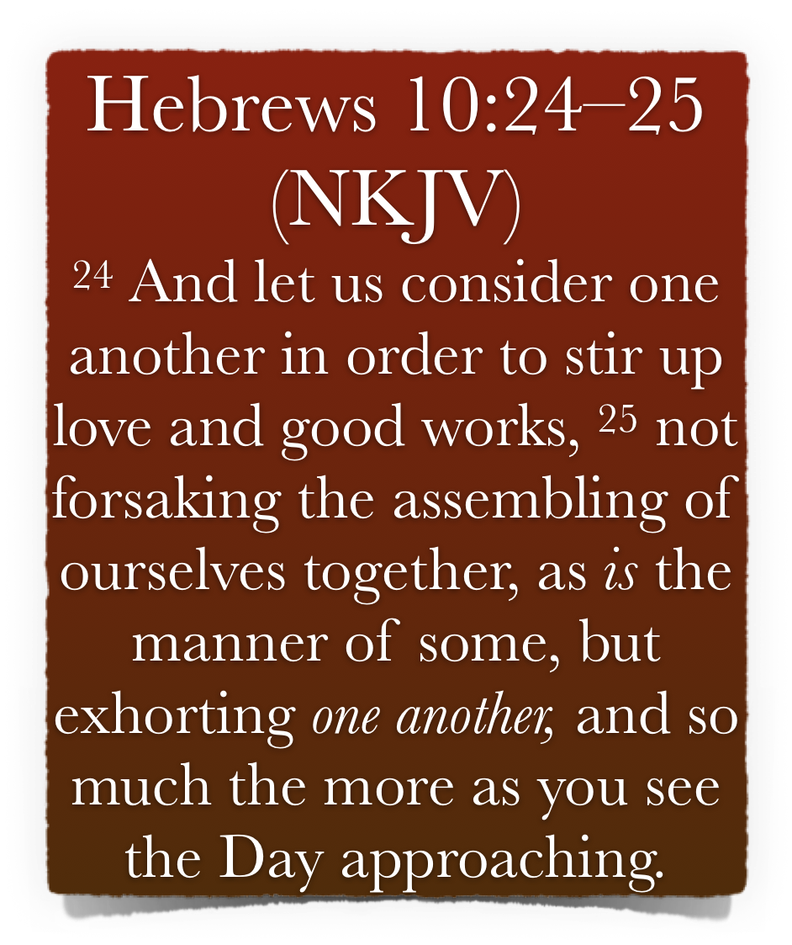
The “Bible Speaks” Series - A Study Book for Teachers & Students Lesson 18 - 10:19-25 pg 98–104
Faith, Hope And Love - 10:19-25
Let Us Consider How Stimulate Others To Love - (10:24,25)
Let Us Consider Others
Let us consider- Present (keep on doing so) active volitive subjunctive of κατανοεω [katanoeō]. The verb used about Jesus in 3:1.
With the mind attentively fixed on “one another” - Take careful note of each other’s spiritual welfare. -
We are to be OTHERS-CENTERED - not self-centered - (Rom 12:15,16; Gal 6:1-5)

Slide 21
The “Bible Speaks” Series - A Study Book for Teachers & Students Lesson 18 - 10:19-25 pg 98–104
Faith, Hope And Love - 10:19-25
Let Us Consider How Stimulate Others To Love - (10:24,25)
Let Us Consider Others
To provoke - (εἰς παροξυσμὸν). Lit. with a view to incitement. to stimulate. In Acts 15:39, the result of provocation; irritation or contention. - (Rom 11:14)
Paul seeks to stir up the Corinthians by the example of the Macedonians (2 Cor. 8:1–8; 9:2).
To stir others to love & good works is an act of love itself - (1 Jn 3:18)

Slide 22
The “Bible Speaks” Series - A Study Book for Teachers & Students Lesson 18 - 10:19-25 pg 98–104
Faith, Hope And Love - 10:19-25
Let Us Consider How Stimulate Others To Love - (10:24,25)
Not forsaking the assembling of ourselves together,
Stirring others to love & good works is done by assembling together.
Assembling together has a two-fold purpose - primarily to worship God, but through worshipping God together we encourage & edify each other. If we “forsake” we discourage.
We have positive duties to fulfill.

Slide 23
The “Bible Speaks” Series - A Study Book for Teachers & Students Lesson 18 - 10:19-25 pg 98–104
Faith, Hope And Love - 10:19-25
Let Us Consider How Stimulate Others To Love - (10:24,25)
Not forsaking the assembling of ourselves together,
Forsake - carries the meaning of choosing not to do what otherwise one can do.
Attitude, not merely attendance, is uppermost. God knows when circumstances prevent one from assembling.
Discuss the issue of a casual attitude - Mal 1:10

Slide 24
The “Bible Speaks” Series - A Study Book for Teachers & Students Lesson 18 - 10:19-25 pg 98–104
Faith, Hope And Love - 10:19-25
Let Us Consider How Stimulate Others To Love - (10:24,25)
All the more as you see the day approaching
Which “day” is meant?
The second coming of Christ? - 2 Thes 1:7-9; 1 Cor. 15; 2 Pet 3:10-14
Destruction of Jerusalem? - 8:13; Mat 24
First day of the week - 10:25; Act 20:7; 1 Cor 16:1,2
The day of death - 9:27

Slide 25
The “Bible Speaks” Series - A Study Book for Teachers & Students Lesson 18 - 10:19-25 pg 98–104
Faith, Hope And Love - 10:19-25
Let Us Consider How to Stimulate Others To Love - (10:24,25)
All the more as you see the day approaching
The lesson of preparedness & watchfulness is a very urgent one - assembling together plays an important part of our being prepared! - 24
We need to be provoked to be diligent in love & good works - Eph 4:12-16; 1 Cor 12:14-20
Our attitude towards assembling says much about our faith & love

Slide 26
The “Bible Speaks” Series - A Study Book for Teachers & Students Lesson 18 - 10:19-25 pg 98–104
Faith, Hope And Love - 10:19-25
Answer Giving Scriptural References
Study Questions For Hebrews 10:19-25
By the blood of Christ we have boldness to do what?
Our high priest, Jesus Christ, is over what?
What should we hold fast?
What serves as our strength that we should not waver?
In what way should we “consider one another?”

Slide 27
The “Bible Speaks” Series - A Study Book for Teachers & Students Lesson 18 - 10:19-25 pg 98–104
Faith, Hope And Love - 10:19-25
Answer Giving Scriptural References
Study Questions For Hebrews 10:19-25
What has the Lord “consecrated for us?”
We should draw near with what kind of heart?
With what must our bodies be washed?
What was the “manner of some?”
Instead of forsaking the assembling, what ought we to do?

Slide 28
The “Bible Speaks” Series - A Study Book for Teachers & Students Lesson 18 - 10:19-25 pg 98–104
Faith, Hope And Love - 10:19-25
Study Questions For Hebrews 10:19-25
_______ Hebrews teaches baptism can be in the form of sprinkling.
_______ We must hold fast the profession of our faith.
_______ We need not bother about others, only work to save ourselves.
_______ We must not forsake the “assembly.”
_______ We must “consider one another” and “exhort one another.”
True
or
False

Slide 29
The “Bible Speaks” Series - A Study Book for Teachers & Students Lesson 18 - 10:19-25 pg 98–104
Faith, Hope And Love - 10:19-25
Find every New Testament passage where being “washed” is stated in relationship to salvation and determine to what practice this must have reference.
Research
Thought Question
Does Hebrews 10:25 teach that it is a sin to miss the services of the church? Explain your answer.

