Slide 1
The “Bible Speaks” Series
A Study Book for Teachers & Students
Robert Harkrider

Slide 2
The “Bible Speaks” Series - A Study Book for Teachers & Students
I. The Superiority of Christ As God’s Spokesman - Hebrews 1:1-4:11
Lesson 1 - 1:1-3 - God Has Spoken o Us Through His Son - 1
Lesson 2 - 1:4-2:4 - The Position of Christ Superior To Angels - 7
Lesson 3 - 2:5-18 - A Savior Made Perfect Through Suffering - 12
Lesson 4 - 3:1-19 - Christ Is Greater Than Moses - 18
Lesson 5 - 4:1-11 - The Christian Sabbath - 23

Slide 3
The “Bible Speaks” Series - A Study Book for Teachers & Students
II. The Superiority of Christ As High Priest - Hebrews 4:12-7:28
Lesson 6 - 4:12-16 - Let Us Come Boldly To The Throne of Grace - 28
Lesson 7 - 5:1-10 - Christ Our Great High Priest - 33
Lesson 8 - 5:11-6:8 - Dangers of Immaturity & Apostasy - 38
Lesson 9 - 6:9-20 - Hope, The Anchor of Our Souls - 44
Lesson 10 - 7:1-17 - How Could Christ Be A High Priest? - 49
Lesson 11 - 7:18-28 - What Christ’s Priesthood Means to Christians - 54

Slide 4
The “Bible Speaks” Series - A Study Book for Teachers & Students
III. The Superiority of The New Covenant of Christ - Hebrews 8:1-10:18
Lesson 12 - 8:1-6 - Christ Is Mediator of a Better Covenant - 59
Lesson 13 - 8:7-13 - What Makes The New Covenant So Great? - 66
Lesson 14 - 9:1-10 - Why Follow Only The “Figure of the True”? - 72
Lesson 15 - 9:11-17 - Three Great Provisions By His Blood of the New Covenant - 79
Lesson 16 - 9:18-28 - Why Was A Blood Sacrifice Necessary? - 86
Lesson 17 - 10:1-18 - Christ The Fulfillment of the Law - 92

Slide 5
The “Bible Speaks” Series - A Study Book for Teachers & Students
IV. Exhortations To Steadfastness In Christ - Hebrews 10:19-13:25
Lesson 18 - 10:19-25 - Faith, Hope & Love - 98
Lesson 19 - 10:25-39 - What If One Turns Away From Christ? - 105
Lesson 20 - 11:1-7 - Faith Essential To Please God - 112
Lesson 21 - 11:8-22 - He Looked For A City - 119
Lesson 22 - 11:23-40 - The World Was Not Worthy of Them - 125

Slide 6
The “Bible Speaks” Series - A Study Book for Teachers & Students
IV. Exhortations To Steadfastness In Christ - Hebrews 10:19-13:25
Lesson 23 - 12:1-13 - Running The Race By Faith - 130
Lesson 24 - 12:14-29 - Refuse Not Him That Speaketh - 137
Lesson 25 - 13:1-14 - Let Us Go Out Side The Camp - 144
Lesson 26 - 13:15-25 - Continually Offer Praise To God - 151

Slide 7
The “Bible Speaks” Series - A Study Book for Teachers & Students Lesson 25 - pgs 144-150
Let Us Go Out Side The Camp - 13:1-14
Running The Race By Faith
There is a GREAT cloud of witnesses
We MUST Look To Jesus
Must Endure Chastening
Must Take Heed To The Lord Jesus

Slide 8
The “Bible Speaks” Series - A Study Book for Teachers & Students Lesson 25 - pgs 144-150
Let Us Go Out Side The Camp - 13:1-14
Introduction
Various Exhortations
Brotherly love - (1)
Hospitality - (2)
Care for those in bonds -(3)
Fidelity in marriage - (4)
Contentment - (5-6)
Submission to those in authority - (7-8)
Stability in doctrines - (9)
Keep before you Christ's reproach - (10-14)

Slide 9
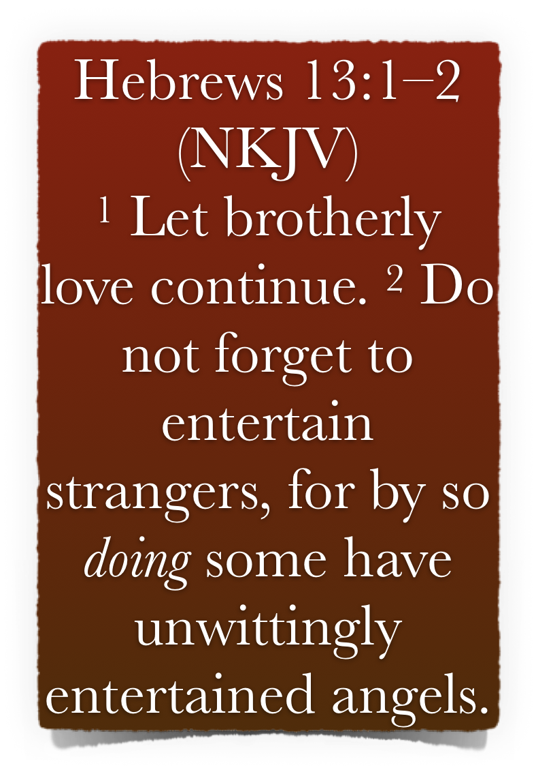
The “Bible Speaks” Series - A Study Book for Teachers & Students Lesson 25 - pgs 144-150
Let Us Go Out Side The Camp - 13:1-14
Exhortations To Remember - (1-7)
Remember to manifest love - 1-3
Let brotherly love continue - (φιλαδελφία μενέτω). Φιλαδελφία - It is imperative that we cultivate a genuine concern & care for one another - Rom. 12:10; 1 Th. 4:9; 1 Pet 1:22; 2 Pet 1:7
Do not forget to entertain strangers - willing to take in and provide for others - Rom. 12:13; 1 Tim. 3:2; Tit. 1:8; 1 Pet. 4:9

Slide 10
The “Bible Speaks” Series - A Study Book for Teachers & Students Lesson 25 - pgs 144-150
Let Us Go Out Side The Camp - 13:1-14
Exhortations To Remember - (1-7)
Remember to manifest love - 1-3
In those days of persecution, scattered & destitute brethren were dependent on brethren opening their homes -
“For by so doing some have unwittingly entertained angels.” As did Abraham (Gen 18:2 ff), — and Lot - Gen. 19; — Gideon - Judges 6:11-23; — The parents of Samson - Judges 13:3-21
Christians also have the opportunity to teach the gospel - Gal 6:10

Slide 11
The “Bible Speaks” Series - A Study Book for Teachers & Students Lesson 25 - pgs 144-150
Let Us Go Out Side The Camp - 13:1-14
Exhortations To Remember - (1-7)
Remember to manifest love - 1-3
“Remember the prisoners” - Another manifestation of brotherly love. - Acts 24:23; 2 Tim 1:16
“The prisoners referred to are those imprisoned for Christ's sake. The Christian must enter into full sympathy with all his suffering brethren.” - B.W. Johnson
Sympathizing with “those who are mistreated” - Heb 10:23 - what if we were in the same condition - 1 Cor 12:26

Slide 12
The “Bible Speaks” Series - A Study Book for Teachers & Students Lesson 25 - pgs 144-150
Let Us Go Out Side The Camp - 13:1-14
Exhortations To Remember - (1-7)
Remember to manifest love - 1-3
“[as being yourselves also in the body] And therefore as being yourselves liable to similar maltreatment. “In the body” does not mean “in the body of the Church,” but “human beings, born to suffer.” — Cambridge Bible for Schools and Colleges
“As being yourselves also in the body”- As subject like them to bodily sufferings. Not in the body - the church, which would require the article — in the sense of being still alive, only in 2 Cor 12:2.

Slide 13
The “Bible Speaks” Series - A Study Book for Teachers & Students Lesson 25 - pgs 144-150
Let Us Go Out Side The Camp - 13:1-14
Exhortations To Remember - (1-7)
Remember to manifest love - 1-3
We are to sympathize with all the oppressed, the suffering, and the sad; We are command to love our neighbor as ourselves (Mat 22:38)
Despite what most commentators say regarding those whom we are to remember who are in chains & mistreated - the context clearly is speaking specifically of fellow Christians. - (brotherly love, vs 1)

Slide 14
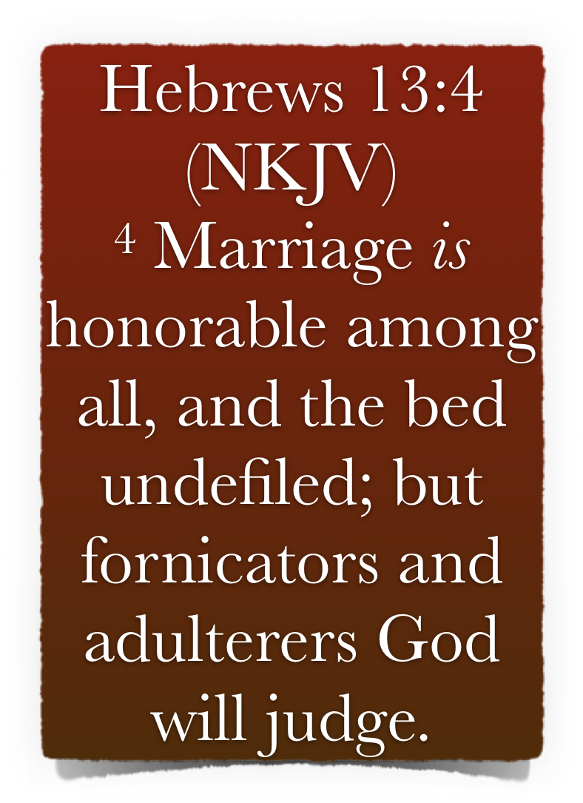
The “Bible Speaks” Series - A Study Book for Teachers & Students Lesson 25 - pgs 144-150
Let Us Go Out Side The Camp - 13:1-14
Exhortations To Remember - (1-7)
Keep Honor In Your Marriage - 4
God designed and ordained marriage for man’s good, (Gen 2:18,24). It should be highly prized and held as sacred.
Sexual relations are confined, by God, to the scripturally approved marriage relationship - (sexual immorality, i.e., fornication, is ANY and every sexual relationship outside of a scriptural marriage) - 1 Cor 7:2-7
“Fornicators & adulterers God will judge” - 1 Co. 6:9; Ga. 5:19; Ep. 5:5; Re 21:8; 22:15

Slide 15
The “Bible Speaks” Series - A Study Book for Teachers & Students Lesson 25 - pgs 144-150
Let Us Go Out Side The Camp - 13:1-14
Exhortations To Remember - (1-7)
Keep Honor In Your Marriage - 4
Marriage is so sacred, only one cause is given by which one may put away their spouse - “fornication” - Mat 19:3-9
Divorce is consistently taught against in the New Testament - 1 Cor 7:10,11
If anyone divorces their spouse for any cause other than fornication, and marries another, that very union is called an adulterous union - Mat 5:32; 19:9; Mark 10:11,12; Luke 16:18; Rom 7:1-3;

Slide 16
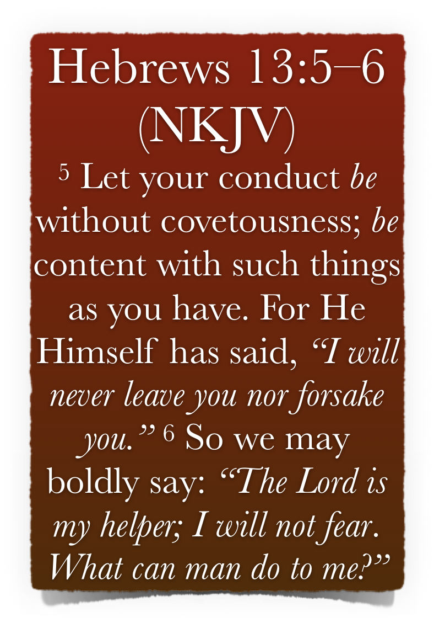
The “Bible Speaks” Series - A Study Book for Teachers & Students Lesson 25 - pgs 144-150
Let Us Go Out Side The Camp - 13:1-14
Exhortations To Remember - (1-7)
Keep Yourself From Covetousness - 5,6
Covetousness is a deceptive sin and is NOT confined to the wealthy - Lu. 8:14; 12:15–21; 16:13, 14; Ro. 1:29.
A form of idolatry - Col. 3:5
Having things & money not in and of itself sinful - covetousness is an attitude of greed - 1 Tim 6:9,10,17-19;

Slide 17
The “Bible Speaks” Series - A Study Book for Teachers & Students Lesson 25 - pgs 144-150
Let Us Go Out Side The Camp - 13:1-14
Exhortations To Remember - (1-7)
Keep Yourself From Covetousness - 5,6
Not wrong to seek to improve ones earthly condition as long as we are faithful to God, accepting the consequences, as they are. - 1 Tim 6:6-8; Phili 4:11.
We must TRUST in God who will never leave us or forsake us - He will always, & in every circumstance provide that which we need - Gen 28:15; Deut 31:6-8; Josh 1:5; 1 Chron 28:20; Psalm 118:6

Slide 18
The “Bible Speaks” Series - A Study Book for Teachers & Students Lesson 25 - pgs 144-150
Let Us Go Out Side The Camp - 13:1-14
Exhortations To Remember - (1-7)
Imitate Those Who Rule Over You - 13:7
Remember your leaders - “who rule over you” - 3 times in this chapter - (vss 17, 24)
First, respect them, (1 Thes 5:13), remembering their counsel; instructions; & their example - note the results of their faith - (6:12; Heb 11; 12:1)
Discuss the difference between what the Hebrew writer exhorts here, with the actions rebuked in 1 Cor 1:12; 4:6.

Slide 19
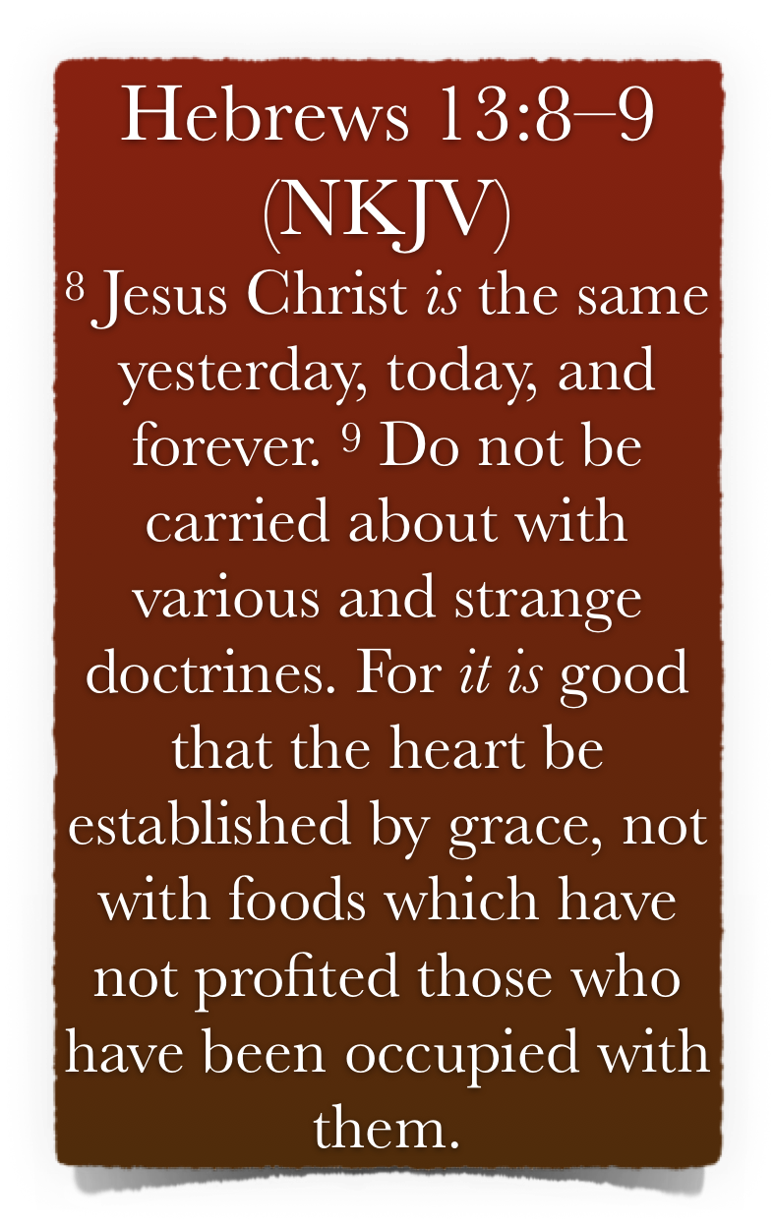
The “Bible Speaks” Series - A Study Book for Teachers & Students Lesson 25 - pgs 144-150
Let Us Go Out Side The Camp - 13:1-14
Let Us Go Forth Unto Jesus - (8-14)
Jesus Is Constant & Unchangeable - (13:8,9)
“Their leaders believed that Jesus is The Christ—the Messiah. The readers were tempted to surrender this faith and to return to Judaism which denied Jesus’s messiahship (comp. ch. 10:29). Hence the writer says, “hold fast and imitate their faith in Jesus as the Christ. He is ever the same. He must be to you, to-day, what he was to them, yesterday, and will be forever to the heavenly hosts—Christ.” Vincent, M. R. (1887). Word studies

Slide 20
The “Bible Speaks” Series - A Study Book for Teachers & Students Lesson 25 - pgs 144-150
Let Us Go Out Side The Camp - 13:1-14
Let Us Go Forth Unto Jesus - (8-14)
Jesus Is Constant & Unchangeable - (13:8,9)
The argument here is for their perseverance in following Christ - is founded on the “immutability” of the Redeemer. - (His faithfulness - Not condition)
“Forever” (εἰς τους αἰωνας [eis tous aiōnas]) - ETERNITY - Jesus Christ is eternally “the same” (1:12) & the revelation of God (1:1f.) is final and never to be superseded or supplemented -

Slide 21
The “Bible Speaks” Series - A Study Book for Teachers & Students Lesson 25 - pgs 144-150
Let Us Go Out Side The Camp - 13:1-14
Let Us Go Forth Unto Jesus - (8-14)
Jesus is Our Altar - (9,10)
New doctrines which conflict with the unchanging message about Jesus Christ should be rejected. - Many such warnings are found in the NT - Gal 1:6-9; Col 2:8; Eph 4:14; 2 Pet 2:1,2
The author’s reference here to all kinds of strange teachings would certainly include that being spread by the Judaizers, but would also include any error which is taught - (Col. 2:8; 2 Tim 2:17,18; etc.)

Slide 22
The “Bible Speaks” Series - A Study Book for Teachers & Students Lesson 25 - pgs 144-150
Let Us Go Out Side The Camp - 13:1-14
Let Us Go Forth Unto Jesus - (8-14)
Jesus is Our Altar - (9,10)
A contrast is intended by the writer, between v 8 and v 9.
In contrast to the fluid and changing configurations of “strange teachings” (v 9), the truth concerning Jesus Christ never changes (v 8).
The word that the former leaders proclaimed is now threatened by teaching that is inconsistent with the message the community received.

Slide 23
The “Bible Speaks” Series - A Study Book for Teachers & Students Lesson 25 - pgs 144-150
Let Us Go Out Side The Camp - 13:1-14
Exhortation (v 7) | Warning (v 9)
A Remember, imitate | A´ Do not allow yourselves to be led away
B your former leaders | B´ strange [itinerant preachers]
C the [one] word of God | C´ diverse [human] teachings
D Consider the accomplishment of their conduct | D’ their adherents are not benefited
E their faith | E´ foods

Slide 24
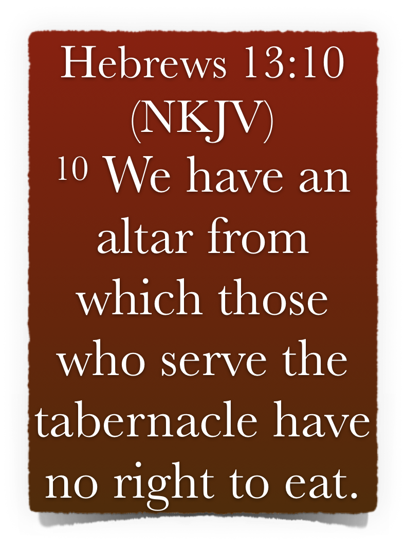
The “Bible Speaks” Series - A Study Book for Teachers & Students Lesson 25 - pgs 144-150
Let Us Go Out Side The Camp - 13:1-14
Let Us Go Forth Unto Jesus - (8-14)
Jesus is Our Altar - (9,10)
“We have an altar,” (v 10) - The word “altar” here is used figuratively of Jesus. The Hebrew Christians should realize it is not them who are shut out of God’s presence, but the unbeliever -
The Jewish priest ate meat sacrificed on material altars - which could not help them - Lev 6:25,26; 7:15
But grace in Christ provides inner, spiritual nourishment & strength - 13:9; 1 Cor 9:13; Heb. 10:1-4, 11, 19-23;

Slide 25
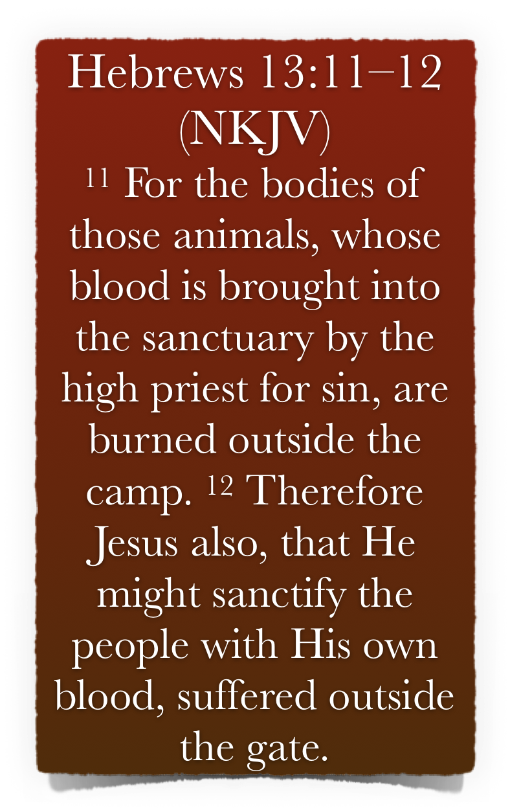
The “Bible Speaks” Series - A Study Book for Teachers & Students Lesson 25 - pgs 144-150
Let Us Go Out Side The Camp - 13:1-14
Let Us Go Forth Unto Jesus - (8-14)
Jesus Suffered Outside the Gate - (11-12)
The sacrifices slain for a sin offering on the day of atonement - the blood was carried by the high priest before the mercy seat, but the bodies were burned without the camp (Lev 4:12,21; 16:27)
Wherefore Jesus also. In order to cleanse his people by becoming the complete atonement he was willing, as a sin offering, to be led without the gate and to suffer there. - (Heb 9:12-14,28; 12:2; 1 Pet 2:24)

Slide 26
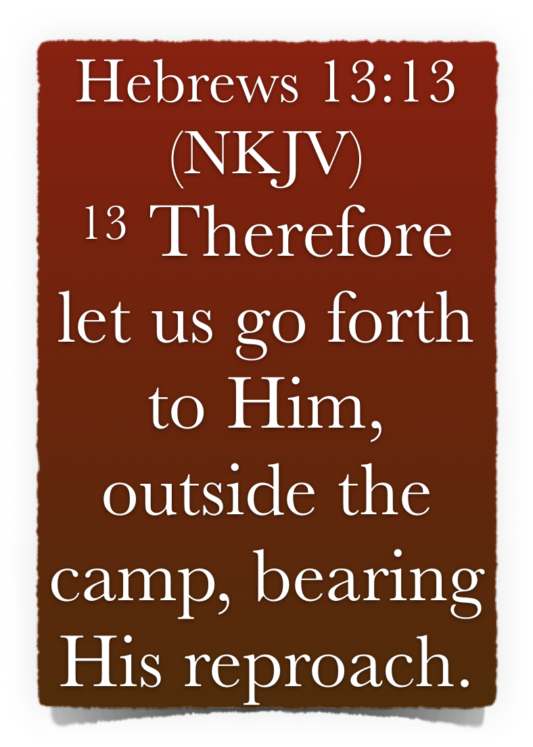
The “Bible Speaks” Series - A Study Book for Teachers & Students Lesson 25 - pgs 144-150
Let Us Go Out Side The Camp - 13:1-14
Let Us Go Forth Unto Jesus - (8-14)
Are You Willing To Bear His Reproach? - (13; Luke 9:26)
For these early Hebrew Christians, much suffering & hardship would be experienced because they were identified with Jesus the Christ - Who was crucified as a criminal in the eyes of the unbelievers.
The meaning here is, that we should be willing to regard ourselves as identified with the Lord Jesus, and to bear the same shame and reproaches which he did - 11:26; 12:3; Mt 5:11; 16:24; Acts 5:41 . . .

Slide 27
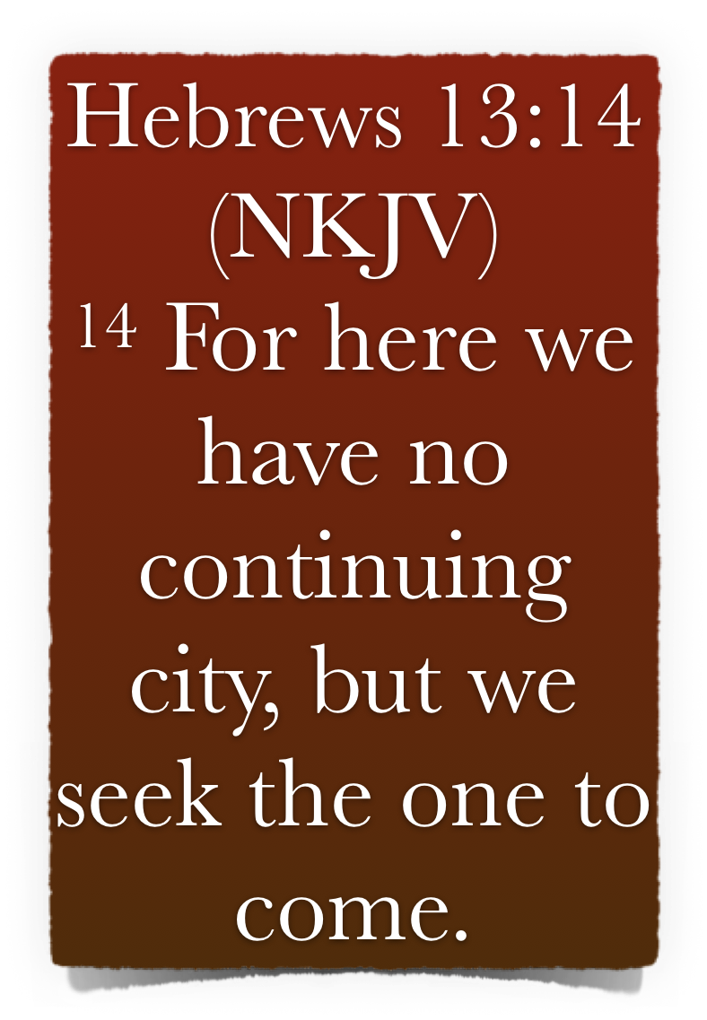
The “Bible Speaks” Series - A Study Book for Teachers & Students Lesson 25 - pgs 144-150
Let Us Go Out Side The Camp - 13:1-14
We Have Here No Continuing City - (14)
We are but strangers & pilgrims - 11:13,14
Their permanent home was not Jerusalem, but heaven, even if they were exiled from the city where they dwelt, and made wanderers in the earth - they would demonstrate, as their fathers had - they were looking for a city who’s builder & maker is God - Heb 4:9; 11:10,13-16; 2 Cor 4:17,18; 5:1-8; Phili 3:20.
Our affections MUST be heavenly - Col 3:1,2; 2 Pet 3:13,14

Slide 28
The “Bible Speaks” Series - A Study Book for Teachers & Students Lesson 25 - pgs 144-150
Let Us Go Out Side The Camp - 13:1-14
We Have Here No Continuing City - (14)
We are but strangers & pilgrims - 11:13,14
We are looking for a city whose builder and maker is God - 11:10
Our sights are set on a better land than this world can provide - heaven - 1 Pet 1:3-9
If we are willing to go outside the camp with Jesus, leaving behind doctrinal errors & corruptions of the flesh, we will secure for ourselves a place in the heavenly city.

Slide 29
The “Bible Speaks” Series - A Study Book for Teachers & Students Lesson 25 - pgs 144-150
Let Us Go Out Side The Camp - 13:1-14
Answer Giving Scriptural References
Study Questions For Hebrews 12:14-29
In what way should we remember those in bonds and suffering adversity?
What promise helps us to be content?
Why did Jesus suffer “without the gate”?
What does he exhort to “let … continue”?
Why should we entertain strangers?

Slide 30
The “Bible Speaks” Series - A Study Book for Teachers & Students Lesson 25 - pgs 144-150
Let Us Go Out Side The Camp - 13:1-14
Answer Giving Scriptural References
Study Questions For Hebrews 12:14-29
What may we “boldly” say?
What do we not have here that we seek?
What does he say about marriage?
What three words describe our relationship toward those who have the rune over us?
It is good for our hearts to established with what?

Slide 31
The “Bible Speaks” Series - A Study Book for Teachers & Students Lesson 25 - pgs 144-150
Let Us Go Out Side The Camp - 13:1-14
Study Questions For Hebrews 12:14-29
_______ Some have entertained angels unawares.
_______ Whoremongers and adulterers will be condemned by God.
_______ One cannot be “carried away” by strange doctrines.
_______ We should bear reproach with Christ.
_______ We should live as though earth is our home.
True
or
False

Slide 32
The “Bible Speaks” Series - A Study Book for Teachers & Students Lesson 25 - pgs 144-150
Let Us Go Out Side The Camp - 13:1-14
Find at least three references in the New Testament that refer to angels helping Christians.
Research
Since Jesus Christ is “the same yesterday and today, and forever” (13:8), does this prove miracles can still be worked today? Explain your answer.
Thought Question

