Slide 1
Therefore if the Son makes you free, you shall be free indeed.—
John 8:36 (NKJV)

Slide 2
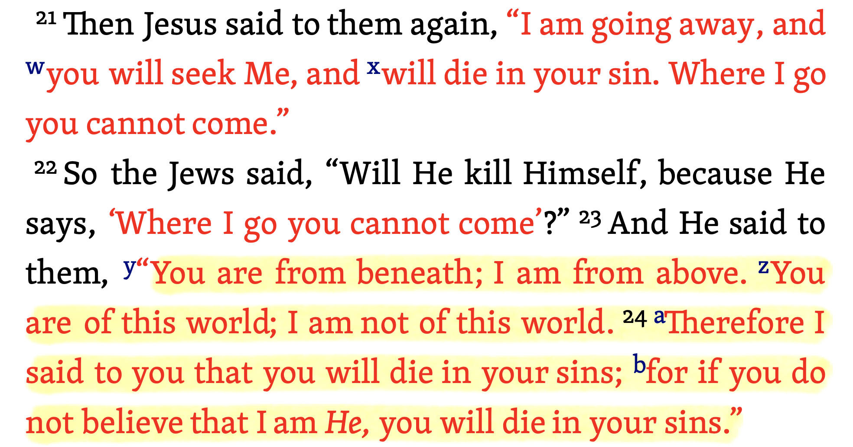
John 8:21–36 (NKJV)

Slide 3
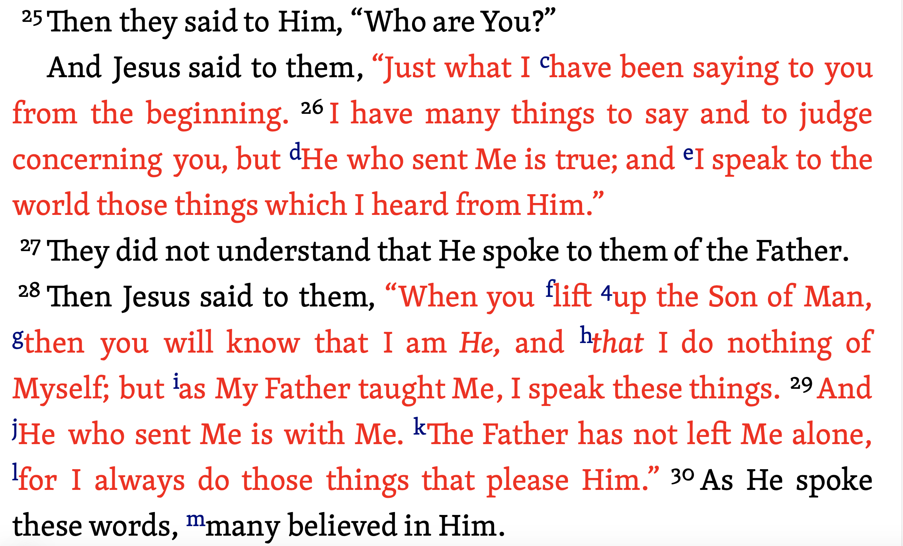
John 8:21–36 (NKJV)

Slide 4
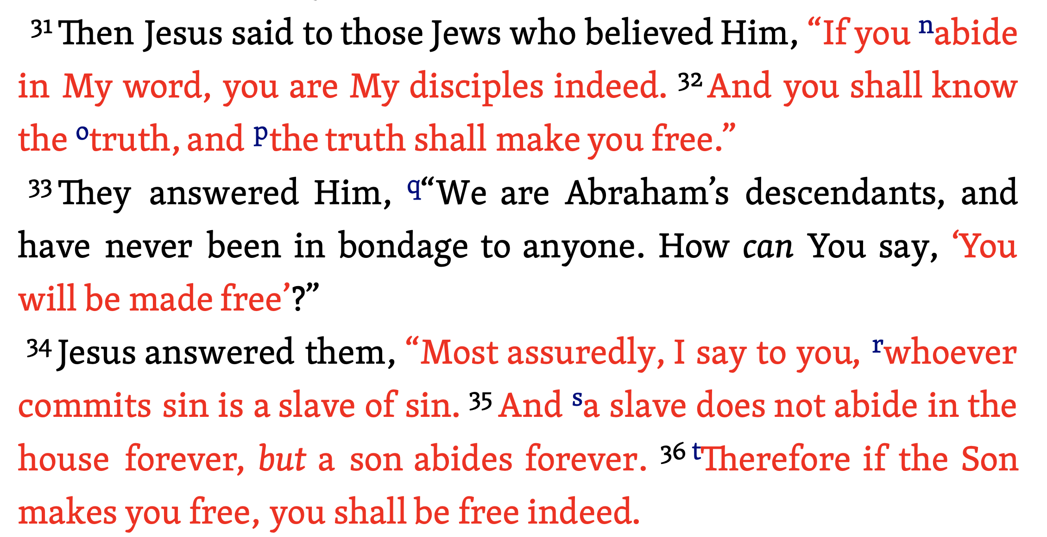
John 8:21–36 (NKJV)

Slide 5
Many Have A Misconstrued Understanding of FREEDOM

Slide 6
Freedom In CHRIST is NOT Freedom FROM HIS AUTHORITY!

Slide 7
To Define: FREEDOM
Freedom is a grand ideal, but is always accompanied by some restrictive code of governance (Isa. 61:1-9; Gal. 5:1-7).
Anarchy vs. Order: Unfettered freedom results in anarchy; responsible freedom leads to order (Judg. 17:6; 21:25; 1 Pet. 2:13-25).
Selfishness vs. Service: Unfettered freedom results in selfishness; responsible freedom leads to service (1 Cor. 10:23-33; Gal. 5:13-15).
Slaves To Sin vs. Slaves of Righteousness: Unfettered freedom results in slavery; Submission to Christ’s authority results in salvation (John 8:31-38; 2 Pet. 2:17-3:2; Rom 6-8).

Slide 8
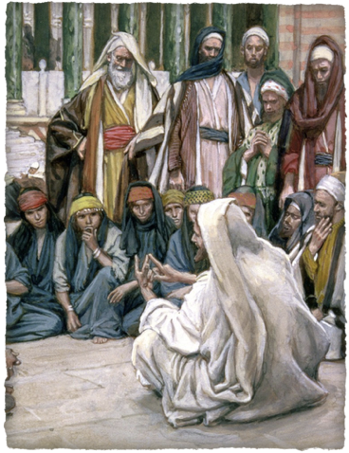
The TRUTH Makes Free
“If you abide in My word,” — Freedom in Christ is conditioned on abiding in Jesus’ teaching - 1:14,17; 6:45; 7:17; 14:6; 15:1-10; 16:13.
“You are My disciples indeed.” —consists of more than being a mere learner, one MUST follow the teachings of Jesus & imitate Him— Luke 6:40,46; 9:23-26; 57-62
“You shall know the truth” — to know “The TRUTH” is to be equipped with what we need to be made free — Jer. 6:16; Jn 6:63-69; 14:6
John 8:31,32 (NKJV)
³¹ “…If you abide in My word, you are My disciples indeed. ³² And you shall know the truth, and the truth shall make you free.”

Slide 9
The TRUTH Makes Free
“THE TRUTH shall make you FREE” from the bondage of sin - vss. 33-36; Is. 61:1; Ro. 6:14–18,22; 8:2,15; Ga. 5:1,13; 2 Ti. 2:25, 26. Ja. 1:25.
This freedom is found only when we listen to Jesus’ words & put them into practice - Jam 1:21,22;
John 8:31,32 (NKJV)
³¹ “…If you abide in My word, you are My disciples indeed. ³² And you shall know the truth, and the truth shall make you free.”

Slide 10
THE SLAVERY OF SIN
More oppressive than any kind physical slavery is the spiritual slavery that comes from being a sinner! — 8:34
Sin is personified as a cruel master. Paul used the same illustration (Rom. 6:15–23; Rom. 7:5-8:3; Gal 3:10-14) - (Compare 1 Jn 1:5-10; 3:4-9).
John 8:33–34 (NKJV)
³³ They answered Him, “We are Abraham’s descendants, and have never been in bondage to anyone. … ³⁴ Jesus answered them, “Most assuredly, I say to you, whoever commits sin is a slave of sin.

Slide 11
THE SLAVERY OF SIN
John 8:33–34 (NKJV)
³³ They answered Him, “We are Abraham’s descendants, and have never been in bondage to anyone. … ³⁴ Jesus answered them, “Most assuredly, I say to you, whoever commits sin is a slave of sin.
Bondage to previous sins — Gal. 3:10; Rom. 3:23
Bondage to habitual sin — 2 Pet 2:12-16; Mat. 12:34;
Bondage to the consequences of sin — Gal. 6:7-9; Isa. 59:1,2; Rom. 6:23; 7:24

Slide 12
THE SLAVERY OF SIN
We have all SINNED — (Rom. 3:23; Titus 3:1-4; etc.)
THEREFORE we ALL Need to be set free from our sins — (Jn 8:24; cf. Rom 7:24)
Which is IMPOSSIBLE apart from God’s unmerited provision of His “only begotten Son”— (Jn 3:15-18; Eph. 2:8.9; Titus 3:5)
John 8:33–34 (NKJV)
³³ They answered Him, “We are Abraham’s descendants, and have never been in bondage to anyone. … ³⁴ Jesus answered them, “Most assuredly, I say to you, whoever commits sin is a slave of sin.

Slide 13
THE SON MAKES FREE
Jesus came into the world to take away our sins, which was accomplished on the cross — (Jn 1:29; Is. 53:11; 1 Cor. 15:3; Gal. 1:4; 1 Pet. 2:24; 1 John 2:2; Rev. 1:5)
As God’s Son, He invites all to come to Him — (Mt 11:28)
The Son makes free all who come to Him and ABIDE in Him — (Rom :6:3-23; 8; Gal 3:26-4:7)
John 8:35–36 (NKJV)
³⁵ And a slave does not abide in the house forever, but a son abides forever. ³⁶ Therefore if the Son makes you free, you shall be free indeed.

Slide 14
THE SON MAKES FREE
There is no freedom that can compare with being emancipated from the devil and set loose from the condemnation sin brings!
Those who believe and are baptized into Christ are NO LONGER Slaves of Sin but FREED: Mark 16:16; Acts 2:38; 22:16; Rom. 6:1-7; Col. 2:12,13
John 8:35–36 (NKJV)
³⁵ And a slave does not abide in the house forever, but a son abides forever. ³⁶ Therefore if the Son makes you free, you shall be free indeed.

Slide 15
The Law of Liberty
A Christian maintains his freedom from the devil by following after the perfect law of liberty — James 1:21-25;
The law of the Spirit replaces a law of sin and death for those who WALK IN IT — Rom. 8:2
We fulfill the law of Christ when we bear one another’s burdens — Gal. 6:2; Rom. 6:18, 22

Slide 16
ARE YOU FREE?
Galatians 5:1 (NKJV)
¹ Stand fast therefore in the liberty by which Christ has made us free, and do not be entangled again with a yoke of bondage.

Slide 17
ARE YOU FREE?
Galatians 5:13 (NKJV)
¹³ For you, brethren, have been called to liberty; only do not use liberty as an opportunity for the flesh, but through love serve one another.

Slide 18
ARE YOU FREE?
Have you heard the TRUTH? — Rom 10:17
Do you believe Jesus is the Son of God? — Jn 8:24
Will you confess Him? — Rom. 10:9,10; Matt. 10:32; Luke 12:8; Acts 8:37
Will you repent? — Lk 13:5;
Will you be baptized? — Mk. 16:16; Acts 2:38; Rom. 6:3

Slide 19
ARE YOU FREE?
Have you been made free, but have since turned back to sin? — 2 Pet 2:19-22
Will you confess your sins — 1 John 1:9,10; James 5:16-20
Will you repent? — Acts 8:22-24

Slide 20
Therefore if the Son makes you free, you shall be free indeed.—
John 8:36 (NKJV)

Slide 21
3/9/19
Joe M. Morgan

Slide 22
Therefore if the Son makes you free, you shall be free indeed.—
John 8:36 (NKJV)

Slide 23
Isaiah 61:1–3 (NKJV)
¹ “The Spirit of the Lord God is upon Me, Because the Lord has anointed Me To preach good tidings to the poor; He has sent Me to heal the brokenhearted, To proclaim liberty to the captives, And the opening of the prison to those who are bound; ² To proclaim the acceptable year of the Lord, And the day of vengeance of our God; To comfort all who mourn, ³ To console those who mourn in Zion, To give them beauty for ashes, The oil of joy for mourning, The garment of praise for the spirit of heaviness; That they may be called trees of righteousness, The planting of the Lord, that He may be glorified.”

