Slide 1
Implications of
>>>> OUR RESURRECTION <<<<
(1 Corinthians 15)

Slide 2
¹⁵ and He died for all, that those who live should live no longer for themselves, but for Him who died for them and rose again.
2 Corinthians 5:15 (NKJV)
“Your will be done …”
“Opened not His mouth”
“It is finished”
The Garden
COMMITMENT
The Trials
CONTROL
The Cross
COMPLETION

Slide 3
THE VICTORY!
HE IS NOT HERE; FOR

Slide 4
THE VICTORY!
¹⁵ and He died for all, that those who live should live no longer for themselves, but for Him who died for them and rose again.
2 Corinthians 5:15 (NKJV)
AM I LIVING FOR JESUS AS I SHOULD BE?

Slide 5
Implications of
& Ascension
JESUS IS
KING
HIGH PRIEST
MEDIATOR
JUDGE
(Mat 28:18-20; Acts 1,2; 17:30,31; Heb 7:1-8:6; 12:22-29; 1 Tim. 2:5,6)

Slide 6
We can CHOOSE SALVATION or REJECT IT
Implications of
>>>> OUR RESURRECTION <<<<
John 5:28–29 (NKJV)
²⁸ Do not marvel at this; for the hour is coming in which all who are in the graves will hear His voice ²⁹ and come forth—those who have done good, to the resurrection of life, and those who have done evil, to the resurrection of condemnation.

Slide 7
We can CHOOSE SALVATION or REJECT IT
Implications of
>>>> OUR RESURRECTION <<<<
Acts 24:15–16 (NKJV)
¹⁵ I have hope in God, which they themselves also accept, that there will be a resurrection of the dead, both of the just and the unjust. ¹⁶ This being so, I myself always strive to have a conscience without offense toward God and men.

Slide 8
We can CHOOSE SALVATION or REJECT IT
Implications of
>>>> OUR RESURRECTION <<<<
2 Corinthians 4:13–14 (NKJV)
¹³ And since we have the same spirit of faith, according to what is written, “I believed and therefore I spoke,” we also believe and therefore speak, ¹⁴ knowing that He who raised up the Lord Jesus will also raise us up with Jesus, and will present us with you.

Slide 9
We can CHOOSE SALVATION or REJECT IT
Implications of
>>>> OUR RESURRECTION <<<<
Romans 8:11 (NKJV)
¹¹ But if the Spirit of Him who raised Jesus from the dead dwells in you, He who raised Christ from the dead will also give life to your mortal bodies through His Spirit who dwells in you.

Slide 10
We can CHOOSE SALVATION or REJECT IT
Implications of
>>>> OUR RESURRECTION <<<<
1 Corinthians 6:13–14 (NKJV)
¹³ Foods for the stomach and the stomach for foods, but God will destroy both it and them. Now the body is not for sexual immorality but for the Lord, and the Lord for the body. ¹⁴ And God both raised up the Lord and will also raise us up by His power.

Slide 11
We can CHOOSE SALVATION or REJECT IT
Implications of
>>>> OUR RESURRECTION <<<<
Philippians 3:10–11 (NKJV)
¹⁰ that I may know Him and the power of His resurrection, and the fellowship of His sufferings, being conformed to His death, ¹¹ if, by any means, I may attain to the resurrection from the dead.

Slide 12
We can CHOOSE SALVATION or REJECT IT
Implications of
>>>> OUR RESURRECTION <<<<
Philippians 3:20–21 (NKJV)
²⁰ For our citizenship is in heaven, from which we also eagerly wait for the Savior, the Lord Jesus Christ, ²¹ who will transform our lowly body that it may be conformed to His glorious body, according to the working by which He is able even to subdue all things to Himself.

Slide 13
We can CHOOSE SALVATION or REJECT IT
Implications of
>>>> OUR RESURRECTION <<<<
1 Thessalonians 4:13–15 (NKJV)
¹³ But I do not want you to be ignorant, brethren, concerning those who have fallen asleep, lest you sorrow as others who have no hope. ¹⁴ For if we believe that Jesus died and rose again, even so God will bring with Him those who sleep in Jesus. ¹⁵ For this we say to you by the word of the Lord, that we who are alive and remain until the coming of the Lord will by no means precede those who are asleep.

Slide 14
We can CHOOSE SALVATION or REJECT IT
Implications of
>>>> OUR RESURRECTION <<<<
BY FAR, THE MOST COMPREHENSIVE TREATMENT OF OUR RESURRECTION IS FOUND IN 1 CORINTHIANS 15

Slide 15
The resurrection
The Foundation of our Hope is the Resurrection of Christ
1 Corinthians 15:1–11 (NASB95)
¹ Now I make known to you, brethren, the gospel which I preached to you, which also you received, in which also you stand, ² by which also you are saved, if you hold fast the word which I preached to you, unless you believed in vain.
They had “received” & were presently “standing” in the “gospel” of the resurrected Christ (15:1-2).
It was this very gospel of the death, burial and resurrection of Christ that saved them and to which they were encouraged to “hold fast” (15:2).

Slide 16
The resurrection
The Foundation of our Hope is the Resurrection of Christ
1 Corinthians 15:1–11 (NASB95)
¹ Now I make known to you, brethren, the gospel which I preached to you, which also you received, in which also you stand, ² by which also you are saved, if you hold fast the word which I preached to you, unless you believed in vain.
If one believes in the BODILY resurrection of Christ, one should have no problem believing in his/her own future bodily resurrection (15:12).
¹² Now if Christ is preached that He has been raised from the dead, how do some among you say that there is no resurrection of the dead?

Slide 17
The resurrection
The Foundation of our Hope is the Resurrection of Christ
1 Corinthians 15:1–11 (NASB95)
³ For I delivered to you as of first importance what I also received, that Christ died for our sins according to the Scriptures, ⁴ and that He was buried, and that He was raised on the third day according to the Scriptures,
Paul “received” this message from God (Galatians 1:11, 12; cf. I Corinthians 11:23).
Christ died for our sins,” “was buried,” (proof of death) and was “raised” – “according to the scriptures” (15:3, 4; Luke 24:25-27; Acts 2:25-36; Psalm 22; Isaiah 53).

Slide 18
The resurrection
The Foundation of our Hope is the Resurrection of Christ
1 Corinthians 15:1–11 (NASB95)
⁵ and that He appeared to Cephas, then to the twelve. ⁶ After that He appeared to more than five hundred brethren at one time, most of whom remain until now, but some have fallen asleep; ⁷ then He appeared to James, then to all the apostles; ⁸ and last of all, as to one untimely born, He appeared to me also.
“He appeared to Cephas” and the “apostles …” (5-8) –
Paul’s affirmation of the irrefutable fact of the bodily resurrection of Christ affirms the reality of a bodily resurrection for all.

Slide 19
The resurrection
The Foundation of our Hope is the Resurrection of Christ
1 Corinthians 15:1–11 (NASB95)
⁹ For I am the least of the apostles, and not fit to be called an apostle, because I persecuted the church of God. ¹⁰ But by the grace of God I am what I am, and His grace toward me did not prove vain; but I labored even more than all of them, yet not I, but the grace of God with me. ¹¹ Whether then it was I or they, so we preach and so you believed.
Paul preached what he had seen on the road to Damascus, and the Corinthians believed him - 15:8-11; Acts 9:3–8; 22:6–11; 26:12–18.
Paul saw the resurrected Jesus (just as the other apostles had) — 1 Cor. 9:1; John 20:27-29

Slide 20
The resurrection
The Foundation of our Hope is the Resurrection of Christ
1 Corinthians 15:12–20 (NASB95)
¹² Now if Christ is preached, that He has been raised from the dead, how do some among you say that there is no resurrection of the dead?
The Corinthians were not denying the bodily resurrection of Jesus, but the future bodily resurrection of humanity. (vs. 11)
If there is no resurrection of the dead, then Christ is not risen (15:12)

Slide 21
The resurrection
Consequences of Denying the Future Resurrection (15:12-20)
1 Corinthians 15:12–20 (NASB95)
¹² Now if Christ is preached, that He has been raised from the dead, how do some among you say that there is no resurrection of the dead?
The logical consequence of denying the future bodily resurrection would lead to the denial of the bodily resurrection of Jesus.
The resurrection they were denying was the same in kind as the resurrection of Jesus!

Slide 22
The resurrection
Consequences of Denying the Future Resurrection (15:12-20)
1 Corinthians 15:12–20 (NASB95)
¹² Now if Christ is preached, that He has been raised from the dead, how do some among you say that there is no resurrection of the dead?
Bodily Resurrection of Jesus
To DENY One
SAME IN KIND
Is To DENY The Other
Bodily Resurrection of ALL

Slide 23
The resurrection
Consequences of Denying the Future Resurrection (15:12-20)
2 Timothy 2:16–18 (NKJV)
¹⁶ But shun profane and idle babblings, for they will increase to more ungodliness. ¹⁷ And their message will spread like cancer. Hymenaeus and Philetus are of this sort, ¹⁸ who have strayed concerning the truth, saying that the resurrection is already past; and they overthrow the faith of some.
Hymenaeus & Philetus
2 Timothy 2:16–18

Slide 24
The resurrection
Consequences of Denying the Future Resurrection
2 Timothy written in app. 67 AD
The teaching of Hymenaeus’ & Philetus’ was dangerous & destructive and could overthrow their faith!
Their ERROR was not merely a matter of TIMING but was also a PERVERSION of the NATURE of the resurrection!

Slide 25
The resurrection
Consequences of Denying the Future Resurrection
1 Corinthians 15:12–20 (NASB95)
¹³ But if there is no resurrection of the dead, not even Christ has been raised; ¹⁴ and if Christ has not been raised, then our preaching is vain, your faith also is vain.
Jesus’ divinity & Lordship was confirmed in His resurrection (Romans 1:4; Phil 2:9-11).
If men do not rise from physical death – Jesus did not rise either!
The death & resurrection of Christ was the MAJOR point driven home in every apostolic sermon in the book of Acts.

Slide 26
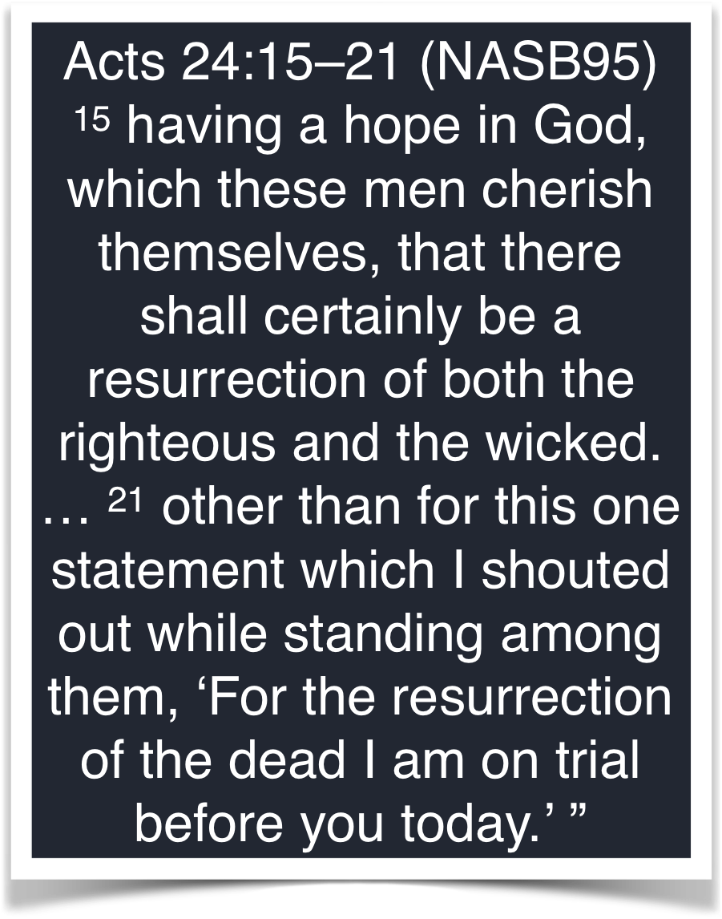
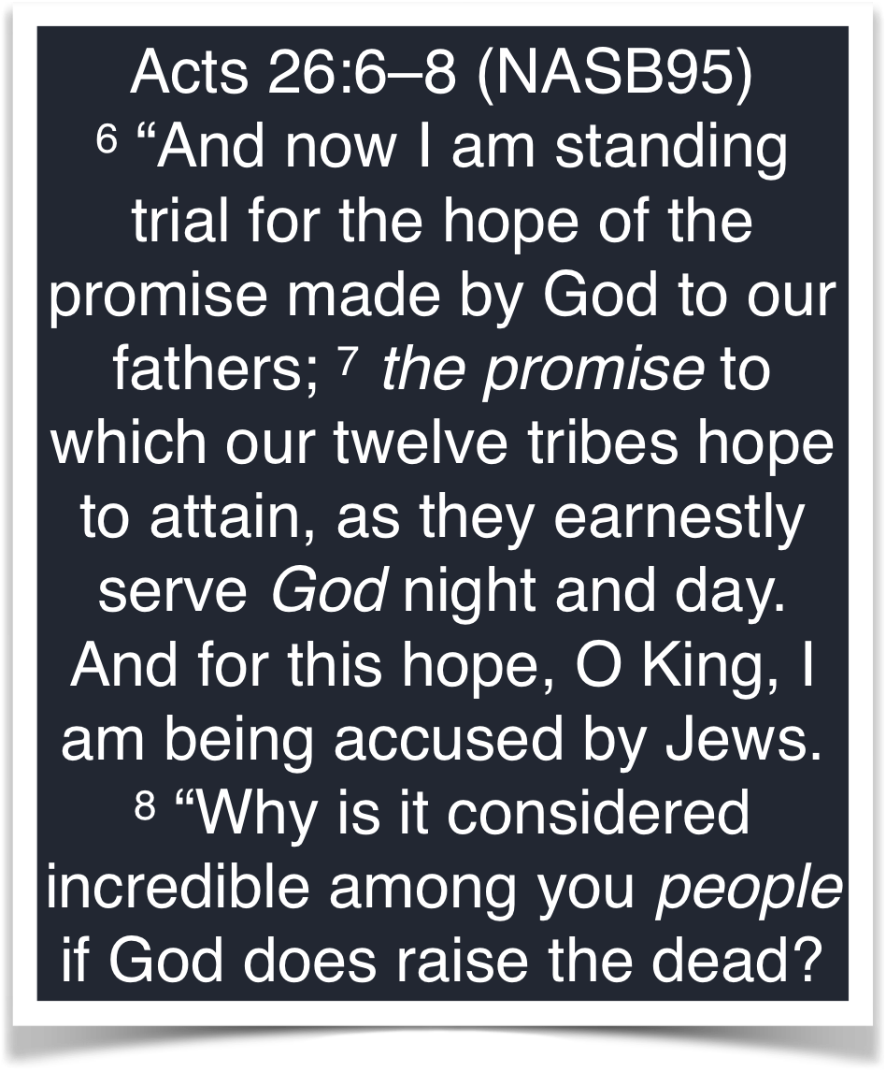
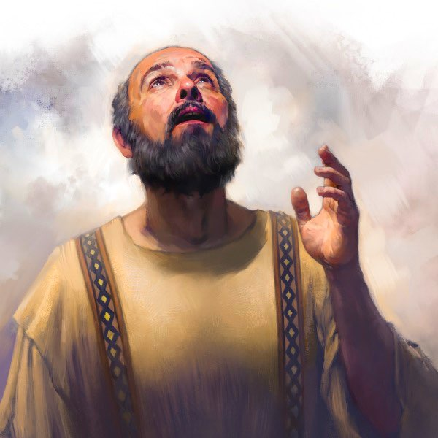
The resurrection
The Foundation of our Hope is the Resurrection of Christ

Slide 27
The resurrection
The Foundation of our Hope is the Resurrection of Christ
1 Corinthians 15:22–23 (NKJV)
22 For as in Adam all die, even so in Christ all shall be made alive. 23 But each one in his own order: Christ the firstfruits, afterward those who are Christ’s at His coming.
Acts 24:15 (NASB95)
15 having a hope in God, which these men cherish themselves, that there shall certainly be a resurrection of both the righteous and the wicked.

Slide 28
The resurrection
The Foundation of our Hope is the Resurrection of Christ
John 5:28–29 (NKJV)
²⁸ … the hour is coming in which all who are in the graves will hear His voice ²⁹ and come forth—those who have done good, to the resurrection of life, and those who have done evil, to the resurrection of condemnation.
Acts 24:15 (NKJV)
¹⁵ having a hope in God, which these men cherish themselves, that there shall certainly be a resurrection of both the righteous and the wicked.
1 Corinthians 15:22–23 (NKJV)
²² For as in Adam all die, even so in Christ all shall be made alive. ²³ But each one in his own order: Christ the firstfruits, afterward those who are Christ’s at His coming.

Slide 29
The resurrection
The Foundation of our Hope is the Resurrection of Christ
1 Corinthians 15:20 (NKJV)
²⁰ But now Christ is risen from the dead, and has become the firstfruits of those who have fallen asleep.
Acts 26:23 (NKJV)
²³ that the Christ would suffer, that He would be the first to rise from the dead, and would proclaim light to the Jewish people and to the Gentiles.”

Slide 30
The resurrection
The Foundation of our Hope is the Resurrection of Christ
Based on the Law & Prophets - The Pharisees Believed in a bodily resurrection of the dead
To deny a bodily resurrection of the dead would logically deny the resurrection of Jesus!
Paul preached the resurrection of Christ

Slide 31
The resurrection
The Foundation of our Hope is the Resurrection of Christ
The
G
O
S
P
E
L
OUR
Our
R
E
S
U
R
R
E
C
T
I
O
N
F
O
R
G
I
V
E
N
E
S
S
P
R
E
A
C
H
I
N
G
O.T.
H
O
P
E
WHY WE (PHARISEES) BELIEVE IN A BODILY RESURRECTION
H
O
P
E
The Errors of The Sadducees
JESUS’ BODILY RESURRECTION

Slide 32
The resurrection
Consequences of Denying the Future Resurrection
“ … if Christ has not been raised …”
“our preaching is empty and your faith is also empty.” — 14
“and we are found false witnesses of God, because we have testified of God that He raised up Christ, whom He did not raise up—if in fact the dead do not rise.” — 15
“Those who have fallen asleep in Christ have perished. If in this life only we have hope in Christ, we are of all men the most pitiable.” — 18,19

Slide 33
The resurrection
The Foundation of our Hope is the Resurrection of Christ
1 Corinthians 15:20 (NKJV)
²⁰ But now Christ is risen from the dead, and has become the firstfruits of those who have fallen asleep.
The first-fruits are the first of a kind - the latter-fruits are the same in kind —
First-fruits, as the initial product, provides both the guarantee and representation of more to come.
JESUS’ BODILY resurrection serves as the guarantee of our bodily resurrection.
1 Corinthians 15:49 (NKJV)
⁴⁹ And as we have borne the image of the man of dust, we shall also bear the image of the heavenly Man.

Slide 34
The resurrection
The Foundation of our Hope is the Resurrection of Christ
1 Corinthians 15:21–22 (NKJV)
²¹ For since by man came death, by Man also came the resurrection of the dead. ²² For as in Adam all die, even so in Christ all shall be made alive.
Just as the sin of Adam brought physical death upon all mankind, so the resurrection of Christ guarantees the bodily resurrection of ALL MEN.
Jesus became man in order to rescue us from “the fear of death” (Hebrews 2:9,14-18).

Slide 35
The resurrection
The Foundation of our Hope is the Resurrection of Christ
1 Corinthians 15:21–22 (NKJV)
²¹ For since by man came death, by Man also came the resurrection of the dead. ²² For as in Adam all die, even so in Christ all shall be made alive.
By Adam came PHYSICAL DEATH!
If Adam had NOT sinned, he would NEVER have died physically!
Because of Adam’s sin - we ALL DIE physically!
Because of Christ’s resurrection - “ALL WILL BE MADE ALIVE!”

Slide 36
The resurrection
The Foundation of our Hope is the Resurrection of Christ
1 Corinthians 15:21–22 (NKJV)
²¹ For since by man came death, by Man also came the resurrection of the dead. ²² For as in Adam all die, even so in Christ all shall be made alive.
WHY DOES PAUL USE ADAM?
Rom 5:12
By ADAM sin entered
Rom 5:12
Spiritual death comes to all for all have sinned
Rom 5:15
Grace to MANY through Christ
UNIVERSAL PROBLEM
UNIVERSAL SOLUTION
1 Cor. 15:21,22
By ADAM came PHYSICAL DEATH to ALL
1 Cor. 15:21,22
in ADAM ALL DIE PHYSICALLY
1 Cor. 15:21,22
ALL made alive —
John 5:28,29;
Acts 24:15

Slide 37
The resurrection
The Foundation of our Hope is the Resurrection of Christ
WHY DOES PAUL USE ADAM?
Rom 5:12
By ADAM sin entered
Rom 5:12
Spiritual death comes to all for all have sinned
Rom 5:15
Grace to MANY through Christ
UNIVERSAL SOLUTION
UNIVERSAL PROBLEM
1 Cor. 15:21,22
By ADAM came PHYSICAL DEATH to ALL
1 Cor. 15:21,22
in ADAM ALL DIE PHYSICALLY
1 Cor. 15:21,22
ALL made alive —
John 5:28,29;
Acts 24:15

Slide 38
The resurrection
The Foundation of our Hope is the Resurrection of Christ
1 Corinthians 15:23 (NKJV)
²³ But each one in his own order: Christ the firstfruits, afterward those who are Christ’s at His coming.
FIRSTFRUITS -
“Prior temporality” (First in time - precedes the harvest)
“Representation of the same quality or character”
“Promise of more of the same kind to come.”
Cf. - Holleman, Resurrection, 50; Hamilton, Holy Spirit, 20,21

Slide 39
The resurrection
The Foundation of our Hope is the Resurrection of Christ
1 Corinthians 15:23 (NKJV)
²³ But each one in his own order: Christ the firstfruits, afterward those who are Christ’s at His coming.
those who are Christ’s at His coming
AFTERWARD
(NEXT)
CHRIST the FIRSTFRUITS
“Promise of more of the same kind to come.”

Slide 40
The resurrection
The Foundation of our Hope is the Resurrection of Christ
1 Corinthians 15:24–26 (NASB95)
²⁴ then comes the end, when He hands over the kingdom to the God and Father, when He has abolished all rule and all authority and power. ²⁵ For He must reign until He has put all His enemies under His feet. ²⁶ The last enemy that will be abolished is death.
… at His coming

Slide 41
The resurrection
The Foundation of our Hope is the Resurrection of Christ
… at His coming
“Then comes the end”
The Messianic reign lasts until Christ hands over the rule to the Father.
The Messianic reign lasts until All opposition is finally and eternally conquered.
The Messianic reign lasts until DEATH has been finally and completely abolished.

Slide 42
The resurrection
The Foundation of our Hope is the Resurrection of Christ
1 Corinthians 15:24 (NKJV)
²⁴ then comes the end, when He hands over the kingdom to the God and Father,
The END
The end of the age - when death is conquered & God’s redemptive plan is finished
The “END” in view in 1 Corinthians 15:24 involves a bodily resurrection which is grounded in the bodily resurrection of Jesus!

Slide 43
The resurrection
The Foundation of our Hope is the Resurrection of Christ
1 Corinthians 15:27–28 (NASB95)
²⁷ For He has put all things in subjection under His feet. But when He says, “All things are put in subjection,” it is evident that He is excepted who put all things in subjection to Him. ²⁸ When all things are subjected to Him, then the Son Himself also will be subjected to the One who subjected all things to Him, so that God may be all in all.
… at His coming

Slide 44
The resurrection
The Foundation of our Hope is the Resurrection of Christ
… at His coming
“When all things are subjected to Him”
“The Son Himself also will be subjected to the” Father.
Every vestige effect of sin will have been abolished.
The ultimate conquering of death is accomplished in the bodily resurrection!

Slide 45
The resurrection
The Foundation of our Hope is the Resurrection of Christ
… at His coming
Paul argues that the denial of a general resurrection is a denial of the Lordship of Christ and a rejection of the Lord’s purpose.
Any view that minimizes the absolute and total victory over sin and death accomplished in the bodily resurrection undermines the foundation of our hope in Christ.

Slide 46
The resurrection
The Foundation of our Hope is the Resurrection of Christ
“… if the dead do not rise at all? “
1 Corinthians 15:29–32 (NASB95)
²⁹ Otherwise, what will those do who are baptized for the dead? If the dead are not raised at all, why then are they baptized for them? ³⁰ Why are we also in danger every hour? ³¹ I affirm, brethren, by the boasting in you which I have in Christ Jesus our Lord, I die daily. ³² If from human motives I fought with wild beasts at Ephesus, what does it profit me? If the dead are not raised, let us eat and drink, for tomorrow we die.

Slide 47
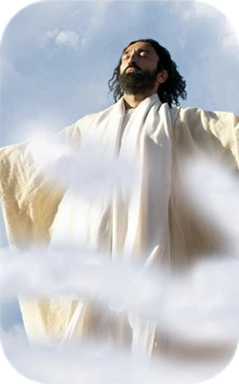
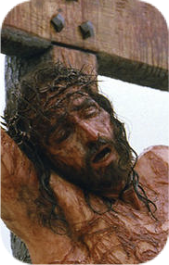
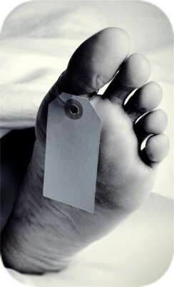
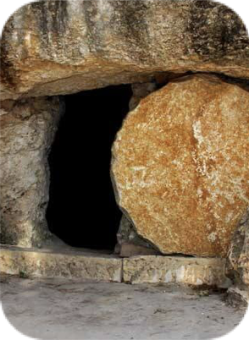
The resurrection
The Foundation of our Hope is the Resurrection of Christ
“… if the dead do not rise at all? “
1 Corinthians 15:29 (NKJV)
²⁹ Otherwise, what will they do who are baptized for the dead, if the dead do not rise at all? Why then are they baptized for the dead?
FACTS
OBEY THE GOSPEL
HOPE

Slide 48
The resurrection
The Foundation of our Hope is the Resurrection of Christ
“… if the dead do not rise at all? “
If there is no resurrection of the dead, why risk your life in the preaching of the gospel (30-32).
“We stand in jeopardy every hour?” = “I die daily” = “I have fought with beasts at Ephesus” (30-32; Acts 19:20-37).
Why not just be a hedonist – party & die? “Eat, drink be merry?” — (32)

Slide 49
The resurrection
The Foundation of our Hope is the Resurrection of Christ
“… if the dead do not rise at all? “
1 Corinthians 15:33–34 (NASB95)
³³ Do not be deceived: “Bad company corrupts good morals.” ³⁴ Become sober-minded as you ought, and stop sinning; for some have no knowledge of God. I speak this to your shame.

Slide 50
The resurrection
Do not be deceived
The teaching of Hymenaeus’ & Philetus’ was dangerous & destructive and can overthrow our faith?
Believing in the resurrection will affect how we LIVE our lives on a daily basis!
SO DO NOT BE DECEIVED

Slide 51
The resurrection
BIBLICAL AFFIRMATION OF THE BODILY RESURRECTION
“How are the dead raised? …”
1 Corinthians 15:35 (NASB95)
³⁵ But someone will say, “How are the dead raised? And with what kind of body do they come?”

Slide 52
The resurrection
BIBLICAL AFFIRMATION OF THE BODILY RESURRECTION
“How are the dead raised? …”
Why would ANYONE mock a future bodily resurrection?
Because of their denial of God’s plan to redeem the whole man. (1 Thes. 5:23)
Because they deny “the power of God" to raise the body (Mat. 22:29-32)
Answer: “You fool” (36).

Slide 53
The resurrection
BIBLICAL AFFIRMATION OF THE BODILY RESURRECTION
“How are the dead raised? …”
1 Corinthians 15:36–37 (NASB95)
³⁶ You fool! That which you sow does not come to life unless it dies; ³⁷ and that which you sow, you do not sow the body which is to be, but a bare grain, perhaps of wheat or of something else.

Slide 54
The resurrection
BIBLICAL AFFIRMATION OF THE BODILY RESURRECTION
“How are the dead raised? …”
Natural analogy (15:36-38)
Evident truth: We regularly plant seed in the ground and observe life.
A “seed” dies, is planted, and life comes forth from that seed in a different form.
Our bodies will be changed and transformed by the power of God (36-37).

Slide 55
The resurrection
BIBLICAL AFFIRMATION OF THE BODILY RESURRECTION
1 Corinthians 15:38–41 (NASB95)
³⁸ But God gives it a body just as He wished, and to each of the seeds a body of its own. ³⁹ All flesh is not the same flesh, but there is one flesh of men, and another flesh of beasts, and another flesh of birds, and another of fish. ⁴⁰ There are also heavenly bodies and earthly bodies, but the glory of the heavenly is one, and the glory of the earthly is another. ⁴¹ There is one glory of the sun, and another glory of the moon, and another glory of the stars; for star differs from star in glory.
“How are the dead raised? …”

Slide 56
The resurrection
BIBLICAL AFFIRMATION OF THE BODILY RESURRECTION
“How are the dead raised? …”
God’s Purpose & Design (38-41)
God gives a variety of “forms” or “bodies” for His creation, i.e. “just as He wished” (38).
Just as God gave a body to each of his creations suiting their needs & his glorious plan, He will provide the type of body necessary for us to function in the spiritual realm throughout all eternity. (39-41)

Slide 57
The resurrection
BIBLICAL AFFIRMATION OF THE BODILY RESURRECTION
“And with what kind of body do they come?”
1 Corinthians 15:42 (NASB95)
⁴² So also is the resurrection of the dead. It is sown a perishable body, it is raised an imperishable body;

Slide 58
The resurrection
BIBLICAL AFFIRMATION OF THE BODILY RESURRECTION
“And with what kind of body do they come?”
1 Corinthians 15:43–44 (NASB95)
⁴³ it is sown in dishonor, it is raised in glory; it is sown in weakness, it is raised in power; ⁴⁴ it is sown a natural body, it is raised a spiritual body. If there is a natural body, there is also a spiritual body.

Slide 59
The resurrection
BIBLICAL AFFIRMATION OF THE BODILY RESURRECTION
“And with what kind of body do they come?”
Contrast Between the Pre-Resurrection Body and the Post-Resurrection Body (15:42-44).
“It” refers to our body, i.e. that which is sown is that which is raised albeit transformed (42-44).
The transformed body will not be subject to decay or death.
Death will have been conquered in its totality.

Slide 60
The resurrection
BIBLICAL AFFIRMATION OF THE BODILY RESURRECTION
37 … “you do not sow the body which is to be”
PRE-RESURRECTION BODY | POST-RESURRECTION BODY
It is sown a perishable body | it is raised an imperishable body;
it is sown in dishonor | it is raised in glory;
it is sown in weakness, | it is raised in power;
it is sown a natural body, | it is raised a spiritual body.
If there is a natural body, | there is also a spiritual body.

Slide 61
The resurrection
BIBLICAL AFFIRMATION OF THE BODILY RESURRECTION
“And with what kind of body do they come?”
A natural body is designed to function in the natural realm, whereas the spiritual body is transformed so as to function in the spiritual realm - an incorruptible, imperishable, powerful, and glorified body.
The phrase “spiritual body” is not equivalent to a bodiless spirit because that would be a denial of the very phrase.

Slide 62
The resurrection
BIBLICAL AFFIRMATION OF THE BODILY RESURRECTION
“And with what kind of body do they come?”
1 Corinthians 15:45–46 (NASB95)
⁴⁵ So also it is written, “The first man, Adam, became a living soul.” The last Adam became a life-giving spirit. ⁴⁶ However, the spiritual is not first, but the natural; then the spiritual.

Slide 63
The resurrection
BIBLICAL AFFIRMATION OF THE BODILY RESURRECTION
1 Corinthians 15:45–46 (NASB95)
⁴⁵ So also it is written, “The first man, Adam, became a living soul.” The last Adam became a life-giving spirit. ⁴⁶ However, the spiritual is not first, but the natural; then the spiritual.
WHY DOES PAUL USE ADAM?
Genesis 2:7
The FIRST Natural HUMAN BEING (living SOUL)
1 Cor. 15:20,21,45-48
LAST Adam - the Life GIVING SPIRIT
Resurrection
1 Cor. 15:49
we will also bear the image of the heavenly
ADAM = ALL HUMANITY

Slide 64
The resurrection
BIBLICAL AFFIRMATION OF THE BODILY RESURRECTION
“And with what kind of body do they come?”
1 Corinthians 15:47–49 (NASB95)
⁴⁷ The first man is from the earth, earthy; the second man is from heaven. ⁴⁸ As is the earthy, so also are those who are earthy; and as is the heavenly, so also are those who are heavenly. ⁴⁹ Just as we have borne the image of the earthy, we will also bear the image of the heavenly.

Slide 65
The resurrection
BIBLICAL AFFIRMATION OF THE BODILY RESURRECTION
“And with what kind of body do they come?”
1 Corinthians 15:50 (NASB95)
⁵⁰ Now I say this, brethren, that flesh and blood cannot inherit the kingdom of God; nor does the perishable inherit the imperishable.

Slide 66
The resurrection
BIBLICAL AFFIRMATION OF THE BODILY RESURRECTION
“And with what kind of body do they come?”
“Flesh and blood” does not negate a resurrection body – it references a corruptible, natural, perishable body (50-54).
“Flesh & blood” = the current BODILY state of the Christians to whom Paul is writing —(Mat 16:17; Gal. 1:16; Eph. 6:12; Heb. 2:14)
These brethren, (50), were SPIRITUALLY alive, (1,2; 12:13), but yet needed to be CHANGED, (51)

Slide 67
The resurrection
BIBLICAL AFFIRMATION OF THE BODILY RESURRECTION
the dead will be raised imperishable, and we will be changed.
1 Corinthians 15:51–52 (NASB95)
⁵¹ Behold, I tell you a mystery; we will not all sleep, but we will all be changed, ⁵² in a moment, in the twinkling of an eye, at the last trumpet; for the trumpet will sound, and the dead will be raised imperishable, and we will be changed.

Slide 68
The resurrection
BIBLICAL AFFIRMATION OF THE BODILY RESURRECTION
the dead will be raised imperishable, and we will be changed.
1 Corinthians 15:51 (NASB95)
⁵¹ Behold, I tell you a mystery; we will not all sleep, but we will all be changed,
WILL NOT All SLEEP
Physical death
BUT ALL WILL BE CHANGED
These brethren, (50), were SPIRITUALLY alive, (1,2; 12:13), but yet needed to be CHANGED, (51)
Instantaneous
At the last Trumpet
The dead will be raised IMPERISHABLE
WE WILL ALL BE CHANGED

Slide 69
The resurrection
BIBLICAL AFFIRMATION OF THE BODILY RESURRECTION
1 Corinthians 15:52 (NASB95)
⁵² in a moment, in the twinkling of an eye, at the last trumpet; for the trumpet will sound, and the dead will be raised imperishable, and we will be changed.
the dead will be raised imperishable, and we will be changed.
“In a moment”:
67.149 στιγμή, ῆς f; ἄτομος, ον: an extremely short unit of time—‘moment, flash, instant.’
στιγμή: ἔδειξεν αὐτῷ πάσας τὰς βασιλείας τῆς οἰκουμένης ἐν στιγμῇ χρόνου ‘he showed him all the kingdoms of the world in a moment of time’ Lk 4:5.
ἄτομος: πάντες δὲ ἀλλαγησόμεθα, ἐν ἀτόμῳ ‘in an instant we shall all be changed’ 1 Cor 15:51–52.
Louw, J. P., & Nida, E. A. (1996). Greek-English lexicon of the New Testament: based on semantic domains (electronic ed. of the 2nd edition.). New York: United Bible Societies.

Slide 70
The resurrection
BIBLICAL AFFIRMATION OF THE BODILY RESURRECTION
1 Corinthians 15:52 (NASB95)
⁵² in a moment, in the twinkling of an eye, at the last trumpet; for the trumpet will sound, and the dead will be raised imperishable, and we will be changed.
the dead will be raised imperishable, and we will be changed.
“In a moment”:
The word atomos (ἄτομος, 823), refers to that which cannot be cut or divided because of its smallness, “indivisible” [W.E. Vines],
Thus, it refers to a particle of time so small that it cannot be divided.

Slide 71
The resurrection
BIBLICAL AFFIRMATION OF THE BODILY RESURRECTION
1 Corinthians 15:52 (NASB95)
⁵² in a moment, in the twinkling of an eye, at the last trumpet; for the trumpet will sound, and the dead will be raised imperishable, and we will be changed.
the dead will be raised imperishable, and we will be changed.
“In the twinkling of an eye”
Only time this phrase is used in the N.T.
67.114 ἐν ῥιπῇ ὀφθαλμοῦ: (an idiom, literally ‘in the blinking of an eye’) an extremely short duration of time—‘quickly, suddenly.’ ἐν ῥιπῇ ὀφθαλμοῦ, ἐν τῇ ἐσχάτῃ σάλπιγγι ‘suddenly, when the last trumpet sounds’ 1 Cor 15:52. For another interpretation of the phrase ἐν ῥιπῇ ὀφθαλμοῦ, see 16.5.

Slide 72
The resurrection
BIBLICAL AFFIRMATION OF THE BODILY RESURRECTION
1 Corinthians 15:52 (NASB95)
⁵² in a moment, in the twinkling of an eye, at the last trumpet; for the trumpet will sound, and the dead will be raised imperishable, and we will be changed.
the dead will be raised imperishable, and we will be changed.
“At the last trumpet;”
The figure is used in a variety of ways in scripture. Context determines application.
The figures in the O.T. of calling God’s people together (Isaiah 27:13; cf. Matt. 24:31) logically demand the reality of the personal visible coming of Christ, the future bodily resurrection and the destruction of the world (I Cor. 15:52; I Thess. 4:13-18).

Slide 73
The resurrection
BIBLICAL AFFIRMATION OF THE BODILY RESURRECTION
1 Corinthians 15:52 (NASB95)
⁵² in a moment, in the twinkling of an eye, at the last trumpet; for the trumpet will sound, and the dead will be raised imperishable, and we will be changed.
the dead will be raised imperishable, and we will be changed.
““The dead will be raised imperishable, and we will be changed”
Just as “it” will be “sown” and “it” will be “raised,” so “this perishable must put on the imperishable, and this mortal must put on immortality” (15:52-54).
Paul succinctly emphasizes this same point in Philippians 3:20-21.
“who will transform our lowly body that it may be conformed to His glorious body”

Slide 74
The resurrection
BIBLICAL AFFIRMATION OF THE BODILY RESURRECTION
1 Corinthians 15:53 (NASB95)
⁵³ For this perishable must put on ªthe imperishable, and this mortal must put on immortality.
the dead will be raised imperishable, and we will be changed.
Perishable: phthartos (φθαρτός, 5349)
23.125 φθαρτός, ή, όν: pertaining to that which is bound to disintegrate and die—‘perishable, mortal.’ ἤλλαξαν τὴν δόξαν τοῦ ἀφθάρτου θεοῦ ἐν ὁμοιώματι εἰκόνος φθαρτοῦ ἀνθρώπου ‘they changed the glory of immortal God for the likeness of a mortal human being’ Ro 1:23.

Slide 75
The resurrection
BIBLICAL AFFIRMATION OF THE BODILY RESURRECTION
1 Corinthians 15:53 (NASB95)
⁵³ For this perishable must put on ªthe imperishable, and this mortal must put on immortality.
the dead will be raised imperishable, and we will be changed.
Imperishable: aphtharsia (ἀφθαρσία, 861),
23.127 ἀφθαρσίαª, ας f: the state of not being subject to decay, leading to death—‘immortal, immortality.’ ἐγείρεται ἐν ἀφθαρσίᾳ ‘it will be raised immortal’ 1 Cor 15:42. It is possible to translate this clause as ‘it will be raised and will never again die.’

Slide 76
The resurrection
BIBLICAL AFFIRMATION OF THE BODILY RESURRECTION
1 Corinthians 15:53 (NASB95)
⁵³ For this perishable must put on ªthe imperishable, and this mortal must put on immortality.
the dead will be raised imperishable, and we will be changed.
Mortal: thnetos (θνητός, 2349),
23.124 θνητός, ή, όν: pertaining to being liable to death (that which will eventually die)—‘mortal.’ μὴ οὖν βασιλευέτω ἡ ἁμαρτία ἐν τῷ θνητῷ ὑμῶν σώματι ‘sin must no longer rule in your mortal bodies’ Ro 6:12. The phrase ‘mortal bodies’ may be rendered as ‘bodies which will die.’

Slide 77
The resurrection
BIBLICAL AFFIRMATION OF THE BODILY RESURRECTION
1 Corinthians 15:53 (NASB95)
⁵³ For this perishable must put on ªthe imperishable, and this mortal must put on immortality.
the dead will be raised imperishable, and we will be changed.
Immortality: athanasia (ἀθανασία, 110),
23.126 ἀθανασία, ας f: the state of not being subject to death (that which will never die)—‘immortality.’…
Vines: - “deathlessness”… it suggests the quality of the life enjoyed, as is clear from 2 Cor. 5:4; for the believer what is mortal is to be “swallowed up of life.

Slide 78
The resurrection
BIBLICAL AFFIRMATION OF THE BODILY RESURRECTION
1 Corinthians 15:53 (NASB95)
⁵³ For this perishable must put on ªthe imperishable, and this mortal must put on immortality.
the dead will be raised imperishable, and we will be changed.
2 Corinthians 5:1–4 (NASB95)
¹ For we know that if the earthly tent which is our house is torn down, we have a building from God, a house not made with hands, eternal in the heavens. ² For indeed in this house we groan, longing to be clothed with our dwelling from heaven, ³ inasmuch as we, having put it on, will not be found naked. ⁴ For indeed while we are in this tent, we groan, being burdened, because we do not want to be unclothed but to be clothed, so that what is mortal will be swallowed up by life.

Slide 79
The resurrection
BIBLICAL AFFIRMATION OF THE BODILY RESURRECTION
1 Corinthians 15:53 (NASB95)
⁵³ For this perishable must put on ªthe imperishable, and this mortal must put on immortality.
the dead will be raised imperishable, and we will be changed.
Romans 2:5–11 (NASB95)
⁵ But because of your stubbornness and unrepentant heart you are storing up wrath for yourself in the day of wrath and revelation of the righteous judgment of God, ⁶ who will render to each person according to his deeds: ⁷ to those who by perseverance in doing good seek for glory and honor and immortality, eternal life; ⁸ but to those who are selfishly ambitious and do not obey the truth, but obey unrighteousness, wrath and indignation. ⁹ There will be tribulation and distress for every soul of man who does evil, of the Jew first and also of the Greek, ¹⁰ but glory and honor and peace to everyone who does good, to the Jew first and also to the Greek. ¹¹ For there is no partiality with God.

Slide 80
The resurrection
BIBLICAL AFFIRMATION OF THE BODILY RESURRECTION
the dead will be raised imperishable, and we will be changed.
1 Corinthians 15:55–57 (NASB95)
⁵⁵ “O death, where is your victory? O death, where is your sting?” ⁵⁶ The sting of death is sin, and the power of sin is the law; ⁵⁷ but thanks be to God, who gives us the victory through our Lord Jesus Christ.

Slide 81
The resurrection
BIBLICAL AFFIRMATION OF THE BODILY RESURRECTION
the dead will be raised imperishable, and we will be changed.
⁵⁵ “O death, where is your victory? O death, where is your sting?”
Paul, under the inspiration of the Holy Spirit, combines these utterances of the prophets in support of his teaching as an inspired writer regarding the future bodily resurrection (Isa. 25:8; Hos. 13:14; 1 Cor. 15:54,55).

Slide 82
The resurrection
BIBLICAL AFFIRMATION OF THE BODILY RESURRECTION
the dead will be raised imperishable, and we will be changed.
⁵⁵ “O death, where is your victory? O death, where is your sting?”
Hosea 13:14 (NASB95)
¹⁴ Shall I ransom them from the power of Sheol? Shall I redeem them from death? O Death, where are your thorns? O Sheol, where is your sting? Compassion will be hidden from My sight.

Slide 83
The resurrection
BIBLICAL AFFIRMATION OF THE BODILY RESURRECTION
the dead will be raised imperishable, and we will be changed.
⁵⁵ “O death, where is your victory? O death, where is your sting?”
The Resurrection of Hosea 13:14
Paul uses the language of Hosea 13:14 in I Corinthians 15:55 to point to the ultimate victory over physical death in the bodily resurrection.
Paul’s usage of this language MUST be understood in light of his immediate context & NOT limited to the contextual events of Hosea.

Slide 84
The resurrection
BIBLICAL AFFIRMATION OF THE BODILY RESURRECTION
New Testament Usage of Old Testament
cf. I Peter 1:10-12
Hos. 11:1: Israel’s Exodus from Egypt
Mt. 2:14-15 —Return of Joseph’s family from Egypt
Jer. 31:15: Mourning of Jewish exiles
Mt. 2:17-18 —Mourning for slain infants
Hos. 1:10 & 2:23: Estranged Jews would become God’s people again
Rom. 9:22-26 —Adoption of Gentiles
Deut 30:12-14
The giving of the Law …
Rom 10:6,7 — The giving of the gospel

Slide 85
The resurrection
ALL FIGURATIVE REFERENCES TO A RESURRECTION ARE GROUNDED IN THE ACTUAL FUTURE BODILY RESURRECTION
Dry bones (Ezek. 37:1-14)
Salvation for Judah (Isa. 26:14, 19)
Those awakened (Dan. 12:1-3)*
Victory over death (Hos. 13:14)*
Israel’s renewal in Christ (Rom. 11:15)
Resurrection of the Beast (Rev. 13:3)
Resurrection of beheaded (Rev. 20:4-6)
*Even IF Most OT references Speak of a figurative resurrection - The FIGURE is GROUNDED IN THE REALITY!
REALITY OF A BODILY RESURRECTION
Acts 2:27, 31; Rom. 8:23; 1 Col. 15:20,22; 2 Cor. 5:1-10; Phili 3:20,21; etc.

Slide 86
The resurrection
BIBLICAL AFFIRMATION OF THE BODILY RESURRECTION
the dead will be raised imperishable, and we will be changed.
1 Corinthians 15:55–57 (NASB95)
⁵⁵ “O death, where is your victory? O death, where is your sting?” ⁵⁶ The sting of death is sin, and the power of sin is the law; ⁵⁷ but thanks be to God, who gives us the victory through our Lord Jesus Christ.

Slide 87
The resurrection
BIBLICAL AFFIRMATION OF THE BODILY RESURRECTION
⁵⁶ The sting of death is sin, and the power of sin is the law;
the dead will be raised imperishable, and we will be changed.
Paul's usage of the term "law" refers to "a sense of a broader principle or rule of cause and effect, which applies to all mankind and includes 'the Adamic law, the Law of Moses, and the law of the Spirit.’" (Rom 5:12-14; 1 Jn 3:4; James 1:25; 2:12; Gal. 6:2)
The "law of Christ" can bring life (Rom. 8:2) or condemnation. (James 5:19-20; I Cor. 5:1-13; 6:9-11; John 12:47-48).

Slide 88
The resurrection
BIBLICAL AFFIRMATION OF THE BODILY RESURRECTION
⁵⁶ The sting of death is sin, and the power of sin is the law;
the dead will be raised imperishable, and we will be changed.
The fact that we are not "under law" in reference to the Law of Moses does not mean we are not under "the law of Christ" (I Cor. 9:21; Gal. 6:2; James 1:25; 2:12).
Our victory in Christ conquers all sin and even physical death itself through the resurrection of Jesus!

Slide 89
The resurrection
BIBLICAL AFFIRMATION OF THE BODILY RESURRECTION
the dead will be raised imperishable, and we will be changed.
1 Corinthians 15:57–58 (NASB95)
⁵⁷ but thanks be to God, who gives us the victory through our Lord Jesus Christ. ⁵⁸ Therefore, my beloved brethren, be steadfast, immovable, always abounding in the work of the Lord, knowing that your toil is not in vain in the Lord.

Slide 90
The resurrection
BIBLICAL AFFIRMATION OF THE BODILY RESURRECTION
⁵⁸ Therefore, my beloved brethren, be steadfast, immovable, always abounding in the work of the Lord, knowing that your toil is not in vain in the Lord.
the dead will be raised imperishable, and we will be changed.
Because you believe in the bodily resurrection of Jesus and your future bodily resurrection, your labor is NOT in vain —
The firm foundation of the bodily resurrection of Jesus and the promise of the future harvest provides motivation for steadfastness in our labor (Heb 6:18,19; 1 John 3:2,3)

Slide 91
We can CHOOSE SALVATION or REJECT IT
Implications of
>>>> OUR RESURRECTION <<<<
Acts 24:15–16 (NKJV)
¹⁵ I have hope in God, which they themselves also accept, that there will be a resurrection of the dead, both of the just and the unjust. ¹⁶ This being so, I myself always strive to have a conscience without offense toward God and men.

Slide 92
We can CHOOSE SALVATION or REJECT IT
Implications of
>>>> OUR RESURRECTION <<<<
Philippians 3:10–11 (NKJV)
¹⁰ that I may know Him and the power of His resurrection, and the fellowship of His sufferings, being conformed to His death, ¹¹ if, by any means, I may attain to the resurrection from the dead.

Slide 93
We can CHOOSE SALVATION or REJECT IT
Implications of
DISOBEDIENT
KING
SUBMISSION
LOST
HIGH PRIEST
SALVATION
HELPLESS
MEDIATOR
SUPPORT
CONDEMNED
JUDGE
SAVIOR

Slide 94
We can CHOOSE SALVATION or REJECT IT
Implications of
>>>> OUR RESURRECTION <<<<
John 5:28–29 (NKJV)
²⁸ Do not marvel at this; for the hour is coming in which all who are in the graves will hear His voice ²⁹ and come forth—those who have done good, to the resurrection of life, and those who have done evil, to the resurrection of condemnation.

Slide 96
Charts by Don McClain
Preached October 13, 2019
West 65th Street church of Christ, P.O. Box 190062, Little Rock AR 72219
501-568-1062
Prepared using Keynote
Email – donmcclain@sbcglobal.net
More Keynote, PPT & Audio Sermons:
https://www.w65stchurchofchrist.com
Implications of
>>>> OUR RESURRECTION <<<<
(1 Corinthians 15)

Slide 97
2 Corinthians 4:13–5:8 (NKJV)
¹³ And since we have the same spirit of faith, according to what is written, “I believed and therefore I spoke,” we also believe and therefore speak, ¹⁴ knowing that He who raised up the Lord Jesus will also raise us up with Jesus, and will present us with you. ¹⁵ For all things are for your sakes, that grace, having spread through the many, may cause thanksgiving to abound to the glory of God.

Slide 98
2 Corinthians 4:13–5:8 (NKJV)
¹⁶ Therefore we do not lose heart. Even though our outward man is perishing, yet the inward man is being renewed day by day. ¹⁷ For our light affliction, which is but for a moment, is working for us a far more exceeding and eternal weight of glory, ¹⁸ while we do not look at the things which are seen, but at the things which are not seen. For the things which are seen are temporary, but the things which are not seen are eternal.

Slide 99
2 Corinthians 4:13–5:8 (NKJV)
¹ For we know that if our earthly house, this tent, is destroyed, we have a building from God, a house not made with hands, eternal in the heavens. ² For in this we groan, earnestly desiring to be clothed with our habitation which is from heaven, ³ if indeed, having been clothed, we shall not be found naked. ⁴ For we who are in this tent groan, being burdened, not because we want to be unclothed, but further clothed, that mortality may be swallowed up by life.

Slide 100
2 Corinthians 4:13–5:8 (NKJV)
⁵ Now He who has prepared us for this very thing is God, who also has given us the Spirit as a guarantee. ⁶ So we are always confident, knowing that while we are at home in the body we are absent from the Lord. ⁷ For we walk by faith, not by sight. ⁸ We are confident, yes, well pleased rather to be absent from the body and to be present with the Lord.

