Slide 1
PREPARING
To Teach Others
THE GOSPEL
1 Peter 3:8-4:2

Slide 2
1 Peter 3:8–4:2 (NKJV)
⁸ Finally, all of you be of one mind, having compassion for one another; love as brothers, be tenderhearted, be courteous; ⁹ not returning evil for evil or reviling for reviling, but on the contrary blessing, knowing that you were called to this, that you may inherit a blessing. ¹⁰ For “He who would love life And see good days, Let him refrain his tongue from evil, And his lips from speaking deceit. ¹¹ Let him turn away from evil and do good; Let him seek peace and pursue it. ¹² For the eyes of the Lord are on the righteous, And His ears are open to their prayers; But the face of the Lord is against those who do evil.”

Slide 3
1 Peter 3:8–4:2 (NKJV)
¹³ And who is he who will harm you if you become followers of what is good? ¹⁴ But even if you should suffer for righteousness’ sake, you are blessed. “And do not be afraid of their threats, nor be troubled.” ¹⁵ But sanctify the Lord God in your hearts, and always be ready to give a defense to everyone who asks you a reason for the hope that is in you, with meekness and fear; ¹⁶ having a good conscience, that when they defame you as evildoers, those who revile your good conduct in Christ may be ashamed. ¹⁷ For it is better, if it is the will of God, to suffer for doing good than for doing evil.

Slide 4
1 Peter 3:8–4:2 (NKJV)
¹⁸ For Christ also suffered once for sins, the just for the unjust, that He might bring us to God, being put to death in the flesh but made alive by the Spirit, ¹⁹ by whom also He went and preached to the spirits in prison, ²⁰ who formerly were disobedient, when once the Divine longsuffering waited in the days of Noah, while the ark was being prepared, in which a few, that is, eight souls, were saved through water.

Slide 5
1 Peter 3:8–4:2 (NKJV)
²¹ There is also an antitype which now saves us—baptism (not the removal of the filth of the flesh, but the answer of a good conscience toward God), through the resurrection of Jesus Christ, ²² who has gone into heaven and is at the right hand of God, angels and authorities and powers having been made subject to Him. ¹ Therefore, since Christ suffered for us in the flesh, arm yourselves also with the same mind, for he who has suffered in the flesh has ceased from sin, ² that he no longer should live the rest of his time in the flesh for the lusts of men, but for the will of God.

Slide 6
PREPARING
To Teach Others
THE GOSPEL
I MUST RECOGNIZE THE NEED
1 Peter 3:8-4:2

Slide 7
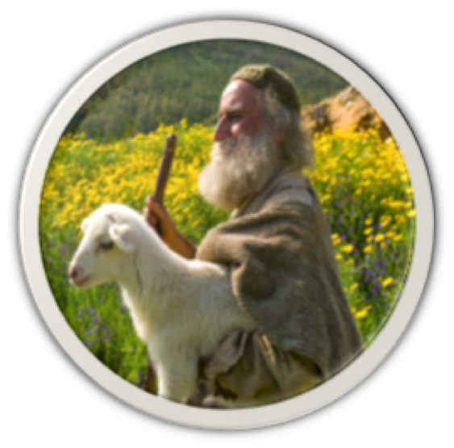
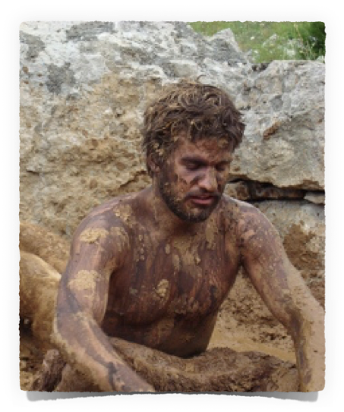
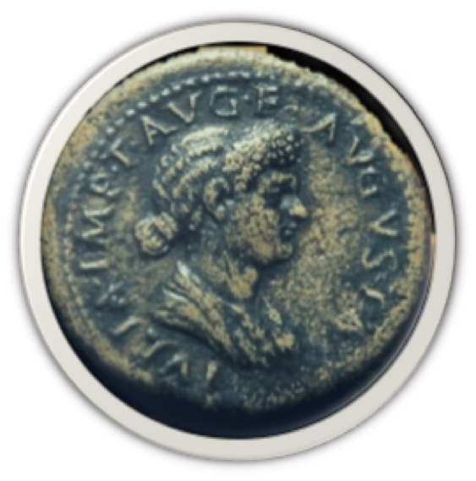
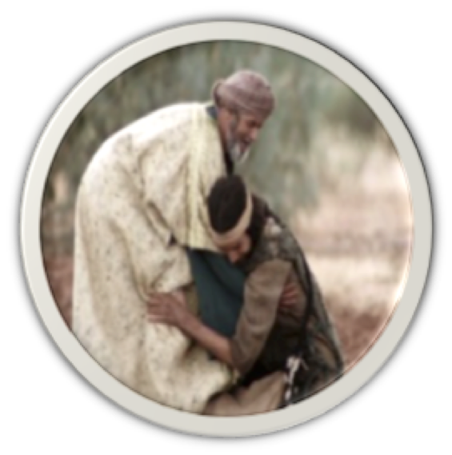
PREPARING
To Teach Others
THE GOSPEL
Do We Recognize …
The condition of the LOST - Eph 2:12; 1 Thes 4:13
The value of the LOST – Mat 18:14; 1 Pet 1:18-21
The love God has for the LOST – Jn 3:16; Rom 5:8-10; 2 Cor 5:19-21
Our responsibility to the lost? – Rom 1:14,15; Jam 5:19,20; Mk 12:29-31

Slide 8
PREPARING
To Teach Others
THE GOSPEL
Do We Recognize …
Our ATTITUDE toward the LOST is manifested in what we do about them — Acts 8:4; Ro 9:1-5; 10:1; Ja 1:22; 2:14-26
Do we care enough?
Do we value the souls of others enough?
Do we truly desire to see the lost saved and the erring restored?

Slide 9
PREPARING
To Teach Others
THE GOSPEL
Do We Recognize …
THE GREATEST NEED – we all have is JESUS — Rom 3:23; 1:16,17; Jn 14:6; Acts 4:12
The greatest SERVICE we can provide another is to lead them to JESUS — Mt. 28:19,20; Ac 8:4
Our need to do everything in our power to bring others to Jesus? — Mt 9:1-8; Mk 2:1-12; Lk 5:17-26

Slide 10
PREPARING
To Teach Others
THE GOSPEL
BEGINS WITH PREPARING MY HEART
1 Peter 3:8-4:2

Slide 11
PREPARING
To Teach Others
THE GOSPEL
PREPARING MY HEART …
3:18 For Christ also suffered once for sins, the just for the unjust, that He might bring us to God, … 4:1 since Christ suffered for us in the flesh, arm yourselves also with the same mind
A mind of COMPASSION, LOVE, TENDERNESS, COURTESY — 1 Pet 3:8; cf. Col. 3:12-14
A DISCIPLINED mind — 1 Pet 3:9-12; Lk 22:40–46; 1 Co. 9:27
A mind of COURAGE — 1 Peter 3:13,14; 1 Cor. 16:13; 2 Tim 2:1-4
A mind of REVERENCE & DEDICATION — 1 Peter 3:15a; Mat 6:19-33; Jn 6:27; etc.

Slide 12
PREPARING
To Teach Others
THE GOSPEL
LEARNING TO SPEAK FOR JESUS
1 Peter 3:8-4:2

Slide 13
PREPARING
To Teach Others
THE GOSPEL
READYING MY TONGUE …
3:15 But sanctify the Lord God in your hearts, and always be ready to give a defense to everyone who asks you a reason for the hope that is in you, with meekness and fear.
Be WILLING to SHARE what we KNOW — 1 Pet 3:15; Jn 1:43-49; Acts 9:20; 1 Thes. 1:8,9
Grow in knowledge and understanding by studying the Bible — 2 Pet. 3:17,18; Eph. 5:17; 1 Tim. 4:13-16; 2 Tim 2:15; 3:16-4:2.
Read and listen to articles, books and sermons by faithful brethren, comparing them w/ the Bible — Acts 17:11,12

Slide 14
PREPARING
To Teach Others
THE GOSPEL
READYING MY TONGUE …
3:15 But sanctify the Lord God in your hearts, and always be ready to give a defense to everyone who asks you a reason for the hope that is in you, with meekness and fear.
Talk about the gospel with faithful & mature Christians — Gal. 2:1-10
Teach a Bible class (children, teens, or adults) — Heb. 5:12-14
Familiarize ourselves with the belief’s of those we are trying to lead to Christ — 2 Cor 2:11
Learn how to use the Bible to effectively answer the most commonly held errors believed.

Slide 15
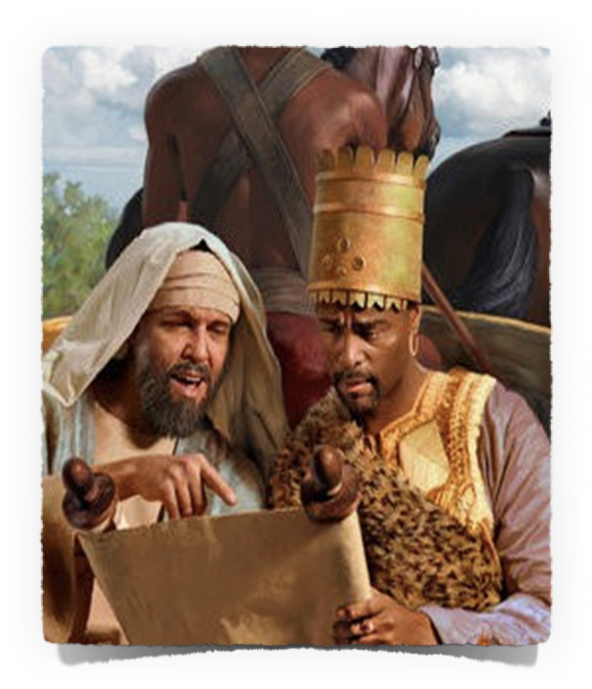
PREPARING
To Teach Others
THE GOSPEL
READYING MY TONGUE …
3:15 But sanctify the Lord God in your hearts, and always be ready to give a defense to everyone who asks you a reason for the hope that is in you, with meekness and fear.
Lessons from Phillip & the eunuch from Ethiopia —
Acts 8:26-39
Be a willing servant of God — (26-29)
Ask questions – (30)
Be accommodative – (31)
Start where they are – (32-34)
Answer questions w/ Scripture – (35)
Be opportunistic - (36-38)
Be persistent - go find someone else – (39,40)

Slide 16
PREPARING
To Teach Others
THE GOSPEL
READYING MY TONGUE …
3:15 But sanctify the Lord God in your hearts, and always be ready to give a defense to everyone who asks you a reason for the hope that is in you, with meekness and fear.
Matthew 28:19; Acts 8:4; 1 Thessalonians 1:8
Books / Articles / Bulletins
Radio programs
Internet: Website / Facebook / Email
Cd’s / MP3 audio files
Videos
Correspondent Courses
In home Bible studies
By Lance Mosher
by Michael Shank

Slide 17
PREPARING
To Teach Others
THE GOSPEL
EXPECT OBSTACLES & OVERCOME
1 Peter 3:8-4:2

Slide 18
PREPARING
To Teach Others
THE GOSPEL
EXPECT OBSTACLES …
4:1 Therefore, since Christ suffered for us in the flesh, arm yourselves also with the same mind, for he who has suffered in the flesh has ceased from sin, …
A rejection of the reliability & absolute authority of the scriptures - (2 Tim 3:16,17; 2 Pet 1:19-21; Mat 24:35; Luke 21:33)
A belief that truth is subjective & relative - (no moral absolutes / doctrine & theology inconsequential) - (Judg 21:25; Jer. 6:16-19)
The emphasis of feelings & emotion over, & instead of, a “thus saith the Lord.” - (Prov 14:12; Jer. 6:16; 10:23)

Slide 19
PREPARING
To Teach Others
THE GOSPEL
EXPECT OBSTACLES …
4:1 Therefore, since Christ suffered for us in the flesh, arm yourselves also with the same mind, for he who has suffered in the flesh has ceased from sin, …
Secular / Worldly
Religion / Man Made
Sec. Education
False Doctrine
NO absolute truth
Subjective Truth
Culture of Toleration
Diversity / Confusion
Materialism
Social In Focus
Wealth / Ease
Wealth / Ease / Busy
Self-Centered Focus
Self-Centered Focus

Slide 20
PREPARING
To Teach Others
THE GOSPEL
EXPECT OBSTACLES …
4:1 Therefore, since Christ suffered for us in the flesh, arm yourselves also with the same mind, for he who has suffered in the flesh has ceased from sin, …
“That the Bible puts a very high premium on truth is indisputable. But sadly, the church today has largely downplayed and abandoned truth, content to follow the spirit of the age. That spirit is comprised of postmodernism, relativism, emotionalism and subjectivism. Truth cannot flourish in such poisoned soil.”
Truth Watch —- by Bill Muehlenberg
(Review of “THE TRUTH WAR” by John MacArthur)

Slide 21
PREPARING
To Teach Others
THE GOSPEL
EXPECT OBSTACLES …
4:1 Therefore, since Christ suffered for us in the flesh, arm yourselves also with the same mind, for he who has suffered in the flesh has ceased from sin, …
Attendance / worship is a menu option
Everyone expects to go to heaven
Balance scale salvation - Salvation by works: good outweighs bad
Doing the absolute minimum to be saved - FAITH ALONE / OSAS / etc.
Content with their religious traditions
No desire or need to search - very closed minded
TOO BUSY!!!!

Slide 22
PREPARING
To Teach Others
THE GOSPEL
EXPECT OBSTACLES …
4:1 Therefore, since Christ suffered for us in the flesh, arm yourselves also with the same mind, for he who has suffered in the flesh has ceased from sin, …
We CANNOT get a person SAVED until we first CONVINCE them they are LOST! — Ro 3:23; 6:23; Acts 4:12
We CANNOT save ANYONE who REFUSES to HEAR the word of God! — 1 Pet. 3:18-21; Mat. 13:11-23
We can ONLY control what we do - not how others respond! - 1 Cor 3:6

Slide 23
PREPARING
To Teach Others
THE GOSPEL
Overcoming The
It HAS ALWAYS BEEN THIS WAY!!
Yet The Fields Are White!!!!

Slide 24
PREPARING
To Teach Others
THE GOSPEL
THOSE OPEN TO THE TRUTH WILL SEE THE TRUTH
We MUST be salty, lights & teachers
Mat 5:13-16;
Phili 2:14-16
Acts 8:4
1 Thes. 1:8-10

Slide 25
PREPARING
To Teach Others
THE GOSPEL
THOSE OPEN TO THE TRUTH WILL SEE THE TRUTH
3
4
Hear
2
Repent
1
Confess
Luke 8:11; Rom. 10:13-17
John 8:24; Heb 11:6
Luke 13:3,5; Acts 17:30
Mat. 10:32,33; Rom 10:9
Acts 2:38; 1 Pet 3:21
Believe
Be Baptized
5

Slide 26
PREPARING
To Teach Others
THE GOSPEL
All need the gospel – which is the only hope for the lost!
If we are truly converted to Christ – we WILL naturally want to tell others!

Slide 27
PREPARING
To Teach Others
THE GOSPEL
Are we STRIVING to maximize our influence, abilities & opportunities?

Slide 28
PREPARING
To Teach Others
THE GOSPEL
When Jesus means everything to ME, I WILL TRY to make Him mean something to someone else!

Slide 30
1 Peter 3:8-4:2
PREPARING
To Teach Others
THE GOSPEL
Charts by Don McClain
Preached December 1, 2019
West 65th Street church of Christ - P.O. Box 190062 - Little Rock AR 72219 - Phone — 501-568-1062 — Email – donmcclain@sbcglobal.net
Prepared using Keynote / More Keynote, PPT & Audio Sermons:
www.w65stchurchofchrist.com

Slide 31
1 Thessalonians 1:2–10 (NKJV)
² We give thanks to God always for you all, making mention of you in our prayers, ³ remembering without ceasing your work of faith, labor of love, and patience of hope in our Lord Jesus Christ in the sight of our God and Father,

Slide 32
1 Thessalonians 1:2–10 (NKJV)
⁴ knowing, beloved brethren, your election by God. ⁵ For our gospel did not come to you in word only, but also in power, and in the Holy Spirit and in much assurance, as you know what kind of men we were among you for your sake.

Slide 33
1 Thessalonians 1:2–10 (NKJV)
⁶ And you became followers of us and of the Lord, having received the word in much affliction, with joy of the Holy Spirit, ⁷ so that you became examples to all in Macedonia and Achaia who believe.

Slide 34
1 Thessalonians 1:2–10 (NKJV)
⁸ For from you the word of the Lord has sounded forth, not only in Macedonia and Achaia, but also in every place. Your faith toward God has gone out, so that we do not need to say anything.

Slide 35
1 Thessalonians 1:2–10 (NKJV)
⁹ For they themselves declare concerning us what manner of entry we had to you, and how you turned to God from idols to serve the living and true God, ¹⁰ and to wait for His Son from heaven, whom He raised from the dead, even Jesus who delivers us from the wrath to come.

