Slide 1
The GREAT REDEEMER
“He led them forth by the right way”
Psalm 107
² Let the redeemed of the Lord say so, Whom He has redeemed from the hand of the enemy, … ⁷ And He led them forth by the right way, That they might go to a city for a dwelling place.

Slide 2
The GREAT REDEEMER
“He led them forth by the right way”
Writer & occasion of Psalm 107 are unknown
Four main divisions:
(1) Introduction: Admonition for the redeemed to acknowledge God’s goodness - (vv. 1-3)
(2) God's goodness to his people is described (vv. 4–32)
(3) God’s government of the world / wicked are punished / righteous redeemed (vv. 33–42).
(4) Conclusion: (vv. 43)

Slide 3
Psalm 107:1–9 (NKJV)
¹ Oh, give thanks to the Lord, for He is good! For His mercy endures forever. ² Let the redeemed of the Lord say so, Whom He has redeemed from the hand of the enemy, ³ And gathered out of the lands, From the east and from the west, From the north and from the south. ⁴ They wandered in the wilderness in a desolate way; They found no city to dwell in. ⁵ Hungry and thirsty, Their soul fainted in them. ⁶ Then they cried out to the Lord in their trouble, And He delivered them out of their distresses. ⁷ And He led them forth by the right way, That they might go to a city for a dwelling place. ⁸ Oh, that men would give thanks to the Lord for His goodness, And for His wonderful works to the children of men! ⁹ For He satisfies the longing soul, And fills the hungry soul with goodness.

Slide 4
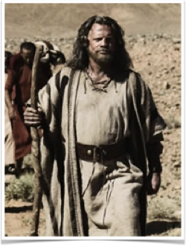
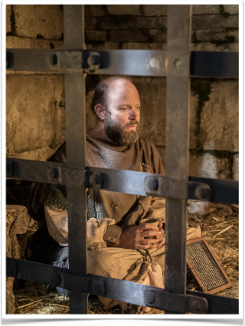
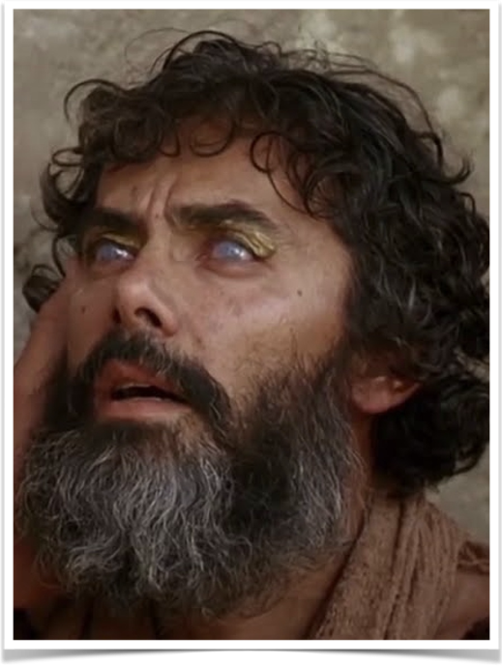
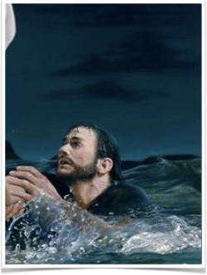
The GREAT REDEEMER
The Lord delivers His people / Four examples:
How God HELPS the lost find their way (v. 4-9)
How God SETS prisoners free (v. 10-16)
How God HEALS the sick & dying (v. 17-22)
How God SAVES the perishing (v. 23-32)

Slide 5
The GREAT REDEEMER
The Lord delivers His people / Four examples:
In each case, when the people plead for the Lord to help them out of their distress, — He DELIVERED (vv. 6, 13, 19, 28).
“Then they cried out to the Lord in their trouble, And He delivered them out of their distresses.”

Slide 6
The GREAT REDEEMER
The Lord delivers His people / Four examples:
SALVATION is a REASON to PRAISE GOD

Slide 7
The GREAT REDEEMER
The Lord delivers His people / Four examples:
The LORD is in CONTROL -
He can make a fruitful land become a wasteland because of the wickedness of the people in the land (33,34; cf. Deut. 29:23-28).
He can ALSO turn a wasteland into land that bears much fruit that it sustains His people (35-38; cf. Ps. 114:8; [Is. 41:17, 18])

Slide 8
The GREAT REDEEMER
“He led them forth by the right way”
7 — And He led them forth by the right way,
9 — For He satisfies the longing soul, And fills the hungry soul with goodness.
20 — He sent His word and healed them, And delivered them from their destructions.
30 — Then they are glad because they are quiet;
30 — So He guides them to their desired haven.

Slide 9
The GREAT REDEEMER
“He led them forth by the right way”
Exhortations to the Redeemed
“Give thanks … for He is good …” (Ps. 107:1-2)
“offer sacrifices of thanksgiving” (Ps. 107:22)
“tell of His works with joyful singing’ (Ps. 107:22)
“extol Him also in the congregation of the people, and praise Him at the seat of the elders. (Ps. 107:32)

Slide 10
The GREAT REDEEMER
“He led them forth by the right way”
There is a RIGHT way - God’s way is the ONLY RIGHT WAY! (Prov. 14:12; Jer. 10:23; Mat. 7:13,14; Jn 14:6)
Not EASY - It is difficult and narrow — (Mat. 7:13,14)
Not always pleasant — (Acts 9:1,2; 2 Tim 3:10-14; Acts 14:22; etc.)
There is a HIGH COST - (Mat 10:34-37; Luke 9:23; 14:26-33)
The end is ETERNAL LIFE - (Mat. 7:13,14; 1 Pet. 1:6-9)

Slide 11
The GREAT REDEEMER
“He led them forth by the right way”
Like those people in the desert, we were lost, but God provided us a way IN CHRIST — Ac 2:38; Ep. 1:3-12; Ga. 3:26,27
Like those in bondage, we were slaves — but God set us free IN CHRIST— Jn. 8:34; Rom. 6:3-23; 8:2; Gal. 5:1
Like those sick, we were sickened by sin — but God healed us IN CHRIST— 1 Pet. 2:24; Acts 22:16; Col. 2:12,13
Like those trapped in the storm, we were perishing, but God saved us IN CHRIST — Rom. 5:9; 1 Pet. 3:20-21; 4:15-19

Slide 12
The GREAT REDEEMER
“He LEADS US In the RIGHT way”
Let US give thanks to the Lord for His lovingkindness, and for His wonders to the sons of men! (Ps. 107:8)
“Let the redeemed of the Lord say so”! Say what? “..For He is good; for His lovingkindness is everlasting (Ps. 107:1-2)
Let US also offer sacrifices of thanksgiving and tell of His works with joyful singing. (Ps. 107:22)
Let US extol Him also in the congregation of the people, and praise Him at the seat of the elders. (Psalm 107:32)

Slide 13
The GREAT REDEEMER
“He LEADS US In the RIGHT way”
Psalm 107:43 (NKJV)
⁴³ Whoever is wise will observe these things, And they will understand the lovingkindness of the Lord.

Slide 15
The GREAT REDEEMER
“He led them forth by the right way”
Psalm 107
Charts by Don McClain
Preached December 29, 2019
West 65th Street church of Christ - P.O. Box 190062 - Little Rock AR 72219 - Phone — 501-568-1062 — Email – donmcclain@sbcglobal.net
Prepared using Keynote / More Keynote, PPT & Audio Sermons:
www.w65stchurchofchrist.com

Slide 16
Jeremiah 31:7–12 (NKJV)
⁷ For thus says the Lord: “Sing with gladness for Jacob, And shout among the chief of the nations; Proclaim, give praise, and say, ‘O Lord, save Your people, The remnant of Israel!’ ⁸ Behold, I will bring them from the north country, And gather them from the ends of the earth, Among them the blind and the lame, The woman with child And the one who labors with child, together; A great throng shall return there. ⁹ They shall come with weeping, And with supplications I will lead them. I will cause them to walk by the rivers of waters, In a straight way in which they shall not stumble; For I am a Father to Israel, And Ephraim is My firstborn.

Slide 17
Jeremiah 31:7–12 (NKJV)
¹⁰ “Hear the word of the Lord, O nations, And declare it in the isles afar off, and say, ‘He who scattered Israel will gather him, And keep him as a shepherd does his flock.’ ¹¹ For the Lord has redeemed Jacob, And ransomed him from the hand of one stronger than he. ¹² Therefore they shall come and sing in the height of Zion, Streaming to the goodness of the Lord For wheat and new wine and oil, For the young of the flock and the herd; Their souls shall be like a well-watered garden, And they shall sorrow no more at all.

