Slide 1
In EVERYTHING
GIVE THANKS
¹⁶ Rejoice always, ¹⁷ pray without ceasing, ¹⁸ in everything give thanks; for this is the will of God in Christ Jesus for you. —
1 Thessalonians 5:16–18 (NKJV)

Slide 2
In EVERYTHING
GIVE THANKS
Our culture encourages us to be discontent with who we are & what we have -
Instead of appreciating the gifts, blessings and talents that we do have, much of our modern culture tries to get us to compare what we have with what others have.

Slide 3
In EVERYTHING
GIVE THANKS
INGRATITUDE Is A SIN

Slide 4
In EVERYTHING
GIVE THANKS
INGRATITUDE Is A SIN
Romans 1:21 (NKJV)
²¹ because, although they knew God, they did not glorify Him as God, nor were thankful, but became futile in their thoughts, and their foolish hearts were darkened.

Slide 5
In EVERYTHING
GIVE THANKS
INGRATITUDE Is A SIN
2 Timothy 3:2–4 (NKJV)
² For men will be lovers of themselves, lovers of money, boasters, proud, blasphemers, disobedient to parents, unthankful, unholy, ³ unloving, unforgiving, slanderers, without self-control, brutal, despisers of good, ⁴ traitors, headstrong, haughty, lovers of pleasure rather than lovers of God,

Slide 6
In EVERYTHING
GIVE THANKS
WHY Are People UNGRATEFUL?

Slide 7
In EVERYTHING
GIVE THANKS
WHY Are People UNGRATEFUL?
Grows out of pride & a self-centered, entitlement perspective.
Manifests a lack of respect for GOD!
Faith, hope nor love can germinate in an ungrateful heart!

Slide 8
In EVERYTHING
GIVE THANKS
lovers of money
NOT lovers of God
boasters
lovers of pleasure
lovers of themselves
proud
unthankful
unholy
unloving
headstrong
haughty
blasphemers
disobedient to parents
traitors
despisers of good
unforgiving
brutal
slanderers
without self-control
2 Timothy 3:2–4

Slide 9
In EVERYTHING
GIVE THANKS
We Have MUCH To Be THANKFUL For!

Slide 10
In EVERYTHING
GIVE THANKS
We Have MUCH To Be THANKFUL For!
Most IMPORTANTLY - Every spiritual blessing we have in Christ - Eph 1:2-14
Our familial relationships - 2 Tim 1:3-5
Faithful brethren - Col 1:3
Every material blessing - our country & daily provisions - 1 Tim. 4:3-5
Our struggles & difficulties in life - James 1:2-6
EVERYTHING from God!- James 1:17

Slide 11
In EVERYTHING
GIVE THANKS
Do I Give THANKS In EVERYTHING?

Slide 12
In EVERYTHING
GIVE THANKS
Do I Give THANKS In EVERYTHING?
Ps 100:4 — Enter into His gates with thanksgiving, And into His courts with praise. Be thankful to Him, and bless His name.
Ps 107:22 — Let them sacrifice the sacrifices of thanksgiving, And declare His works with rejoicing.
Ps 116:17 — I will offer to You the sacrifice of thanksgiving, And will call upon the name of the LORD.

Slide 13
In EVERYTHING
GIVE THANKS
Do I Give THANKS In EVERYTHING?
Ephesians 5:20 (NKJV)
²⁰ giving thanks always for all things to God the Father in the name of our Lord Jesus Christ,

Slide 14
In EVERYTHING
GIVE THANKS
Do I Give THANKS In EVERYTHING?
Philippians 4:4–7 (NKJV)
⁴ Rejoice in the Lord always. Again I will say, rejoice! ⁵ Let your gentleness be known to all men. The Lord is at hand. ⁶ Be anxious for nothing, but in everything by prayer and supplication, with thanksgiving, let your requests be made known to God; ⁷ and the peace of God, which surpasses all understanding, will guard your hearts and minds through Christ Jesus.

Slide 15
In EVERYTHING
GIVE THANKS
Do I Give THANKS In EVERYTHING?
Colossians 2:6–7 (NKJV)
⁶ As you therefore have received Christ Jesus the Lord, so walk in Him, ⁷ rooted and built up in Him and established in the faith, as you have been taught, abounding in it with thanksgiving.

Slide 16
In EVERYTHING
GIVE THANKS
Do I Give THANKS In EVERYTHING?
Colossians 3:15–17 (NKJV)
¹⁵ And let the peace of God rule in your hearts, to which also you were called in one body; and be thankful. ¹⁶ Let the word of Christ dwell in you richly in all wisdom,

Slide 17
In EVERYTHING
GIVE THANKS
Do I Give THANKS In EVERYTHING?
Colossians 3:15–17 (NKJV)
teaching and admonishing one another in psalms and hymns and spiritual songs, singing with grace in your hearts to the Lord. ¹⁷ And whatever you do in word or deed, do all in the name of the Lord Jesus, giving thanks to God the Father through Him.

Slide 18
In EVERYTHING
GIVE THANKS
Do I Give THANKS In EVERYTHING?
Colossians 4:2–4 (NKJV)
² Continue earnestly in prayer, being vigilant in it with thanksgiving; ³ meanwhile praying also for us, that God would open to us a door for the word, to speak the mystery of Christ, for which I am also in chains, ⁴ that I may make it manifest, as I ought to speak.

Slide 19
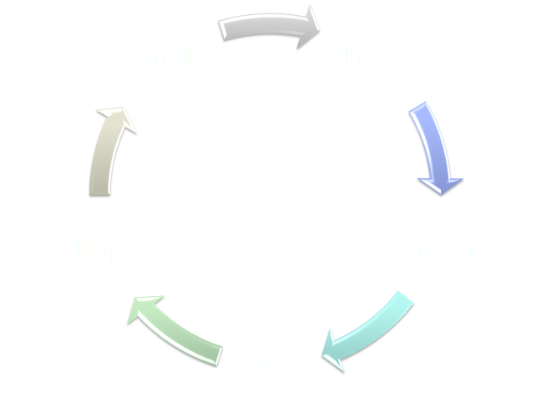
In EVERYTHING
GIVE THANKS
Do I Give THANKS In EVERYTHING?
Gratitude

Slide 20
In EVERYTHING
GIVE THANKS
Do I Give THANKS In EVERYTHING?
By our words – Phil 4:6
Giving thanks – Phil 1:3-4
Singing - Eph 5:19,20
Always – 1 Thes 5:16-18
By the life we live – Rom 12:1-2
By our humble obedience to Christ – 1 Jn 5:3
By teaching others - Acts 8:4

Slide 21
In EVERYTHING
GIVE THANKS
Do I Give THANKS In EVERYTHING?

Slide 22
In EVERYTHING
GIVE THANKS
Do I Give THANKS In EVERYTHING?
Being thankful IS NOT dependent on how much stuff we have - or our state in life - but our attitude towards God, His provisions & promises.

Slide 23
In EVERYTHING
GIVE THANKS
Do I Give THANKS In EVERYTHING?
Acknowledge Ingratitude As A Sin
Do Not Major In Your Troubles
Learn To Be Content With What You have
Express Your Gratitude In Word & Deed

Slide 24
In EVERYTHING
GIVE THANKS
Do I Give THANKS In EVERYTHING?
Consider what God has done for you!
Obey the gospel, (believe, repent, confess, be baptized)
Live for Jesus who died for you!

Slide 26
In EVERYTHING
GIVE THANKS
Charts by Don McClain
Preached November 24, 2019
West 65th Street church of Christ - P.O. Box 190062 - Little Rock AR 72219 - Phone — 501-568-1062 — Email – donmcclain@sbcglobal.net
Prepared using Keynote
More Keynote, PPT & Audio Sermons:
www.w65stchurchofchrist.com

Slide 27
Colossians 3:12–17 (NKJV)
¹² Therefore, as the elect of God, holy and beloved, put on tender mercies, kindness, humility, meekness, longsuffering; ¹³ bearing with one another, and forgiving one another, if anyone has a complaint against another; even as Christ forgave you, so you also must do. ¹⁴ But above all these things put on love, which is the bond of perfection. ¹⁵ And let the peace of God rule in your hearts, to which also you were called in one body; and be thankful.

Slide 28
Colossians 3:12–17 (NKJV)
¹⁶ Let the word of Christ dwell in you richly in all wisdom, teaching and admonishing one another in psalms and hymns and spiritual songs, singing with grace in your hearts to the Lord. ¹⁷ And whatever you do in word or deed, do all in the name of the Lord Jesus, giving thanks to God the Father through Him.

