Slide 1
(2 Peter 1:5-11)
“Making Our Calling & Election Sure”

Slide 2
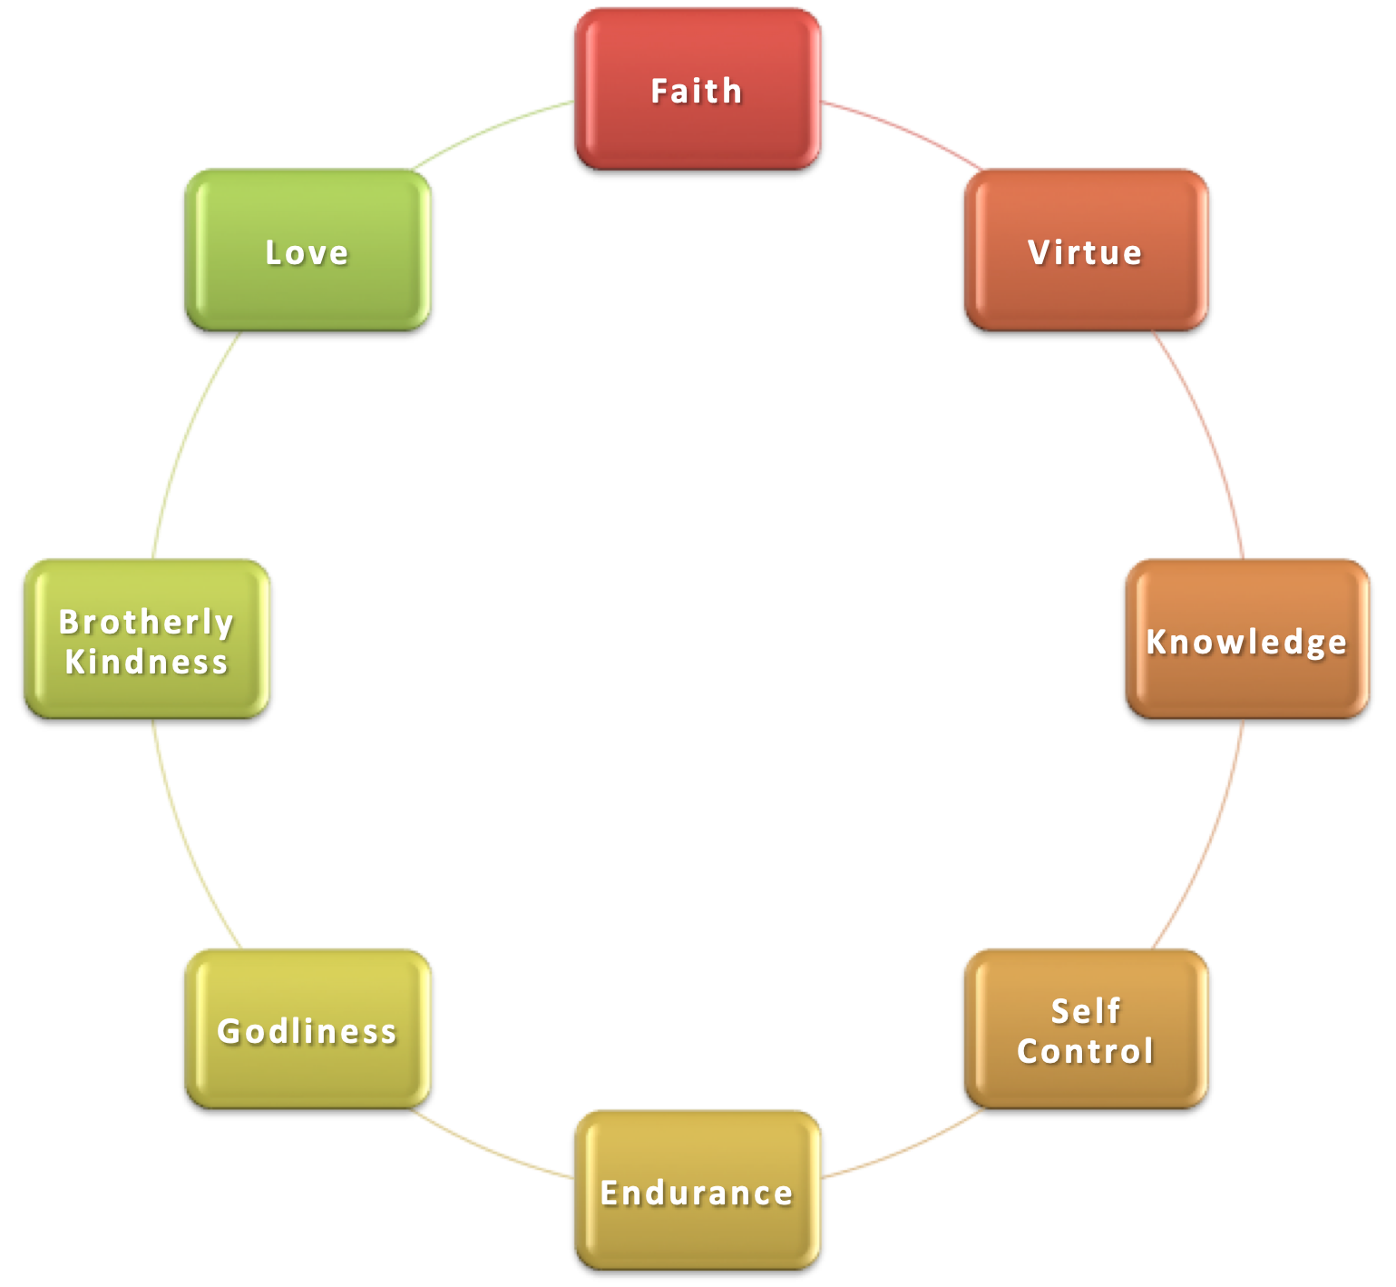
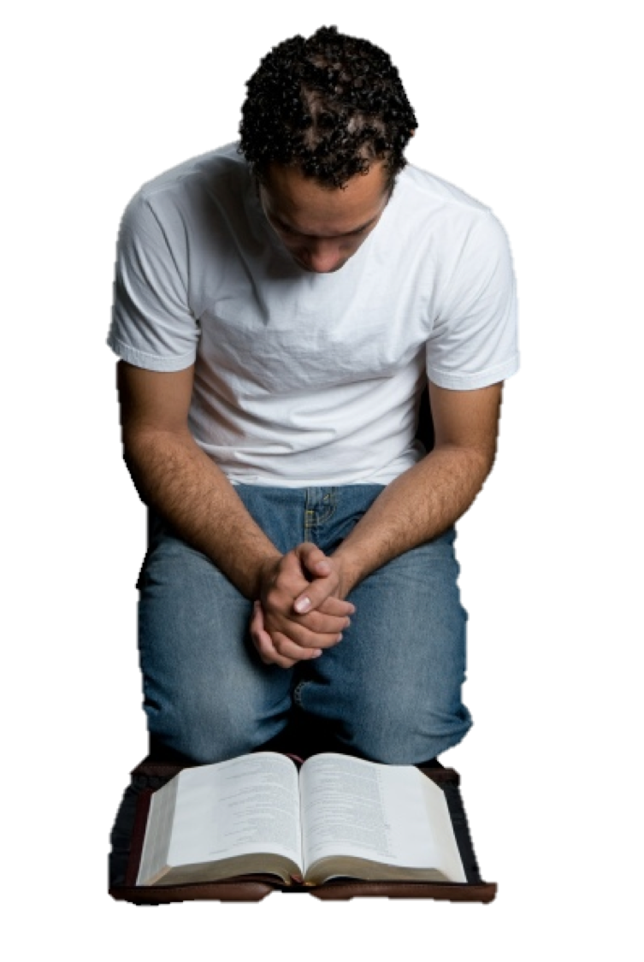
“Making Our Calling & Election Sure”
To make our calling and election sure, we MUST GIVE ALL DILIGENCE to GROW?
2 Peter 1:5-10 (NKJV) ⁵ giving all diligence, add to your . . . ¹⁰ Therefore, brethren, be even more diligent to make your call and election sure,

Slide 3
“Making Our Calling & Election Sure”
2 Peter 1:5–11 (NKJV)
⁵ But also for this very reason, giving all diligence, add to your faith virtue, to virtue knowledge, ⁶ to knowledge self-control, to self-control perseverance, to perseverance godliness, ⁷ to godliness brotherly kindness, and to brotherly kindness love. ⁸ For if these things are yours and abound, you will be neither barren nor unfruitful in the knowledge of our Lord Jesus Christ.

Slide 4
“Making Our Calling & Election Sure”
2 Peter 1:5–11 (NKJV)
⁹ For he who lacks these things is shortsighted, even to blindness, and has forgotten that he was cleansed from his old sins. ¹⁰ Therefore, brethren, be even more diligent to make your call and election sure, for if you do these things you will never stumble; ¹¹ for so an entrance will be supplied to you abundantly into the everlasting kingdom of our Lord and Savior Jesus Christ.

Slide 5
“Making Our Calling & Election Sure”
ADD TO YOUR PRECIOUS FAITH …
But also for this very reason (1:5a)
By faith we have accepted God’s call to receive the provision for our salvation (1:1; Rom. 1:16,17; 6:16-18)
Through knowledge of God’s provision we have received grace and peace, receiving all things that pertain to life and godliness (1:2,3)
God’s glory and virtue has given us great and precious promises, through which we can partake of the divine nature (1:4a)
We have therefore escaped the corruption that is in the world (4b)
2 Peter 1:5 (NKJV)
⁵ But also for this very reason, giving all diligence, add to your faith virtue, to virtue knowledge,

Slide 6
“Making Our Calling & Election Sure”
ADD TO YOUR PRECIOUS FAITH …
Giving all diligence (1:5b)
68.64 σπουδὴν πᾶσαν παρεισφέρω: (an idiom, literally ‘to bring every effort to’) to do one’s very best in attempting to do something—‘to do one’s best, to make every effort to, to try as hard as possible.’ σπουδὴν πᾶσαν παρεισενέγκαντες ἐπιχορηγήσατε ἐν τῇ πίστει ὑμῶν τὴν ἀρετήν ‘do your very best to add goodness to your faith’ 2 Pe 1:5. …
2 Peter 1:5 (NKJV)
⁵ But also for this very reason, giving all diligence, add to your faith virtue, to virtue knowledge,

Slide 7
“Making Our Calling & Election Sure”
ADD TO YOUR PRECIOUS FAITH …
Giving all diligence (1:5b)
Diligence is an oft repeated command (Ex. 15:26; Deut 4:9; 6:7; Jos 23:11; Pr 4:23; Rom 12:11; 2 Tim 2:15; Heb. 4:11; 6:11; 11:6; 2 Pet. 1:5,10; 3:14)
Requires Purpose – Mature Christians do not just happen - they are made (Jos. 24:15; Mat. 6:33; Rom. 6:16-18)
Requires Commitment – Can’t be double minded (1 Kings 18:21; Acts 11:23)
Requires Continued pursuit – No shortcuts - Takes time, great effort and patience (1 Cor. 15:58; Col. 1:23)
2 Peter 1:5 (NKJV)
⁵ But also for this very reason, giving all diligence, add to your faith virtue, to virtue knowledge,

Slide 8
“Making Our Calling & Election Sure”
ADD TO YOUR PRECIOUS FAITH …
Add to your faith (1:5c)
Add To – ἐπιχορηγέω - epichorēgeō
To supply, furnish, to minister unto – [Vines; Thayer; BDAG] - 1:11; 2 Cor. 9:10; Gal. 3:5; Col. 2:19
The verb rendered add (ἐπιχορηγήσατε) is derived from χορός a chorus, . . The verb originally means to bear the expense of a chorus . . . In the NT sense of supplying or providing.
2 Peter 1:5 (NKJV)
⁵ But also for this very reason, giving all diligence, add to your faith virtue, to virtue knowledge,

Slide 9
“Making Our Calling & Election Sure”
ADD TO YOUR PRECIOUS FAITH …
Add to your faith (1:5c)
Faith is the foundation (1:1; Rom. 10:9-17; Heb. 11:1, 6)
Faith is personal (John 8:24)
Faith is the motivation (Gal 2:20; Heb. 10:39; 11:1-12:11)
Faith MUST ACT (2 Cor. 5:7; James 1:22-25; 2:14-26)
Faith MUST GROW (Luke 17:5; 2 Thes. 1:3; Rom. 10:17)
2 Peter 1:5 (NKJV)
⁵ But also for this very reason, giving all diligence, add to your faith virtue, to virtue knowledge,

Slide 10
“Making Our Calling & Election Sure”
ADD TO YOUR PRECIOUS FAITH …
Add Virtue (1:5c)
ἀρετήa, ῆς f: the quality of moral excellence—‘outstanding goodness, L.N.
Original and general sense seems to be blended with the impression made on others, i.e., renown, excellence or praise (Hort)
Emirates from God’s goodness and divine nature (vs. 3; Phil. 4:8)
2 Peter 1:5 (NKJV)
⁵ But also for this very reason, giving all diligence, add to your faith virtue, to virtue knowledge,

Slide 11
“Making Our Calling & Election Sure”
ADD TO YOUR PRECIOUS FAITH …
Add Knowledge – Vs. 5; Rom 15:14; 1 Cor. 1:5; 2 Cor 4:6
(gnōsin) Insight, understanding
Knowledge of God and ourselves (Eccl. 12:13; Acts 17:23-31)
Knowledge of His will (Phili 3:8; 2 Pet 3:18; Acts 17:11,12; Eph 3:5; Hos. 4:6; 1 Pet. 2:2; Heb. 5:12-14)
Gained from examining scripture (Acts 17:11)
2 Peter 1:5 (NKJV)
⁵ But also for this very reason, giving all diligence, add to your faith virtue, to virtue knowledge,

Slide 12
“Making Our Calling & Election Sure”
ADD TO YOUR PRECIOUS FAITH …
Add Self Control – vs. 6; Gal 5:23; Acts 24:25
“Restraint of one's emotions, impulses, or desires, self-control” - [BDAG]
Need to be constantly in control (thoughts, tongue, temper and actions) Jas. 1:14; 1 Cor. 9:25-27; 2 Cor 10:5
Doing RIGHT is our choice!
2 Peter 1:5–7 (NKJV)
⁶ to knowledge self-control, to self-control perseverance, to perseverance godliness,

Slide 13
“Making Our Calling & Election Sure”
ADD TO YOUR PRECIOUS FAITH …
Add Perseverance – vs. 6; Jas. 1:2-4,13; Job; Jas. 5:11
Capacity to hold out or bear up in the face of difficulty, patience, endurance, fortitude, steadfastness, perseverance [BDAG]
Run with endurance - Acts 14:22; Rom 5:3; Heb. 10:36; 12:1-3, 6:12; Jas. 5:7-8
2 Peter 1:5–7 (NKJV)
⁶ to knowledge self-control, to self-control perseverance, to perseverance godliness,

Slide 14
“Making Our Calling & Election Sure”
ADD TO YOUR PRECIOUS FAITH …
Add Godliness – vs. 6; 1:3; 3:11; Prov. 1:7; Ps 112:1
"To be devout," denotes piety, a “Godward attitude," seeking to do what pleases God.
Piety & Respect for God - much more valuable than anything in this world (1 Tim 4:7,8; 6:6)
Society is becoming more godless & immoral (2 Tim 3:1-5; 4:1-5)
2 Peter 1:5–7 (NKJV)
⁶ to knowledge self-control, to self-control perseverance, to perseverance godliness,

Slide 15
“Making Our Calling & Election Sure”
ADD TO YOUR PRECIOUS FAITH …
Add Brotherly Kindness – vs. 7; Rom 12:10; 1 Thes 4:9; Heb 13:1; 1 Pet 1:22
Loving and being kind to other Christians, (We ARE family) (John 13:34,35; 1 Pet. 1:22; Eph. 4:32)
As children of God, we MUST seek the spiritual development of each other for the good of the body (Rom. 12:3-16; 1 Cor. 12:12-26)
Let us seek to express our kindness in word and deed! (Gal 6:10; 1 Thes 4:10; 1 John 3:14-17
2 Peter 1:7 (NKJV)
⁷ to godliness brotherly kindness, and to brotherly kindness love.

Slide 16
“Making Our Calling & Election Sure”
ADD TO YOUR PRECIOUS FAITH …
Add Love – Rom 13:10; 1 Cor 13:1-8,13; 16:14
Seeks the best interest of its object because we value it - Rom 13:10; 5:8,9
As Christ loved us - Eph. 5:2
Without love, anything we do profits nothing - 1 Cor 13:1:8
Binds all qualities - Col 3:14
2 Peter 1:7 (NKJV)
⁷ to godliness brotherly kindness, and to brotherly kindness love.

Slide 17
“Making Our Calling & Election Sure”
ADD TO YOUR PRECIOUS FAITH …
Add Love – Rom 13:10; 1 Cor 13:1-8,13; 16:14
Love for God - Mat. 22:37
Love for neighbor - Mat. 22:39
Love for wives, husbands, children - Eph. 5:25, Titus 2:4
Love for enemies - Mat. 5:44
2 Peter 1:7 (NKJV)
⁷ to godliness brotherly kindness, and to brotherly kindness love.

Slide 18
“Making Our Calling & Election Sure”
ADD TO YOUR PRECIOUS FAITH …
For if these things are yours and abound (8)
Things needed to be added to our faith are obtainable (Phil. 4:13)
“Abound” = literally “and are increasing” - Peter again stressing the need for continual growth.
We will be useful to the Lord and bear much fruit (Mat. 13:23)
True knowledge of God can only be attained by the person who grows morally (1:5-7)
2 Peter 1:8 (NKJV)
⁸ For if these things are yours and abound, you will be neither barren nor unfruitful in the knowledge of our Lord Jesus Christ.

Slide 19
“Making Our Calling & Election Sure”
IF WE DO NOT ADD TO OUR FAITH
For he who lacks these things … (9)
“is shortsighted, even to blindness,” i.e., near-sighted, dim-sighted - focused upon the things of this world and unable to see that which can only be seen through FAITH (Re. 3:17; 2 Co. 4:3, 4, 17,18; Rom. 8:17-39)
“and has forgotten that he was cleansed from his old sins.” - The one who doesn’t grow after being baptized forgets the great blessing of salvation (Psalm 103:1-5; 2 Peter 2:20-22)
2 Peter 1:9 (NKJV)
⁹ For he who lacks these things is shortsighted, even to blindness, and has forgotten that he was cleansed from his old sins.

Slide 20
“Making Our Calling & Election Sure”
if you do these things
Be even more diligent to make your call and election sure (10)
Our calling & election are conditioned upon us "doing these things" - the clear necessary implication is we can fall (2 Pet. 2:20-22; Heb. 3:14-4:1; etc.)
Our election and security are NOT UNCONDITIONAL (John 10:27-29; Rom. 8:1-39; etc.)
If we do these things we will never stumble so as to be eternally lost (Col. 1:23; John 15:5-11)
2 Peter 1:10 (NKJV)
¹⁰ Therefore, brethren, be even more diligent to make your call and election sure, for if you do these things you will never stumble;

Slide 21
“Making Our Calling & Election Sure”
if you do these things
2 Peter 1:11 (NKJV)
¹¹ for so an entrance will be supplied to you abundantly into the everlasting kingdom of our Lord and Savior Jesus Christ.
2 Peter 1:10 (NKJV)
¹⁰ Therefore, brethren, be even more diligent to make your call and election sure, for if you do these things you will never stumble;

Slide 22
“Making Our Calling & Election Sure”
To make our calling and election sure, we MUST GIVE ALL DILIGENCE to GROW?
2 Peter 1:5-10 (NKJV) ⁵ giving all diligence, add to your . . . ¹⁰ Therefore, brethren, be even more diligent to make your call and election sure,

Slide 23
“Making Our Calling & Election Sure”
To make our calling and election sure, we MUST GIVE ALL DILIGENCE to GROW?
2 Peter 1:5-10 (NKJV) ⁵ giving all diligence, add to your . . . ¹⁰ Therefore, brethren, be even more diligent to make your call and election sure,
God has given us what we need to grow into fruitful Christians (1:1-4)

Slide 24
“Making Our Calling & Election Sure”
To make our calling and election sure, we MUST GIVE ALL DILIGENCE to GROW?
2 Peter 1:5-10 (NKJV) ⁵ giving all diligence, add to your . . . ¹⁰ Therefore, brethren, be even more diligent to make your call and election sure,
Great effort is required on our part in order to be fruitful Christians - (1:5,10)

Slide 25
“Making Our Calling & Election Sure”
To make our calling and election sure, we MUST GIVE ALL DILIGENCE to GROW?
2 Peter 1:5-10 (NKJV) ⁵ giving all diligence, add to your . . . ¹⁰ Therefore, brethren, be even more diligent to make your call and election sure,
The reward - security & entrance into God’s everlasting kingdom - (1:8,11)

Slide 26
“Making Our Calling & Election Sure”
To make our calling and election sure, we MUST GIVE ALL DILIGENCE to GROW?
2 Peter 1:5-10 (NKJV) ⁵ giving all diligence, add to your . . . ¹⁰ Therefore, brethren, be even more diligent to make your call and election sure,
If we fail to grow we will fall & be in danger of being eternally lost - (1:9; 2:20-22)

Slide 27
“Why True Faith Is Precious”
INTRODUCTION TO SECOND PETER
Have you obtained the “like precious faith these brethren received?
Have you believed and obeyed the truth?
Have you escaped the corruption that is in the world?

Slide 29
(2 Peter 1:5-11)
“Making Our Calling & Election Sure”

Slide 30
Philippians 1:9–11 (NKJV)
⁹ And this I pray, that your love may abound still more and more in knowledge and all discernment, ¹⁰ that you may approve the things that are excellent, that you may be sincere and without offense till the day of Christ, ¹¹ being filled with the fruits of righteousness which are by Jesus Christ, to the glory and praise of God.

